Slide 1
Medium Motion Effects in GLV approach
Andrey Sadofyev
LANL, T-2
in collaboration with M. Sievert and I. Vitev

Slide 2
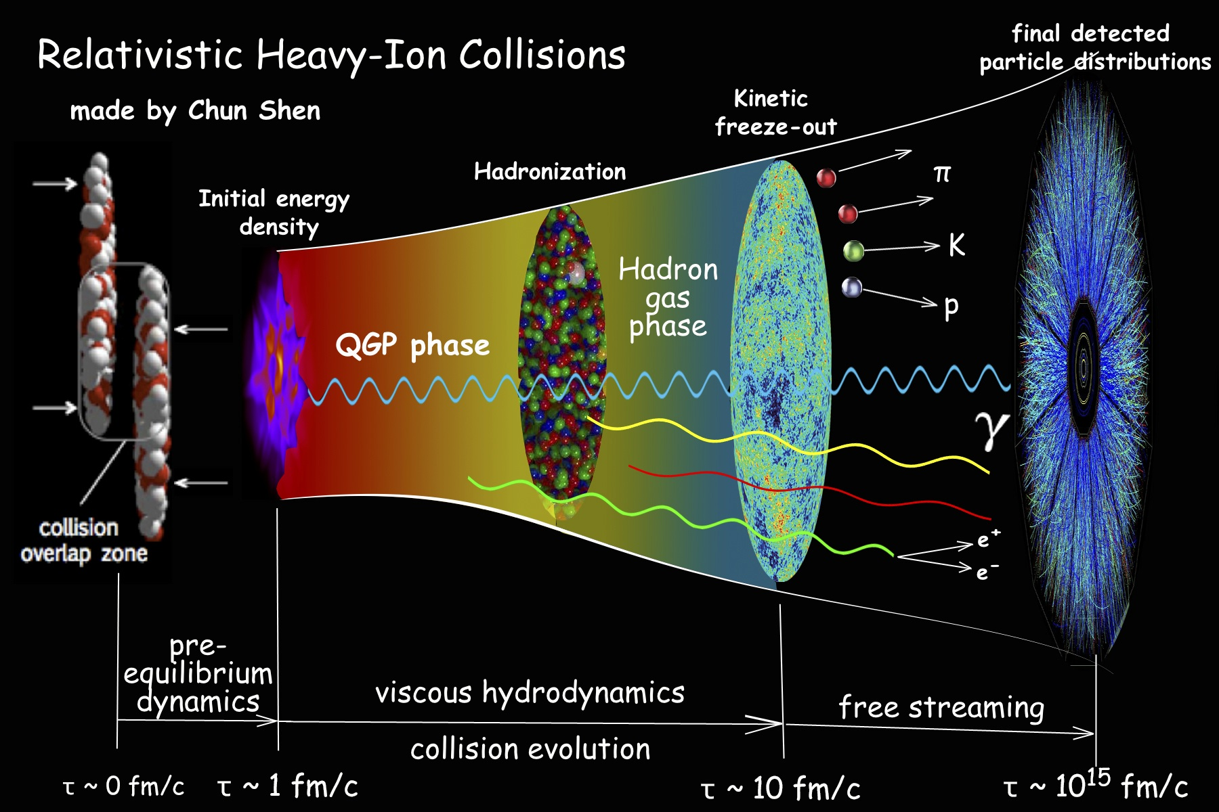

Slide 3
Heavy-Ion Collisions
K. Rajagopal et al, 2018
Big questions:
QCD matter in Early Universe;
QCD phase diagram;
Emergence of complex matter;
…
“A central goal of ultrarelativistic heavy ion collisions, then, is to use these experiments to recreate droplets of Big Bang matter in the laboratory -- where we can learn about its material properties as well as about its phase diagram in ways that we will never be able to do via observations made with telescopes or satellites.”
“A substantial component of understanding the nature of any complex material in condensed matter physics is mapping its full phase diagram, and the same is true in QCD.”
“In the history of the universe, liquid quark-gluon plasma was the earliest complex form of matter to form… Not only was liquid QGP the earliest complex matter to form, there is also a sense in which it is the simplest form of complex matter that we know of, namely the complex matter that is “closest”, most directly connected to, the fundamental laws that govern all matter in the universe, in this case the fundamental theory of QCD…”

Slide 4
Heavy-Ion Collisions
How can we study QGP:
How does this matter appear?
How does it look like when it is almost unperturbed?
What do we know about evolution of its perturbations?
How do “external” probes see this matter?
…
Hydrodynamic and quantum fluctuations in this system, thermalization, imprints of the initial conditions in the final state, etc;
Thermodynamics and hydrodynamics, EOS, energy density and charge distributions, etc;
A variety of transport phenomena, kinetic coefficients in the medium description at different stages, collective modes, etc;
Distinct probes – jets, heavy quarks, quarkonia, etc. Their interaction with the medium and difference in their behavior in HIC vs pp;

Slide 5
Heavy-Ion Collisions
How can we study QGP:
How does this matter appear?
How does it look like when it is almost unperturbed?
What do we know about evolution of its perturbations?
How do “external” probes see this matter?
…
Hydrodynamic and quantum fluctuations in this system, thermalization, imprints of the initial conditions in the final state, etc;
Thermodynamics and hydrodynamics, EOS, energy density and charge distributions, etc;
A variety of transport phenomena, kinetic coefficients in the medium description at different stages, collective modes, etc;
Distinct probes – jets, heavy quarks, quarkonia, etc. Their interaction with the medium and difference in their behavior in HIC vs pp;

Slide 6
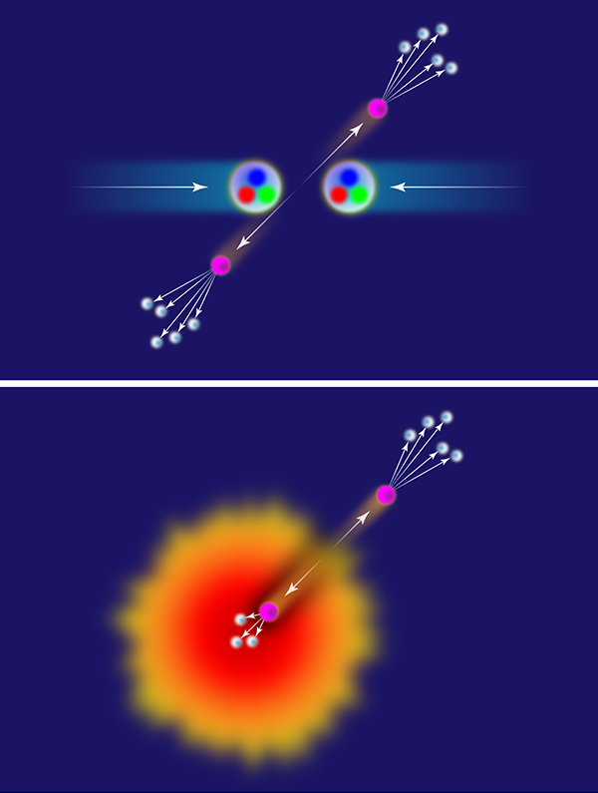
Jets
p+p
A+A
APS/Alan Stonebraker
Jets are cone-shaped sprays of hadrons evolved from high-energy partons produced in the initial hard collisions;
Jets are main available probes of the plasma;
Jets see the plasma at multiple scales, “X-ray” the medium;
What can we learn about QGP evolution using jets?

Slide 7
Jets
Two issues from a theorist point of view:
Jets are produced in hard processes (weakly coupled physics);
QGP is strongly coupled (collective dynamics, low viscosity);
1) What’s about the jet-medium interaction?
(hard to describe/many models)
Medium is evolving but most models of jet-medium interaction treat it as being static;
2) What information can be accessed in principle?
(effects of flow/non-uniform distributions/etc)

Slide 8
Jets
Two issues from a theorist point of view:
Jets are produced in hard processes (weakly coupled physics);
QGP is strongly coupled (collective dynamics, low viscosity);
1) What’s about the jet-medium interaction?
(hard to describe/many models)
Medium is evolving but most models of jet-medium interaction treat it as being static;
2) What information can be accessed in principle?
(effects of flow/non-uniform distributions/etc)

Slide 9
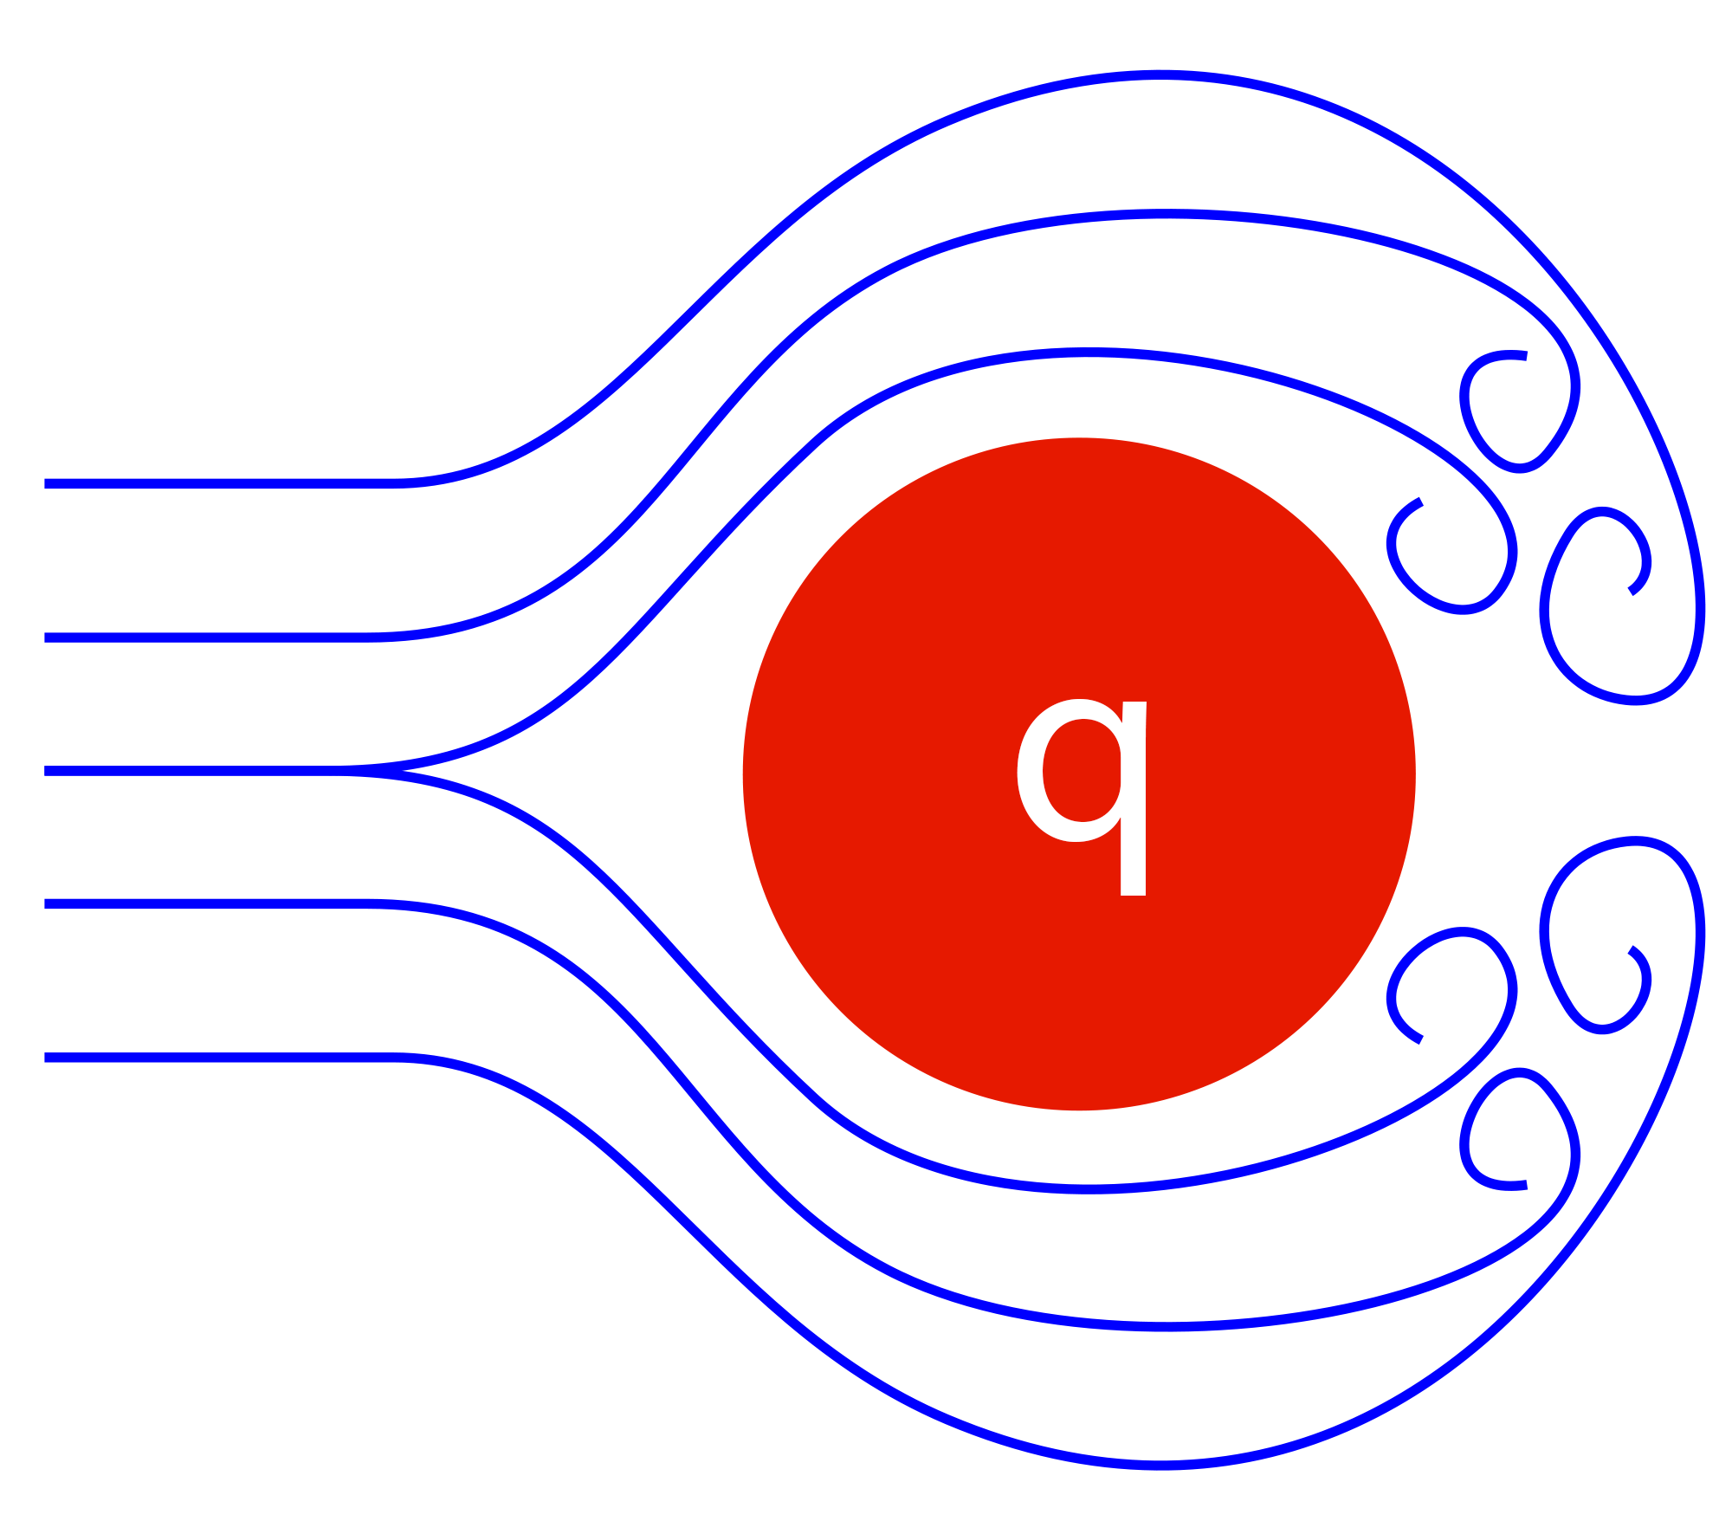
A Toy Illustration: Drag Force

Slide 10
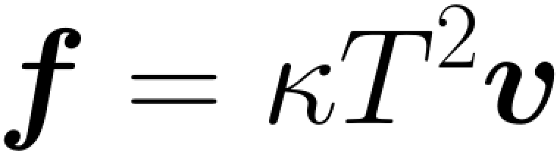
A Toy Illustration: Drag Force
A heavy impurity, say a heavy quark in QGP, moving in a fluid loses energy. The dissipative force (drag) exerted on it is proportional to the relative velocity between the medium and HQ;
In the infinite mass limit one may expect that
where the coefficient is model dependent;
What’s if the matter is flowing? Is energy loss sensitive to the change in the relative velocity or in the temperature only through the form of the force above or there are new contributions?
One can also expect that it will be non-trivial to distinguish different models by this single coef;

Slide 11
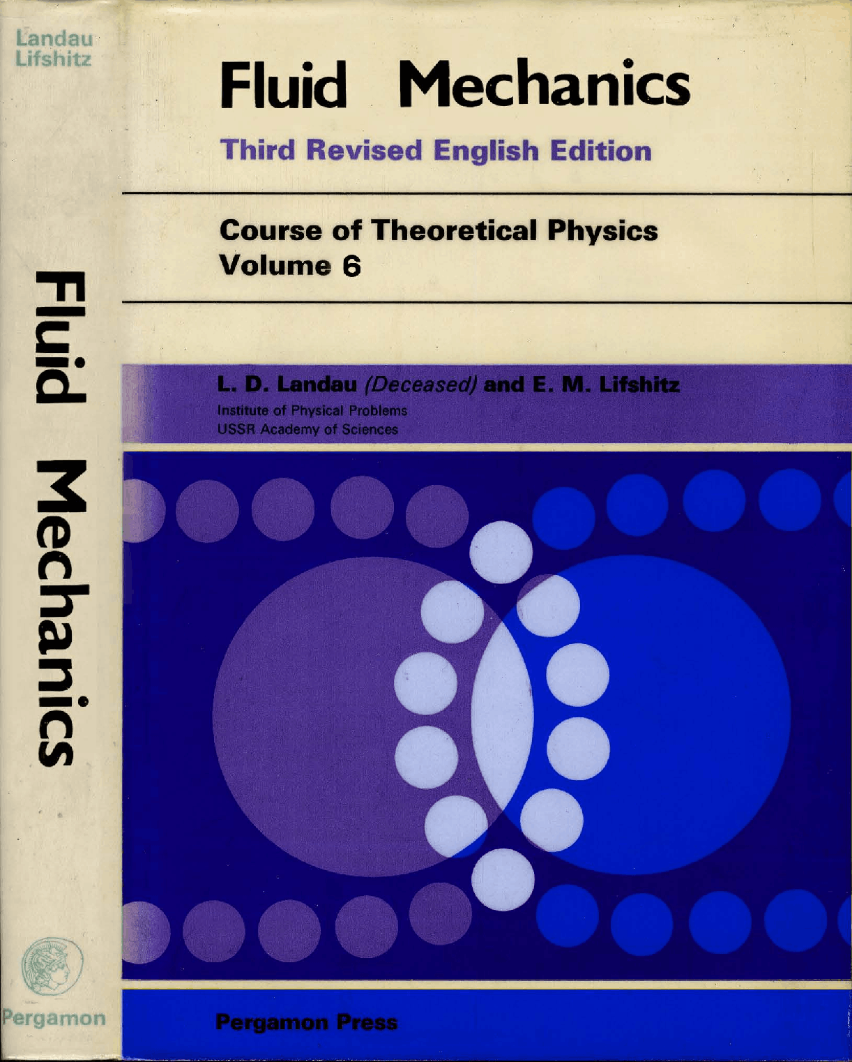

Slide 12
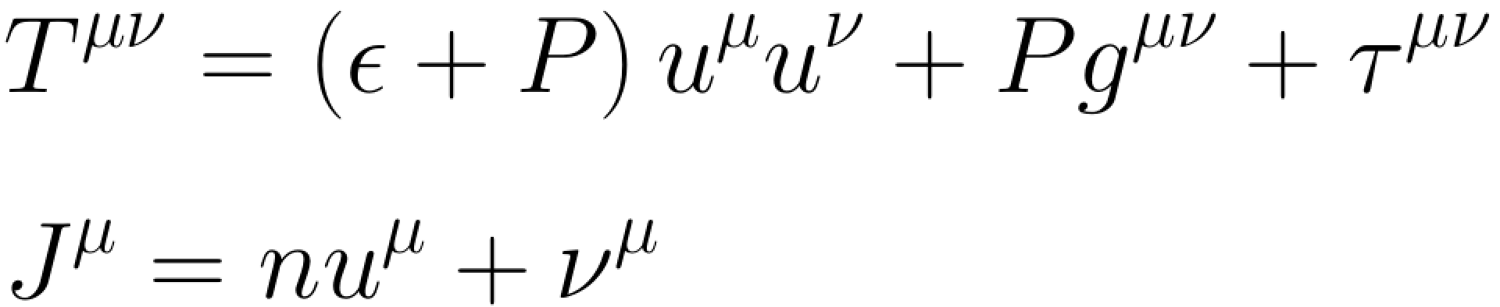
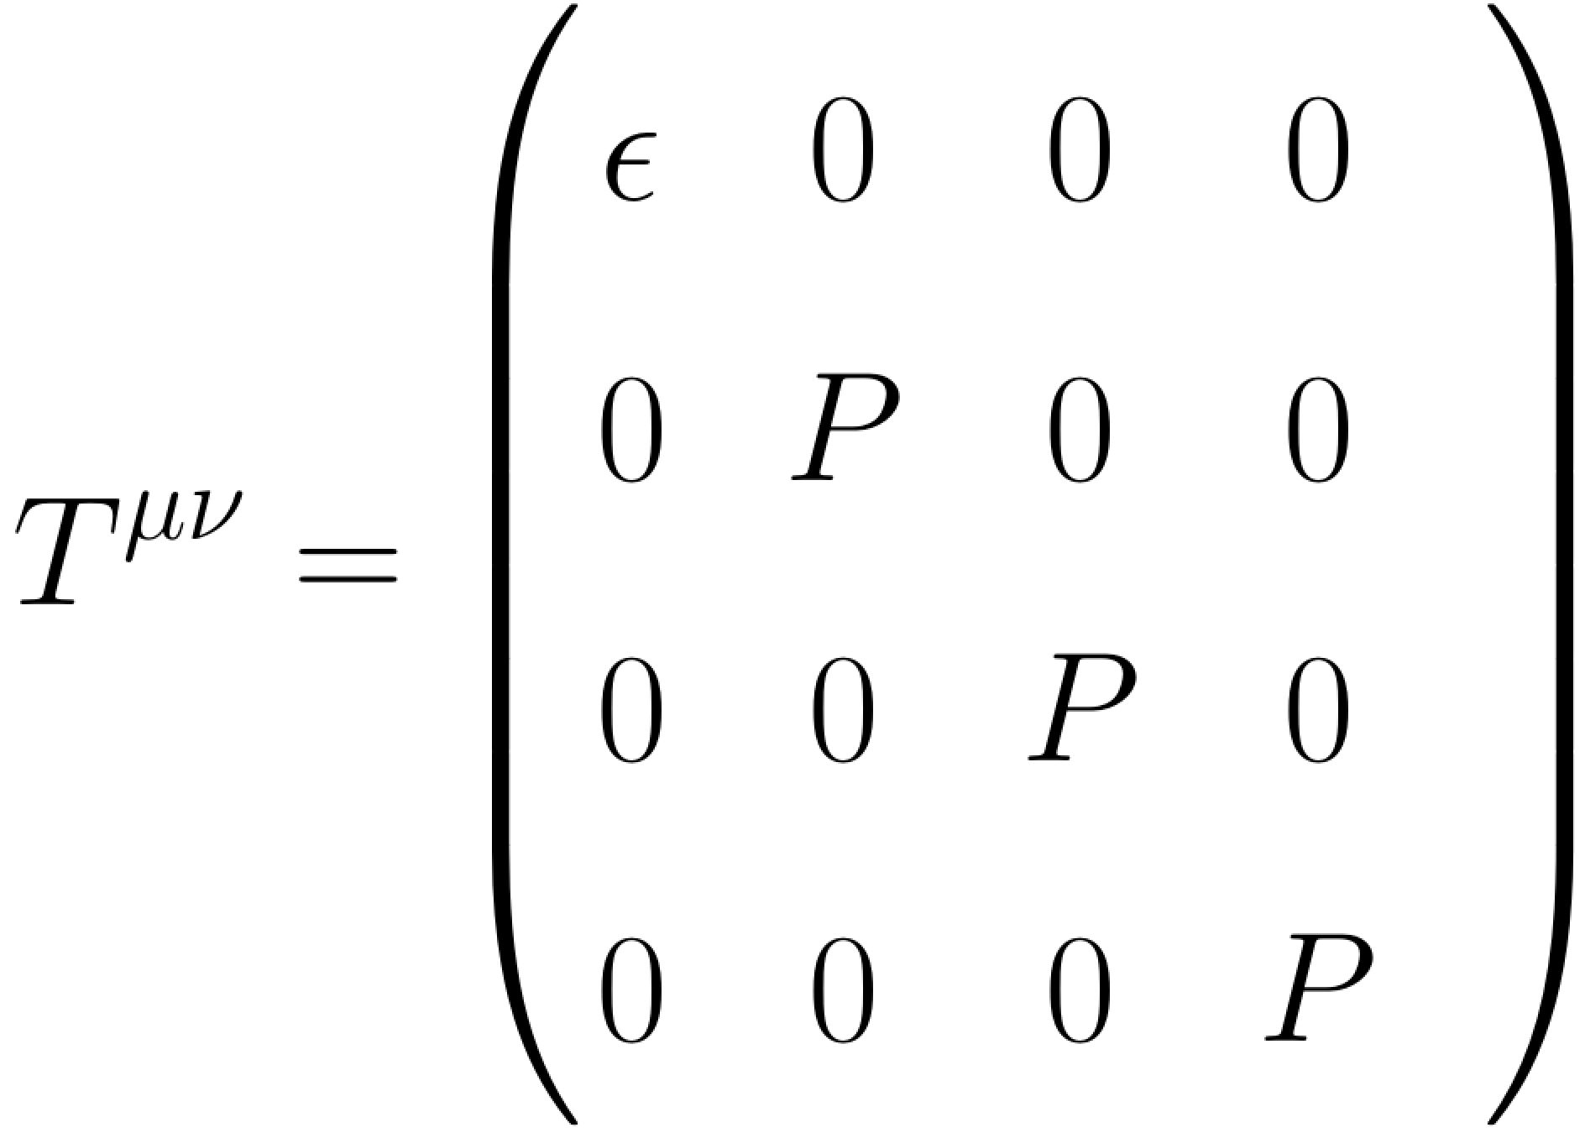
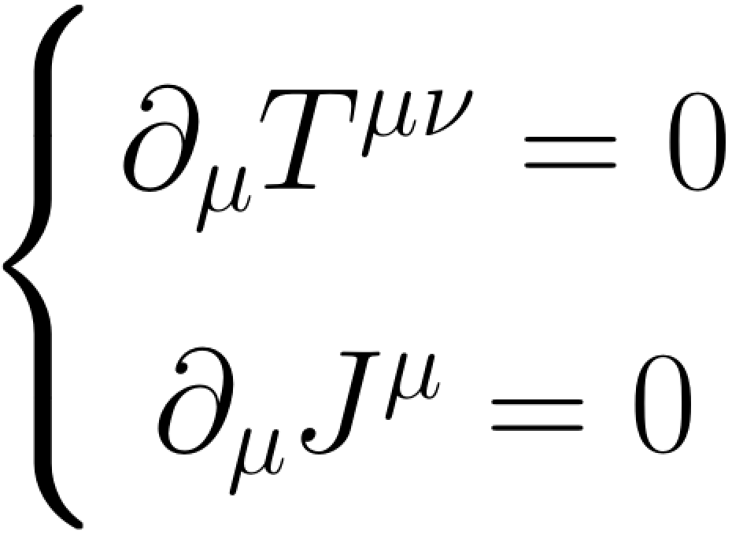
Hydrodynamics
dissipation/higher gradients
constitutive relations
conservation laws
Ideal Hydrodynamics

Slide 13
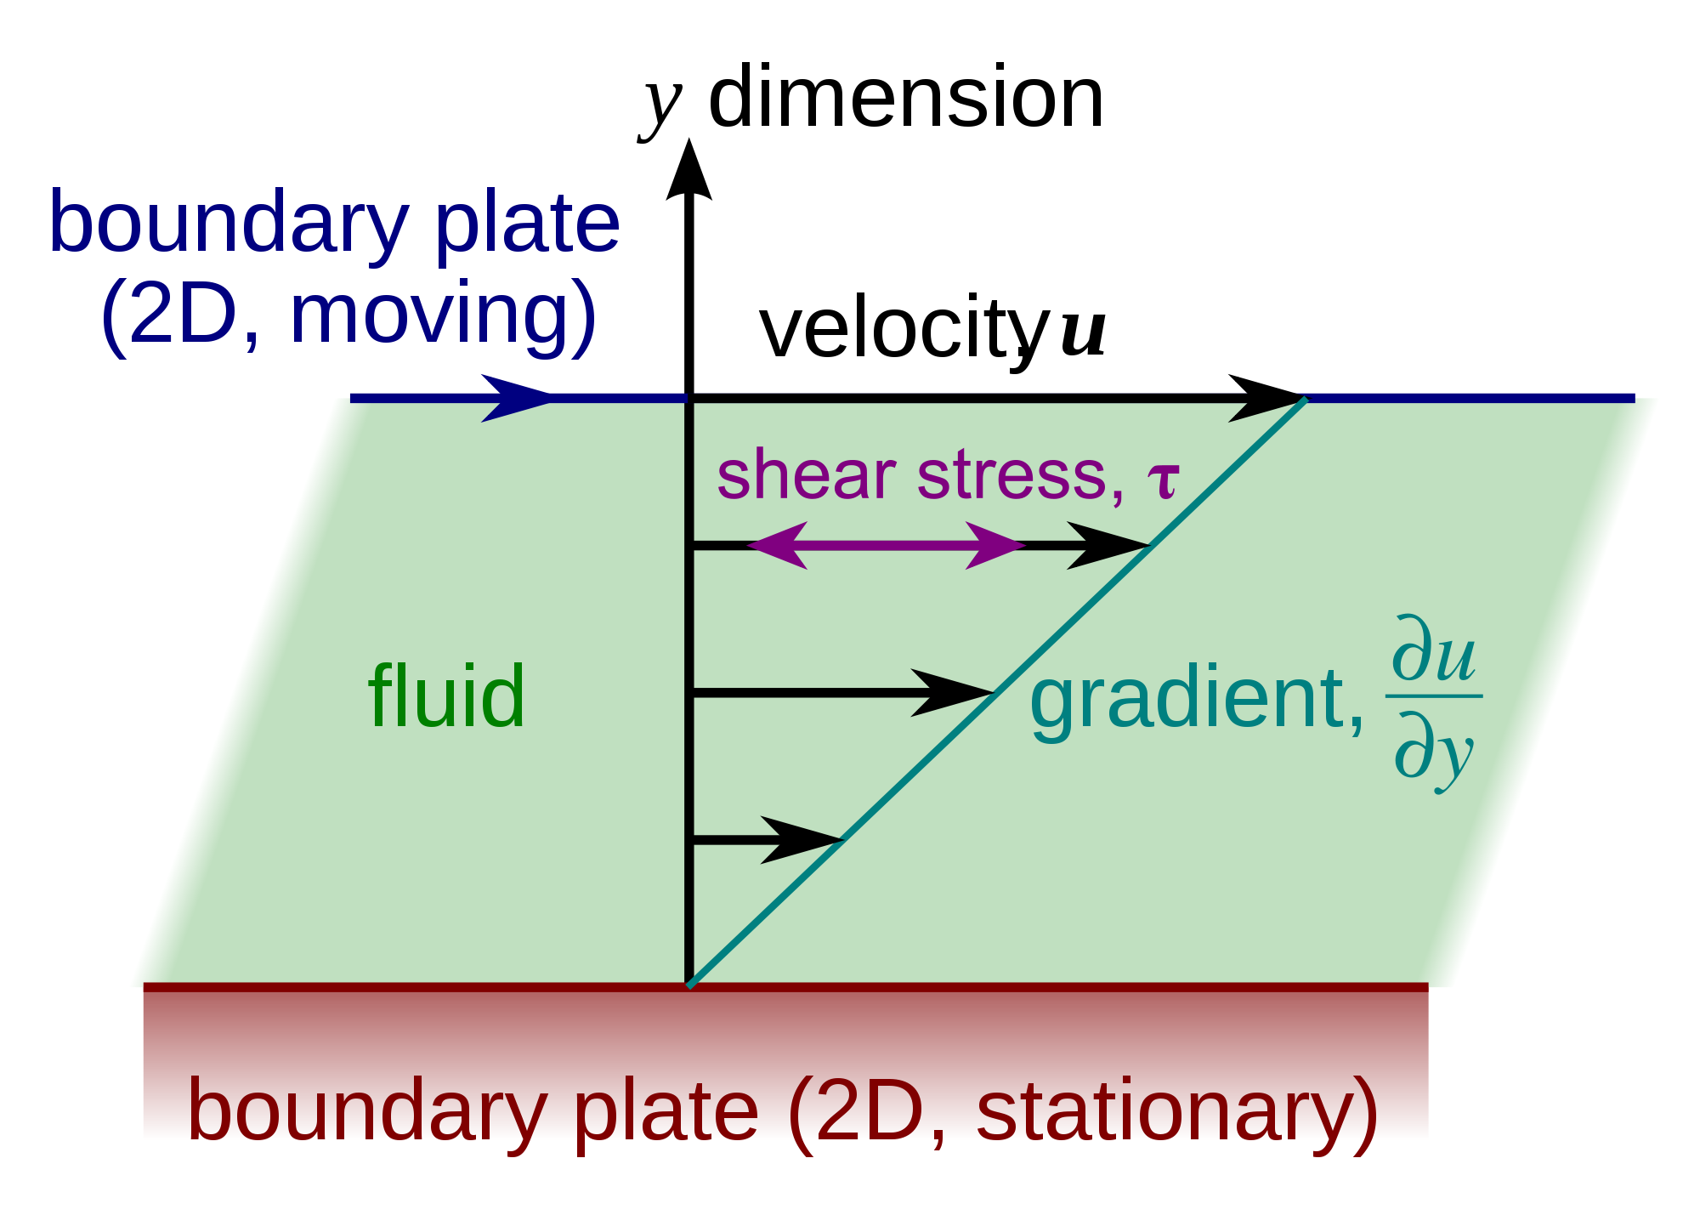
Hydrodynamics
dissipation/higher gradients
wikipedia

Slide 14
Hydrodynamics
dissipation, higher gradients
in the gradient expansion
constitutive relations
conservation laws
Viscous Hydrodynamics

Slide 15
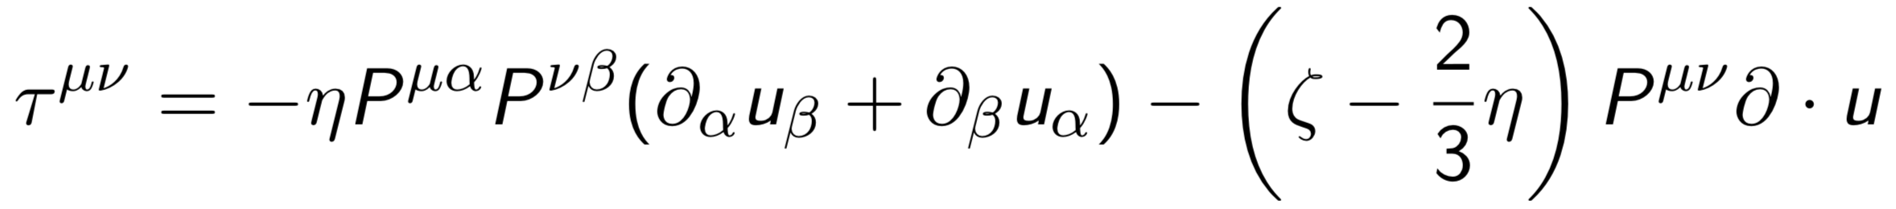
Hydrodynamics
dissipation, higher gradients
in the gradient expansion
constitutive relations
the contribution of the first order in gradients
=
the first order hydrodynamics
shear viscosity
Viscous Hydrodynamics

Slide 16
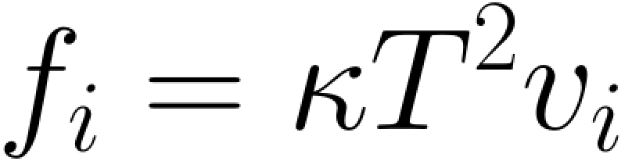
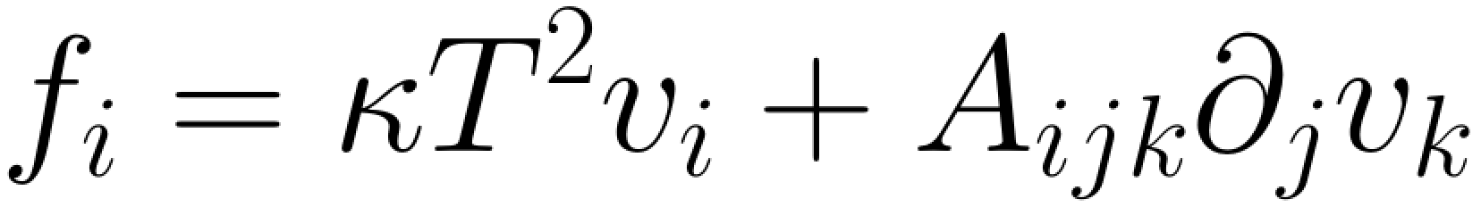
A Toy Illustration: Drag Force
K. Rajagopal, M. Lekaveckas, JHEP, 2014; K. Rajagopal, AS, JHEP, 2015
For a result to all order in gradients, see J. Reiten, AS, 2019
The drag force is not a part of the hydrodynamic description and depends on the medium motion through the relative velocity (nth-order hydro + ideal order drag force);
However, in general, one may expect that it depends on the medium motion in an involved way and also gains gradient corrections:
These arguments are pretty general. Can one see that in a particular theory? Yes, e.g. these corrections were explicitly derived in the strongly coupled holographic plasma.

Slide 17
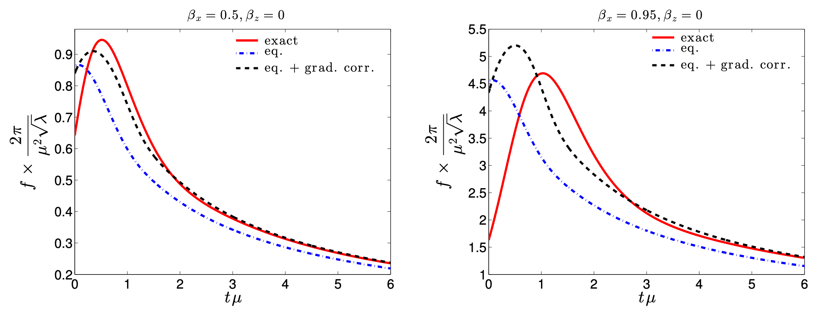
A Toy Illustration: Drag Force
K. Rajagopal, M. Lekaveckas, JHEP, 2014
K. Rajagopal et al, JHEP, 2013
“Actual drag force (red curves) on a heavy quark being dragged through the debris produced in the collision of two sheets of energy. We compare the actual drag force to the zeroth order calculation (blue dot-dashed curve) which neglects the effects of fluid gradients and our calculation in which the effects of fluid gradients are included up to first order (black dashed curves). At late times, when the fluid has hydrodynamized, the gradient corrections included in the black dashed curves yield a much better description of the full result.”

Slide 18
What’s about the jet-medium interaction?

Slide 19
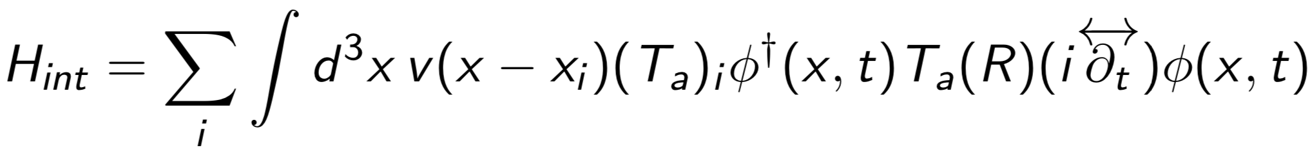
The GLV calculation
GLV, NPB, 2001
The jet-medium interaction (the energy loss) can treated perturbatively in a QCD based model leading to a successful description of many experimental observations;
The simplest version of this description is based on a model potential for in medium sources integrated into a perturbative calculation for QCD amplitudes in the eikonal approximation (large jet energy)
written for scalar quarks, where the sum goes over the sources;
It is assumed that the sources cannot interact with each other and the averaging over sources in the amplitude squared, in fact, reduces to a single sum (no source interference);

Slide 20
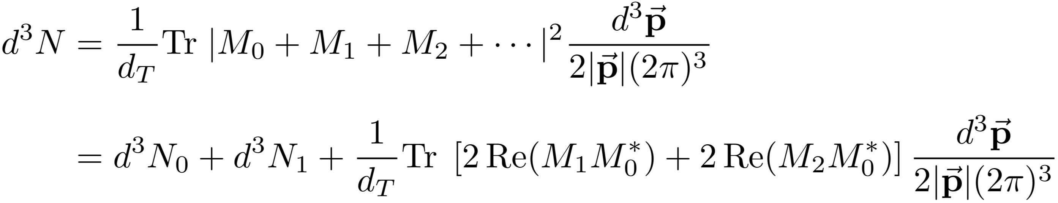
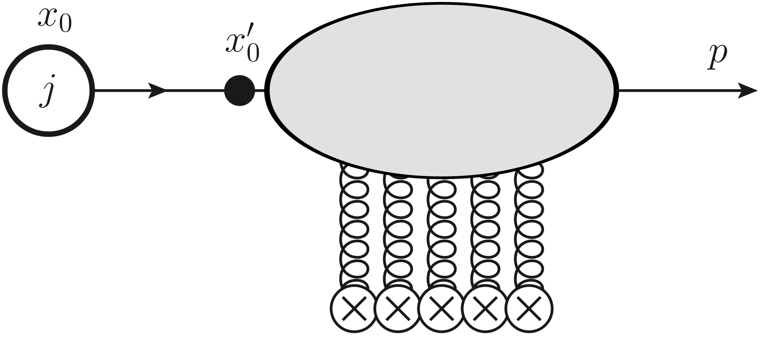
The GLV calculation
GLV, NPB, 2001
Elastic scattering
As an illustration let’s consider the simplest process – the production of a single quark by a source term creating an energetic quark (the momentum broadening in the medium):

Slide 21
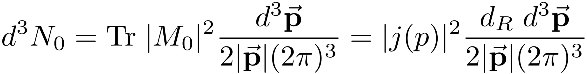
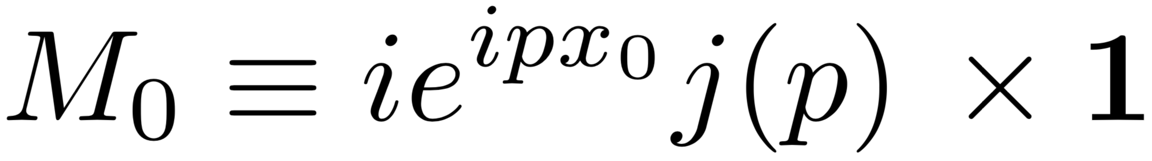
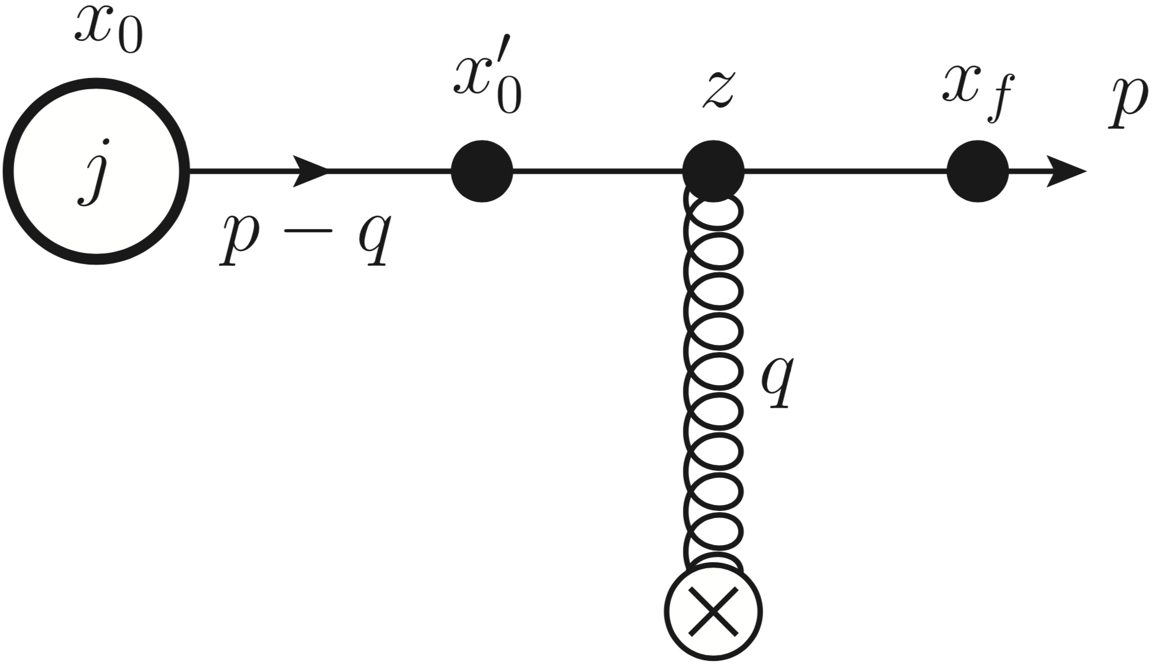
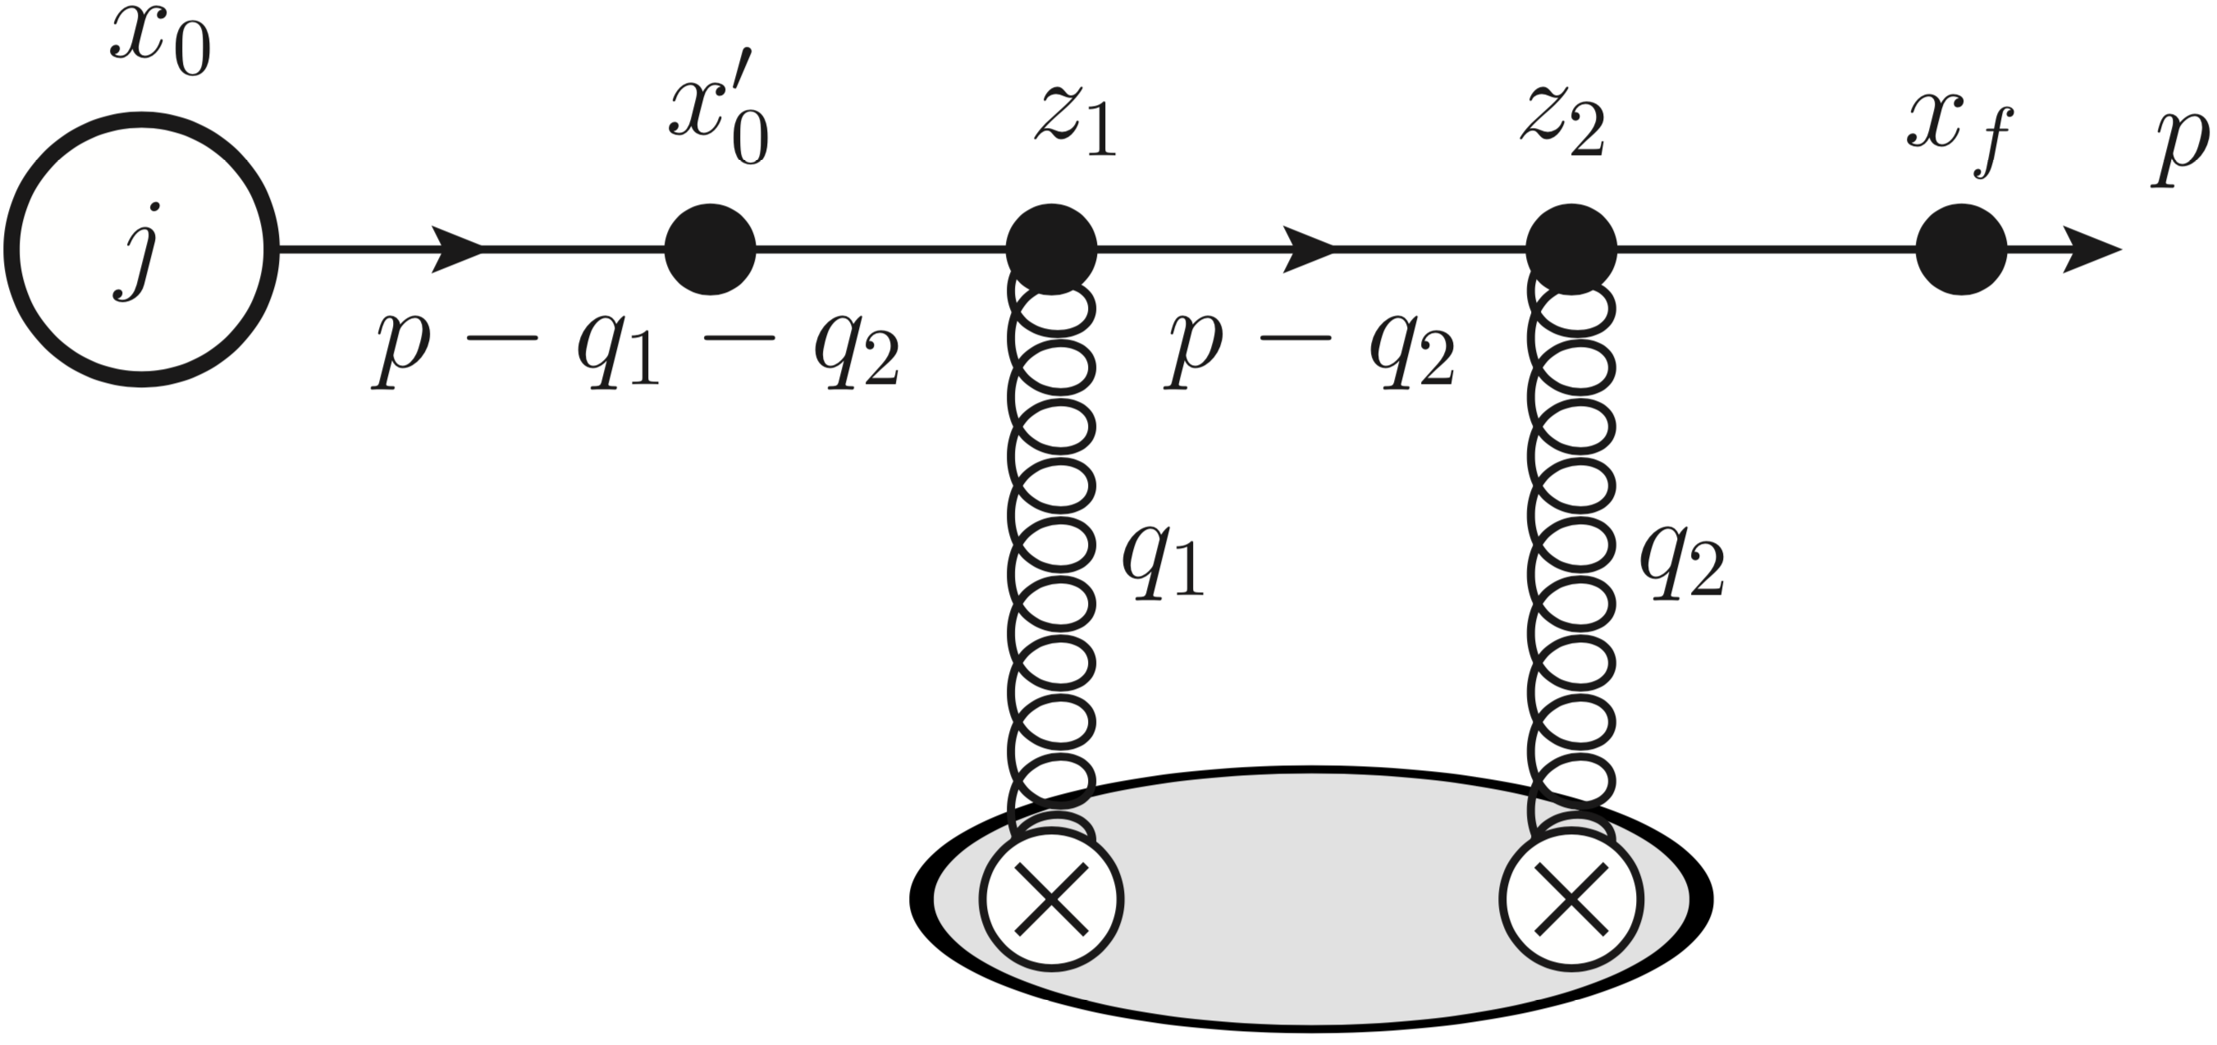
The GLV calculation
GLV, NPB, 2001
Elastic scattering
As an illustration let’s consider the simplest process – the production of a single quark by a source term creating an energetic quark (the momentum broadening in the medium). Expanding in the number of interactions we start with
inclusive distribution of jets in the wave packet
and at the next order we have calculate

Slide 22
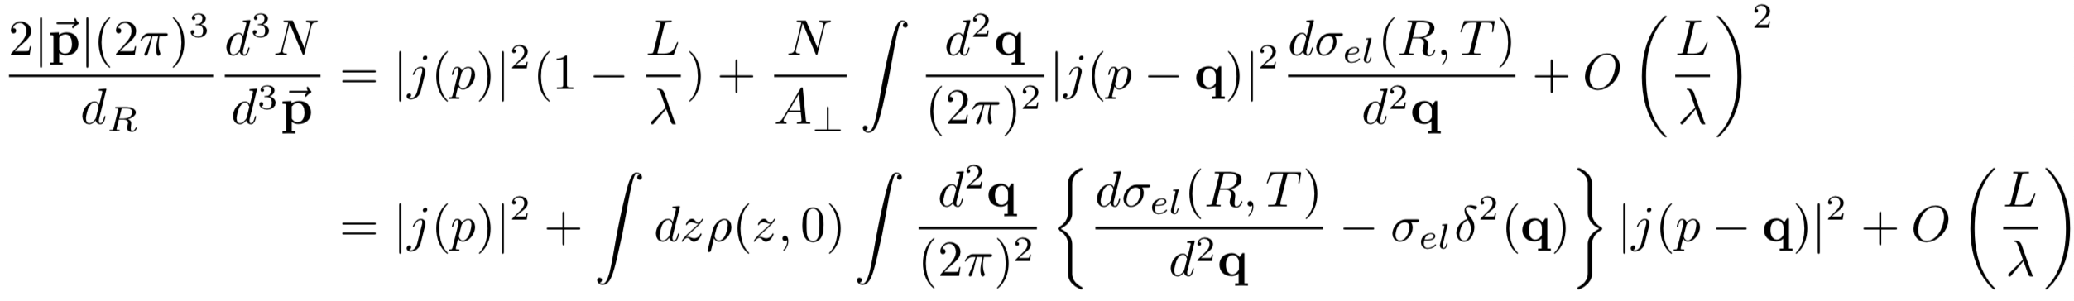
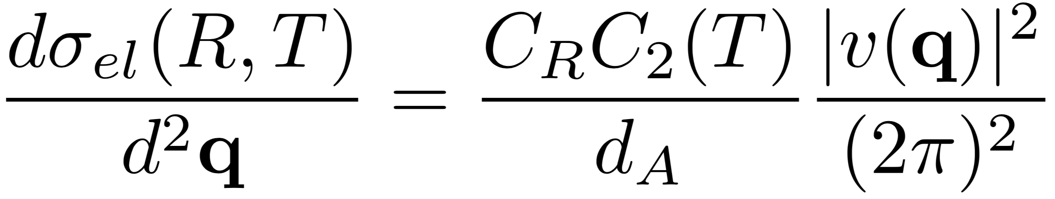
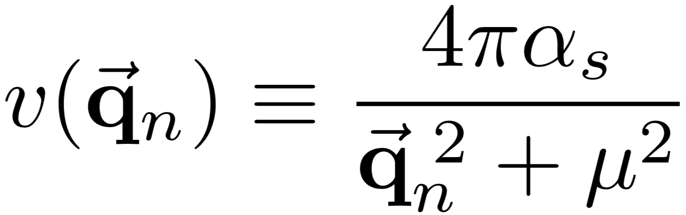
The GLV calculation
GLV, NPB, 2001
Elastic scattering
the first order in opacity
and

Slide 23
The GLV calculation
GLV, NPB, 2001
Re-summation for broadening

Slide 24
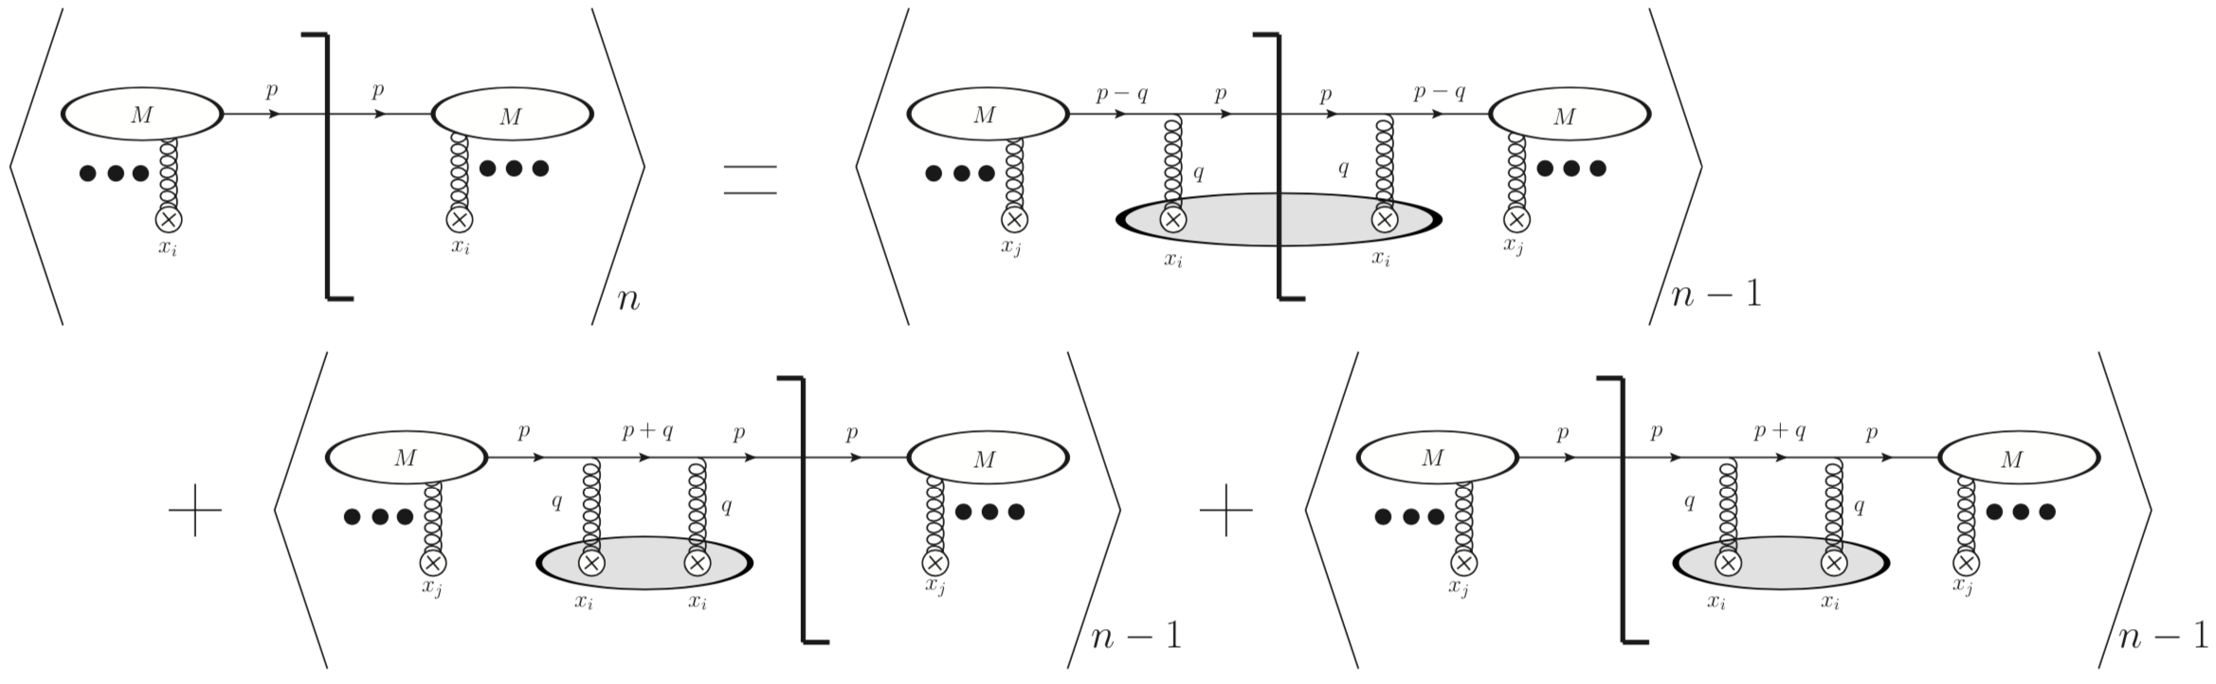
The GLV calculation
Recursion relation

Slide 25
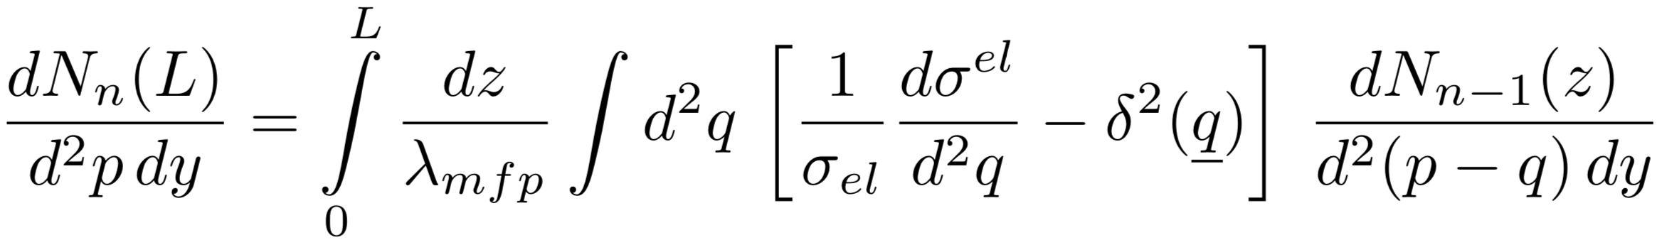
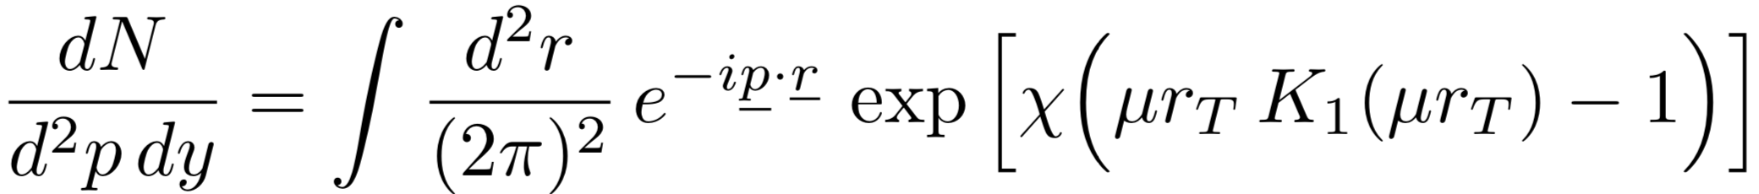
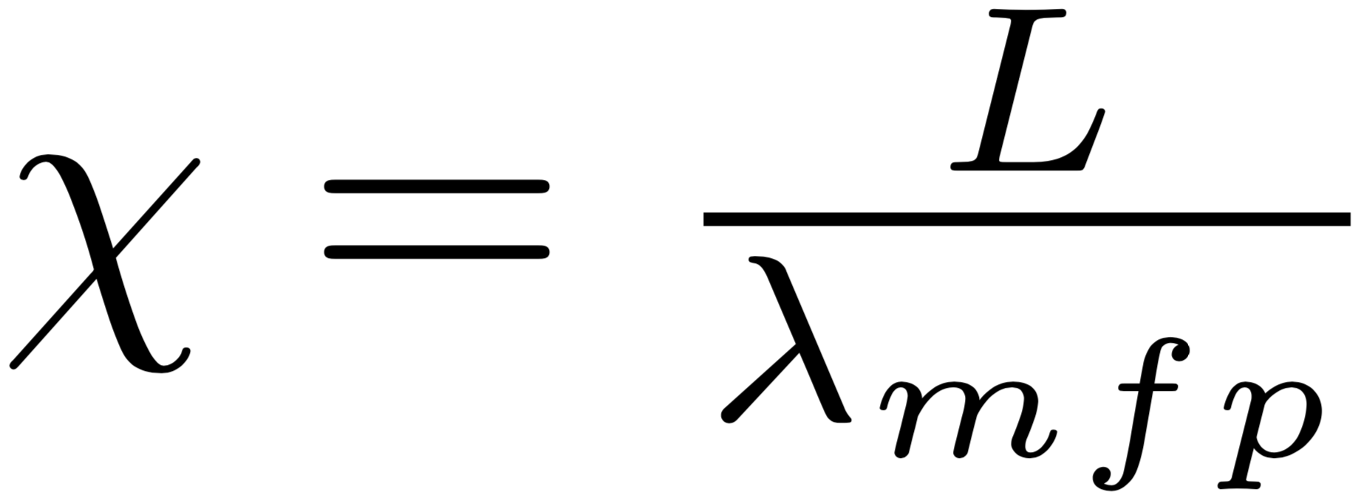
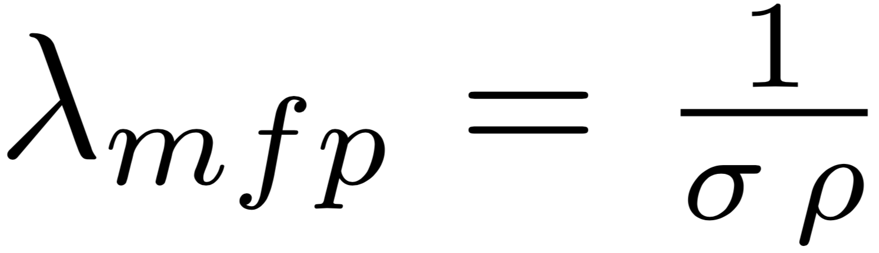
The GLV calculation
Recursion relation
mean free path
which can be explicitly re-summed
opacity

Slide 26
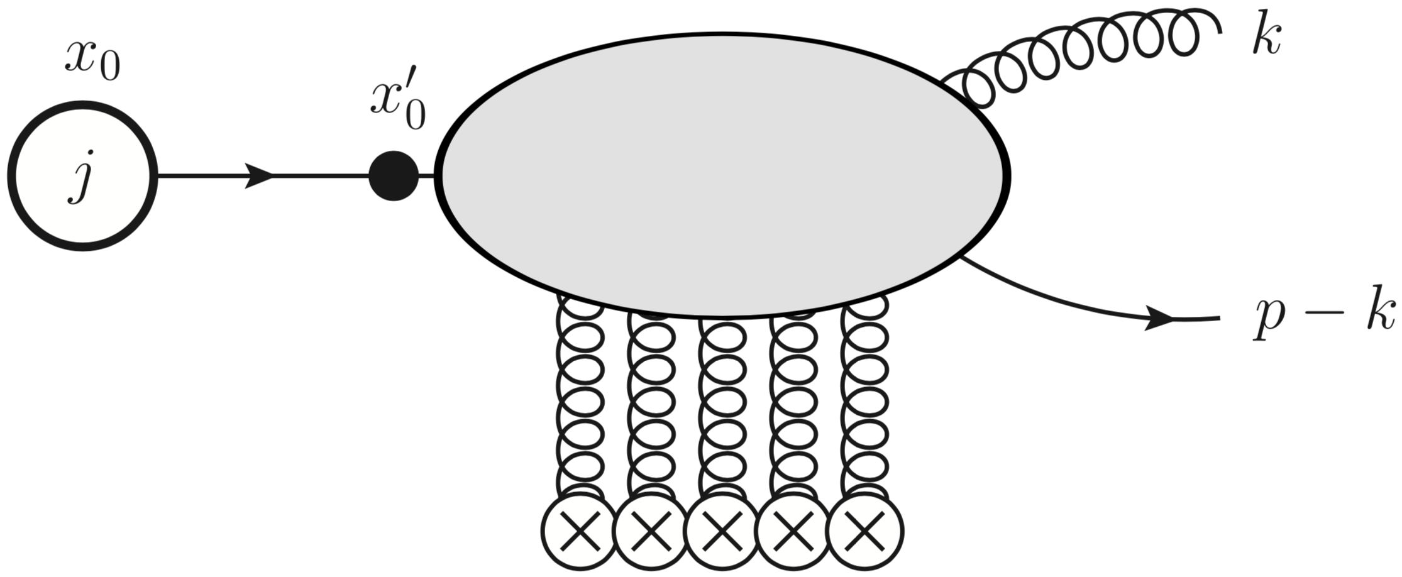
The GLV calculation
GLV, NPB, 2001
Re-summation for gluon spectrum

Slide 27
The GLV calculation
Re-summation for gluon spectrum
GLV, NPB, 2001: Reaction operator, solution to any order in opacity, soft gluon approximation and broad source approximation;
G. Ovanesyan, I. Vitev, JHEP, 2011: Finite gluon energy and broad source approximation, first order in opacity;
M. Sievert, I. Vitev, PRD, 2018: Finite gluon energy, general source, solution to any order in opacity;

Slide 28
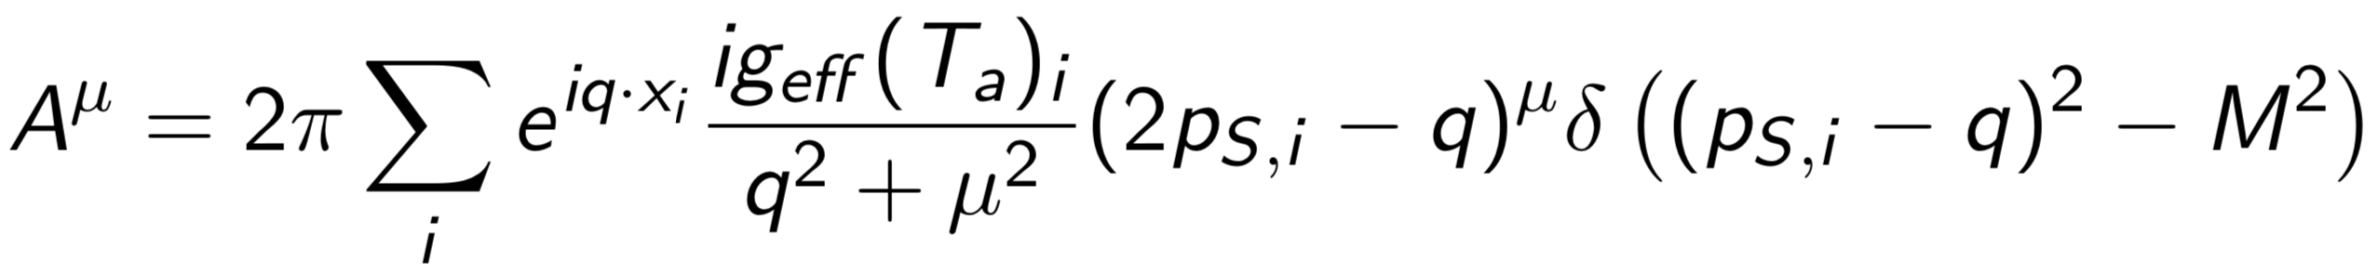
Medium Motion Effects in GLV
AS, M. Sievert, I. Vitev, in progress
allow the source to move
with the medium

Slide 29
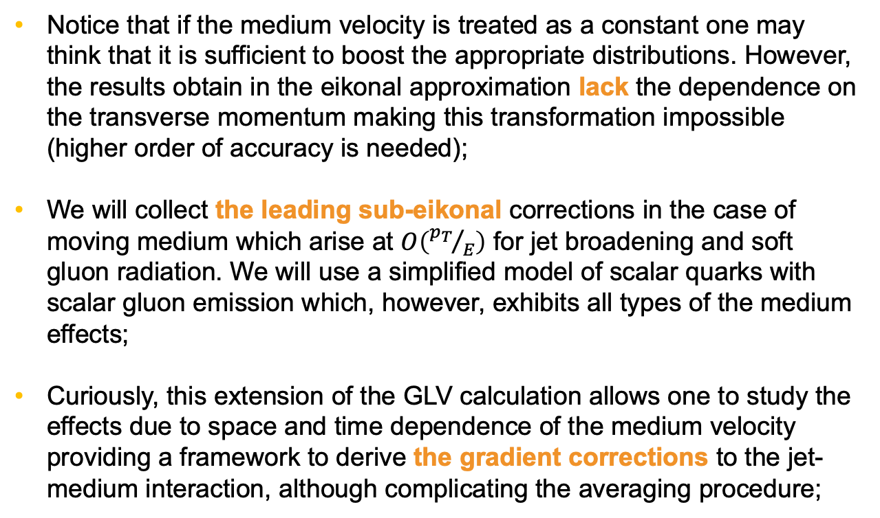
Medium Motion Effects in GLV
AS, M. Sievert, I. Vitev, in progress
Notice that if the medium velocity is treated as a constant one may think that it is sufficient to boost the appropriate distributions. However, the results obtain in the eikonal approximation lack the dependence on the transverse momentum making this transformation impossible (higher order of accuracy is needed);
We will collect the leading sub-eikonal corrections in the case of moving medium which arise at $O\left({p_{T}}/E\right)$ for jet broadening and soft gluon radiation. We will use a simplified model of scalar quarks with scalar gluon emission which, however, exhibits all types of the medium effects;
Curiously, this extension of the GLV calculation allows one to study the effects due to space and time dependence of the medium velocity providing a framework to derive the gradient corrections to the jet-medium interaction, although complicating the averaging procedure;

Slide 30
Medium Motion Effects in GLV
AS, M. Sievert, I. Vitev, in progress
Elastic scattering
or in the limit of infinite sources mass
where u is 4-velocity rescaled with the gamma factor
Thus, the main modification is due to a non-zero energy transfer and the vertex corrections!

Slide 31
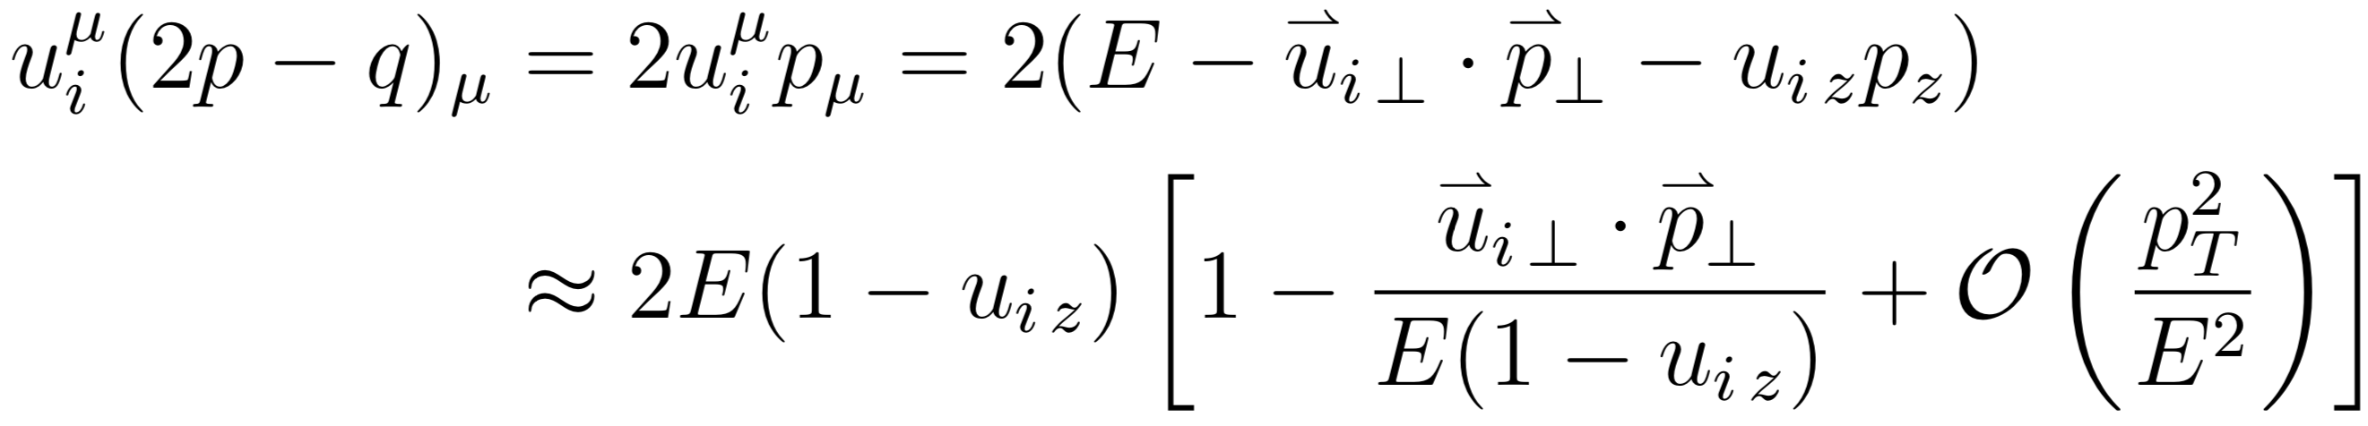
Medium Motion Effects in GLV
AS, M. Sievert, I. Vitev, in progress
Elastic scattering
the vertex correction

Slide 32
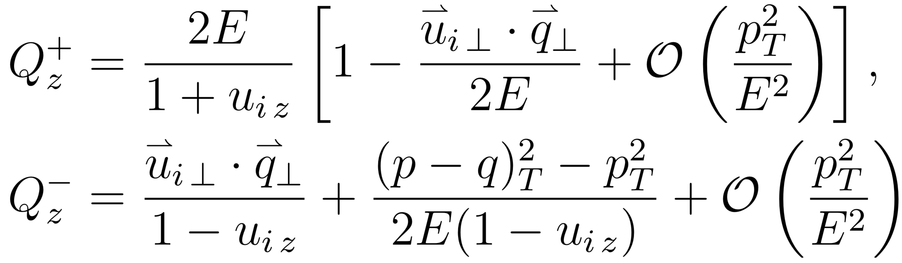
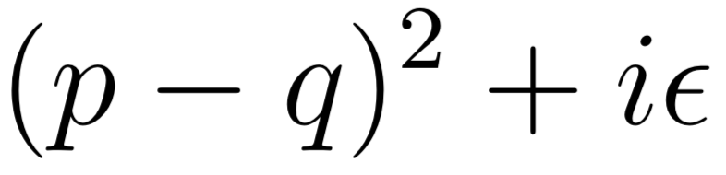
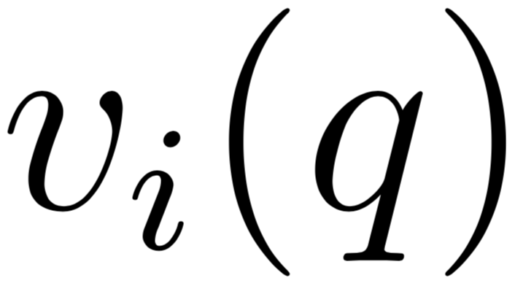
Medium Motion Effects in GLV
AS, M. Sievert, I. Vitev, in progress
Elastic scattering
the larger pole results in highly suppressed contribution
the poles at complex values of q can be ignored due to exponential suppression in the limit when the distance between scattering centers are large comparing to the screening length

Slide 33
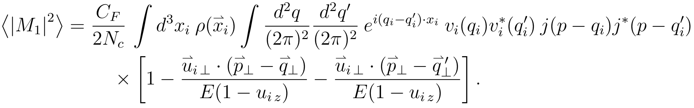
Medium Motion Effects in GLV
AS, M. Sievert, I. Vitev, in progress
Elastic scattering
and in the limit of constant medium velocity we readily find
density rescaling in the medium element rest frame
where there is also implicit velocity dependence in the elastic scattering cross section

Slide 34
Medium Motion Effects in GLV
AS, M. Sievert, I. Vitev, in progress
Gradient corrections
For small velocity amplitude
For small velocity gradients

Slide 35
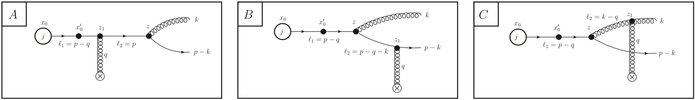
AS, M. Sievert, I. Vitev, in progress
Medium Motion Effects in GLV
Soft gluon emission
The velocity effects:
The non-zero energy transfer;
The vertex correction;
The modification of poles in the quark/gluon propagators;
The momentum shift in the medium potential;
The shift in the phases;

Slide 36
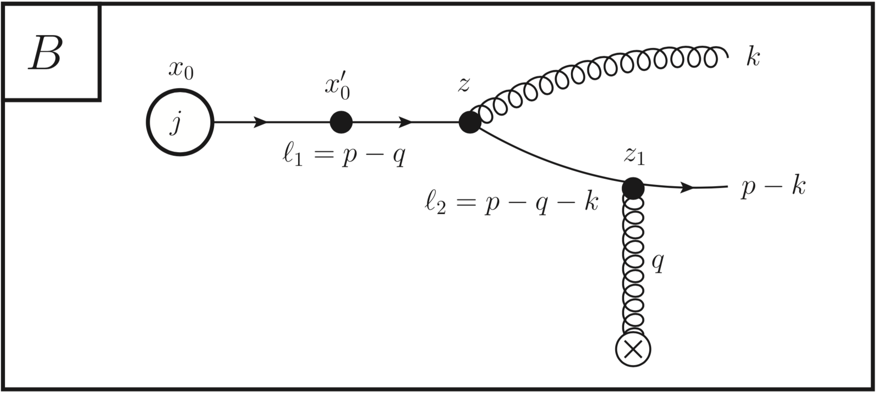
AS, M. Sievert, I. Vitev, in progress
Medium Motion Effects in GLV
Soft gluon emission
The non-zero energy transfer;
The vertex correction;
The modification of the poles;
The momentum shift in the potential;
The shift in the phases;

Slide 37
AS, M. Sievert, I. Vitev, in progress
Medium Motion Effects in GLV
Soft gluon emission
The non-zero energy transfer;
The vertex correction;
The modification of the poles;
The momentum shift in the potential;
The shift in the phases;
where x is the momentum fraction of the radiated scalar gluon

Slide 38
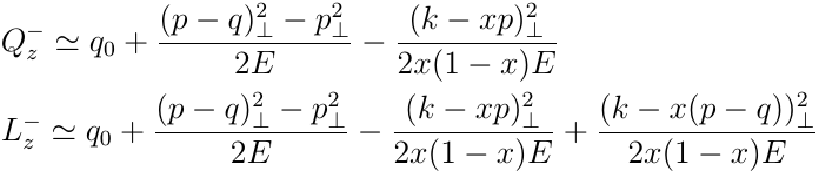
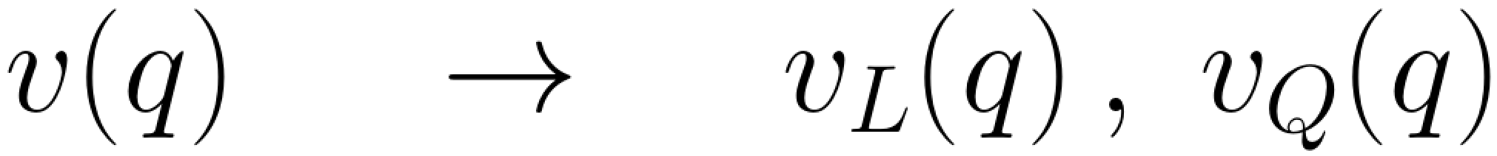
AS, M. Sievert, I. Vitev, in progress
Medium Motion Effects in GLV
Soft gluon emission
The non-zero energy transfer;
The vertex correction;
The modification of the poles;
The momentum shift in the potential;
The shift in the phases;

Slide 39
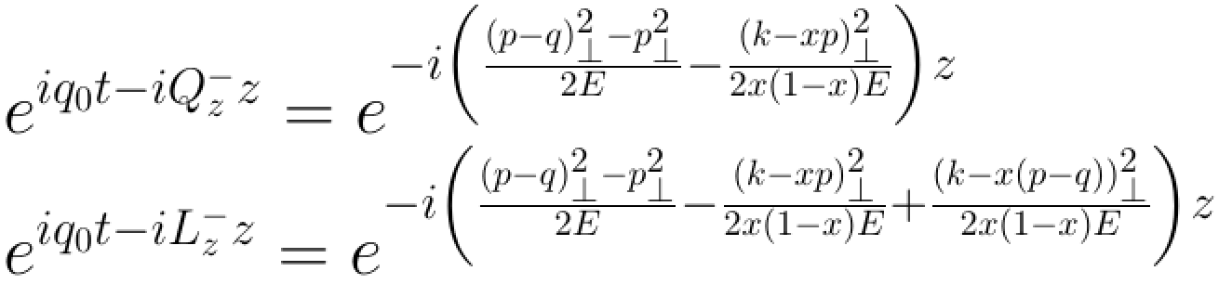

AS, M. Sievert, I. Vitev, in progress
Medium Motion Effects in GLV
Soft gluon emission
The non-zero energy transfer;
The vertex correction;
The modification of the poles;
The momentum shift in the potential;
The shift in the phases;
since $z\sim t$

Slide 40
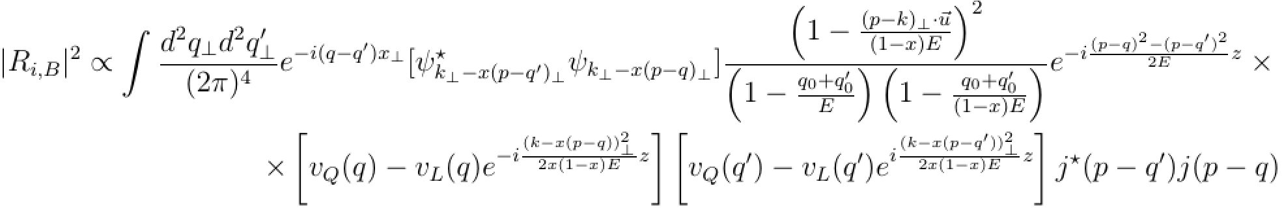
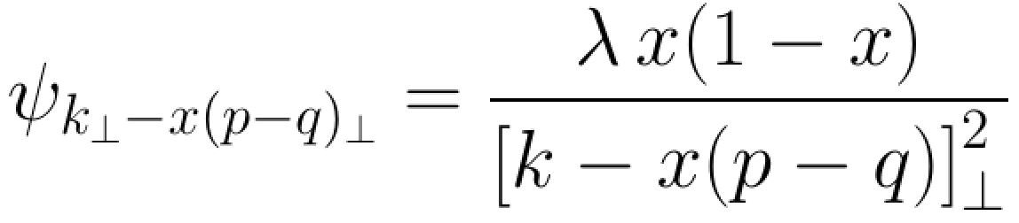
AS, M. Sievert, I. Vitev, in progress
Medium Motion Effects in GLV
Soft gluon emission
The non-zero energy transfer;
The vertex correction;
The modification of the poles;
The momentum shift in the potential;
The shift in the phases;
and

Slide 41
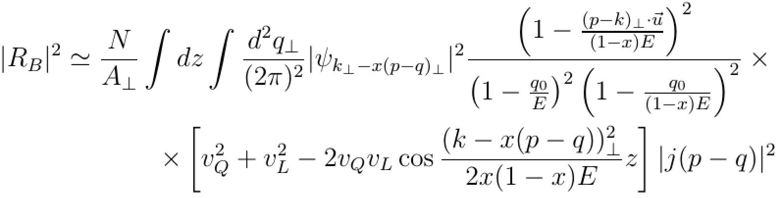
AS, M. Sievert, I. Vitev, in progress
Medium Motion Effects in GLV
Soft gluon emission
The non-zero energy transfer;
The vertex correction;
The modification of the poles;
The momentum shift in the potential;
The shift in the phases;
light-front w.f.
in the constant velocity limit

Slide 42
AS, M. Sievert, I. Vitev, in progress
Medium Motion Effects in GLV
Soft gluon emission
The non-zero energy transfer;
The vertex correction;
The modification of the poles;
The momentum shift in the potential;
The shift in the phases;
light-front w.f.
Notice that while the phase is unmodified the amplitudes are now shifted

Slide 43
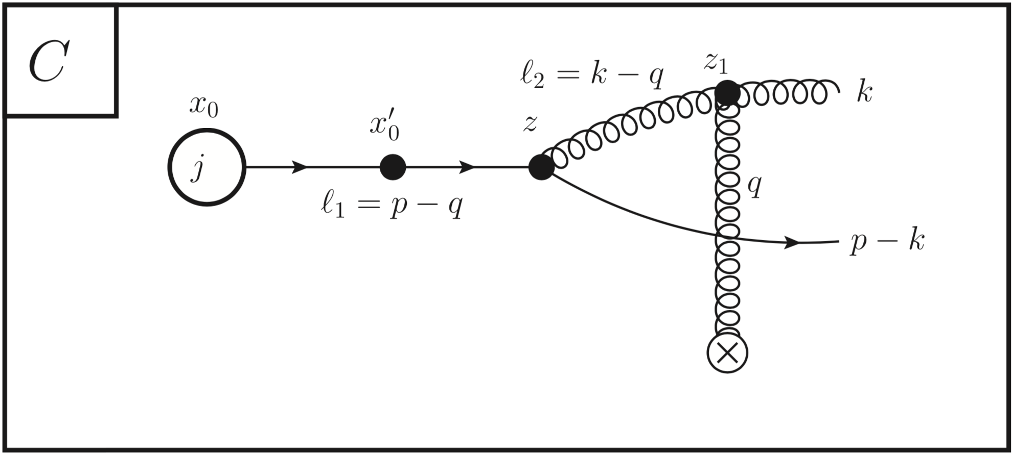
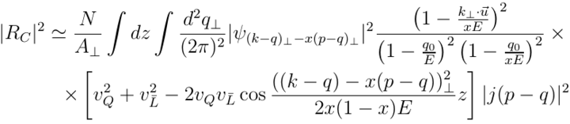
AS, M. Sievert, I. Vitev, in progress
Medium Motion Effects in GLV
Soft gluon emission
The non-zero energy transfer;
The vertex correction;
The modification of the poles;
The momentum shift in the potential;
The shift in the phases;
light-front w.f.
Notice that while the phase is unmodified the amplitudes are now shifted

Slide 44
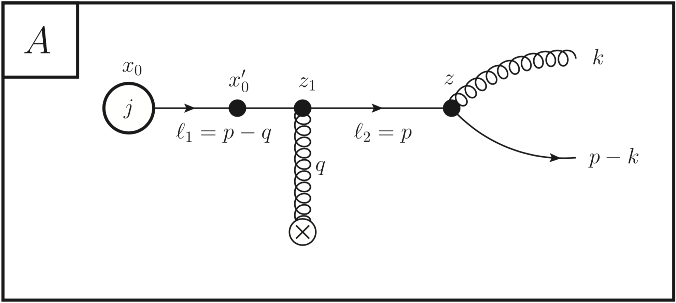
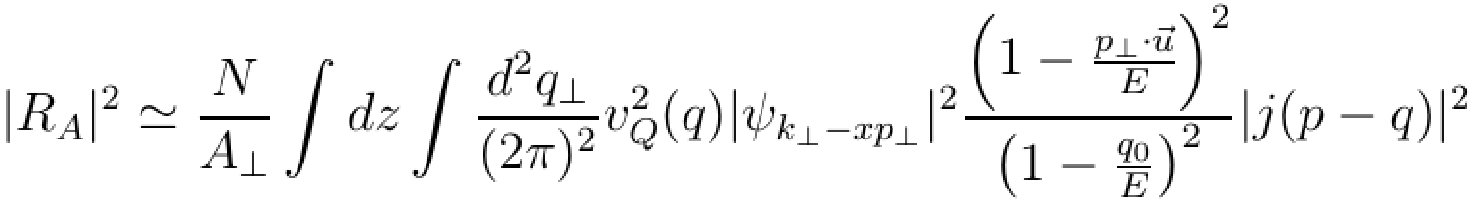
AS, M. Sievert, I. Vitev, in progress
Medium Motion Effects in GLV
Soft gluon emission
The non-zero energy transfer;
The vertex correction;
The modification of the poles;
The momentum shift in the potential;
The shift in the phases;
light-front w.f.
Notice that while the phase is unmodified the amplitudes are now shifted

Slide 45
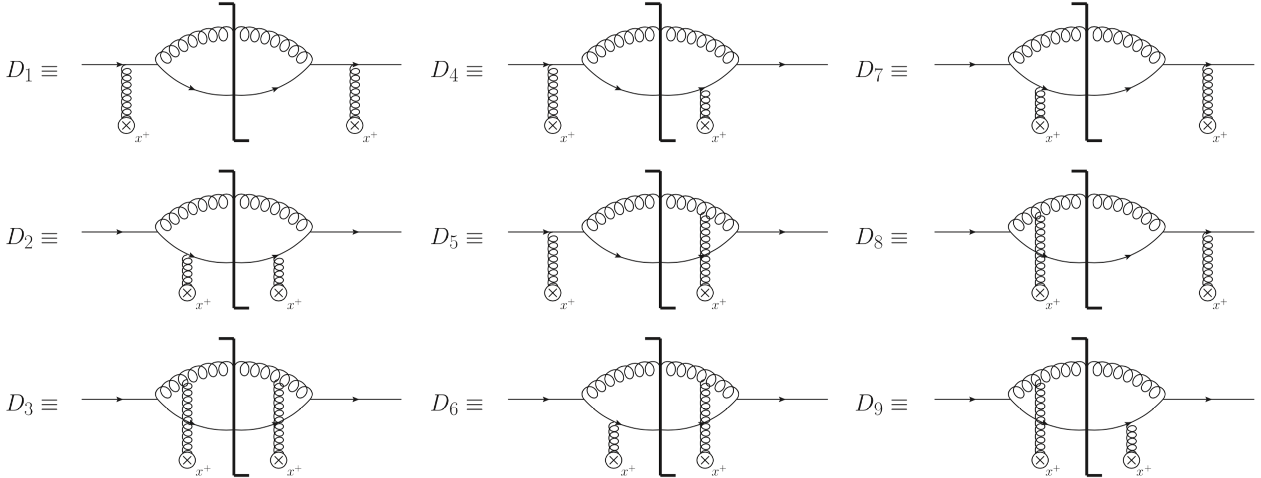
AS, M. Sievert, I. Vitev, in progress
Medium Motion Effects in GLV
Soft gluon emission

Slide 46
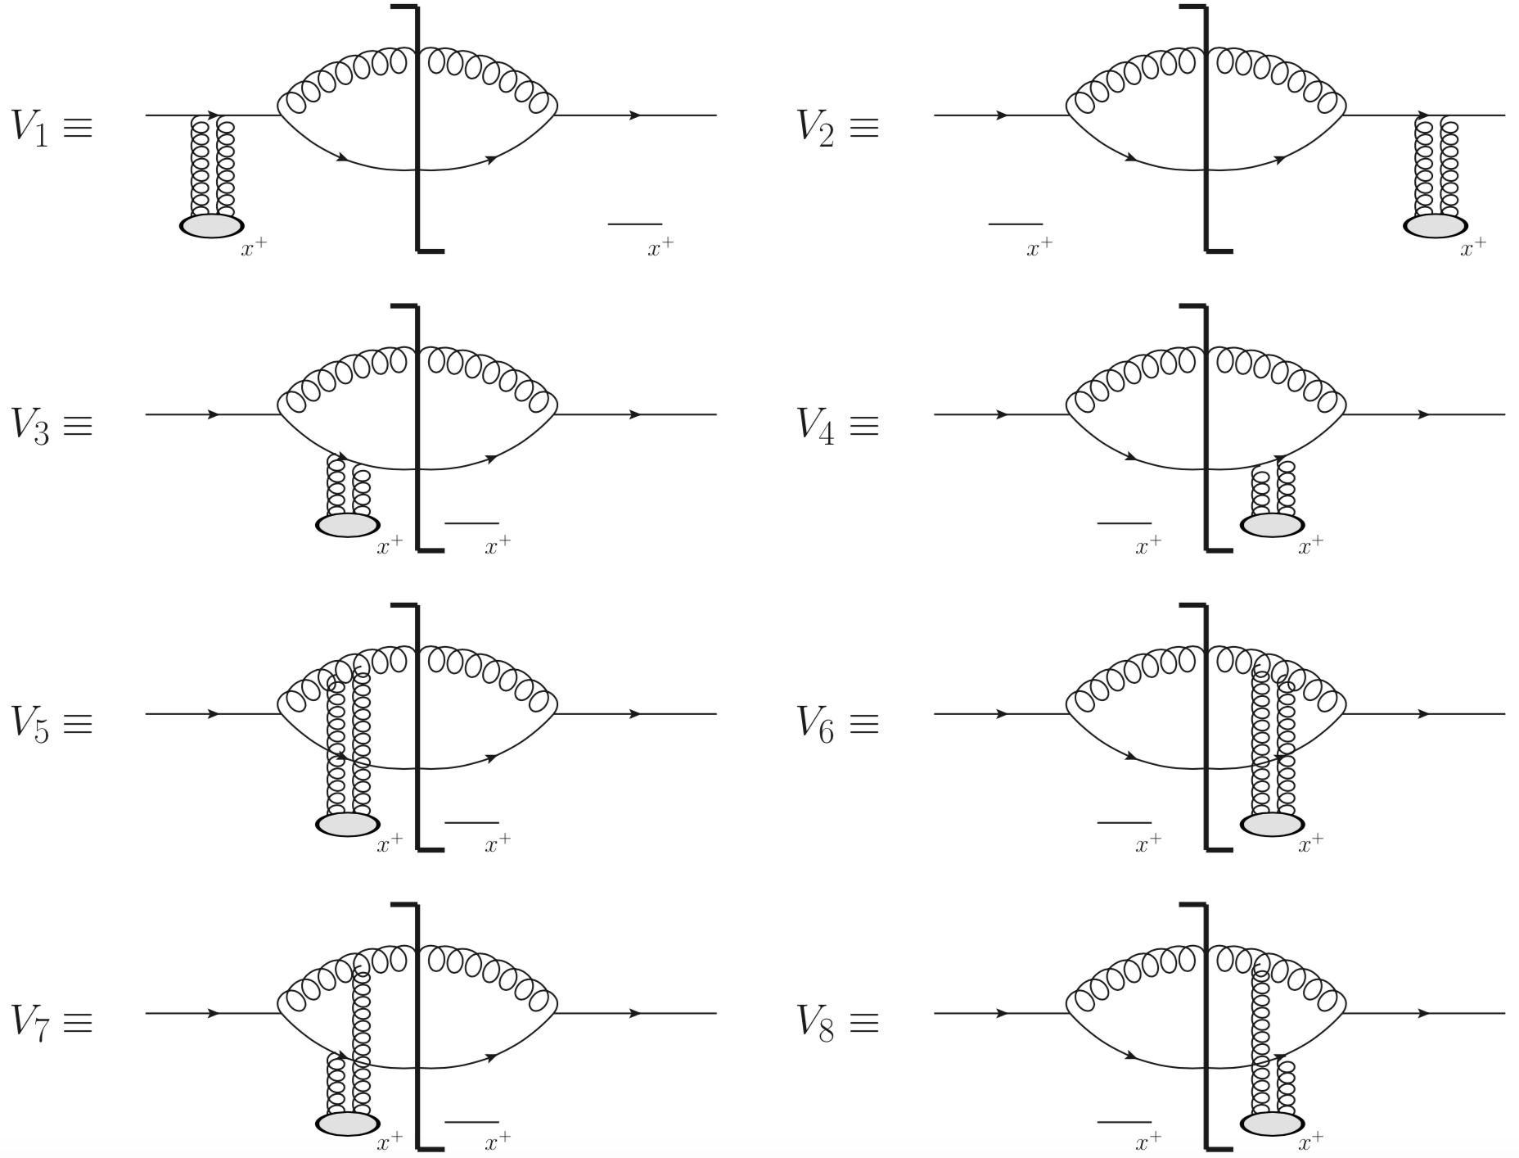
AS, M. Sievert, I. Vitev, in progress
Medium Motion Effects in GLV
Soft gluon emission

Slide 47
AS, M. Sievert, I. Vitev, in progress
Summary
We considered the leading sub-ekonal corrections to the jet-broadening and soft gluon emission in the GLV setup;
The medium velocity results in a non-zero energy transfer but no modification in the transverse momentum transfer;
The medium velocity leads to a multiplicative factor in the single Born amplitudes due to the vertex corrections;
The effects of the medium motion velocity can be systematically taken into account with no approximation on its form;
If the velocity is varying in space and time it affects the source averaging procedure. In the simplest approximations one can study the corresponding corrections to the amplitudes analytically;

Slide 48
AS, M. Sievert, I. Vitev, in progress
Summary
We considered the leading sub-ekonal corrections to the jet-broadening and soft gluon emission in the GLV setup;
The medium velocity results in a non-zero energy transfer but no modification in the transverse momentum transfer;
The medium velocity leads to a multiplicative factor in the single Born amplitudes due to the vertex corrections;
The effects of the medium motion velocity can be systematically taken into account with no approximation on its form;
If the velocity is varying in space and time it affects the source averaging procedure. In the simplest approximations one can study the corresponding corrections to the amplitudes analytically;
More details in our upcoming paper!

