Slide 1
Transverse Convective Instabilities of a Bunch with Space Charge
Alexey Burov
Fermilab, AD AST-APS
Discussions with E. Metral, Yu. Alexahin and T. Zolkin are appreciated.
JLab, Mar 21, 2019
AB

Slide 2
The Problem
Single bunch in a circular machine
Linear optics
Zero chromaticity
Short Wake
Space charge
What sorts of modes are there?
AB

Slide 3
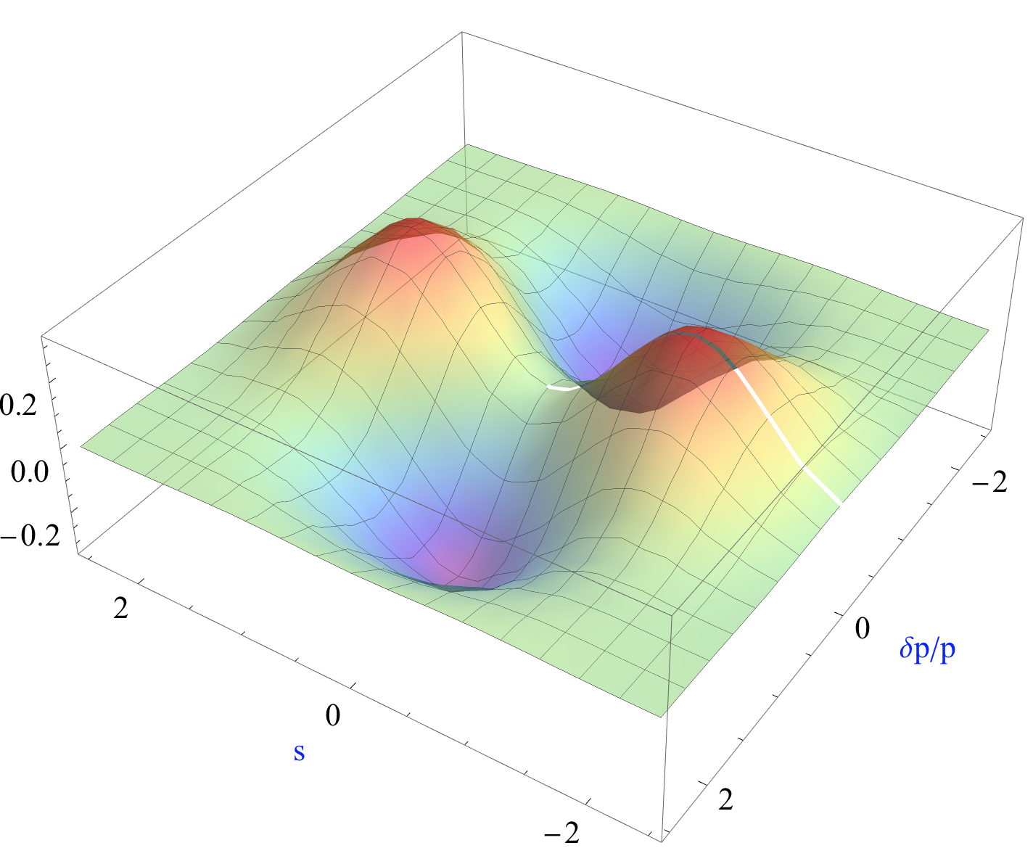

No SC, no Wake
$$Ω_{m}=ω_{b}+mω_{s}$$
Sacherer’s HT mode {2,1}
AB

Slide 4
Frank Sacherer (1940-1978)
AB

Slide 5
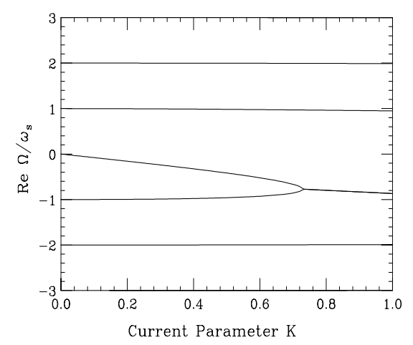
Wake, No SC
TMCI
First detected at PETRA; explained by R.D. Kohaupt (DESY), 1980
AB

Slide 6
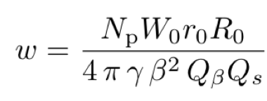




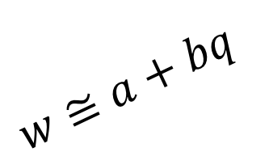
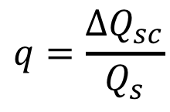
TMCI @ SC
$$w$$
TMCI
$$w≅a+bq$$
Stability
$$a$$
$$q=\frac{ΔQ_{sc}}{Q_{s}}$$
$$1$$
$$q$$
Blaskiewicz (1998), Burov (1999+), Balbekov (2009+), Burov & Zolkin (2017)
AB

Slide 7
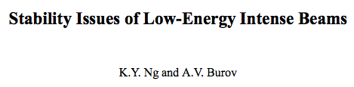


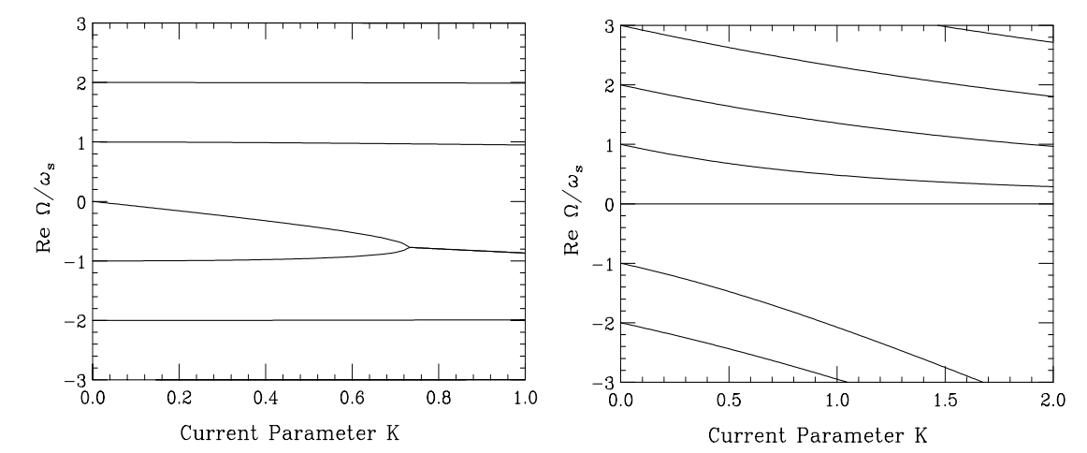
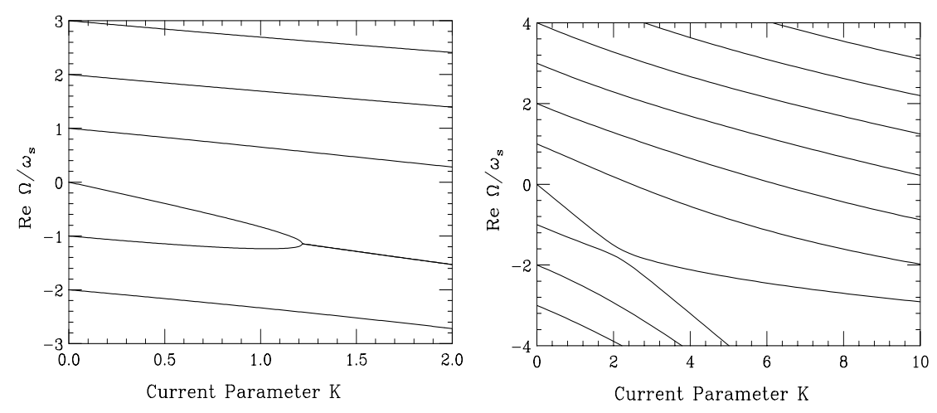

TMCI @ SC
Explanation of the TMCI suppression
no SC
no wake
wake + SC
wake + more SC
$$N_{th}∝\frac{1}{w/N−q/N}$$
AB

Slide 8

Contradiction #1
$$w$$
TMCI
$$w≅a+bq$$
SPS: Instability
$$a$$
$$1$$
$$q$$
AB

Slide 9

Contradiction #2
$$w$$
TMCI
$$w≅a+bq$$
$$a$$
$$1$$
$$q$$
At SSC, TMCI threshold is intensity independent!
$$w∝q$$
AB

Slide 10
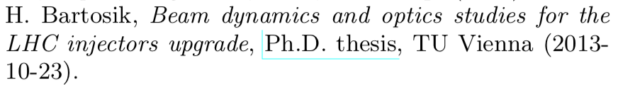
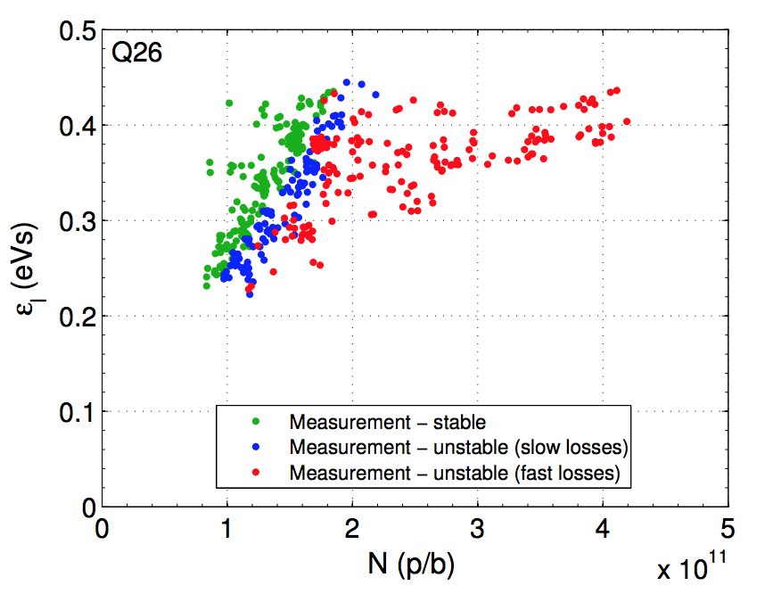
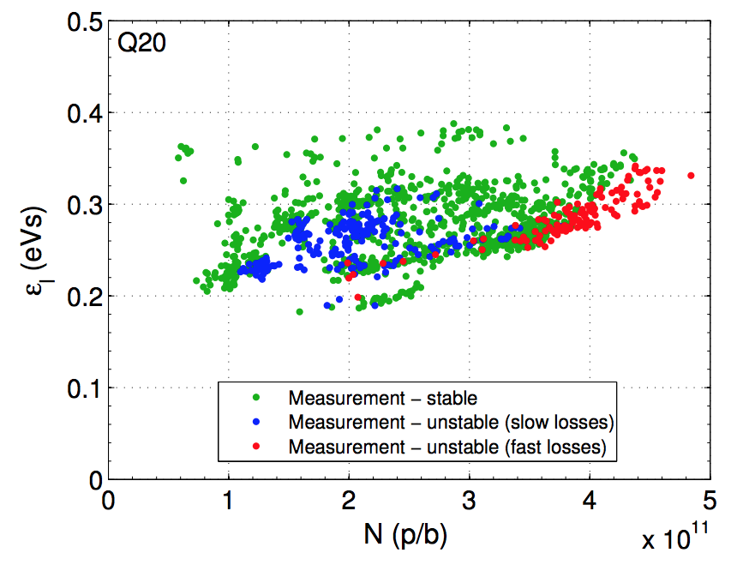
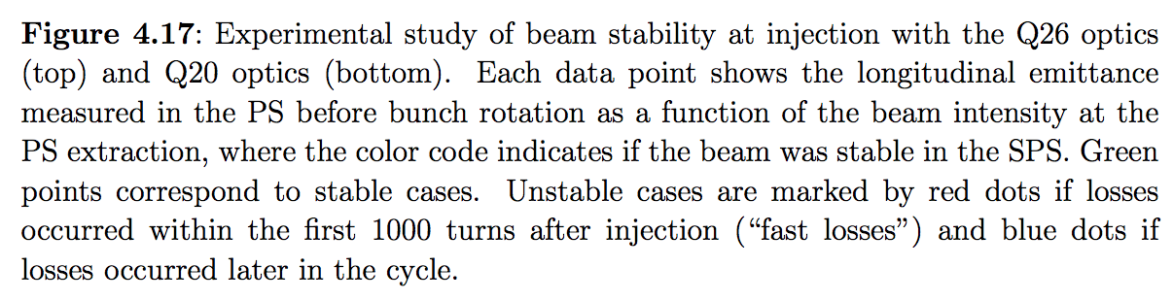
SPS Instability
These measurements reasonably agree with no SC TMCI threshold,
but SC was really huge at Q26, q > 20.
These measurements contradict to everything in the TMCI @ SSC theory!
AB

Slide 11

Resolution of the Conundrum
$$w$$
TMCI
$$w≅a+bq$$
Convective Instabilities
$$a$$
$$1$$
$$q$$
AB

Slide 12
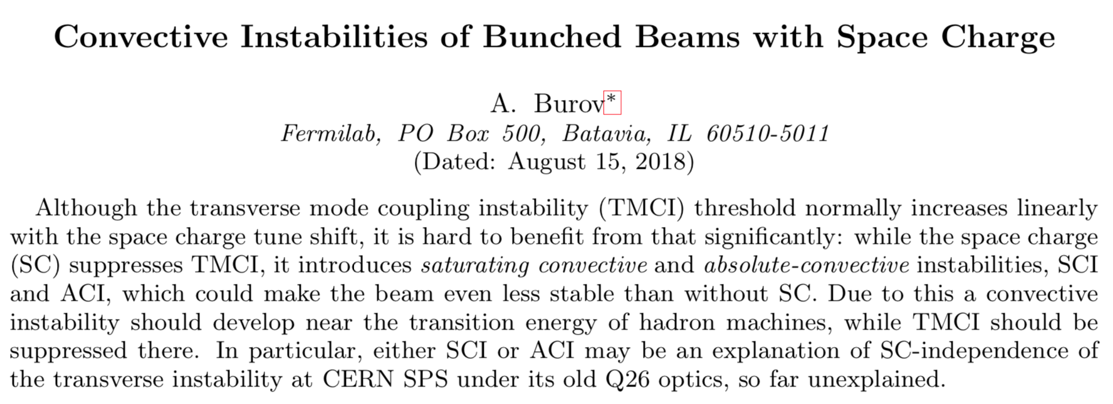

Resolution
arXiv:1807.04887
Mar 11: accepted by PRAB
Beam stability requires more than !
$$ℑ ν≤0$$
AB

Slide 13
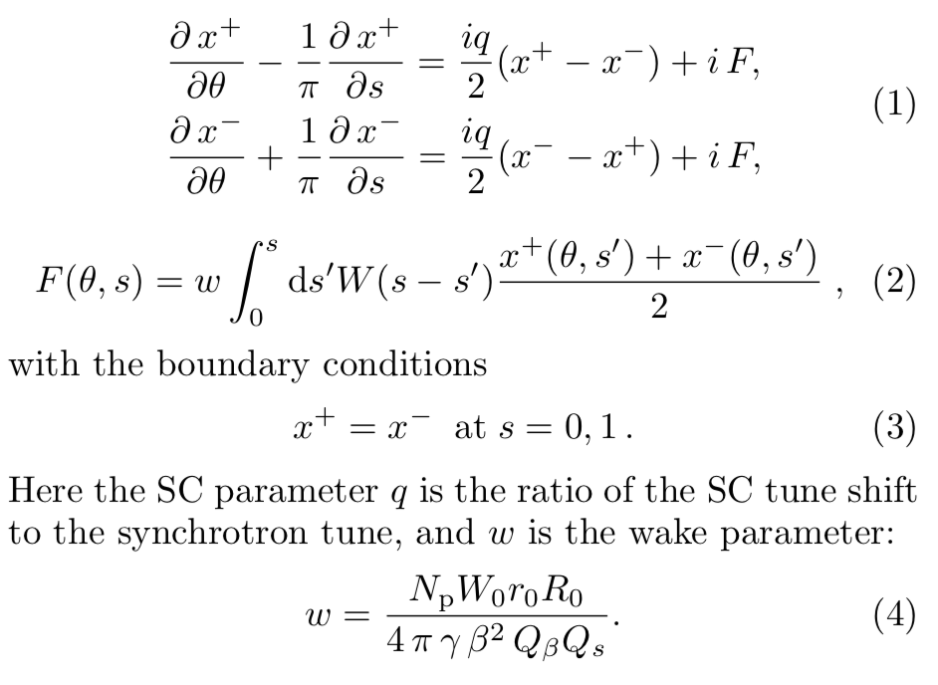



Air-Bag, Square well (ABS)
$$δp/p$$
head
tail
$$s$$
$$s$$
ABS: longitudinal plane
M. Blaskiewicz, 1998
AB

Slide 14
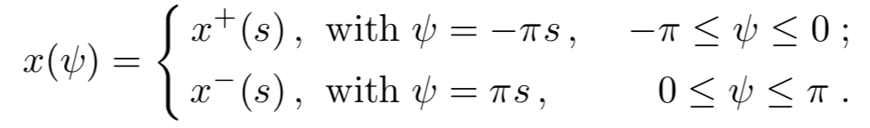
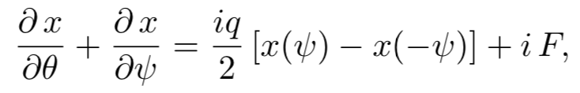
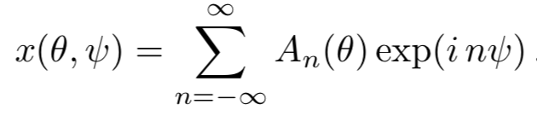
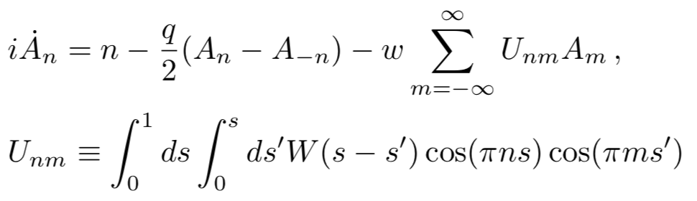
Air-Bag, Square well (ABS)
AB

Slide 15
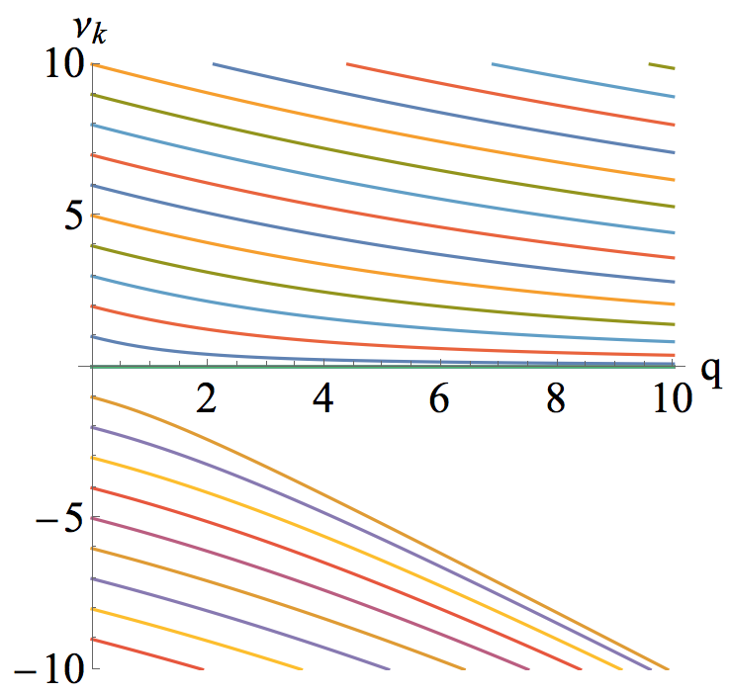

No-Wake Eigenvalues
AB

Slide 16
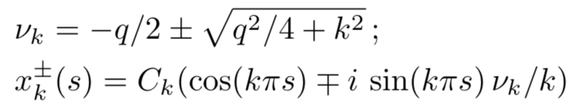
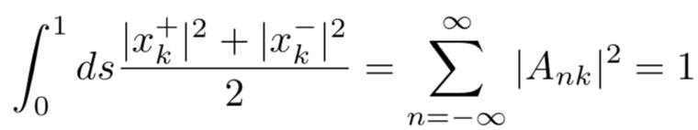
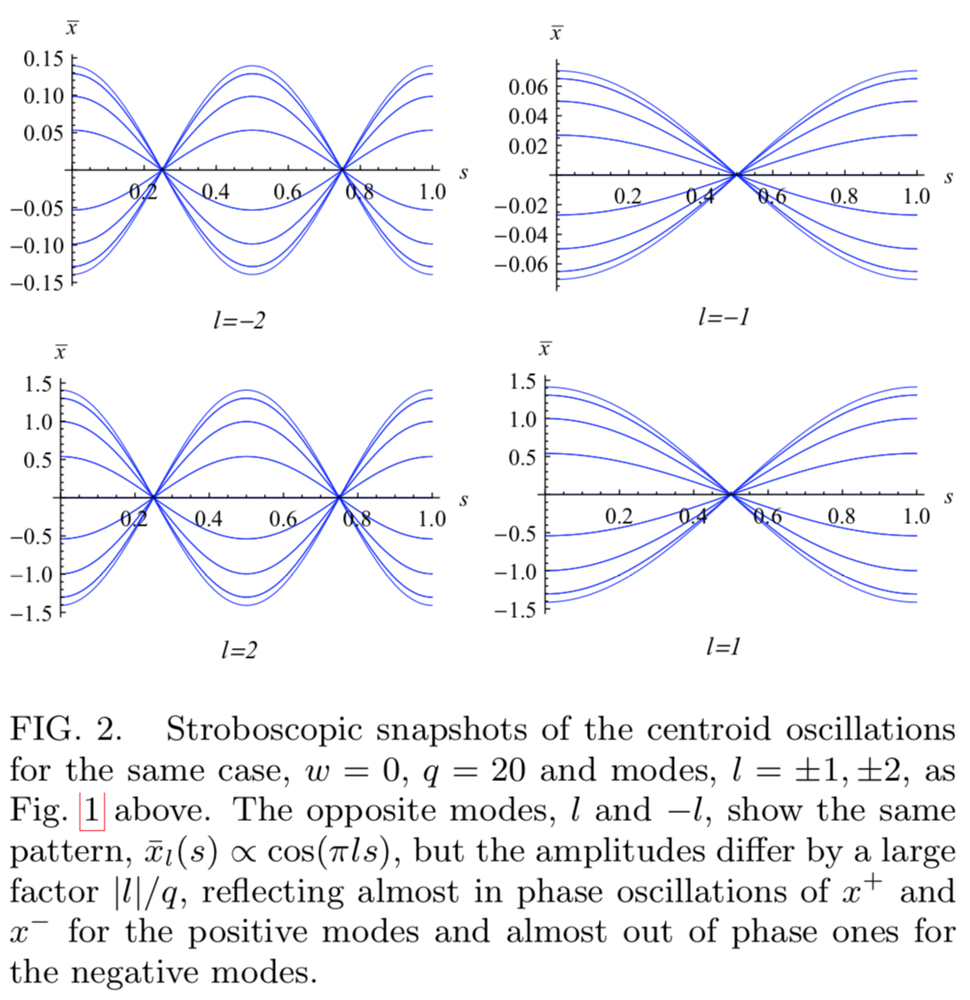


No-Wake Eigensystem
q = 20
$$\overline{x}=(x^{+}+x^{−})/2$$
AB

Slide 17
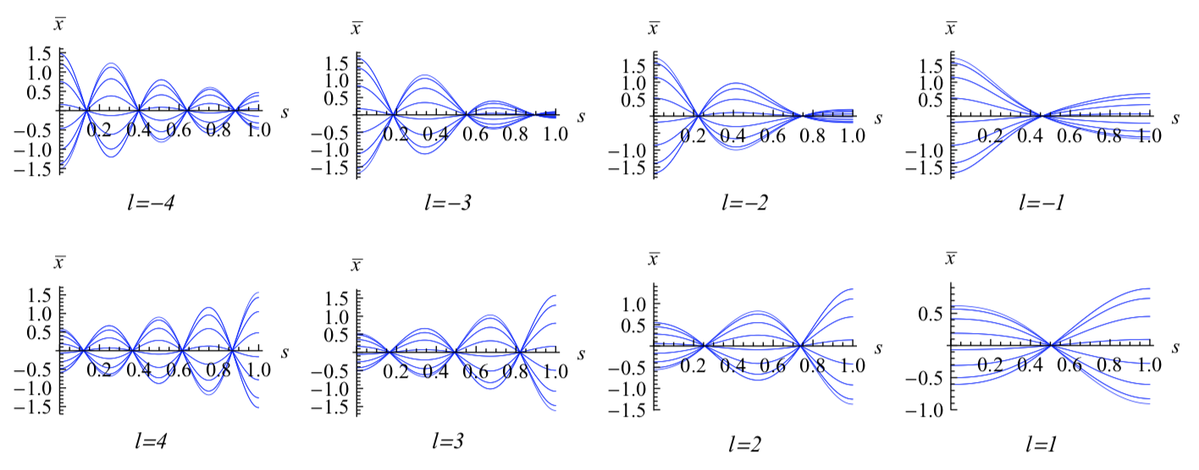





Eigen-Centroids, No SC
$$\overline{k}=\sqrt{k_{r}^{2}−α^{2}}$$
$$W\left(s\right)=exp\left(−αs\right) sin\left(\overline{k}s\right)$$
$α=k_{r}/$ (2$Q_{r}$)
Near TMCI
Modes -2 and -3 are about to couple
$$k_{r}=10 Q_{r}=1$$
w = 13
At no-SC, $w_{th}=15$
AB

Slide 18
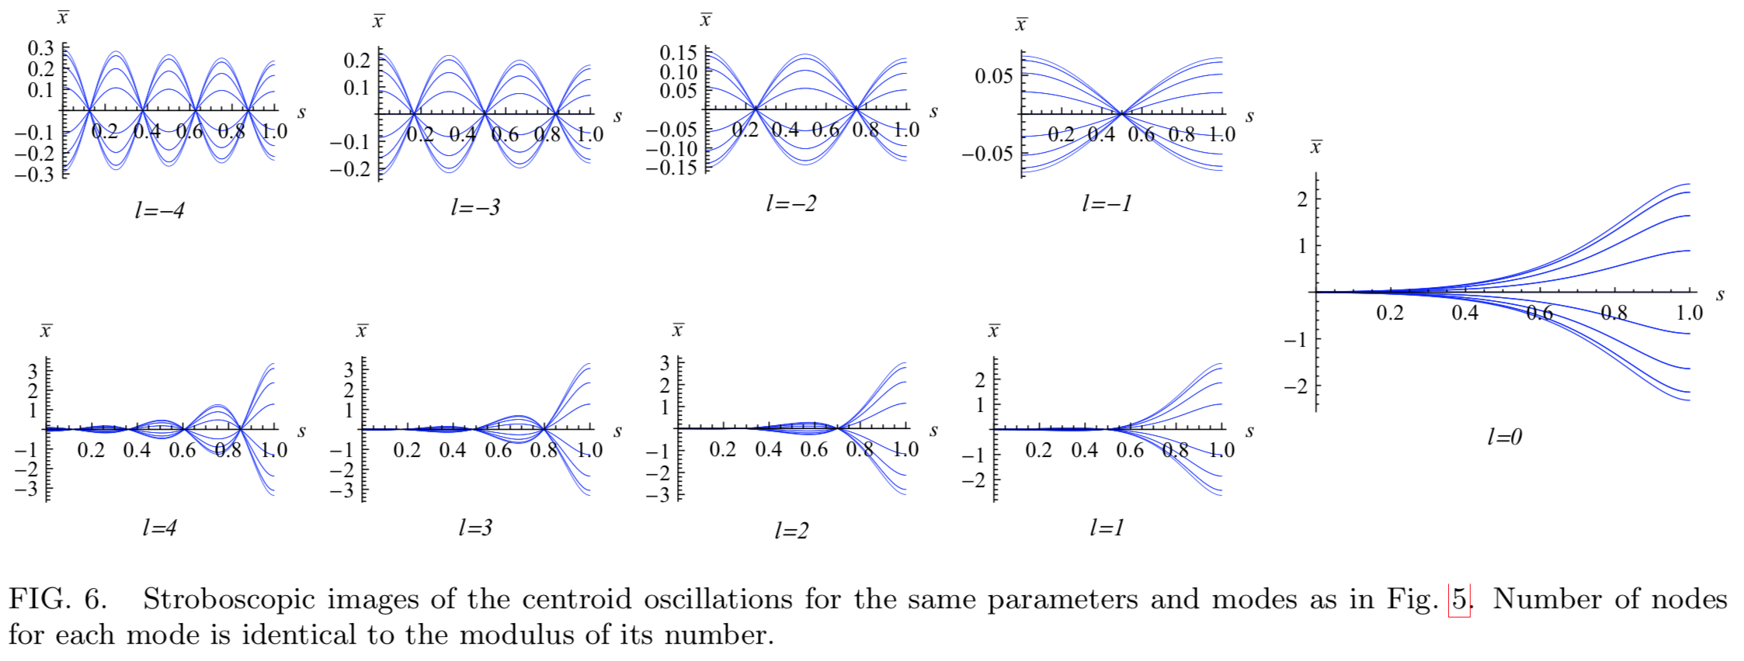
Centroid oscillations, strong-strong case
q = 20
w = 13
Threshold w=115 at this q
AB

Slide 19
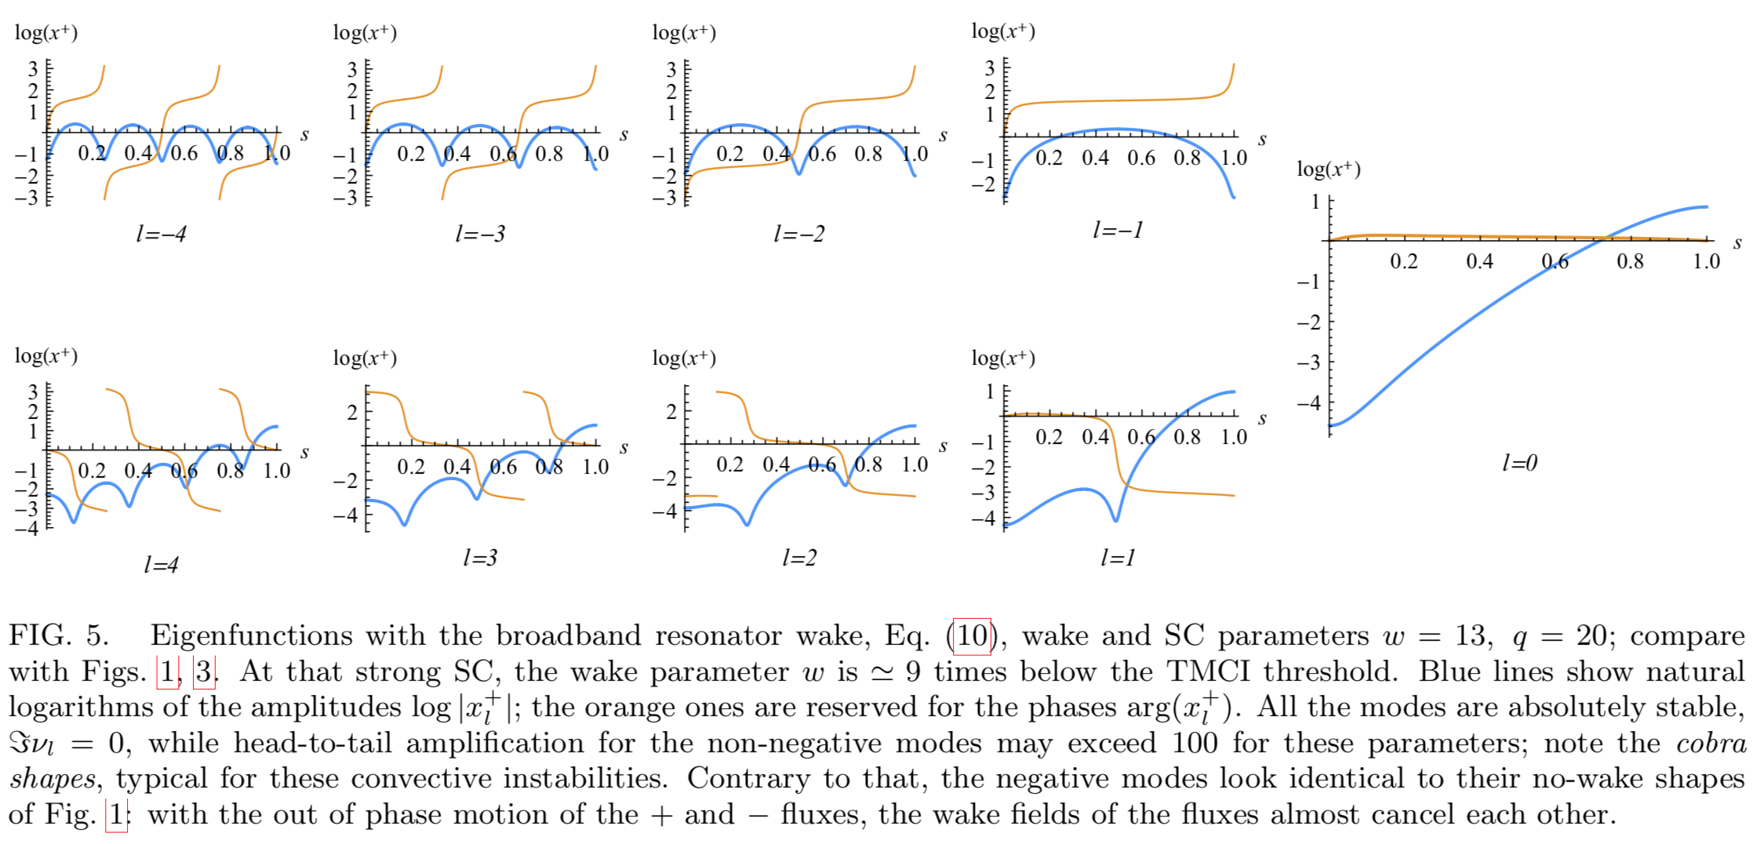


Same case
Wake & Strong SC
$$arg x^{+}$$
$$log|x^{+}|$$
q = 20
w = 13
AB

Slide 20
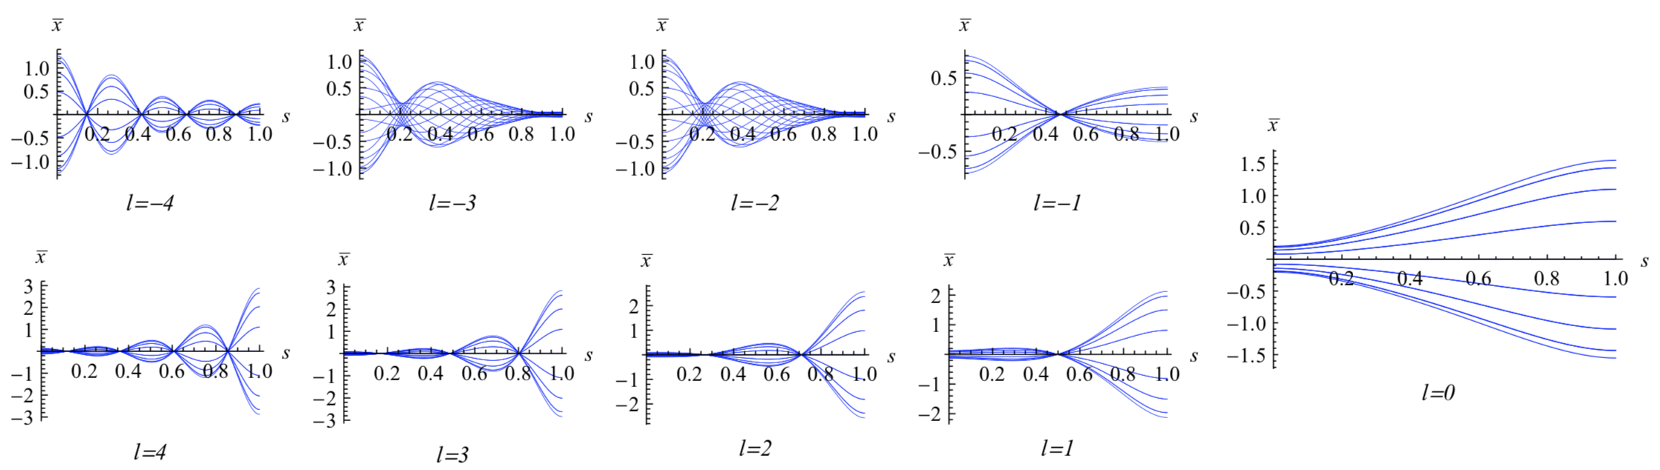
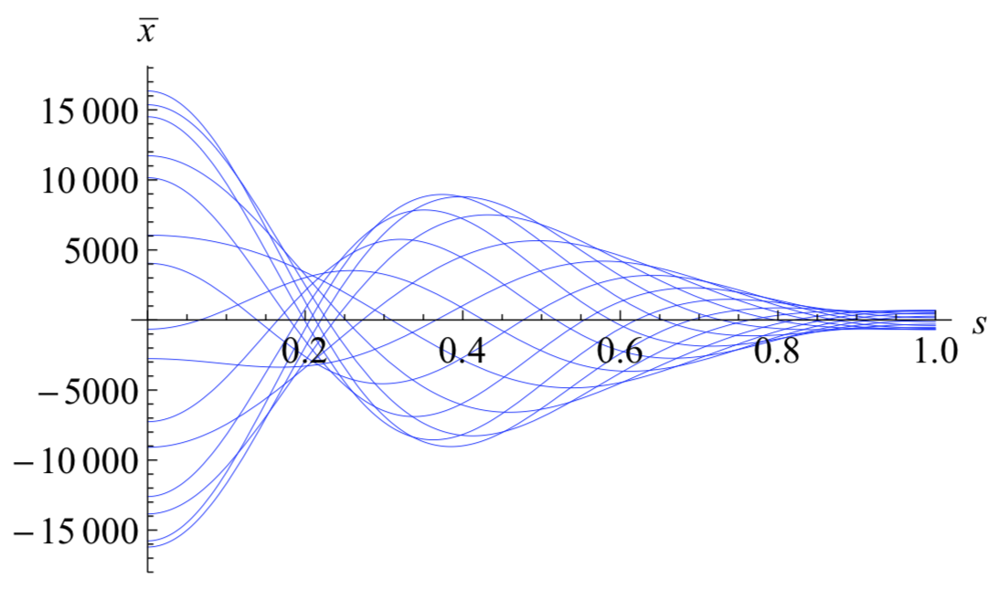
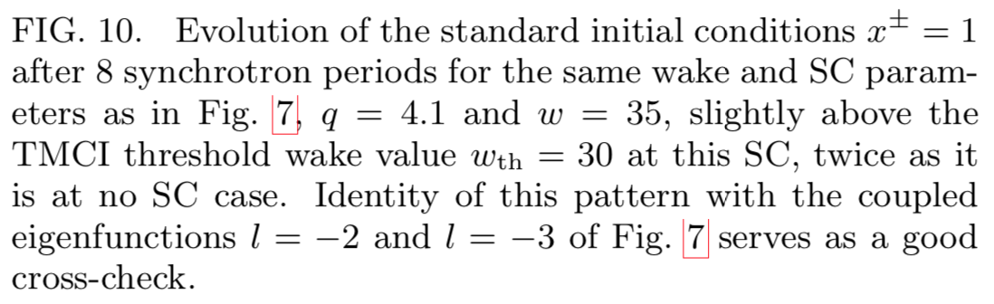
Centroid, above the TMCI
q = 4
w = 35
AB

Slide 21
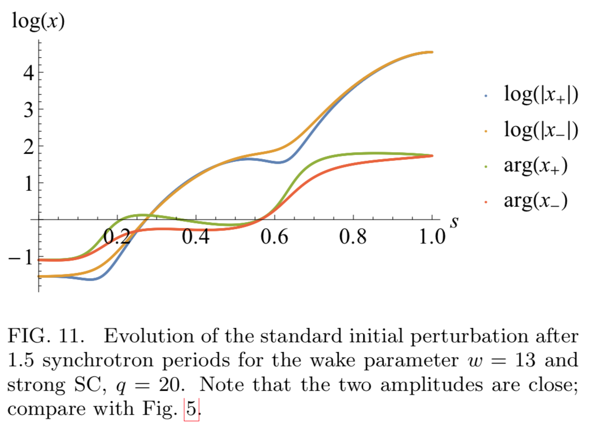
Cauchy Problem
w=13, q = 20
AB

Slide 22
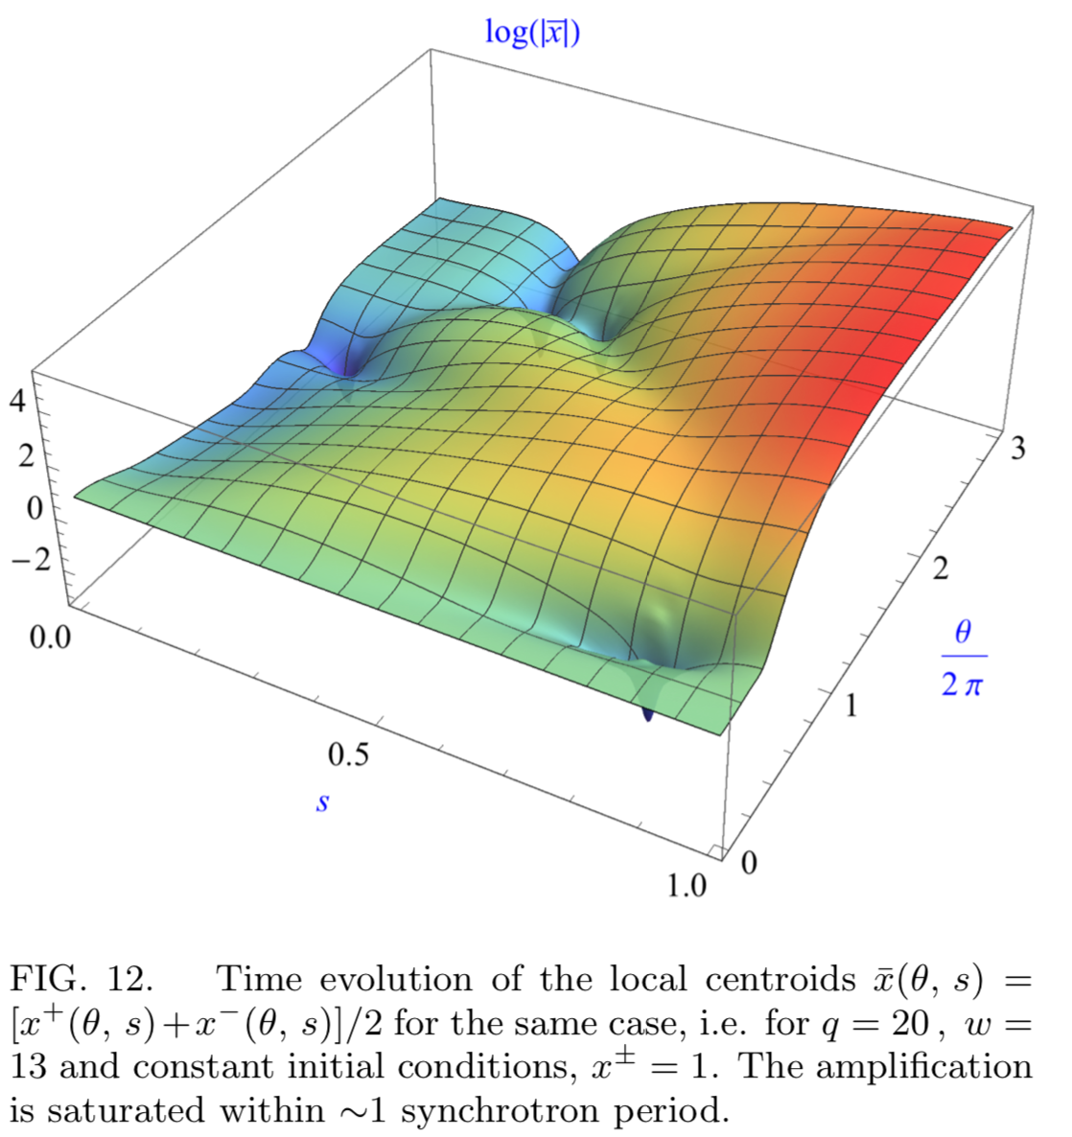

$$\overline{x}=(x^{+}+x^{−})/2$$
w=13, q = 20
AB

Slide 23
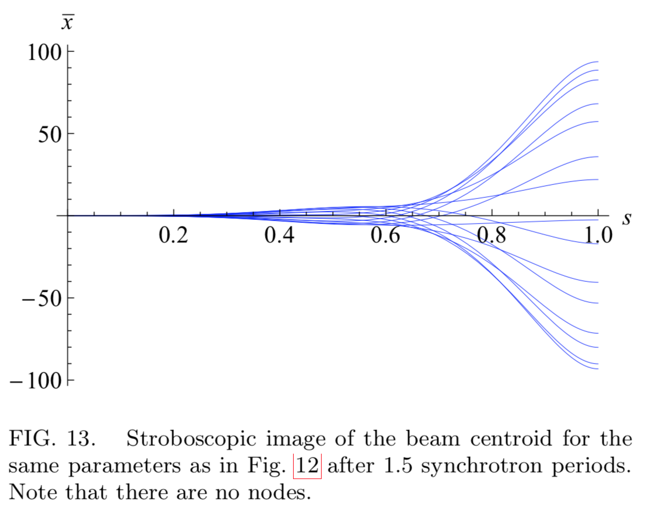
w=13, q = 20
AB

Slide 24
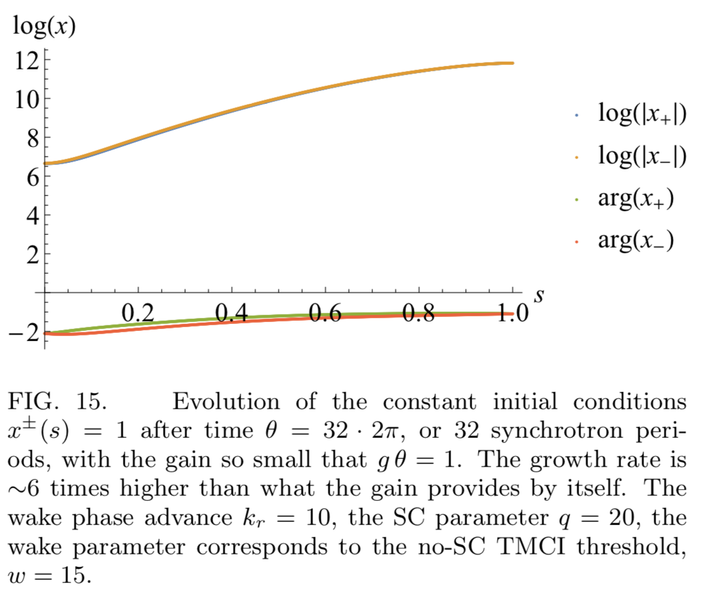
Absolute-Convective Instability (ACI)
AB

Slide 25
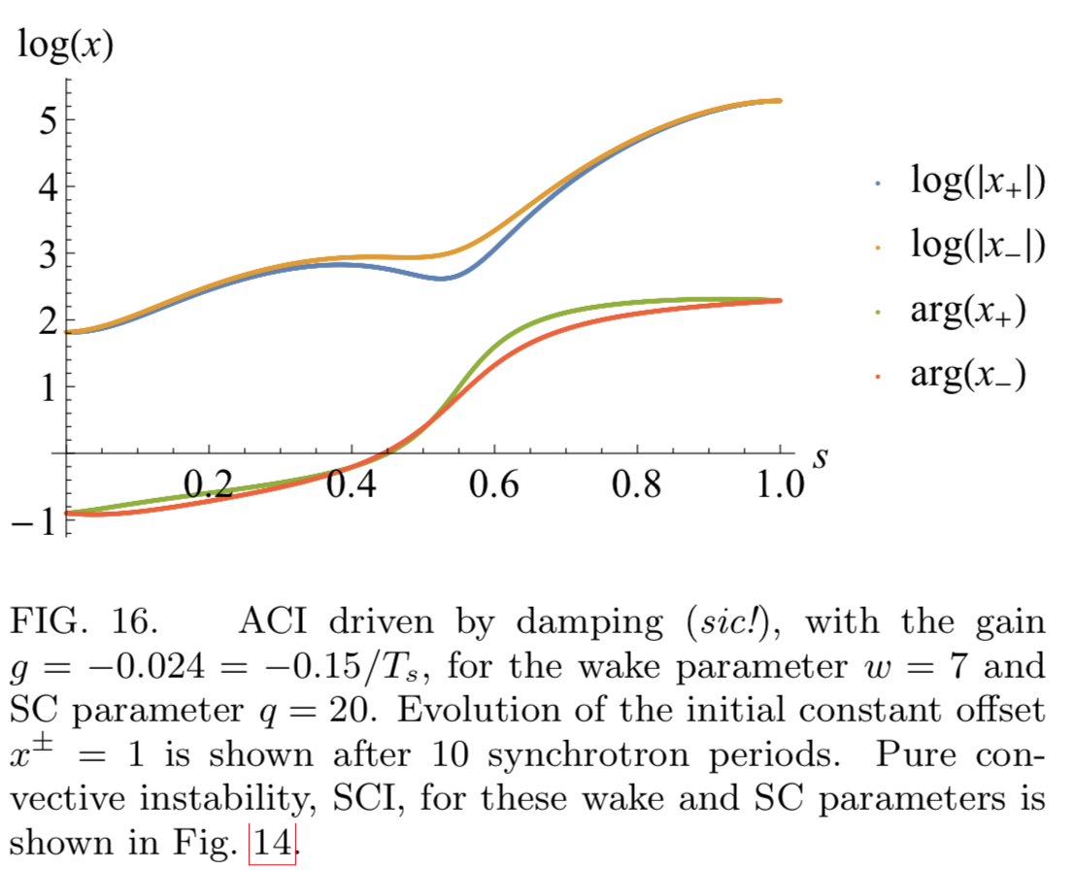
ACI excited by damping
AB

Slide 26
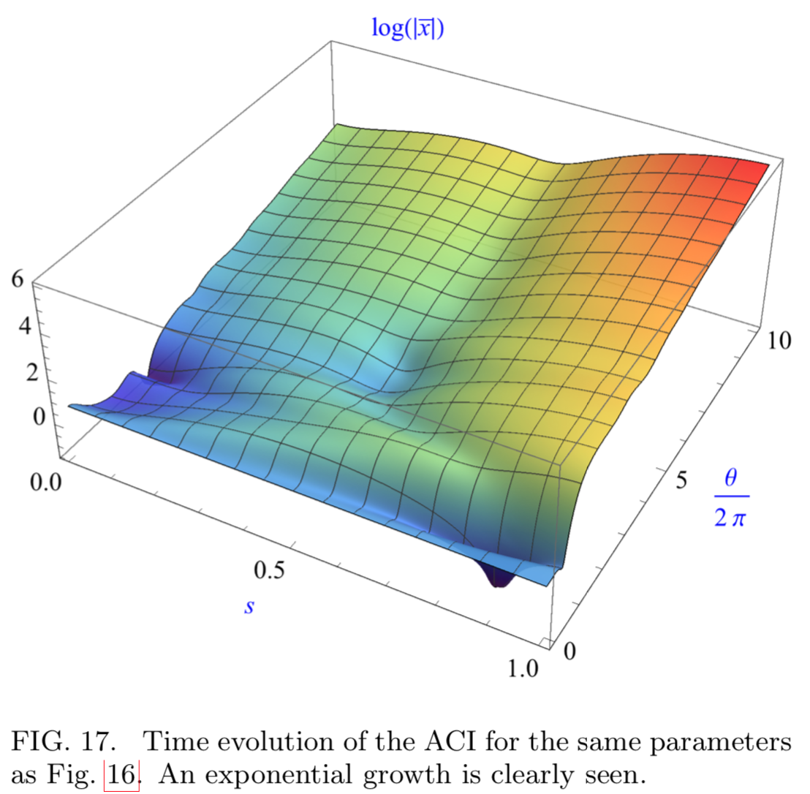
ACI excited by damping
AB

Slide 27
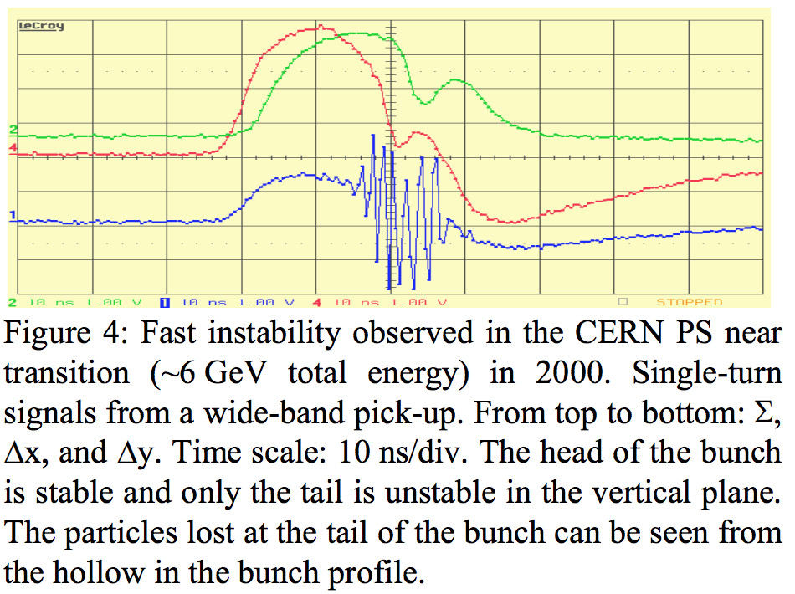
PS Observations
E. Metral, HB 2005
AB

Slide 28
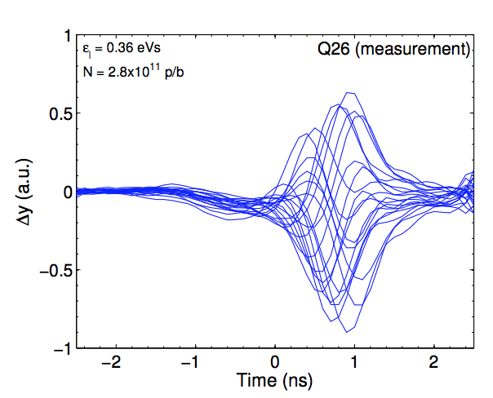
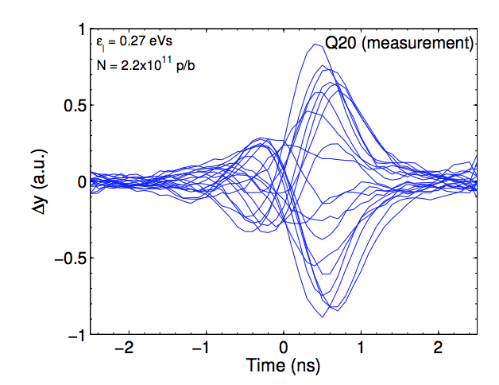
SPS Observations
H. Bartosik, CERN, Thesis, 2013
AB

Slide 29
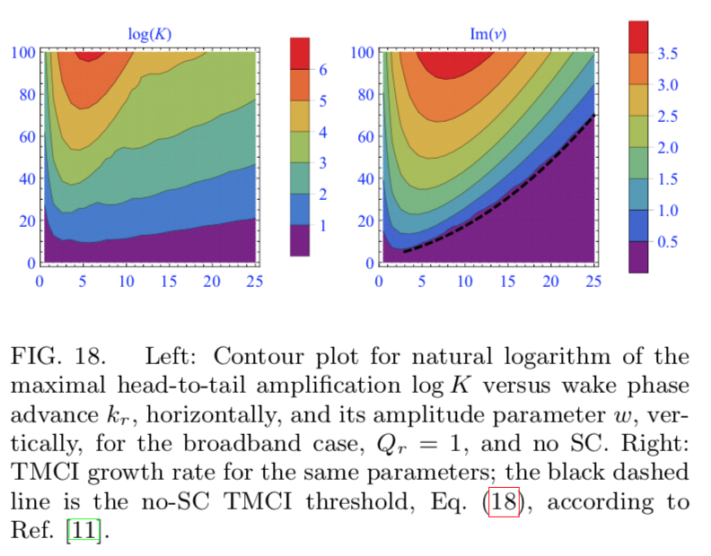
Amplification and Growth Rate, BB wake
No SC
AB

Slide 30
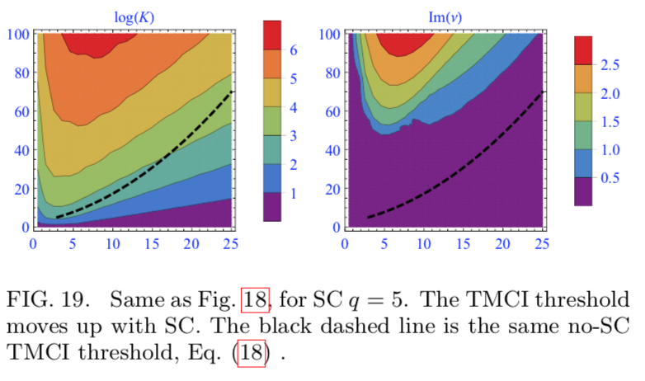

$$q=5$$
AB

Slide 31
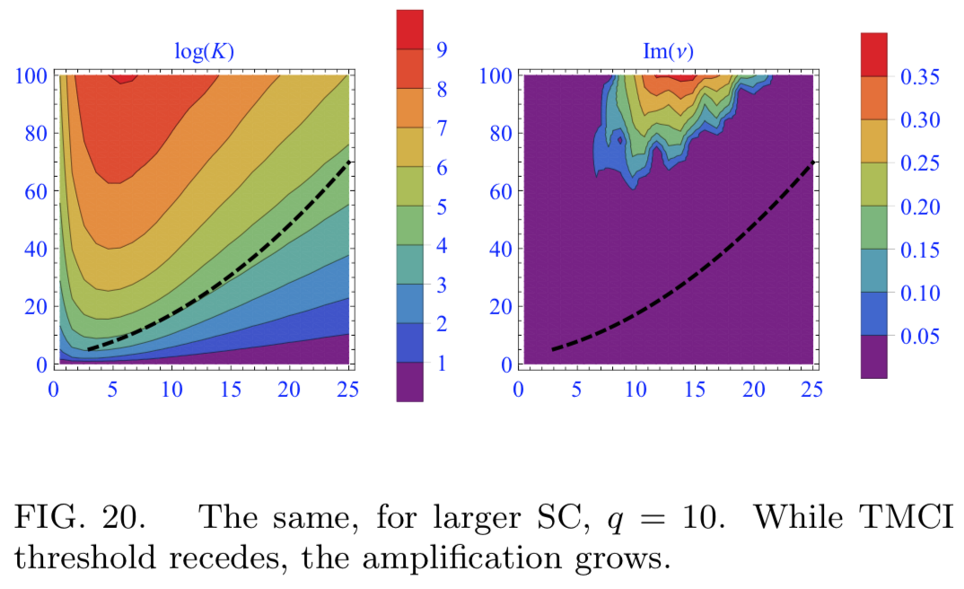

$$q=10$$
AB

Slide 32
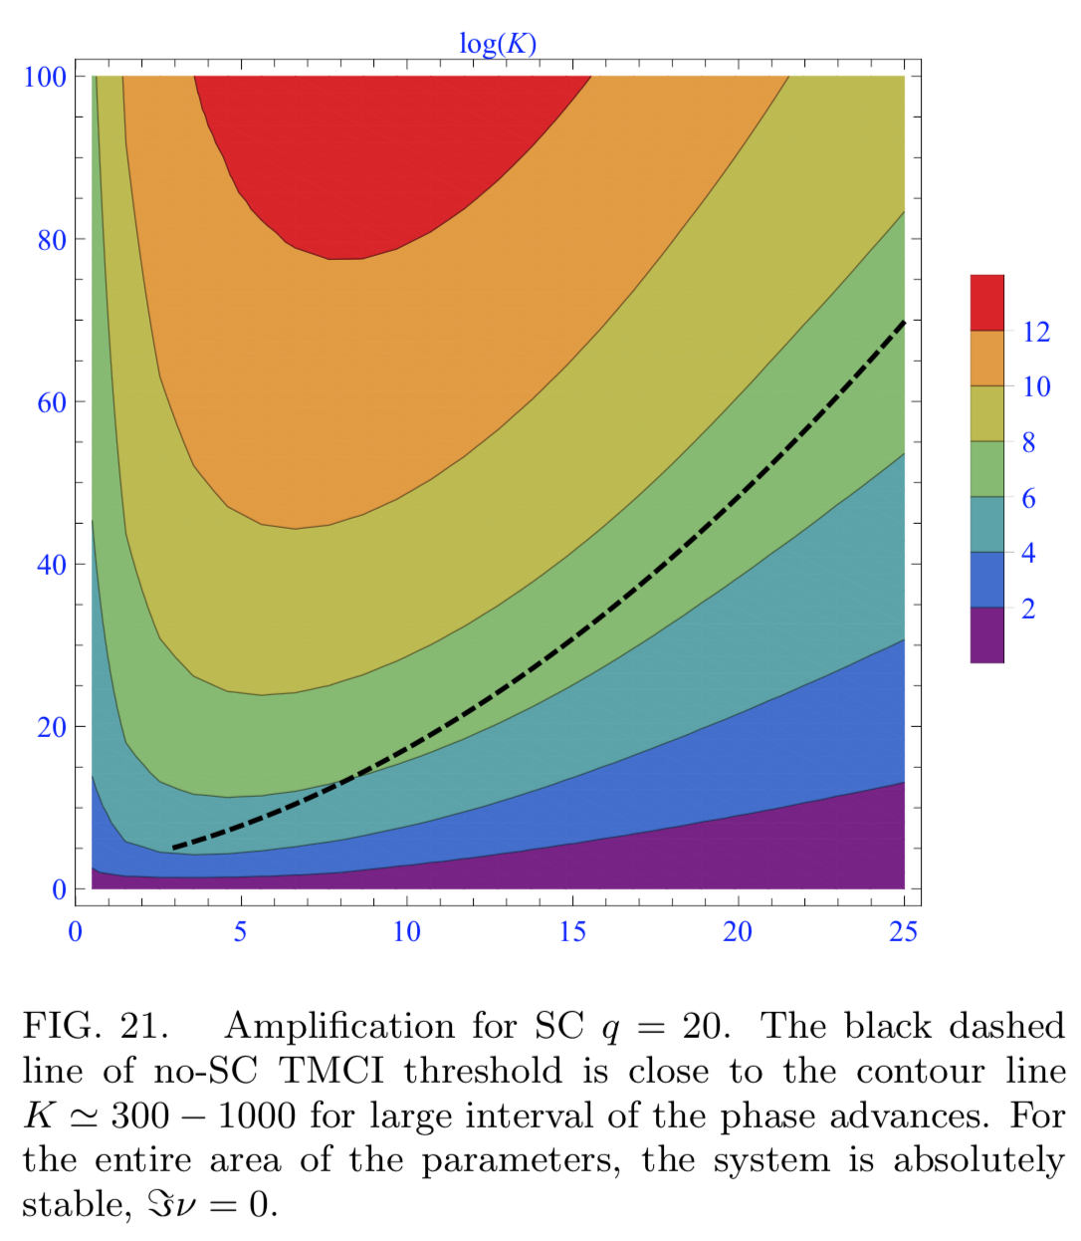

$$q=20$$
AB

Slide 33
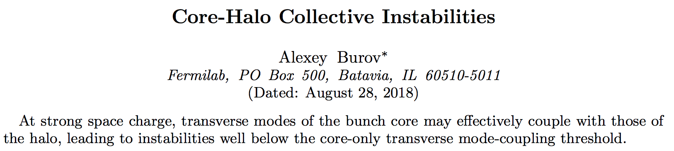
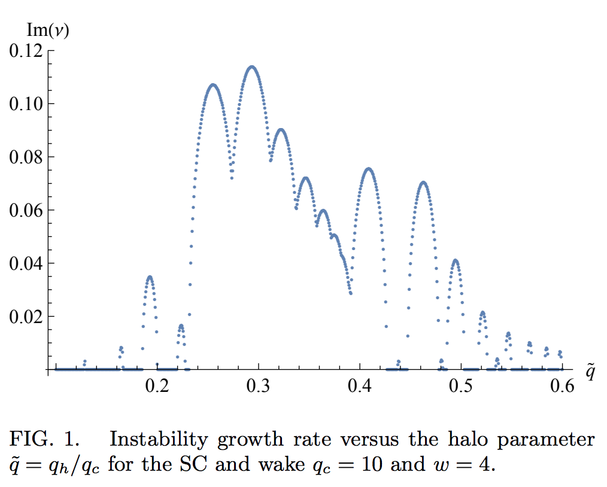
https://arxiv.org/pdf/1808.08498.pdf
AB

Slide 34
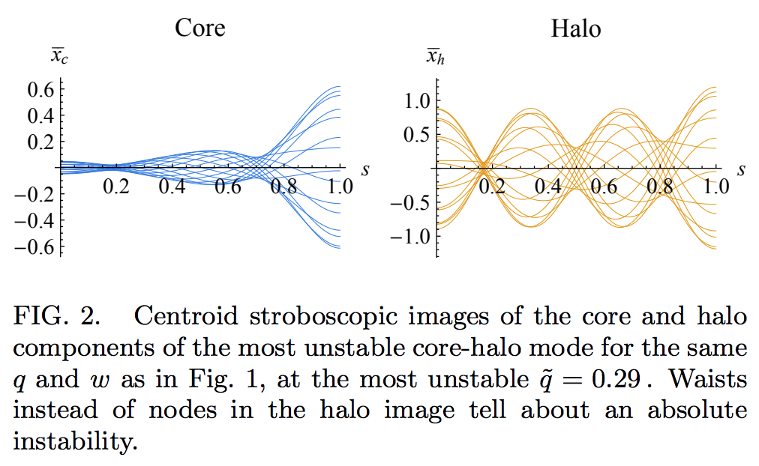
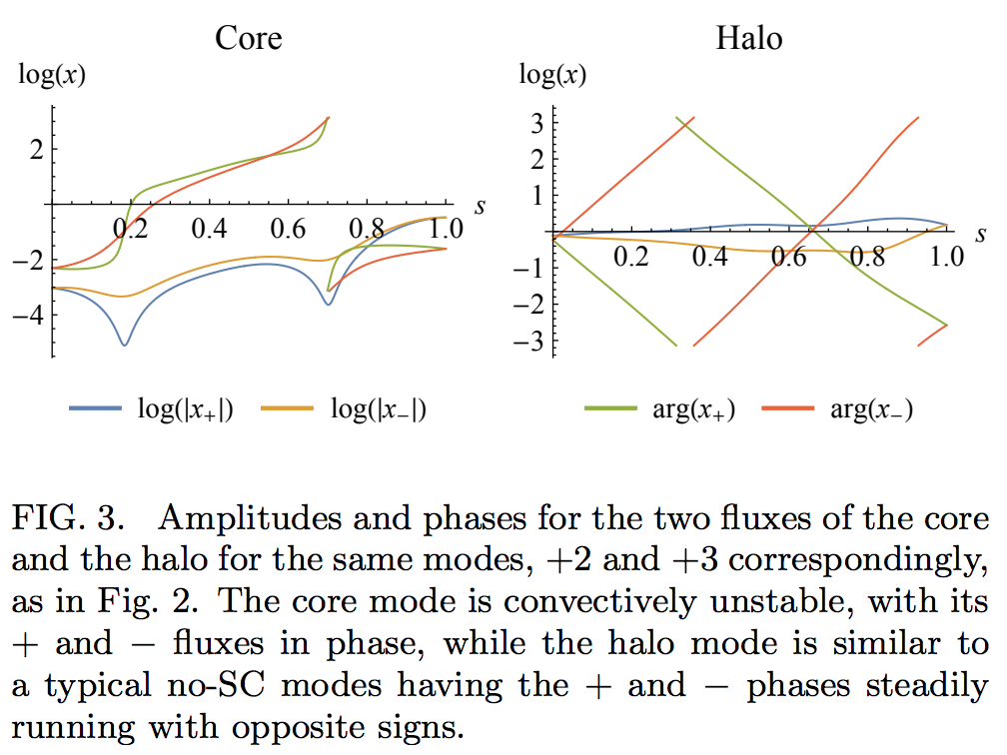
AB

Slide 35
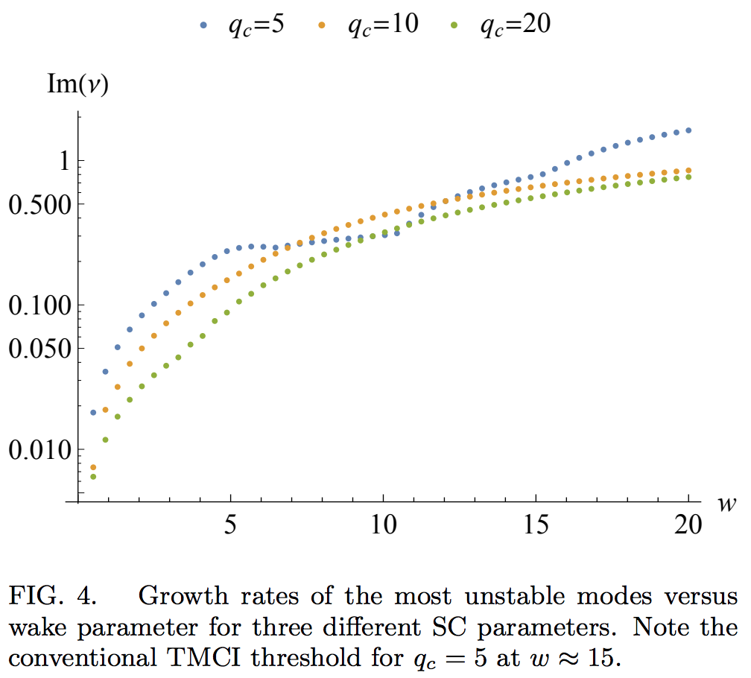
AB

Slide 36
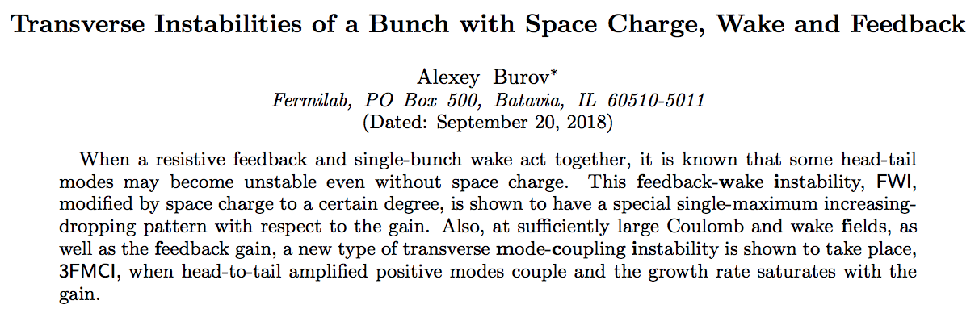
https://arxiv.org/pdf/1809.06927.pdf
AB

Slide 37
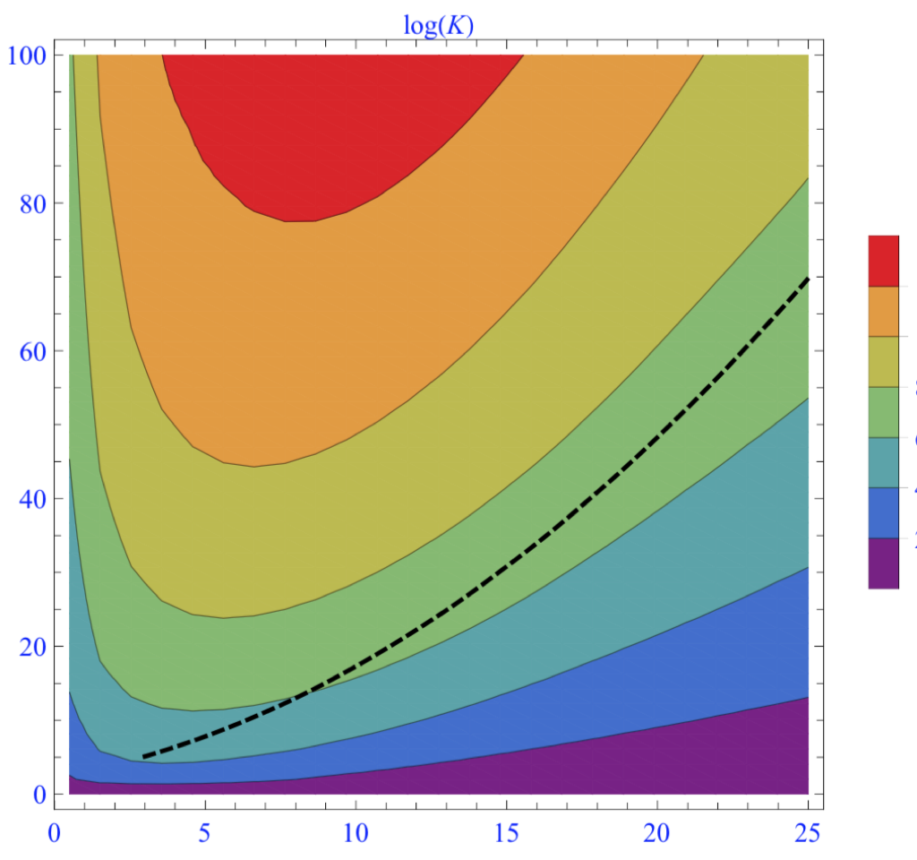
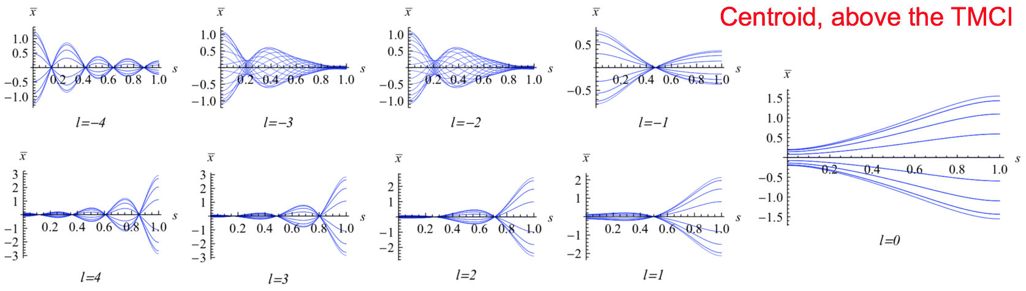
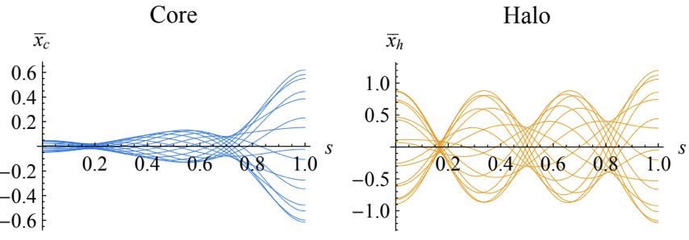





Summary
$$w$$
TMCI
$$w≅a+bq$$
Convective Instabilities
$$a$$
$$1$$
$$q$$
AB

Slide 38
Many thanks!
AB

