Slide 1

Multipole fringe fields
Bruno Muratori, ASTeC (STFC), Daresbury Laboratory, Cockcroft Institute (05/03/19)

Slide 2
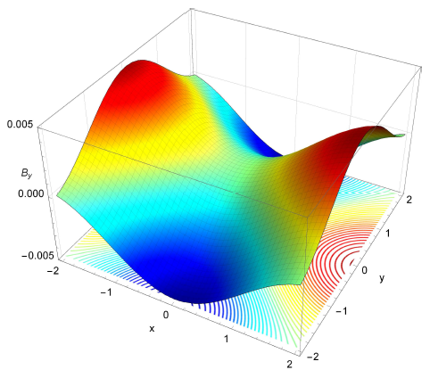
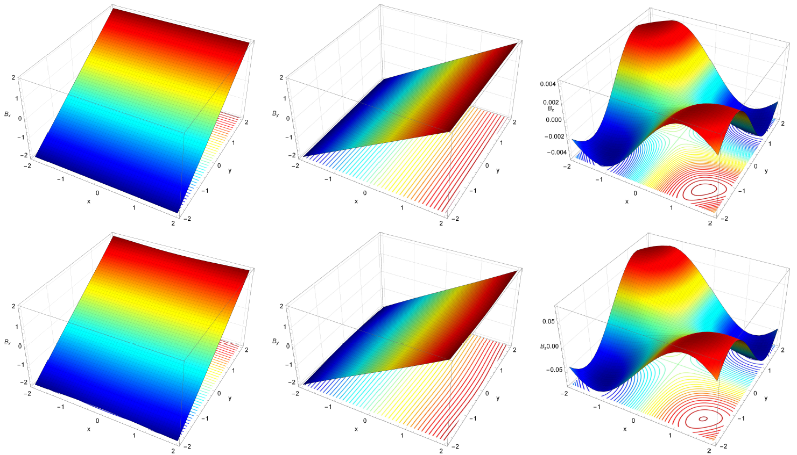
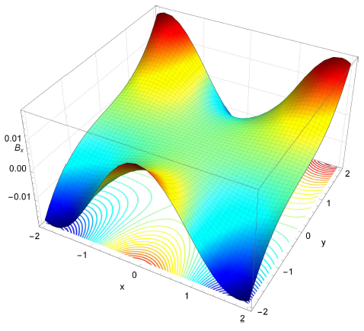
Fringe Fields
for multipoles
How to satisfy 3D Maxwell
GPT implementation
Recreation of pole-face
LHC inner triplet quadrupole
EMMA quadrupole
LHC triplet tracking

Slide 3
Overview
Motivation
- Why do we want to do this ?
Dipoles
- Very simplified model to inform what may happen for higher order multipoles
Multipoles
- Extension of dipole theory to multipoles ? (http://arxiv.org/abs/1404.1762 & PRST-AB)
Quadrupoles
- Details of how the theory works for the second order multipole
HL-LHC inner triplet application
EMMA application
Sextupoles & octupoles
Looking at trajectories in the HL-LHC inner triplet
GPT implementation
Possible future directions
Conclusions
Please note: there is some maths
involved but all of it is trivial (+/-)
and I use it as a guide for the talk
you do not need to worry about it
(but it is there if you want it later).
Important results in red boxes.
There are many slides so, in the interest of time, I shall go through them rather fast. However,
you can refer back to the slides of this talk if you need more information & please stop me & ask
For clarifications at any time. If there is something missing or which you do not understand,
please do not hesitate to contact me and I shall do my best to answer all your questions.
Work done with: Andy Wolski, Liverpool University, Cockcroft Institute & James Jones ASTeC
Daresbury Laboratory, Cockcroft Institute, Bas Van der Geer & Marieke de Loos, Pulsar Physics

Slide 4
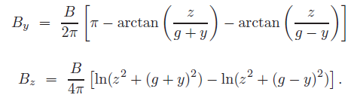
Motivation / History
Hard edge models are not realistic when it comes to modelling magnets in an accelerator, in
particular, a small accelerator such as EMMA where fringe fields dominate and overlap between
magnets.
Fringe fields for dipoles are well understood and, often the form assumed is
The main problem with this expression is that, though it does indeed decay, it does so only at
infinity (in z) rather than earlier. This can create problems with space charge solvers where the
fringe fields are truncated because, even if they look like zero, they are not. Therefore, if the
field is truncated, this creates a discontinuity and, typically, the space charge algorithm dwells
on this discontinuity and so takes a very long time to come up with an answer.
Fringe fields for quadrupoles and higher order multipoles are approximated via an expansion
on-axis. This expansion is rather approximate when one goes considerably off-axis as is the case
for example in the EMMA ns-FFAG or the HL-LHC inner triplet quadrupoles.

Slide 5








Fringe fields - dipoles (1)
Magneto-static Maxwell
(B_{x} = 0)
Enge-type decay
where the Enge coefficients (a₀, a₁, a₂, a₃, a₄, a₅) influence the fall-off in the z direction.
There are many other (possibly better ?) decays possible – this method is always valid.
Solution
for any function e(z + iy).
Particular case
Gives
B_{z} is required because we wish B_{y} to decay (along z) while still satisfying Maxwell.

Slide 6




Fringe fields – dipoles – details
Note: I only consider the fringe field of the dipole on one side. It is extendible by symmetry.
Given a function B(x,y) which satisfies
we introduce new coordinates and hence so
and now satisfies
which can easily be integrated to give
Note: Solutions of the 2D Laplace equation which are infinitely differentiable & smooth must
be singular or zero. Representations of magnets (inside the magnet) are not singular but they
are not infinitely differentiable either. For fringe fields to decay smoothly, one needs to have a
sufficiently differentiable function to represent them. Therefore, by the above consideration,
we should expect singularities.

Slide 7
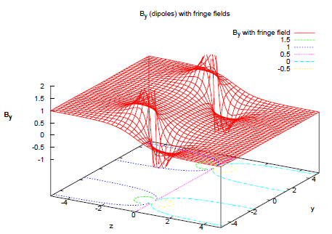
Fringe fields – dipoles (2)
Singularities are necessary to have non-trivial
solutions. These can be neglected as they lie
outside the magnet and are not in the bending
plane (x) and the beam never sees them. There is
also an infinite number of them (along z = 0).
As you go up & down in the
dipole (y), the value of B_{y}
increases as one goes
away from the axis (in
the fringe region) and
reaches the pole.
B_{y}
y
z
Lines show edges (y only)
of dipole which avoid
singularities.
(Reminder of dipole layout – view from side)

Slide 8
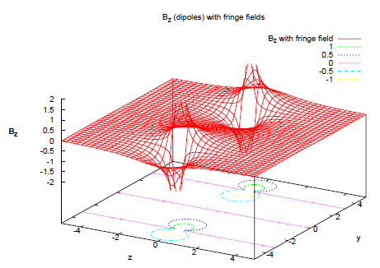
Fringe fields – dipoles (3)
Particles on axis do not see a B_{z} field as is to be
expected and particles with a positive y see a
negative B_{z} whereas particles with a negative y
see a positive B_{z}. This is un-avoidable when the
dipole is in the centre as it should be.
Both B_{y} and B_{z} are smooth in
the (x) direction as expected.
Singularities could be
thought of as where
the current and coils
might be if you wish.
B_{z}
y
z
Lines show edges (y only)
of dipole which avoid
singularities.
(Reminder of dipole layout – view from side)

Slide 9


Fringe fields - dipoles (4)
From static Maxwell we have
Which implies the existence of the following two potentials
respectively.
For dipoles these two potentials may be written explicitly as
with the only possible gauge freedom being a constant, and
The gauge freedom in the vector potential above is extensive and other forms may be more
appropriate, the one above is just one of the simplest with the other components set to zero.
This should help considerably in finding a symplectic kick expression for the fringe field of a
dipole which has already been done (Wu, Forest & Robin).

Slide 10
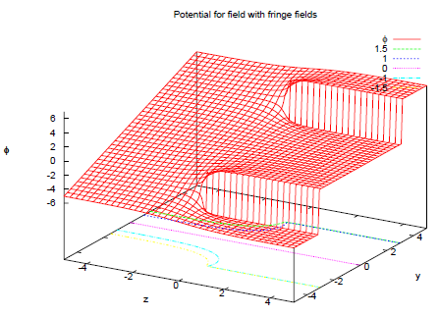
Fringe fields - dipoles (5)
The scalar potential for the dipole field, being the
integral of the field, shows the singularities as
step functions. From the potential, we can look at
the lines of constant φ and this gives us the pole
face geometry. The profiles encompass the
singularities, agreeing with the assertion that
these represent the coils of the winding
of the dipole.
Contours showing possible
pole-face profiles
y
z
Lines show edges (y only)
of dipole which avoid
singularities.
(Reminder of dipole layout – view from side)

Slide 11


Fringe fields – multipoles (1)
Solution for dipoles extendible to multipoles as well.
Requires full solution of 3D static magnetic part of Maxwell equations
→
There is a ‘formal’ solution for Laplace’s equation due to Whittaker (1902)
for any function f.
Best known solution
Can nevertheless solve the 3D static Maxwell as a function of f(x,y,z) with x and y denoting
the usual coordinates inside the multipole and z (or really s) remaining essentially a free
parameter. This can be chosen to be the usual Enge-type decay function. The solution has
singularities, these are necessary and come from the 2D case where they cannot be avoided
(any function satisfying Laplace’s equation in the complex domain, which is differentiable and
smooth is either zero or singular).

Slide 12





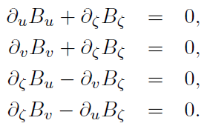



Fringe fields – multipoles (2)
If we define the following coordinates
Together with the corresponding transformation and a re-scaling of the field components
Hence
So an n-pole multipole (without fringe field) is given by
and therefore the quadrupole is written as

Slide 13
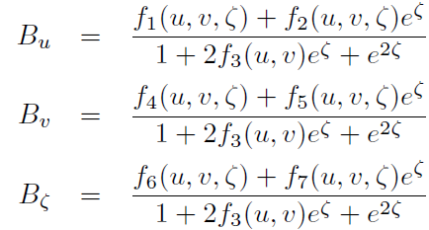
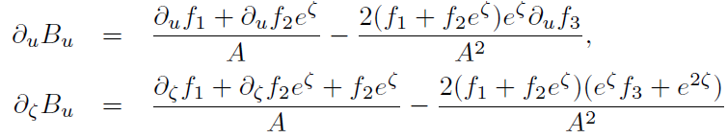

Fringe fields – multipoles (3)
It is now possible to make the following ansatz for
the fall-off that we would like the field to have. From
this we equate coefficients of exp(ζ) and then solve
the equations simultaneously. By using the symmetries
of the new set of equations, we can hope to have a
general solution to the 3 dimensional magneto-static
Maxwell equations that we can derive the fringe field
expressions from.
There are only two types of derivative to worry about
with

Slide 14
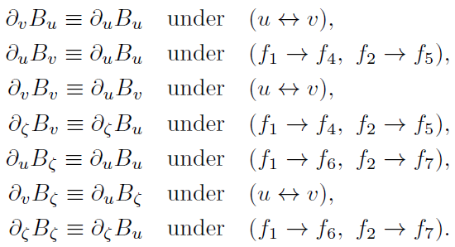
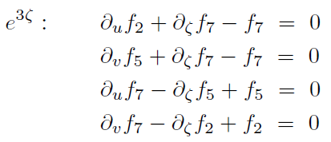
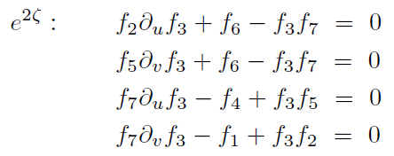
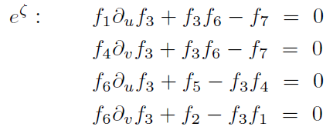
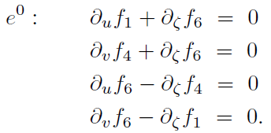
Fringe fields – multipoles (4)
There is a lot of symmetry in the equations
and, using this, together with recognising
several existing simple equations inside the
main ones, it is possible to equate all the
coefficients of exp(nζ) (n = 3,2,1,0). Notice
how the exp(0) equations are the same as
the original system so we have a
transformation from one solution to another.
Original system

Slide 15
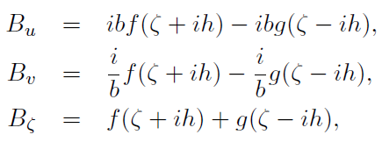
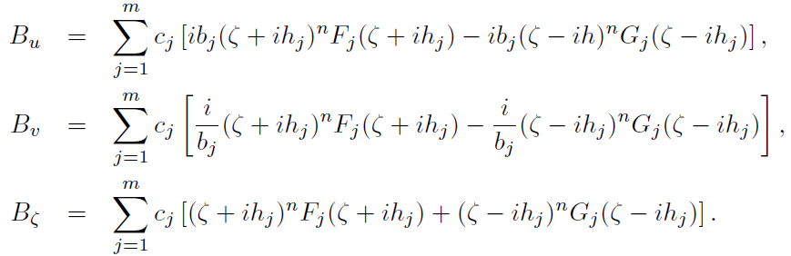
Fringe fields – multipoles (5)
It is possible to show that the following is a solution of the 3D magneto-static equations (for
the full derivation please see paper: http://arxiv.org/abs/1404.1762)
for any functions f(ζ + ih) and g(ζ - ih)
where b is a constant and h is given by
Note that B_{u} and B_{v} are proportional to each other so that it is not possible to describe a
quadrupole with this solution. However, it is possible, due to the linearity of the equations,
to add several of these solutions together as follows:

Slide 16






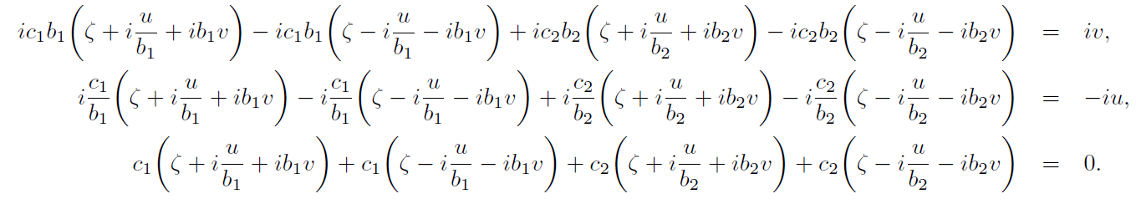
Fringe fields – quadrupoles (1)
where
and
represent the order of the multipole (n) and F(ζ + ih) and
G(ζ + ih) are multiplicative functions which we choose to give the correct behaviour for large
ζ and which are 1 or -1 for large negative ζ (ζ = 0 represents the region where the field is ½
the nominal value inside the magnet – this is just a property of the very simple Enge-style fall
off that was chosen with a₁ being the only non-zero coefficient). , m is a
constant to be determined by how many terms are required in the sum and so are b_{j} and c_{j}.
The constants b_{j} and c_{j} should satisfy simultaneous equations to ensure the correct behaviour
of the field inside the magnet (z large and negative) with and B_{ζ} = 0.
The constants may be introduced due to the linearity of the Maxwell equations.
Quadrupole equations

Slide 17
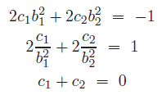

Fringe fields – quadrupoles (2)
giving the solution
Note that m = 2 for a quadrupole, more elementary solutions could have been included but
this was not necessary. Also, because of the way the coefficient b appears we have that b = -b
and b → 1/b gives B_{x} → B_{x} and B_{y} → -B_{y}. Further, we see that we cannot have b₁ = 0 or 1 as this
would lead to a singularity in. either b₂ or c₁ and c₂ (but we will come back to this later …)
The results are extendible to higher order multipoles in a straightforward way, however, the
higher the order, the more three dimensional solutions discussed above need to be included.
This gives a solution for the fringe field of a quadrupole. However, this solution still has one
remaining free constant, namely b (0 < b < 1). This constant appears to be independent of the
usual Enge coefficients (a₀, a₁, a₂, a₃, a₄, a₅). However, this may not be entirely so and it shall be
examined in more detail later on. For now, b appears to influence the rapidity of the fall-off in
the transverse coordinates.

Slide 18
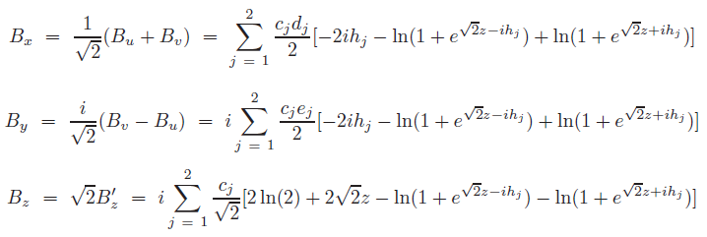

Fringe fields – quadrupoles (3)
If we return to our usual magnetic field B_{x},B_{y} and B_{z} in the usual coordinates (x, y, z), and
remembering B_{z} and z were re-scaled:
where
and h_{j} is now
So we are now in a position to look at plots of the various components of the magnetic field
and to look at what the meaning of different values of b is. First we check that the behaviour
of the fields is as expected and that the symmetries are what they should be.

Slide 19
Fringe fields – quadrupoles (4)
B_{x}, B_{y} & B_{z} at z = -4, -2
Courtesy: James Jones

Slide 20
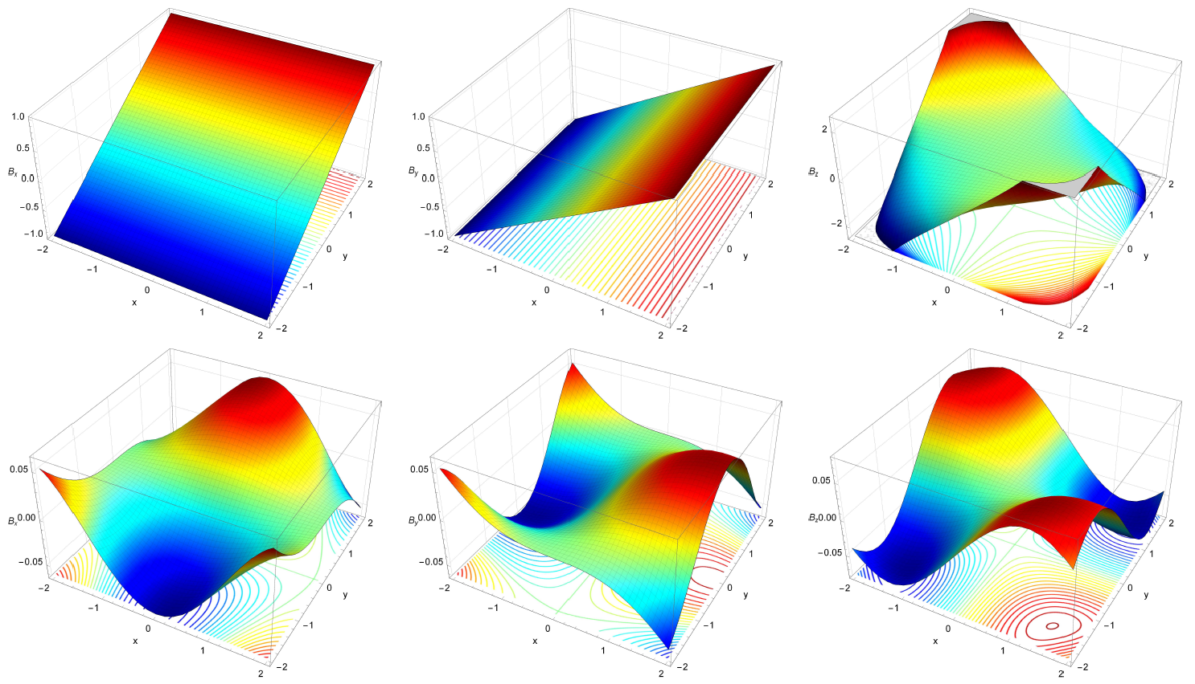
Fringe fields – quadrupoles (5)
B_{x}, B_{y} & B_{z} at z = 0, 2
Courtesy: James Jones

Slide 21
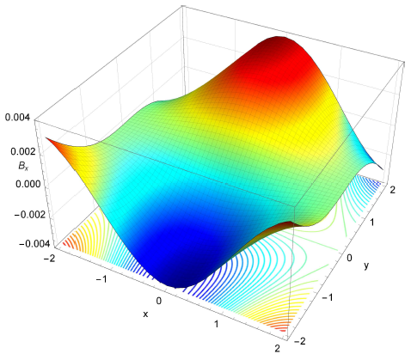
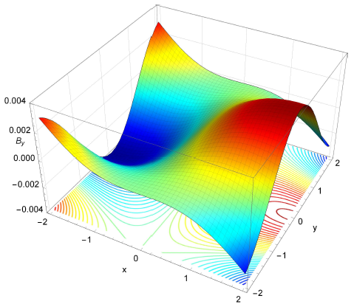
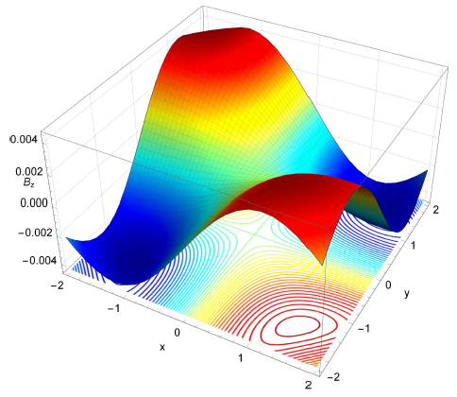
Fringe fields – quadrupoles (6)
B_{x}, B_{y} & B_{z} at z = 4
Courtesy: James Jones

Slide 22
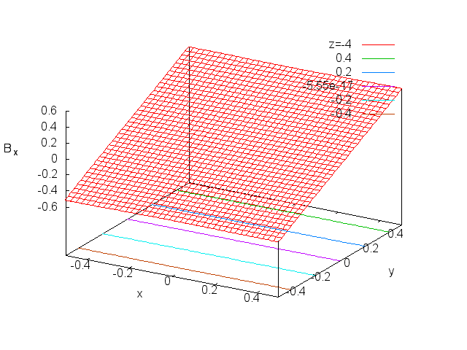
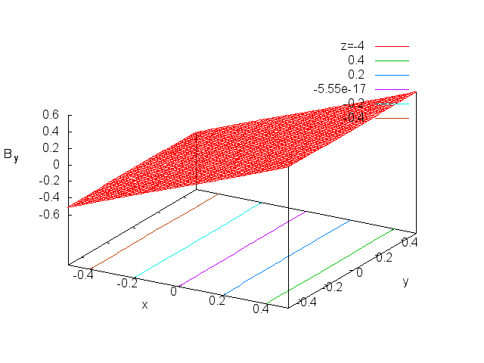
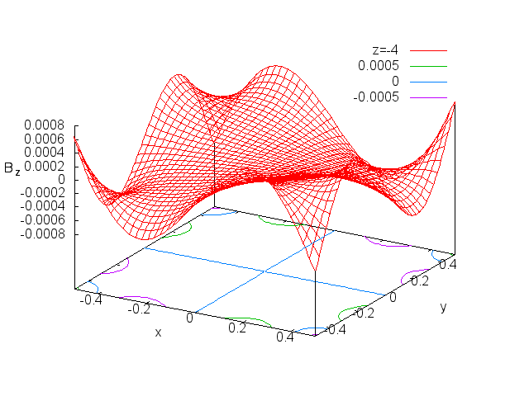
Fringe fields – quadrupoles (7)
b = 0.1 for all movies
z goes from -4 to +4 in
arbitrary coordinates

Slide 23
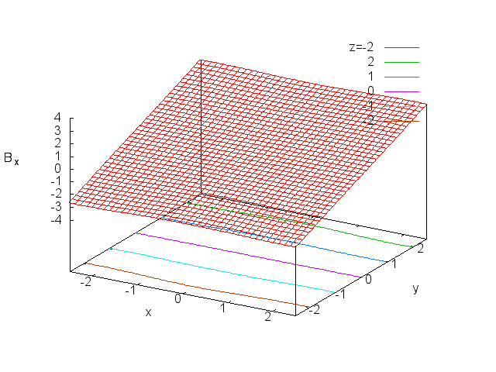
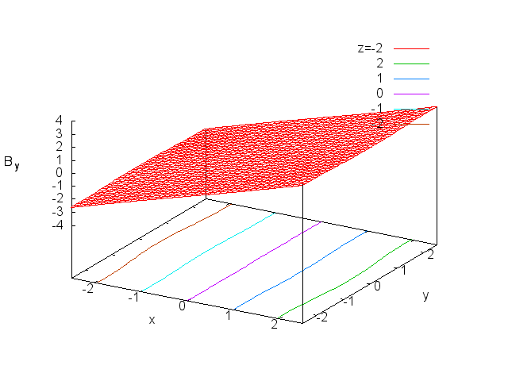
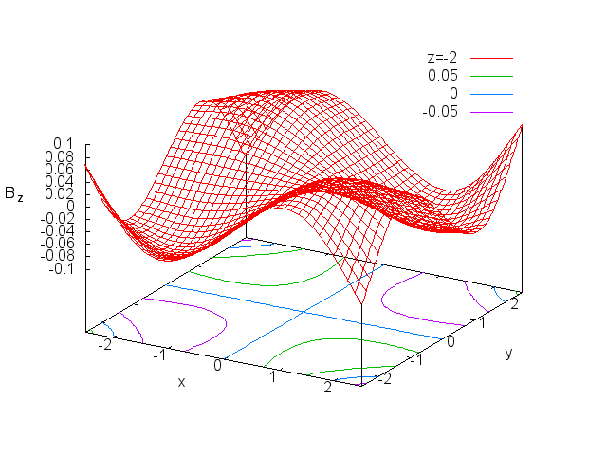
Fringe fields – quadrupoles (8)
b = 0.9 for all movies
z goes from -4 to +4 in
arbitrary coordinates

Slide 24
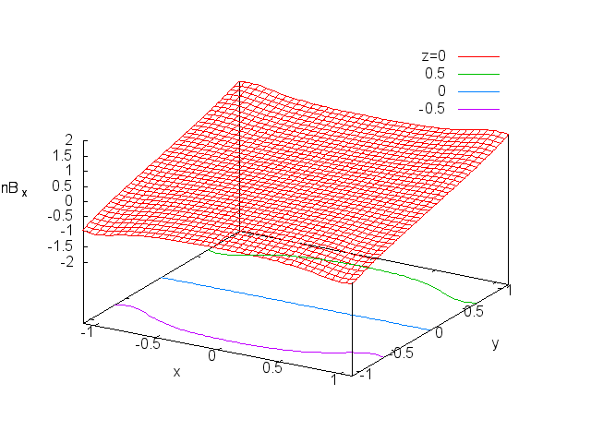
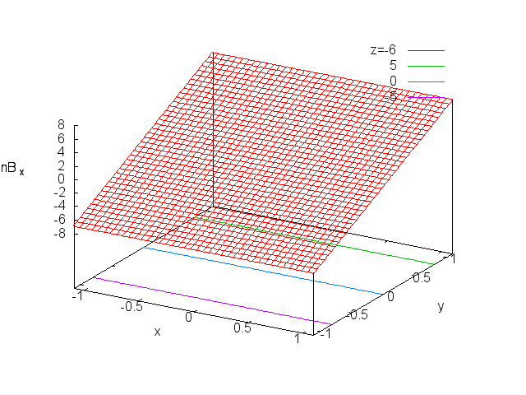
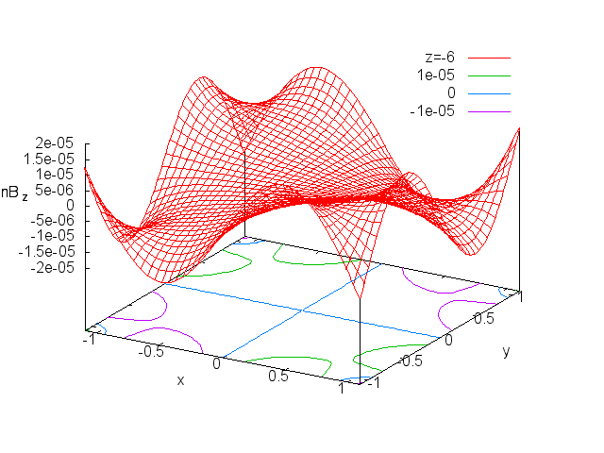
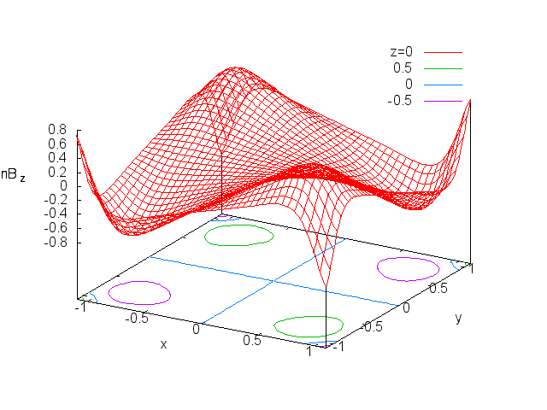
Fringe fields – quadrupoles (9)
If we treat the singularities or step functions as our limits of validity of the model and identify
them with current from the magnet coils, then it is possible to re-scale all the components of
the magnetic fields to see the exact effect that the constant b has on the model.
x and y are now
normalised and z is
fixed by how the
singularities move as
one goes through the
fringe field.
b = 0.1
b = 0.9
Note that the vertical
scale no longer has any
meaning.
A higher value of b
means a smoother
transition but a higher
value of B_{z} w.r.t B_{x,y} in
order to achieve it.

Slide 25
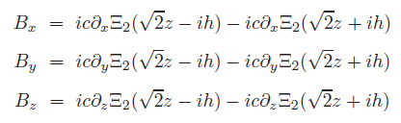

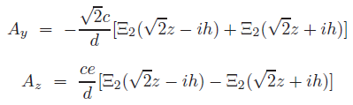
Fringe fields – quadrupoles (10)
So we can write
where
where Li₂ is the di-logarithm or poly-logarithm of order 2
And the scalar and vector potential may be written as

Slide 26

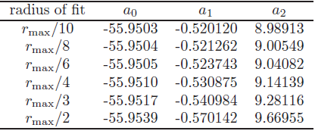
Fringe fields – quadrupoles (11)
We can fit a function of the form
to the fall-off in order to keep things as simple as possible and just illustrate the idea. This is just
for illustration, the function if far too simple to reflect reality …
Application to one quadrupole of the HL-LHC inner triplet

Slide 27
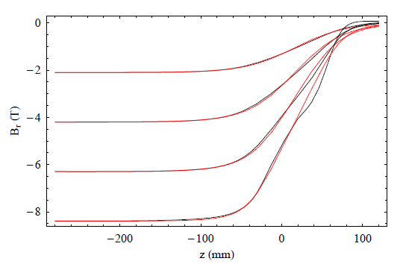
Fringe fields – quadrupoles (12)
Radial component of the magnetic field in an HL-LHC inner triplet quadrupole as a function of
position along lines of given radius and with cylindrical polar co-ordinate θ = π/4. Each pair of
black and red lines shows the field at a different radius, from rmax/5 to 4rmax/5, with
rmax = 75mm. The black lines show the field obtained from the (numerical) magnetic model;
the red lines show the analytical model, with fit parameters given in the table with radius of fit
rmax/10, and b₁ = 2.5. (remember b is equivalent to 1/b).

Slide 28
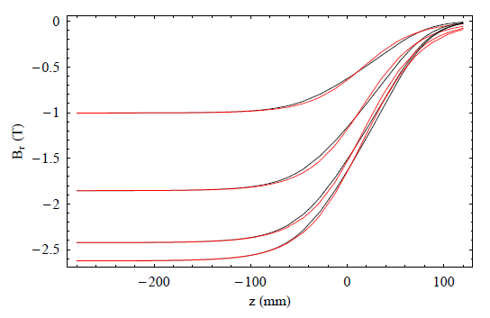
Fringe fields – quadrupoles (13)
Radial component of the magnetic field in an HL-LHC inner triplet quadrupole as a function of
position along lines of fixed distance r = rmax/4. Each pair of black and red lines shows the field
at a different value of the cylindrical polar co-ordinate θ, from π/16 to π/4 (in steps of π/16).
The black lines show the field obtained from the (numerical) magnetic model; the red lines
show the analytical model, with fit parameters given in the table with radius of fit rmax/10, and
b₁ = 2.5. (remember b is equivalent to 1/b).

Slide 29
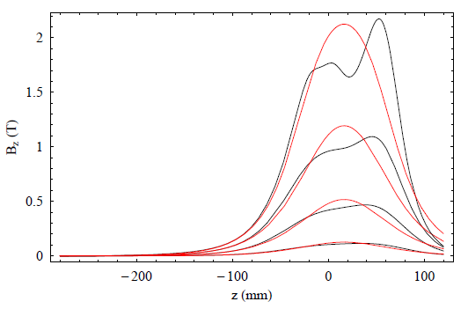
Fringe fields – quadrupoles (14)
Longitudinal component of the magnetic field in an HL-LHC inner triplet quadrupole as a
function of position along lines of given radius and with cylindrical polar co-ordinate θ = π/4.
Each pair of black and red lines shows the field at an increasing radius, from rmax/5 to 4rmax/5,
rmax = 75mm. The black lines show the field obtained from the (numerical) magnetic model;
the red lines show the analytical model, with fit parameters given in the table with radius of fit
rmax/10, and b₁ = 2.5 (remember b is equivalent to 1/b).

Slide 30
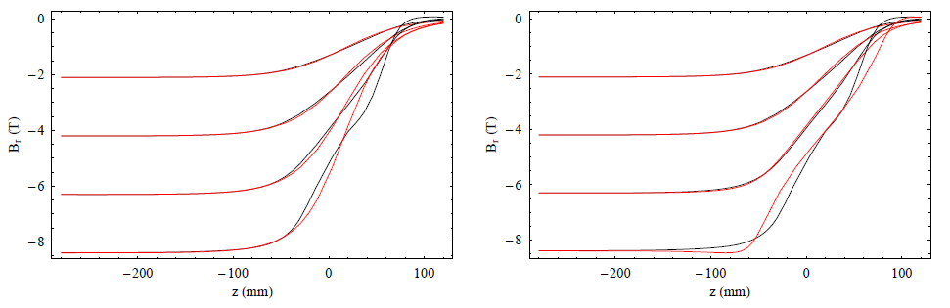
Fringe fields – quadrupoles (15)
Radial component of the magnetic field in an HL-LHC inner triplet quadrupole as a function of
position along lines of given radius and with cylindrical polar co-ordinate θ = π/4. for different
values of b (b = 1.5 left and b = 3.5 right).

Slide 31
Fringe fields – quadrupoles (16)
Surface of constant scalar potential φ = 0.25Tm in a representation of the HL-LHC inner triplet
quadrupole, with gradient falling as an Enge function in the fringe field. The parameters of the
Enge function correspond to the first line in the table.

Slide 32
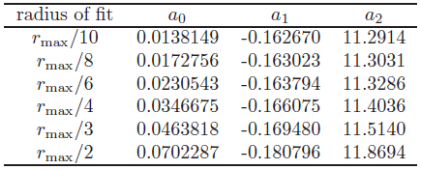
Fringe fields – quadrupoles (17)
We can fit a function of the form
to the fall-off in order to keep things as simple as possible and just illustrate the idea. This is just
for illustration, the function if far too simple to reflect reality …
Application to EMMA

Slide 33
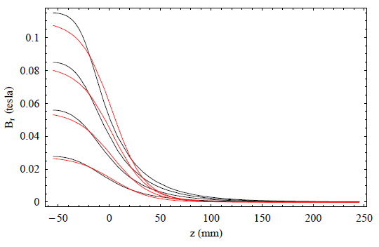
Fringe fields – quadrupoles (18)
Radial component of the magnetic field in an EMMA F quadrupole as a function of position
along lines of given radius and with cylindrical polar co-ordinate θ = π/4. Each pair of black
and red lines shows the field at a different radius, from rmax/5 to 4rmax/5, with rmax = 36mm.
The black lines show the field obtained from the (numerical) magnetic model; the red lines
show the analytical model, with fit parameters given in the table with radius of fit rmax/10,
and b₁ = 1.8 (remember b is equivalent to 1/b). The centre of the quadrupole is at the far left of
the plot, z = −53.6mm.

Slide 34
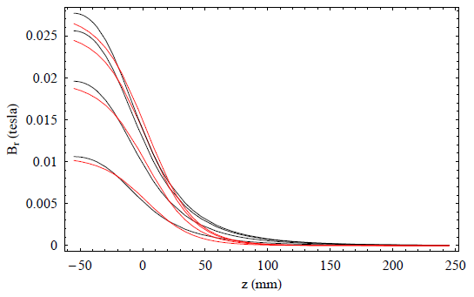
Fringe fields – quadrupoles (19)
Radial component of the magnetic field in an EMMA F quadrupole as a function of position
along lines of fixed distance r = rmax/4. Each pair of black and red lines shows the field at a
different value of the cylindrical polar co-ordinate θ, from π/16 to π/4 (in steps of π/16). The
black lines show the field obtained from the (numerical) magnetic model; the red lines show
the analytical model, with fit parameters given in Table 2 with radius of fit rmax/10, and
b₁ = 1.8 (remember b is equivalent to 1/b). The centre of the quadrupole is at the far left of
the plot, z = −53.6mm.

Slide 35
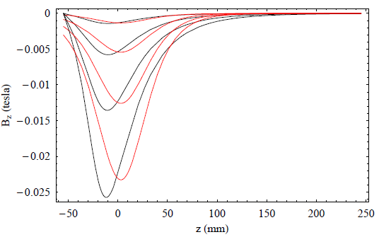
Fringe fields – quadrupoles (20)
Longitudinal component of the magnetic field in an EMMA F quadrupole as a function of
position along lines of given radius and with cylindrical polar co-ordinate θ = π/4. Each pair
of black and red lines shows the field at an increasing radius, from rmax/5 to 4rmax/5, with
rmax = 36mm. The black lines show the field obtained from the (numerical) magnetic model;
the red lines show the analytical model, with fit parameters given in the table with radius of
fit rmax/10, and b₁ = 1.8 (remember b is equivalent to 1/b). The centre of the quadrupole is
at the far left of the plot, z = −53.6mm.

Slide 36
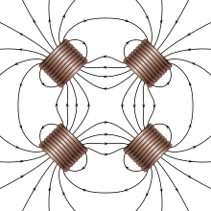
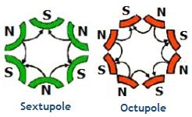
Fringe fields – additional constants (1)
The additional constant b in the quadrupole case affects the rapidity of the
fall-off in the transverse (x,y) plane.
Only one such constant is required in a quadrupole because there is the
possibility of a general scaling since the singularities of the expressions
dictate the limits of the quadrupole.
Quadrupole
For higher order multipoles, there are additional degrees of freedom to
fix, therefore, it seems natural that there should also be more constants.
Sextupoles – 2 constants
Octupoles – 3 constants
.
.
.
n-pole – (n-2)/2 constants
Note: “n” here is different to “n” everywhere else … ☺

Slide 37
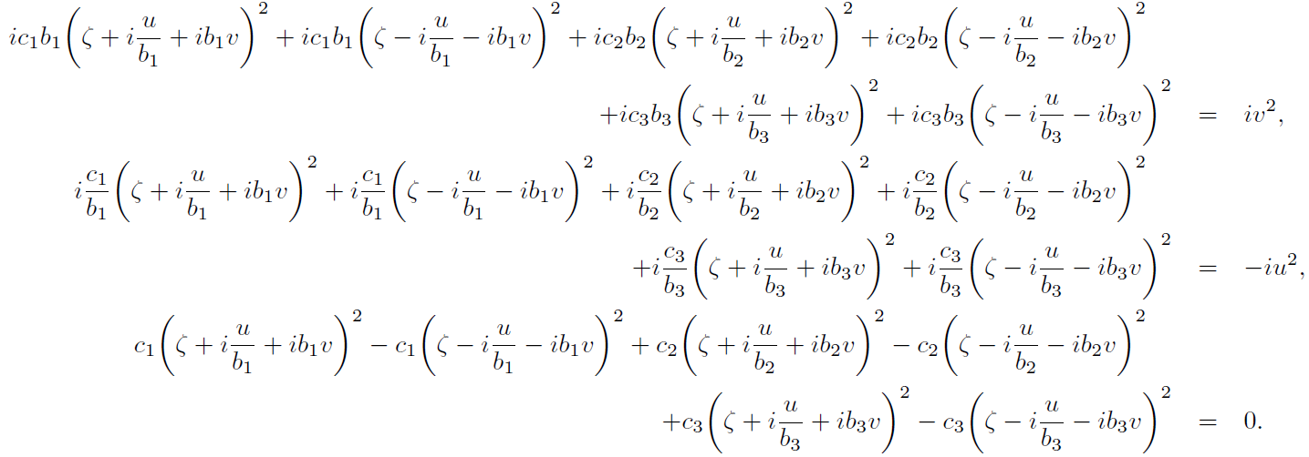
Fringe fields – sextupoles (1)
According to the sextupole geometry, we need n = 2 in the defining fringe field equations above.
Therefore, assuming we are inside the magnet and away from any fringe field so F(ζ + ih_{j}) = ±1
G(ζ - ih_{j}) = ±1 for any j, and we proceed by strict analogy to the quadrupole case. Therefore, the
equations we have to satisfy for the components of the magnetic field (for B_{u}, B_{v} and B_{ζ} in order)
are
Sextupole equations
Giving the following four equations to satisfy

Slide 38
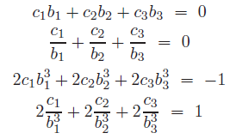


Fringe fields – sextupoles (2)
Which can be solved in an analogous way to the quadrupole case (only more complicated). The
solution now involves two independent constants

Slide 39
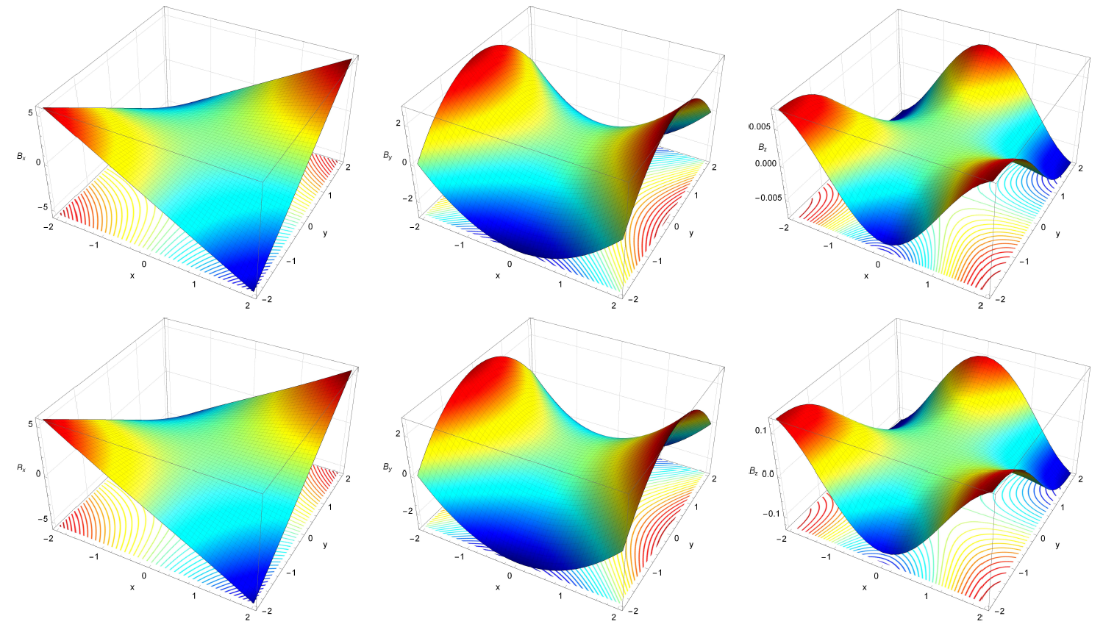
Fringe fields – sextupoles (3)
B_{x}, B_{y} & B_{z} at z = -4, -2
Courtesy: James Jones

Slide 40

Fringe fields – sextupoles (4)
B_{x}, B_{y} & B_{z} at z = 0, 2
Courtesy: James Jones

Slide 41


Fringe fields – sextupoles (5)
B_{x}, B_{y} & B_{z} at z = 4
Courtesy: James Jones

Slide 42

Fringe fields – octupoles (1)
According to the octupole geometry, we need n = 3 in the defining fringe field equations. We
use the same functions F and G as for the previous cases. Therefore, the equations we have to satisfy for the components of the magnetic field (for B_{u}, B_{v} and B_{z} in order) are
Octupole equations
Giving the following five equations to satisfy

Slide 43


Fringe fields – octupoles (2)
Which can be solved in an analogous way to the sextupole case (only more complicated). The
solution now involves three independent constants

Slide 44

Fringe fields – octupoles (3)
B_{x}, B_{y} & B_{z} at z = -4, -2
Courtesy: James Jones

Slide 45

Fringe fields – octupoles (4)
B_{x}, B_{y} & B_{z} at z = 0, 2
Courtesy: James Jones

Slide 46


Fringe fields – octupoles (5)
B_{x}, B_{y} & B_{z} at z = 4
Courtesy: James Jones

Slide 47

Fringe fields – multipoles (1)
According to the multipole geometry, we need n = n in the defining fringe field equations. We
use the same functions F and G as for the previous cases. Therefore, the equations we have to satisfy for the components of the magnetic field (for B_{u}, B_{v} and B_{z} in order) are
Multipole equations
Giving the following n+2 equations to satisfy

Slide 48



Fringe fields – multipoles (2)
with , m is a positive integer and the number of equations is determined by
Which can be solved in an analogous way to the octupole case (only more complicated !). The
solution now involves n-2 independent constants

Slide 49



Fringe fields – multipoles (3)
Potentials for the multipole solution
with
where Li_{n} is the poly-logarithm of order n
giving the potentials

Slide 50

Fringe fields – trajectories (1)
HL-LHC Inner triplet
Red line: trajectory obtained by a
Runge-Kutta integration of the
Newtonian equations of motion
(dp/dt = q v x B), using the field map
provided by CERN (i.e. no fitting).
Black line: trajectory obtained by a
Runge-Kutta integration of the
Hamilton equations of motion, using
the vector potential obtained by
fitting the field map with an Enge
function roll-off of the gradient.
Black points: trajectory obtained by a
Wu-Forest-Robin (explicit symplectic
integration) of the Hamilton equations
of motion, using the vector potential
obtained by fitting the field map with
an Enge function roll-off of the gradient.
Courtesy: Andy Wolski

Slide 51

Fringe fields – trajectories (2)
HL-LHC Inner triplet
Red line: trajectory obtained by a
Runge-Kutta integration of the
Newtonian equations of motion
(dp/dt = q v x B), using the field map
provided by CERN (i.e. no fitting).
Black line: trajectory obtained by a
Runge-Kutta integration of the
Hamilton equations of motion, using
the vector potential obtained by
fitting the field map with an Enge
function roll-off of the gradient.
Black points: trajectory obtained by a
Wu-Forest-Robin (explicit symplectic
integration) of the Hamilton equations
of motion, using the vector potential
obtained by fitting the field map with
an Enge function roll-off of the gradient.
Courtesy: Andy Wolski

Slide 52

Fringe fields – trajectories (3)
HL-LHC Inner triplet
Red line: trajectory obtained by a
Runge-Kutta integration of the
Newtonian equations of motion
(dp/dt = q v x B), using the field map
provided by CERN (i.e. no fitting).
Black line: trajectory obtained by a
Runge-Kutta integration of the
Hamilton equations of motion, using
the vector potential obtained by
fitting the field map with an Enge
function roll-off of the gradient.
Black points: trajectory obtained by a
Wu-Forest-Robin (explicit symplectic
integration) of the Hamilton equations
of motion, using the vector potential
obtained by fitting the field map with
an Enge function roll-off of the gradient.
Courtesy: Andy Wolski

Slide 53


Fringe fields – trajectories (4)
HL-LHC Inner triplet
Red line: trajectory obtained by a
Runge-Kutta integration of the
Newtonian equations of motion
(dp/dt = q v x B), using the field map
provided by CERN (i.e. no fitting).
Black line: trajectory obtained by a
Runge-Kutta integration of the
Hamilton equations of motion, using
the vector potential obtained by
fitting the field map with an Enge
function roll-off of the gradient.
Black points: trajectory obtained by a
Wu-Forest-Robin (explicit symplectic
integration) of the Hamilton equations
of motion, using the vector potential
obtained by fitting the field map with
an Enge function roll-off of the gradient.
Courtesy: Andy Wolski

Slide 54

Simple expression for quadrupoles
It is possible to take the limit as b → 1 to obtain simpler expressions which still satisfy Maxwell
but are much simpler to implement in tracking codes. This has already been implemented in the
General Particle Tracer (GPT) code by the authors Bas and Marieke Van Der Geer. If this limit is
taken, then the additional degree of freedom which dictates the rapidity of the fringe field fall
off as one goes off-axis is no longer available. However, this does imply a lack of generality but it
is not an important one in most cases, though in both cases considered in this talk we found that
this constant is indeed required.
Courtesy: Bas Van Der Geer

Slide 55
GPT Application (1)
Field-profile 1 mm off-axis
Equations: Bruno Muratori
Implementation: Pulsar Physics
Test case:
Two quadrupoles (GPT tutorial)
10.000 particles
10 mm bunch length

Slide 56

GPT Application (2)
Transverse size of 15 mm
Conclusion:
It works
Gives same results
But much faster
Difference depends on the increasing
accuracy of the calculation
☺

Slide 57

GPT Application (3)
Why is the same not been done for sextupoles & higher in GPT ? This has been done but is
not really simple enough yet to be implemented easily …
The main problem is that the resulting expressions for all the fields are clearly real according
to human interpretation but this is not true according to machine interpretation.
The expressions involve poly-logarithmic functions of the type:
Li_{n}(x + iy) + Li_{n}(x – iy)
If anyone has any great ideas & would
like to help me with this they are most
welcome ☺
There is another (small-ish) problem … In the
quadrupole case, taking the limit as b → 1
to obtain simpler expressions which still
satisfy Maxwell can be done because of
l’Hôpital’s rule. However, any higher order
needs taking the limit of more than one constant. I have done so in a 2017 IPAC paper. The only
small problem is that a higher dimensional L’Hôpital rule does not & probably should not exist
in general (which constant comes first ?) so limits are not straightforward …
If anyone has any great ideas & would like to help me with this they are most welcome ☺

Slide 58
What next ?
Potentials
with
where Li_{n} is the poly-logarithm of order n
The scalar potential can be used to try & figure out the pole-face shape as was already done here
for the LHC inner triplet quadrupole.
Vector potential can be used in order to generate symplectic kicks which can in turn be used in
tracking codes in order to make tracking more computationally efficient.
Combined function magnets: How do fringe fields operate here ? Do they simply overlap ?
What about the trajectories in the fringe ? Should all be done “following” the bunch.

Slide 59
What next ?
Given that all magnets have fringe fields, whether we like it or not as they are required in order that the Maxwell equations be satisfied. Why not accept this ?
We can use the constructions given so far to have full control of fringe fields & how they decay & which multipole orders are present in the magnet for a given pole-face.
Use full Enge model or alternative so as to be able to describe the desired magnet fall-off with maximum accuracy – leading to a change in the pole-face.
Could this make the magnet easier to design ideally ?
Could it make the magnet easier to build ?
Have all the relevant vector potentials to develop symplectic kicks for any multipole fringe field.
Currently looking into this with Matthew Crouch & Andy Wolski. It requires integration & this may not be trivial because the expressions become very complicated. However, the fringe field decay is valid for any function so there may be easier fall-offs than the Enge one which could be considered (e.g. the one due to S. Kato).

Slide 60
Conclusions
- Works for multipoles, not just quadrupoles with analytical formula for each case as long
as they are built out of the correct functions (f(z + ih) and g(z - ih))
- Decay does not have to be Enge-type. There are others (also singular) but the only real
difference would be the rapidity of the fall-off I believe …
- B_{z} is a relevant quantity which seems to be often ignored and can be a much as 1/10 or
more of the other components (depending on the value of b and considering the region
where field is maximum & non-singular – so going off-axis as in EMMA for example)
- Also useful for the inner triplet region for HL-LHC because beam goes through this quite a
lot off-axis so the fringe fields of the quadrupoles may matter considerably.
This was only done for the simplest Enge-type fall off and to give an idea what the fields are
and it now has to be repeated for a more general case with (a₀, a₁, a₂, a₃, a₄, a₅) non-zero.
- Having the 3 vector potential allows for symplectic expressions to be derived for the ‘kick’
due to any multipole fringe field hopefully following a recipe of Y.K. Wu, E. Forest and
D.S. Robin which may be useful for implementation in tracking programs.
- GPT works very well when quadrupoles with fringe fields are used.
- Could it quicken certain aspects of magnet design ?
- Extension to any combined function magnet straightforward ?

Slide 61


Slide 62
Thank you very much for your time
Any questions / comments / suggestions ?
☺
Acknowledgements: all my colleagues in the Cockcroft Institute and everyone who has given
me feedback about what could be done with the theory and what should be explained better !

Slide 63
Spares

Slide 64
Fringe Fields
for multipoles
How to satisfy 3D Maxwell
GPT implementation
Recreation of pole-face
LHC inner triplet quadrupole
EMMA quadrupole
LHC triplet tracking

Slide 65

Choice of coordinates
x
y
Dipoles
z
z
Beam goes along z
View from the top
View from the side
With a similar set-up for quadrupoles and higher orders, z is the longitudinal coordinate
y
z
x
Transverse cross-section

Slide 66








Fringe fields – quadrupoles (3)
Detail of quadrupole solution
Take n = 1 for the quadrupole first and look at its behaviour. For simplicity, an Enge type fall-off
is imposed (for the gradient rather than the field) in the case where only one of the constants is
present for the decay functions F_{j} and G_{j} (we can take F_{j} = G_{j}). Hence, asking that:
which gives:
or
have an Enge fall-off
If we look at the gradient
for different values of the constant b:
Black line = on-axis, blue & red are away from the axis: left plot
right plot
The red line is for b = 2 (= 0.5) & the blue is for b = 4 (= 0.25)

Slide 67

What next ?

Slide 68


FMA for the HL-LHC Inner Triplet
Beam goes very much off axis in the HL-LHC inner triplet so it is expected that fringe fields play a
major role in the operation of this magnet.
Frequency Map Analysis was done by Sam Jones. These results are still very preliminary but they
show that the inclusion of fringe fields can change the dynamic aperture considerably. Below is
just one of the quadrupoles for the HL-LHC inner triplet and was done with a field map. It will be
repeated using the analytic expression for the fringe fields instead of a field map in the near
future.
Courtesy: Sam Jones, David
Newton & Andy Wolski
Nominal HL-LHC
Nominal HL-LHC plus fringe

Slide 69


Slide 70


Slide 71


Slide 72


Slide 73


Slide 74





Slide 75

Fringe field of a solenoid
Near the ends, the field of a solenoid will have a radial component
Integration volume
For a long solenoid, this can be approximated near the end as
Measured from end

Slide 76
Combined Function Magnets

Slide 77



CFM – preliminaries (1)
Cartesian coordinates (X, Y,Z) to cylindrical (x,y,s):
For a normal coordinate transformation, the components of field also transform:
The magneto-static Maxwell equations become:
where

Slide 78


CFM – preliminaries (2)
The components of the vector field also transform according to
The Maxwell equations to be solved in
these coordinates are
We further choose the following simplification
which we can do for the time being. Looking at
the simplest case first:
Dipoles:
The equations to be solved simplify to
with the requirements that
where B₀ is a constant

Slide 79







CFM – preliminaries (3)
The solution is quite simple and can be written as
If we further note that
corresponds to a gauge term and may be removed then
the solution becomes
In general
and
give (with A_{x} = A_{y} = 0):
1
for A_{s} and
so
If we further ask that nothing depends on ‘s’, which makes sense outside solenoids, then:
2

Slide 80





CFM – preliminaries (4)
We can also try to solve the Maxwell equations directly If we assume
then
1,2
Assume following form of f(x,y) for simplicity
so
Periodic solutions do not really make
sense so we are left with:
c₁ & c₂ const.
The first equation can be reduced to:
d₁ & d₂ const.
so

Slide 81




CFM – preliminaries (5)
We now need to substitute these expressions back into the Maxwell equations to further
constrain them
from which we have:
Substituting into the remaining equation and gathering terms in x and y, we have:
So we can write:

Slide 82

CFM – dipole & quadrupole (1)
We need to satisfy
with the function f(x,y) and g(x,y) therefore, we require the following expansion:
So we can write B_{x} as
From which we easily find that
c₂ = d₁ = 0
Substituting this into the equation for g(x,y), we have:

Slide 83




CFM – dipole & quadrupole (2)
Hence, using the following expansion:
we arrive at:
So, for a combined function magnet consisting of just dipole and quadrupole, we can write:
with c₃ = B₀, and c₁d₂ = B₁. Plotting B_{x} and B_{y} we have:

Slide 84

CFM – dipole & quadrupole (3)
This appears to make sense because the field, B_{x}, gets stronger as we go from the middle of the
combined function magnet towards it centre.

Slide 85

CFM – dipole & quadrupole (4)
Similarly, B_{y} behaves as expected (I think) as h, or the inverse of the radius of curvature varies.
Note that B₀, the dipole component has been subtracted.

