Slide 1

Terahertz Driven
Particle Acceleration
S.P Jamison
Department of Physics, Lancaster University, U.K.
Cockcroft Institute for Accelerator Science, Daresbury, U.K.
S.P. Jamison, Jefferson Laboratory, August 2019

Slide 2

Outline
Why and what of terahertz acceleration
Status of the field
Travelling source concept
Dispersion-free subluminal propagation of single-cycle pulses
Acceleration in dielectric lined waveguides
Velocity matching
Structure characterization
Demonstrations at 35 MeV
S.P. Jamison, Jefferson Laboratory, August 2019

Slide 3
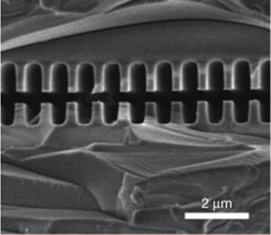
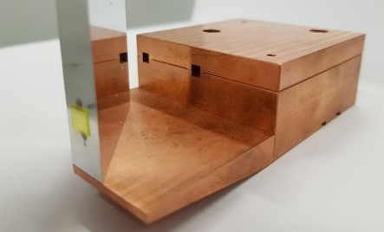
Why THz radiation for particle acceleration?
Radio frequencies
THz frequencies
Optical frequencies
Frequency ≈3 GHz period ≈ 300 ps,
λ ≈ 10 cm Cavity aperture ~ 2 cm
E_{acc} ~ 10 - 100 MV m⁻¹
Pulse length: 5 ms (superconducting) 5 μs (normal conducting)
Frequency ≈1 THz period ≈ 1 ps,
λ ≈ 300 μm – 1 mm Cavity aperture ≈ 1 mm
E_{acc} ≈ 100 MV/m to > GV/m
Pulse length 1-5 ps
Frequency ≈300 THz period ≈ 3 fs,
λ ≈ 0.8 – 1 μm Cavity aperture ≈ 1 μm
E_{acc} ≈ 100 MV m⁻¹ to >> GV/m
Pulse length 20 fs – 1 ps
THz advantages:
50um silica
Oscillation period short, and well matched to the bunch duration
High field strengths possible.
Wavelength allows for easy fabrication of structures.
THz challenges:
Obtaining sub-luminal phase velocities
Broadband pulses – controlling dispersion
High field THz sources still challenging
[2] E.A Peralta et al., Nature, 503.7474 (2013): 91-94
S.P. Jamison, Jefferson Laboratory, August 2019
Notes:
There are several points to consider; (1) phase matching of electrons and THz pulse over a wide bandwidth,
(2) accelerating gradient, (3) shunt impedance, and (4) ease of fabrication.
(5) Other issues include charging of the dielectric and electron bunch injection into a small aperture.
waveguide dispersion typically results in an unmatched group velocity and so the pulse envelope of a short THz pulse changes along the length of the structure. This reduces field amplitude and therefore accelerating gradient as the envelope propagates at a different velocity to the electron

Slide 4
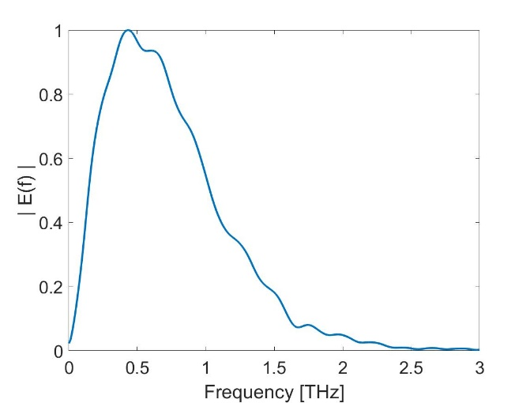
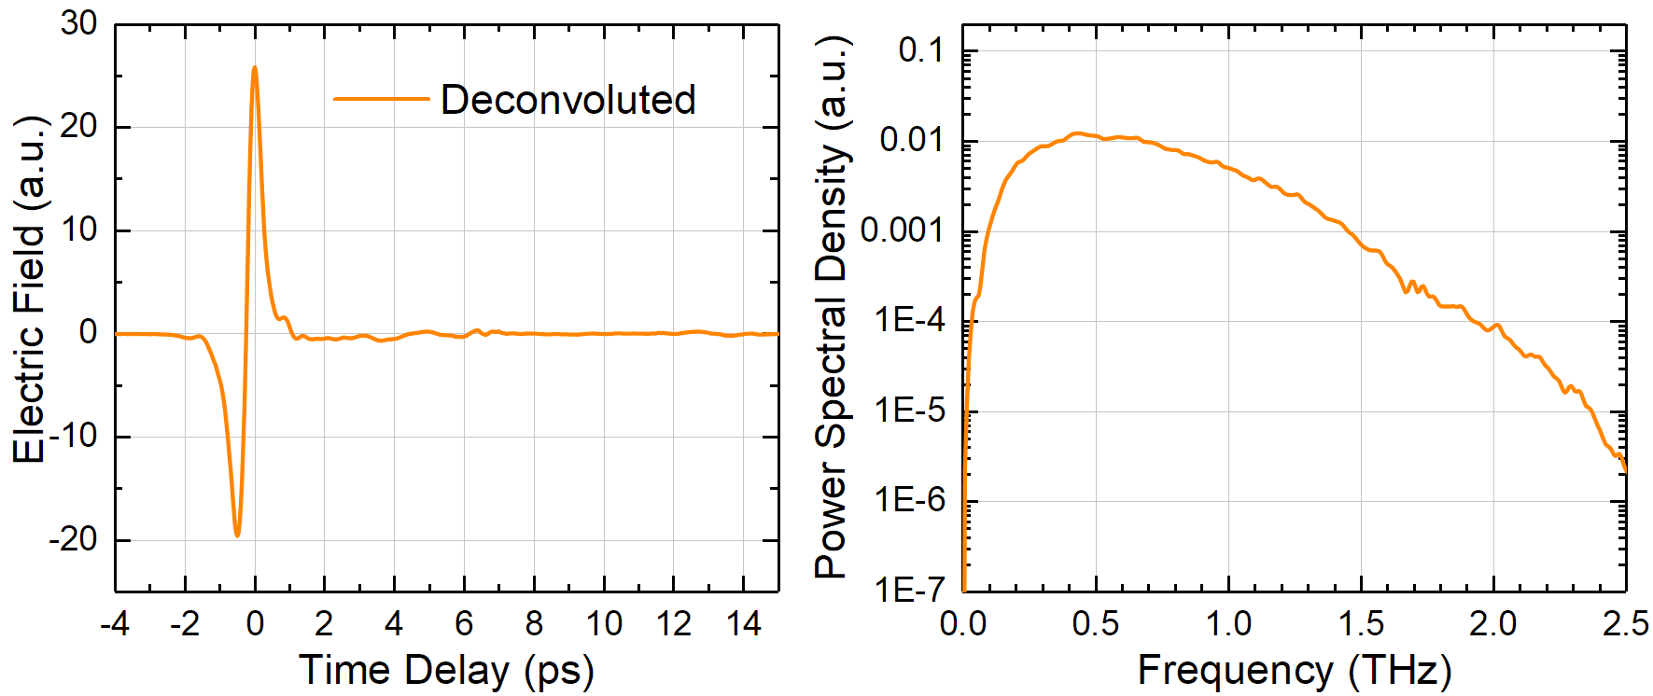
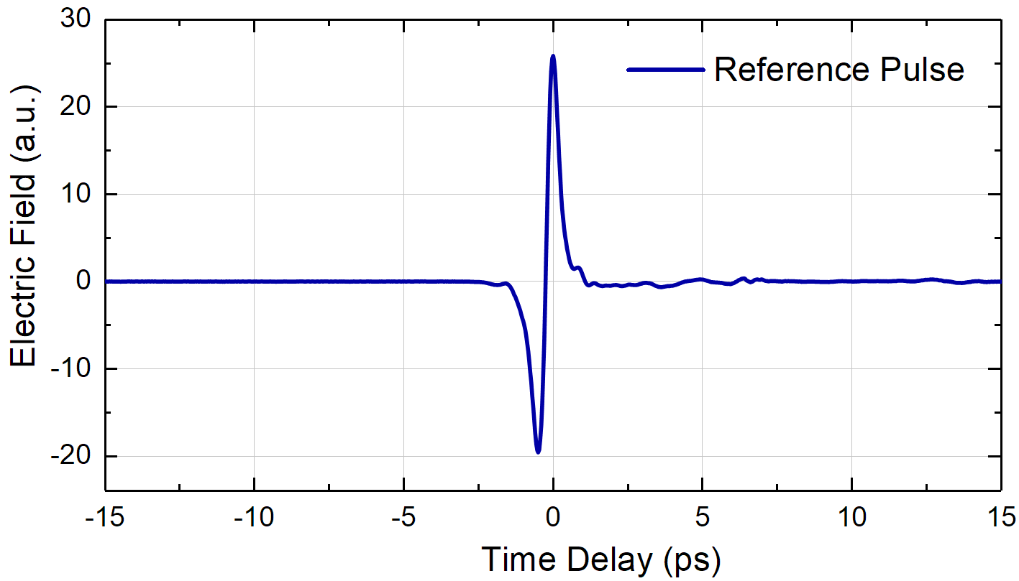
Terahertz pulses from optical-rectification
Difference frequency mixing by broadband ultra-short optical pulse
χ_{ijk}⁽²⁾(ω; ω₁^{opt},ω₂^{opt} )
Coherent mixing of optical frequencies leads to electric-field following time-derivative of optical pulse envelope
E(t) ~ A(t)cos(w₀t)
2nd harmonic generation
ω₁^{opt}
ω₁^{opt} + ω₂^{opt}
THz pulse
NonLin. crystal
dA(t)/dt
Laser field
ω₂^{opt}
ω₁^{opt} - ω₂^{opt}
Very high fields strengths possible
> > 100 MV/m readily achievable
> 3 GV/m demonstrated (at focus)
Convolve over all combinations of frequencies
Octave spanning spectrum
single-cycle pulse,
sub-ps oscillation period
Spectrum from Fourier transform
S.P. Jamison, Jefferson Laboratory, August 2019

Slide 5
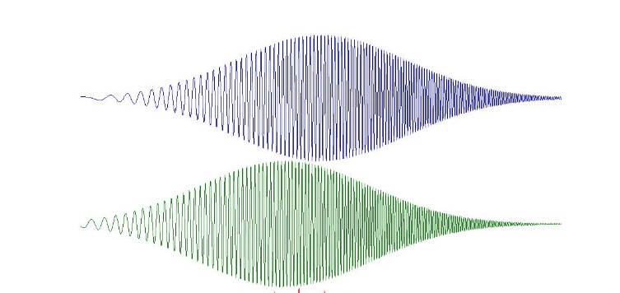
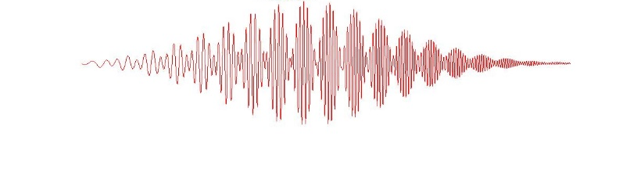
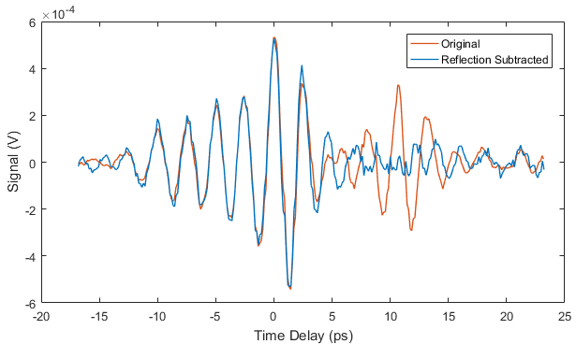
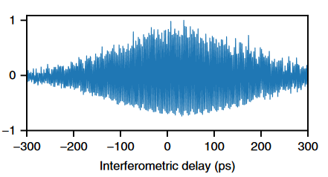
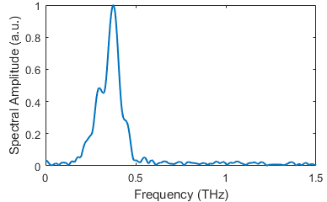
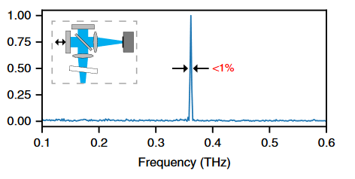
Terahertz pulses from optical-rectification
Quasi-monochromatic THz from temporal shaping of optical pulses
chirped pulse beating: Simple technique for envelope control
Identical chirped optical pulses overlapped with time delay
Bandwidth increases with optical pulse duration
Frequency tunable by time delay
S.P. Jamison, Jefferson Laboratory, August 2019

Slide 6
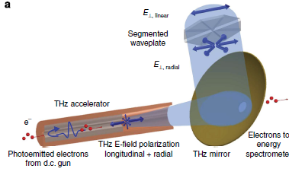
THz acceleration, bunching & streaking
Sub-relativistic beams (<100keV)
THz driven acceleration
THz driven acceleration & streaking ‘STEAM’ segmented device
≈ 10keV acceleration on 60keV beams
Nanni et al. Nature Comm.6 8486 (2015)
THz driven bunching & streaking
Kealhofer, et al. Science, 352 429 (2016)
D. Zhang et al. Nature Photon. 12, 336 - 342 (2018)
S.P. Jamison, Jefferson Laboratory, August 2019

Slide 7
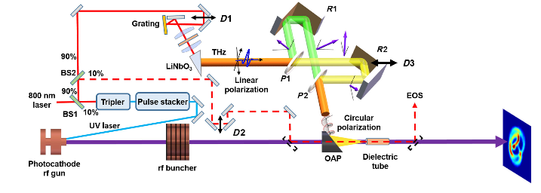
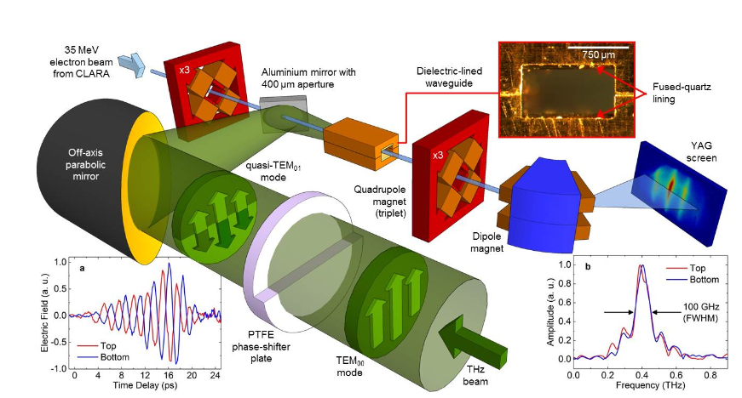
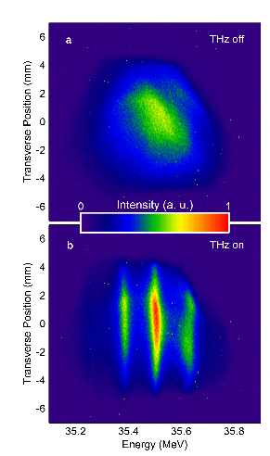
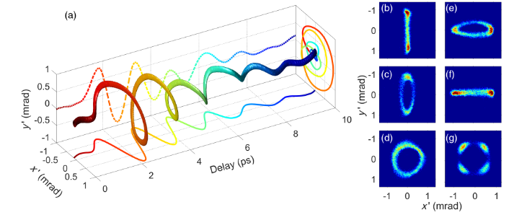
THz acceleration, bunching & streaking
Relativistic Beams
THz driven streaking of relativistic beams
E.C. Snivley et al, arXiv 1906.03358 (2019)
L. Zhao, et al. Phys Rev X, 8, 021061 (2018)
Shanghai Jiao Tong University
SLAC
M.T. Hibberd et al, arXiv 1908.04055 (2019)
Cockcroft Institute
L. Zhao, et al. Phys Rev Lett, 122, 144801 (2019)
S.P. Jamison, Jefferson Laboratory, August 2019

Slide 8
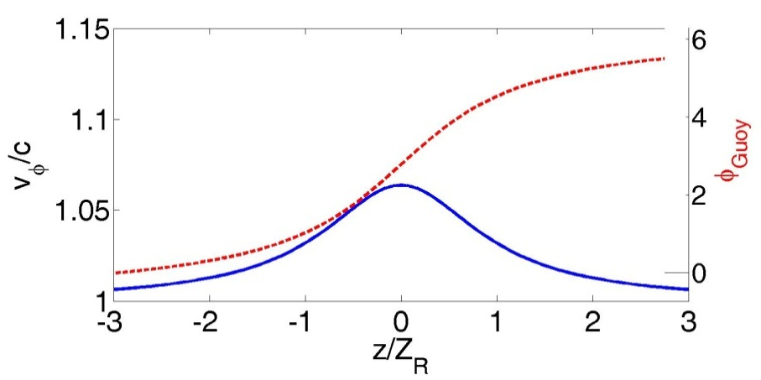
Particle acceleration requirements
Energy gain
Matching of electromagnetic phase velocity and particle velocity
Longitudinal electric-field polarization states
THz phase velocity always v_{φ}> c in free space
Acceleration still possible, but limited to Rayleigh length interaction
Travelling source excitation
Dielectric loaded waveguides
Photonic bandgap structures
Velocity matching solutions
S.P. Jamison, Jefferson Laboratory, August 2019

Slide 9
Velocity matching in dielectric structures
Side-pumped structures
Dielectric Laser Acceleration
Phase-step structure
Maintaining the particle-field acceleration phase
Particle trajectory
Particle travels half-cell as electric field oscillates half cycle
Dielectric step in adjacent half-cell provide λ/2 phase shift in field
Not a cavity structure :
no field enhancement
Laser propagation
THz time-delay structure
Single-cycle pulse precludes using periodic l/2 phase shift
Increasing dielectric delays of pulse
Isolation between cells required to control THz diffraction.
electrons

Slide 10
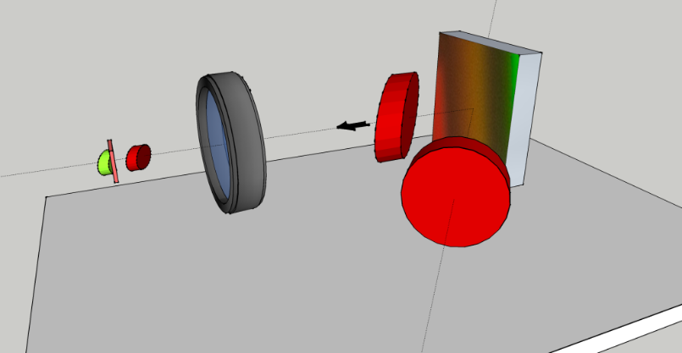

THz subluminal travelling source Dispersion-free single-cycle pulse propagation
concept:
Diffraction grating & broadband ultra-short pulses
Phase-fronts remain ⊥ to propagation
Pulse (group) front can be arbitrarily tilted w.r.t propagation
Antenna / Non-lin. Xtal
THz emitter
Pulse envelope
V_{φ}^{eff}
Phase-fronts
Walsh et al. Nat Coms 8, 421 (2017)
S.P. Jamison, Jefferson Laboratory, August 2019

Slide 11
THz subluminal travelling source Dispersion-free single-cycle pulse propagation
Travelling source generates ‘virtual’ incident THz wave.
observe ‘reflected’ Thz wave from surface
Source velocity v_{THz}^{eff} < c equivalent to total-internal reflection criterion
FDTD simulation of travelling source near vacuum boundary
Walsh et al. Nat Coms 8, 421 (2017)
Evanescent-wave accelerator
Pavlfalvi et al. Phys Rev ST (2014)
S.P. Jamison, Jefferson Laboratory, August 2019

Slide 12
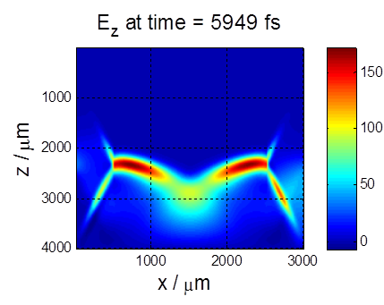
THz subluminal travelling source Configuration for acceleration
Mirror- symmetric excitation provides cancellation of transverse electric and magnetic fields
Interaction of 5MeV electrons with 10 MV/m traveling source
S.P. Jamison, Jefferson Laboratory, August 2019

Slide 13
THz subluminal travelling source Measuring the travelling-source in the near-field
Pump beam for THz generation
χ₁₂₃⁽²⁾
χ₁₂₃⁽²⁾
Retro-reflect probe
from rear surface
... Probe from
optical delay-line
To polarisation monitoring Photo-diodes
Measurement of modest-field ‘transverse pump’ sources
Walsh et al. Nat Coms 8, 421 (2017)
S.P. Jamison, Jefferson Laboratory, August 2019

Slide 14
THz subluminal travelling source High-field Travelling-source with Tilted pulse fronts
Cherenkov emission in high-field non-linear materials
Excitation with titled pulse at Cherenkov angle
S.P. Jamison, Jefferson Laboratory, August 2019

Slide 15
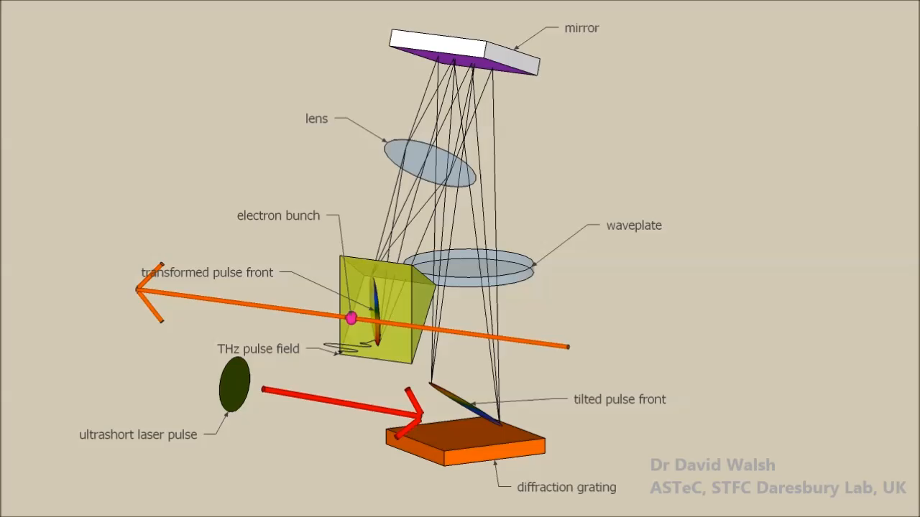
THz subluminal travelling source High-field Travelling-source with Tilted pulse fronts
Measurement of high-field LiNbO3 sources
Walsh et al. Nat Coms 8, 421 (2017)
Complicated THz-laser phase-matching geometry
Attempts so far in relativistic-beam experiments unsuccessful
S.P. Jamison, Jefferson Laboratory, August 2019

Slide 16
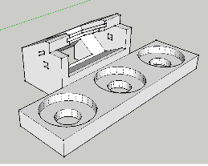
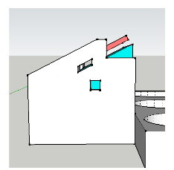
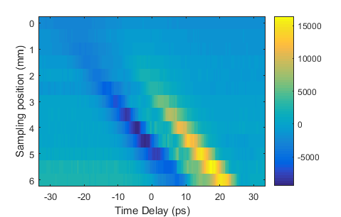
THz deflection of 100keV electrons
Travelling source experiment
Laser induced beam deflection observed…
... but due to laser heating & pyro-electric field from non-linear crystal
In situ measurement of traveling THz field, 100um from surface
Mitigations to be implemented
S.P. Jamison, Jefferson Laboratory, August 2019

Slide 17
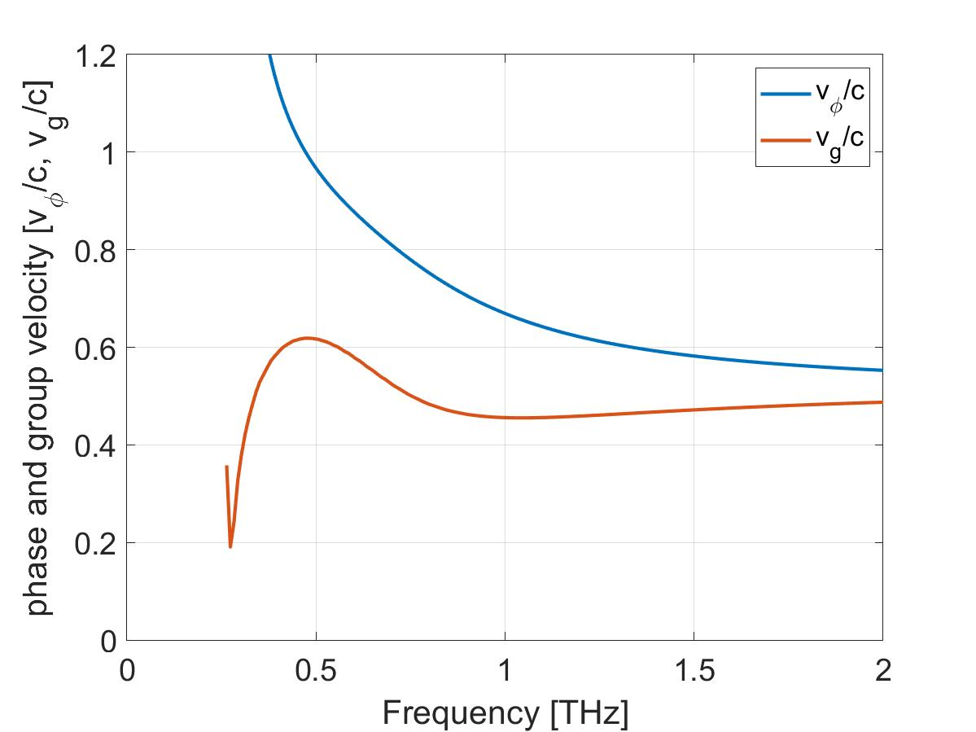
Dielectric lined waveguides for particle beam acceleration
Mode patterns in waveguide can support longitudinal electric field
Dielectric layers enable velocity matching of carrier-frequency to particle beam
Longitudinal Cross-section field pattern
Propagation direction
LSE₁₁ mode
S.P. Jamison, Jefferson Laboratory, August 2019

Slide 18
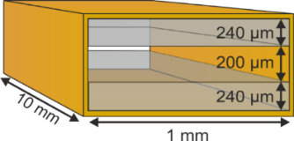
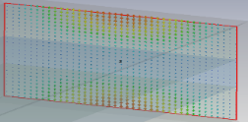
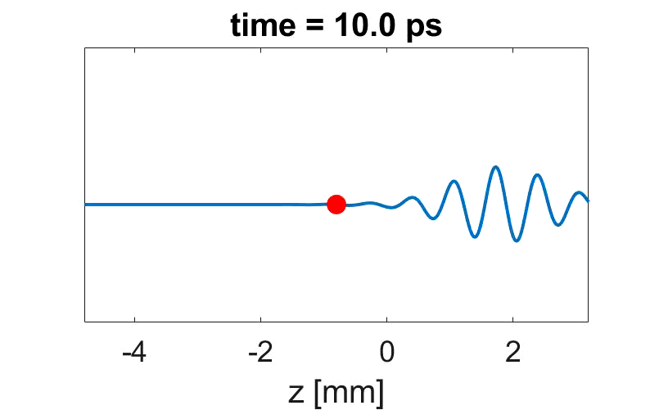
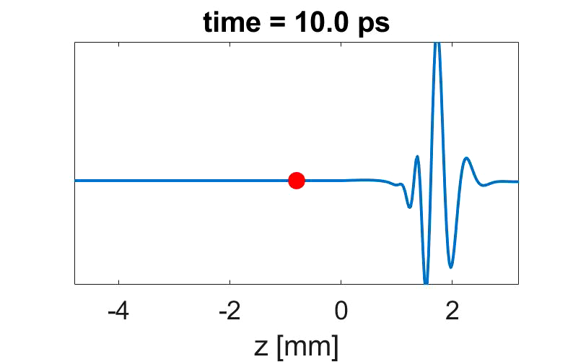
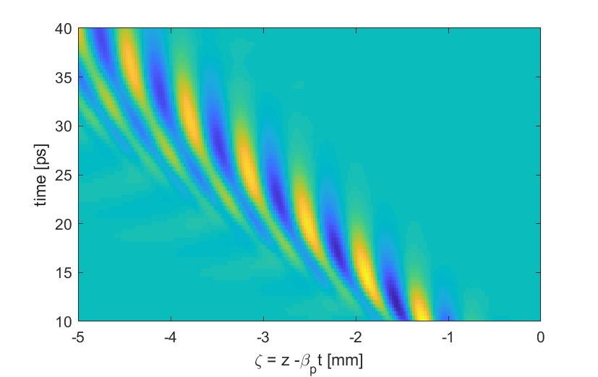
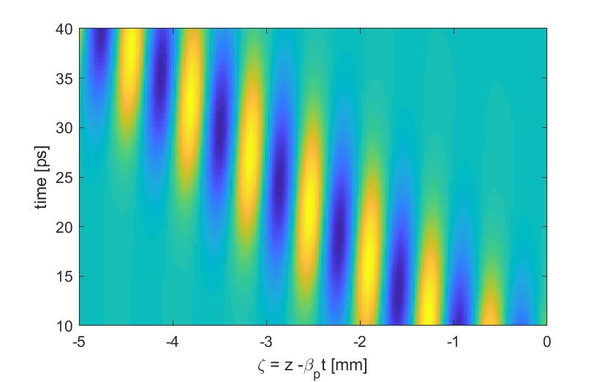
Dielectric lined waveguides for relativistic particle beam acceleration
Phase velocity matching, v_{φ} = β c
Group velocity v_{g} << v_{φ}
few-cycle THz input (quasi-monochromatic)
Single-cycle THz input
Field in frame of 50MeV electron beam (v = 0.9995 c)
Particle trajectory
Particle trajectory
Particle see constant electric field phase (accelerator or decelerating)
S.P. Jamison, Jefferson Laboratory, August 2019

Slide 19
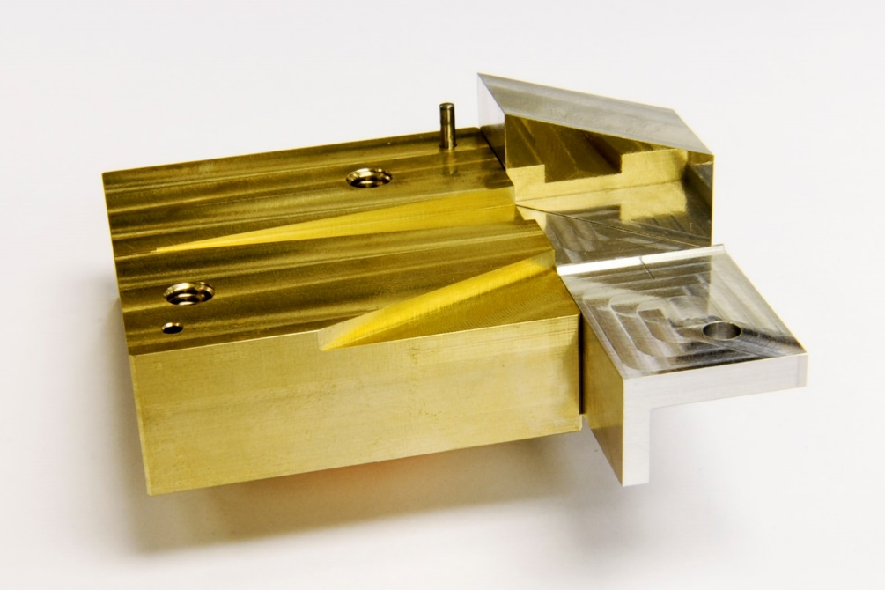
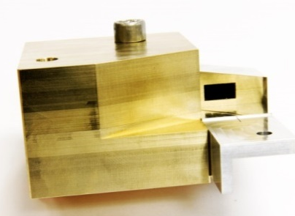
Dielectric-lined waveguide structures
Lower half of waveguide assembly
Waveguide
Lined with 50um thick quartz
Coupling horn
THz mirror with 400um electron aperture
Crystal shelf
Laser pulse dump channel
Fully assembled
50um silica
S.P. Jamison, Jefferson Laboratory, August 2019

Slide 20
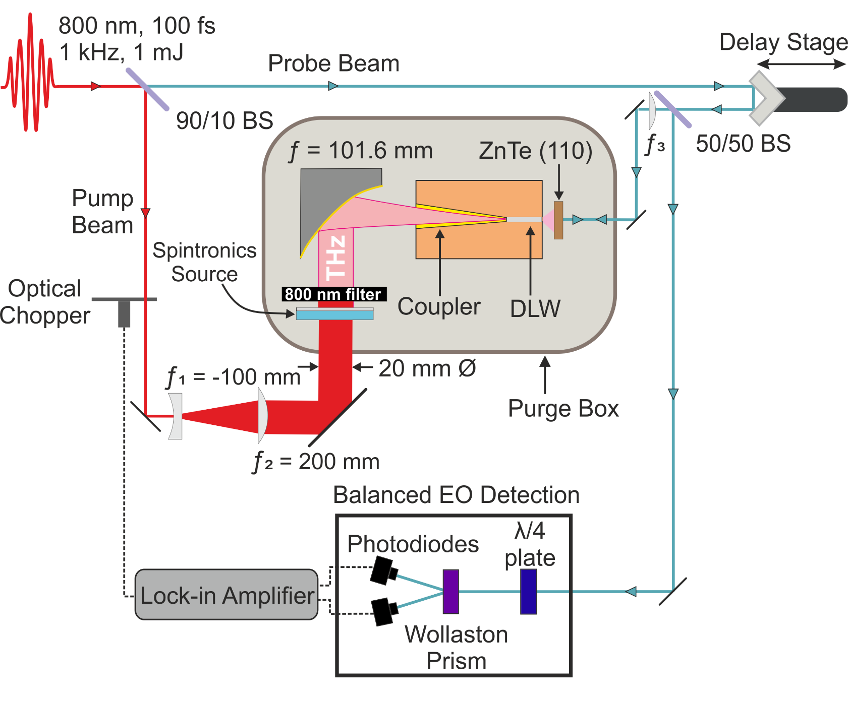
THz network analyser for waveguides
structure characterization with electro-optic time-domain sampling
S.P. Jamison, Jefferson Laboratory, August 2019

Slide 21
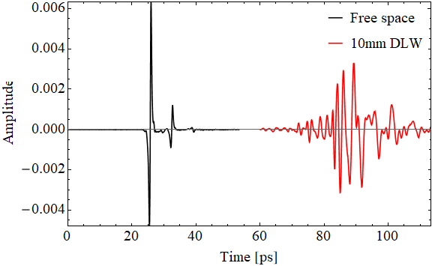
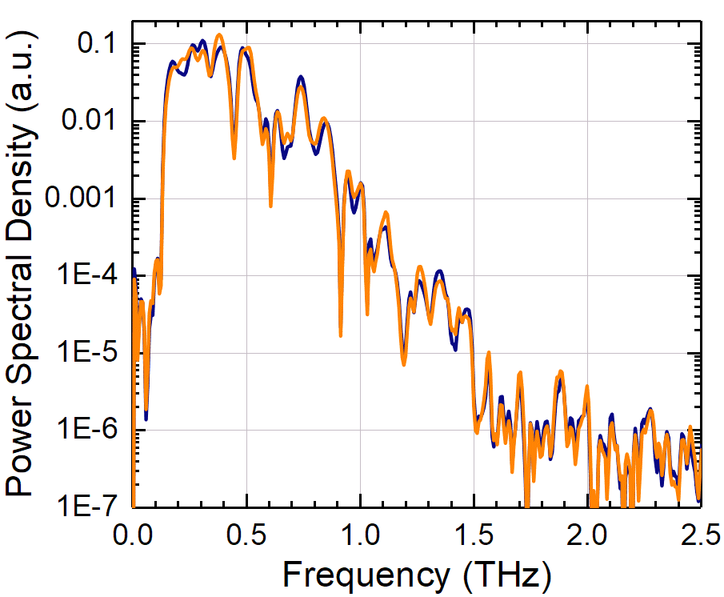
THz network analyser for waveguides
structure characterization with electro-optic time-domain sampling
Power spectra
Time domain scans of input reference &
10mm long dielectric-lined waveguide
Free-space
plus phase
spectra
waveguide
10mm & 5mm guides with identical couplers measured to isolate coupler dispersion
S.P. Jamison, Jefferson Laboratory, August 2019

Slide 22
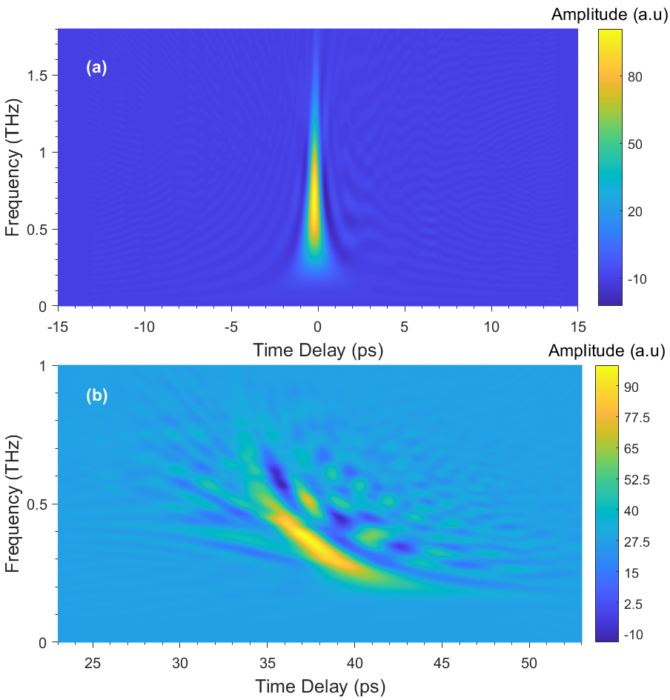
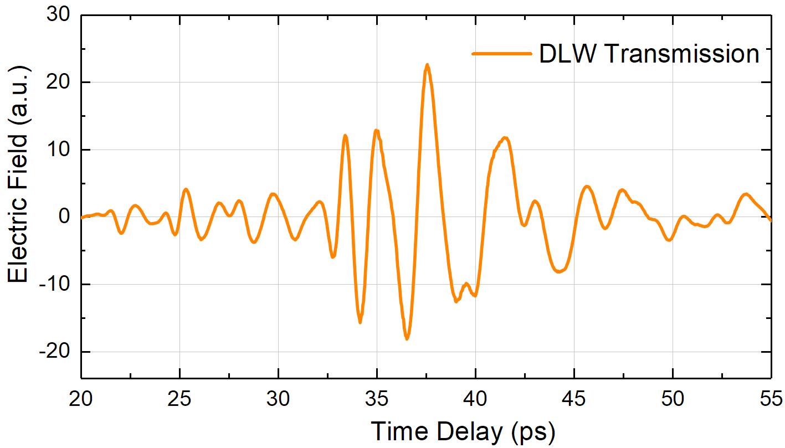
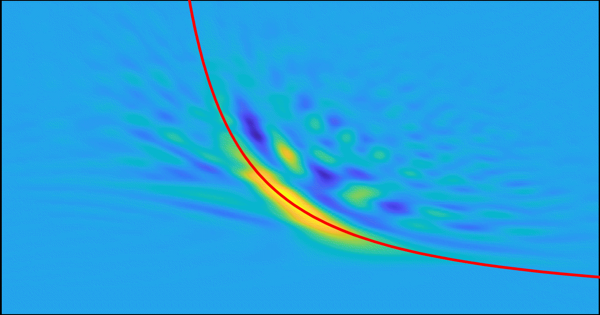
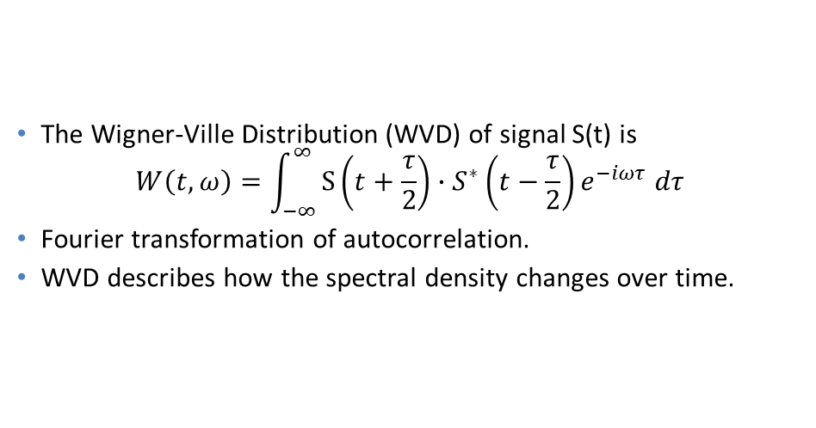
THz network analyser for waveguides
structure characterization with electro-optic time-domain sampling
The Wigner-Ville Distribution (WVD) of signal S(t) is
$$W\left(t,ω\right)=\int_{−∞}^{∞}{S\left(t+\frac{τ}{2}\right)}∙S^{∗}\left(t−\frac{τ}{2}\right)e^{−iωτ }dτ$$
Fourier transformation of autocorrelation.
WVD describes how the spectral density changes over time.
S.P. Jamison, Jefferson Laboratory, August 2019
Notes:
Having now the corrected, free of reflections waveforms, we proceed with time-frequency analysis. We can see how the frequency content changes over time.
although this model did not consider the influence the effect of the coupler.

Slide 23

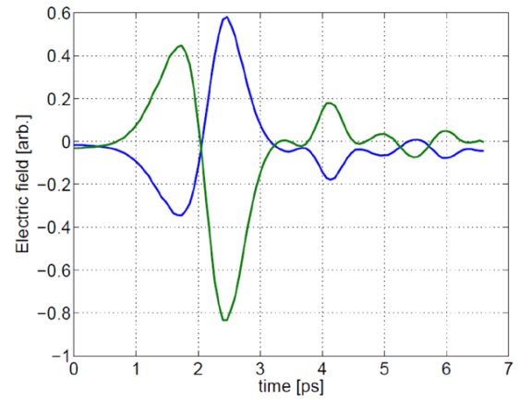
Longitudinal electric fields for Acceleration
Photo-conductive Antenna
Laser-initiated current surge
Laser excitation
Radial 120kV
bias field (μs pulse)
<50 fs rise time, >100 ps decay/capture time
Transverse polarisation
Longitudinal polarisation
E_{y}
Cliffe et al. Appl. Phys. Lett. 105, 191112 (2014)
Simple but lacks temporal shaping capability; High-field strengths problematic
S.P. Jamison, Jefferson Laboratory, August 2019

Slide 24
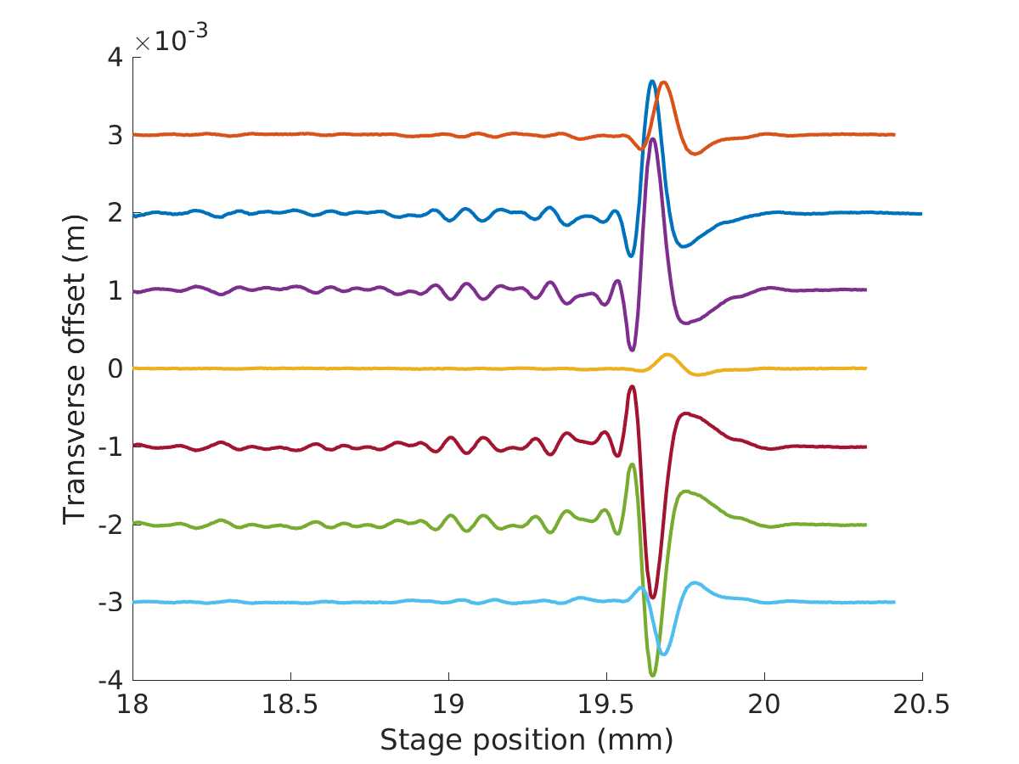
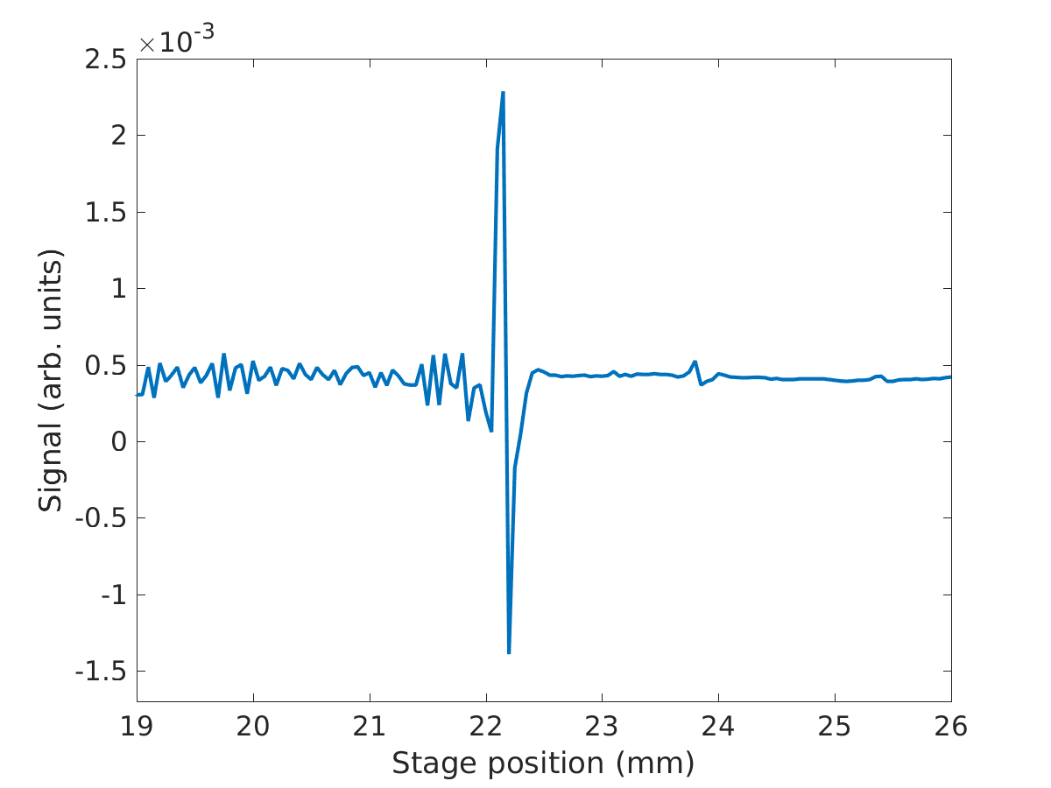
Longitudinal fields for Acceleration
Optical rectification with Polarity Inversion
χ₁₂₃⁽²⁾
Zero divergence of E-field in free-space
⇒
Polarity inversion between crystals generates transverse gradients
Longitudinal field maintains zero-divergence
−χ₁₂₃⁽²⁾
Off-axis transverse field
On-axis longitudinal field
time
time
S.P. Jamison, Jefferson Laboratory, August 2019

Slide 25
Longitudinal fields for Acceleration
High-field LiNbO3 source non-collinear Cherenkov phase matching
Spintronic Source with Magnetic-field Polarisation control
Optical rectification emission
On-axis Longitudinal field
Cliffe at al. Appl Phys Lett 108, 221102 (2016)
Hibberd at al. Appl Phys Lett 114, 031101 (2019)
S.P. Jamison, Jefferson Laboratory, August 2019

Slide 26
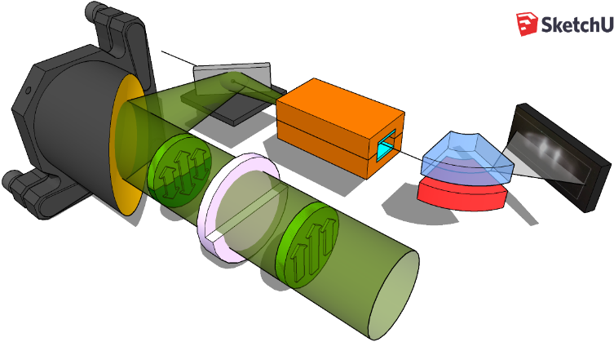
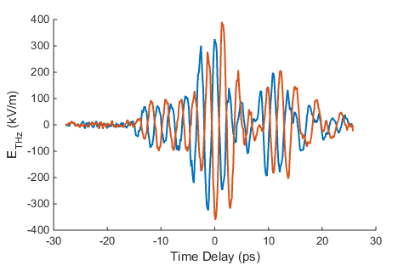
Longitudinal fields for Acceleration
Quasi-monochromatic phase-shifter
Teflon plate with λ/2 phase step
Upper half THz beam Lower half THz beam
Delay generates polarity inversion polarity inversion
S.P. Jamison, Jefferson Laboratory, August 2019

Slide 27
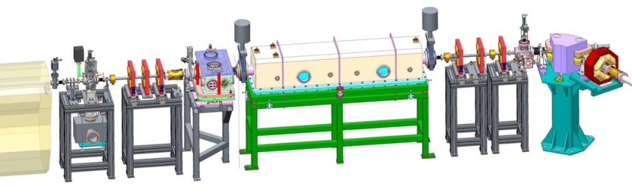
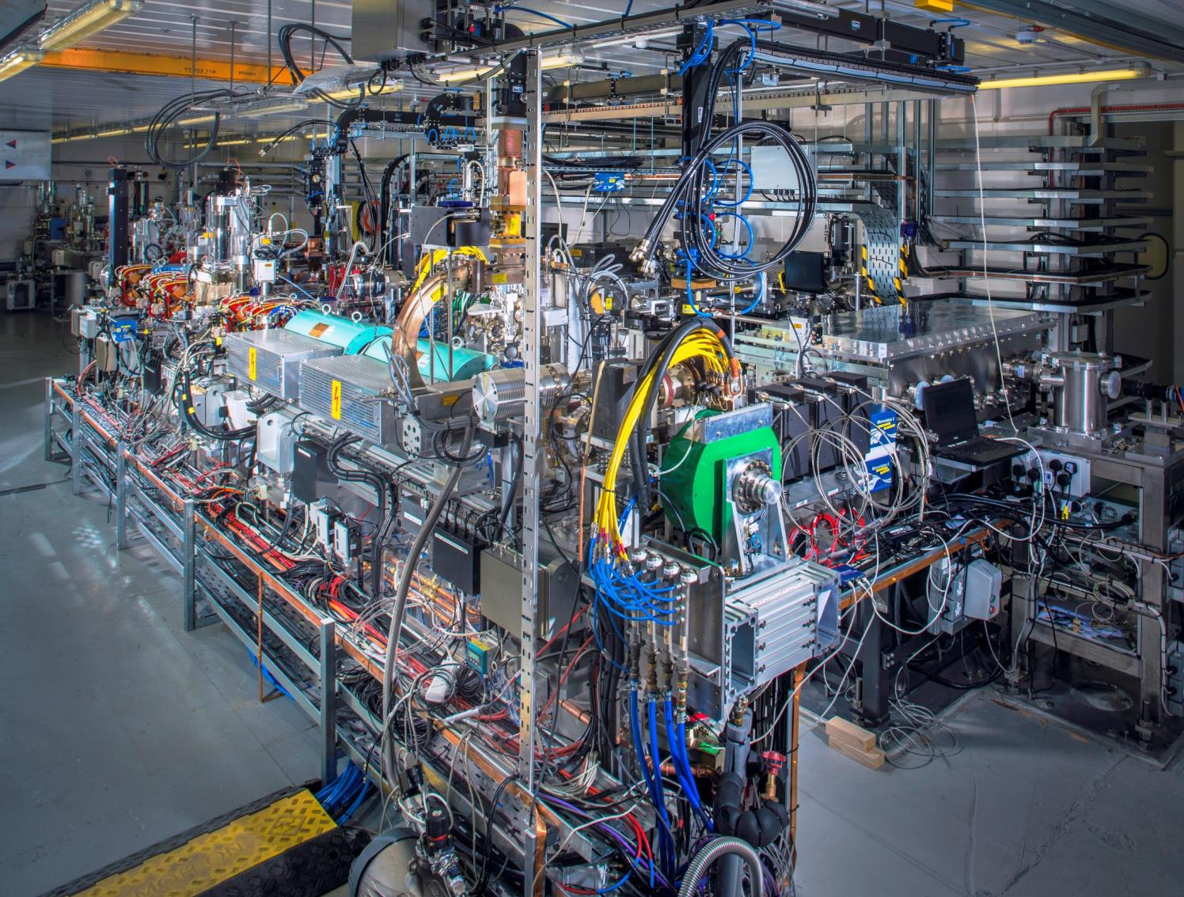
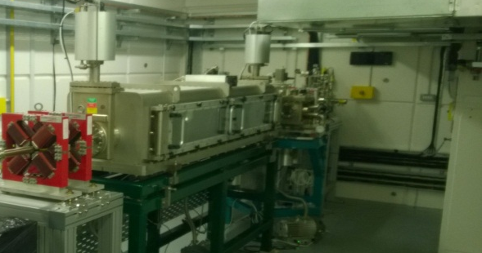
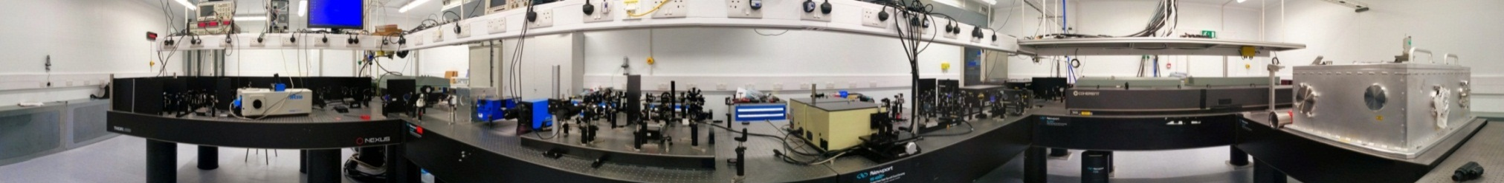
Relativistic electron beam acceleration
35MeV electron bunches, CLARA test facility
From demonstration of source to demonstration of particle acceleration
Experimental station
CLARA Phase 1 50MeV Beam
Latte-lab: 200mJ laser coupled to CLARA experiment beamline
S.P. Jamison, Jefferson Laboratory, August 2019

Slide 28
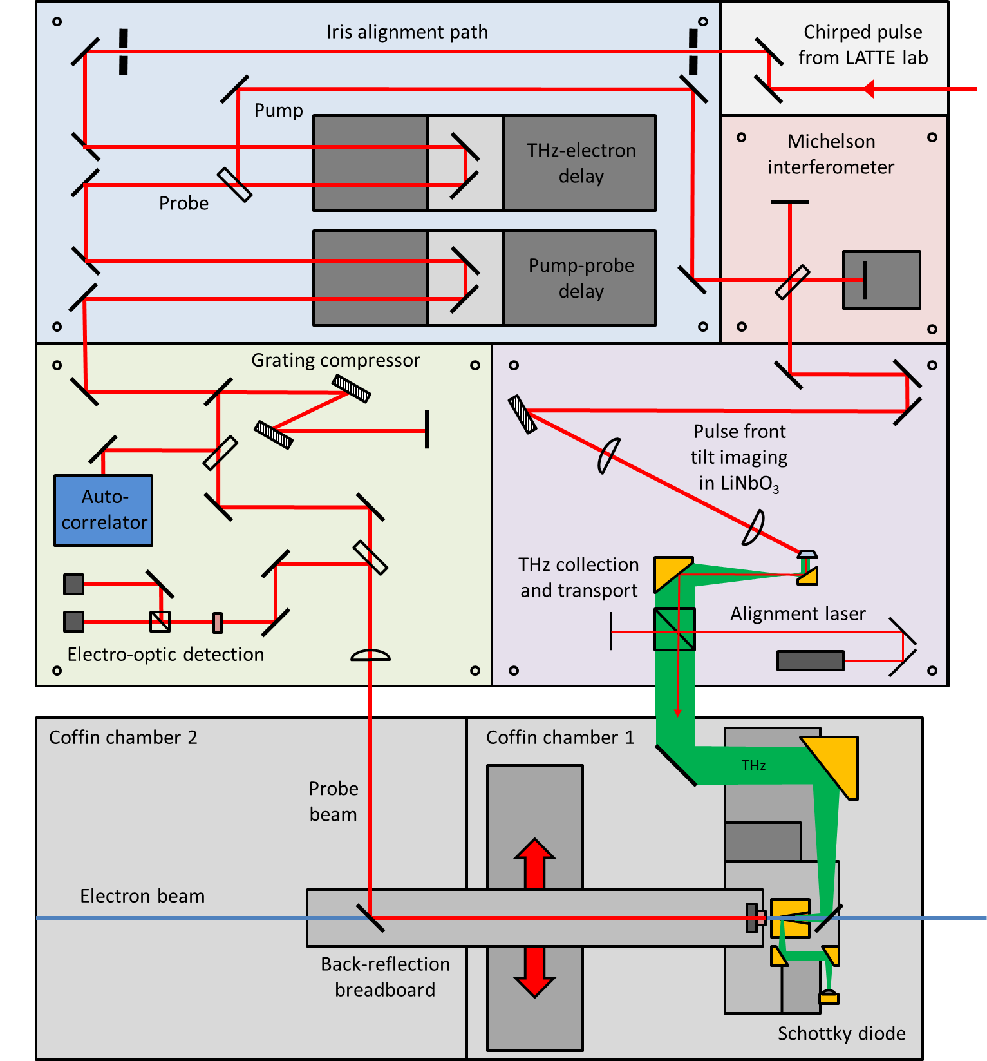
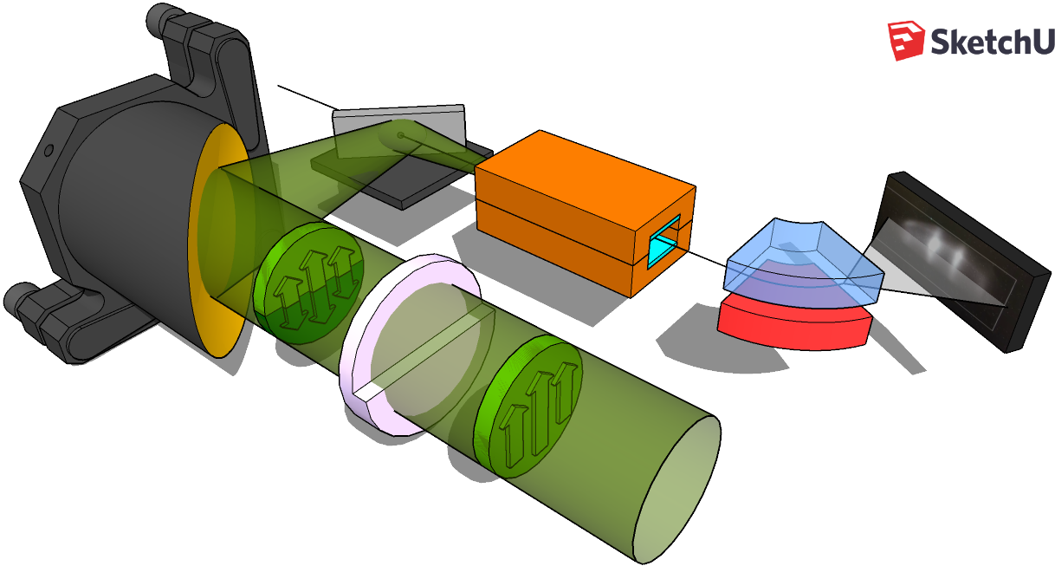
Relativistic electron beam acceleration
Optical and THz experimental layout
Delay-stages (THz-electron & THz-probe)
Chirped pulse
beating for
monochromatic THz
Probe compressor
& EOS
detection
Tilted pulse-front LiNbO3 source
35 MeV
electron beam
Dielectric-lined
waveguide
Phosphor screen
parabolic
mirror
Dipole
magnet
PTFE
phase-shifter
THz beam
S Jamison OTST, Santa Fe, March 2019

Slide 29


Slide 30


Slide 31


Slide 32


Slide 33



Slide 34



Relativistic electron beam acceleration
Experimental layout
Electron beam optical system
S.P. Jamison, Jefferson Laboratory, August 2019

Slide 35


Relativistic electron beam acceleration
THz-induced energy modulation
Image on electron spectrometer
Clara operated in a long-bunch configuration.
Bunch duration 7 ps FWHM
approximately linear chirp
THz off
Periodic energy gain/loss imposed by THz interaction
THz on
M.T. Hibberd et al, arXiv 1908.04055 (2019)
S.P. Jamison, Jefferson Laboratory, August 2019

Slide 36

Relativistic electron beam acceleration
THz-induced energy modulation
Single-shot electron energy spectra
Energy modulation visibility up to 90%
Non-sinusoidal modulation:
Dependent on the acceleration absolute magnitude; slice energy-spread & emittance
Peak THz acceleration determined from model fit to data ; sinusoidal THz-driven modulation )
Acceleration of 8.8 keV
Effective interaction length limited to approximately 4.3mm by group velocity walk-off and the THz pulse duration
Average acceleration gradient of 2MV/m
M.T. Hibberd et al, arXiv 1908.04055 (2019)
S.P. Jamison, Jefferson Laboratory, August 2019

Slide 37

Relativistic electron beam acceleration
THz-induced energy modulation
S.P. Jamison, Jefferson Laboratory, August 2019

Slide 38
Relativistic electron beam acceleration
“THz zero-cross” for time-energy bunch diagnostic
Phase-space distribution was obtained from THz period τ= 2.5 ps (0.4 THz) and measured energy modulation period δE(E).
2.5ps
Linear chirp :
Measured : 47.5 keV/ps
Beam dynamics calcs: 53 keV/ps
From 100 single-shot spectra, with varying THz-electron beam timing
M.T. Hibberd et al, arXiv 1908.04055 (2019)
S.P. Jamison, Jefferson Laboratory, August 2019

Slide 39
Relativistic electron beam acceleration
Waveguide resonant response
Modulation period and depth observed as function of THz frequency
Modulation period independent of THz frequency
100 GHz THz source bandwidth
Phase-matching effectively filters interaction to 0.40THz modulation
Indications of differing modulation period beyond bandwidth range
Modulation strength (a.u.)
Modulation period (keV)
THz source spectrum
M.T. Hibberd et al, arXiv 1908.04055 (2019)
S.P. Jamison, Jefferson Laboratory, August 2019

Slide 40
Relativistic electron beam acceleration
(near) single-bucket acceleration
Clara operated in a low energy spread configuration. τ_{bunch} = 4ps FWHM
Asymmetric acceleration dependent on THz-bunch timing.
Energy spread doubled 21keV to 42keV (symmetric broadening)
10 keV acceleration in 4mm
Residual chirp of 8keV/ps inferred
S.P. Jamison, Jefferson Laboratory, August 2019

Slide 41
Summary
Particle – THz velocity matching schemes demonstrated
Longitudinal Polarized THz sources
Demonstrated Acceleration of 35MeV electron bunches
Travelling source : LiNbO3, PCA, ZnTe
Dielectric lined waveguides: 100keV; Relativistic
Single-cycle : polarity inversion. PCA, optical rectification
Quasi-monochromatic: transverse profile phase-shifting
Energy spectra modulation of chirped electron beams
Acceleration / deceleration of short bunches
THz zero-cross diagnostic for energy-time characterization
Future work
Demonstrate MeV energy gain and 100 MeV/m gradients
Development of THz driven injector
100 keV photogun with THz velocity bunching and acceleration
THz transverse deflection diagnostic development
S.P. Jamison, Jefferson Laboratory, August 2019

Slide 42




Acknowledgments
Cockcroft Institute
THz Electron Acceleration Group
Steven Jamison
Graeme Burt
Dan Lake
Alisa Healy
Oliver Findlay
Darren Graham
Rob Appleby
Elliott Smith
Vasilis Georgiadis
Morgan Hibberd
David Walsh
Ed Snedden
James Jones
Tom Pacey
Yuri Saveleiv
Open post-doctoral fellow positons:
Experimental accelerator physics - THz acceleration
Electro-optic diagnostics – AWAKE plasma wake-field acceleration
Contact s.jamison@lancaster.ac.uk
S.P. Jamison, Jefferson Laboratory, August 2019

Slide 44
Potential slice emittance diagnostic
β_{x} minimisation
Spatial resolution & visibility on screen maximized with quadrupole scan.

Slide 45


Our approach
Narrowband THz pulses were phase-velocity matched using a longitudinal accelerating mode in a DLW structure
DLW structure: rectangular copper waveguide with a vertical 575 μm-thick free space aperture
A quasi-TEM01 mode was generated by a phase-shifter plate providing an effective polarity inversion along the midline of the THz beam
Quadrupole triplets provided electron bunch transverse control for coupling into the DLW and for optimizing the energy resolution of the dipole spectrometer
Notes:
acceleration of relativistic electron beams driven by laser-generated THz radiation.
Narrowband and frequency-tunable THz pulses were phase-velocity matched to 35 MeV electron bunches (vp = ve = 0.9999c) using a longitudinal accelerating mode in a DLW structure for collinear interaction
Frequency-tunable, narrowband (100 GHz FWHM) THz pulses with approximately 2 microJ energy were generated through chirped-pulse beating in
a lithium niobate crystal.

Slide 46


Dispersion relation
5 mm DLW
10 mm DLW

Slide 47


Dispersion relation
v_{e}=0.548
f=0.53±0.01 THz

Slide 49
Longitudinal fields for Acceleration
Quasi-monochromatic phase-shifter
Upper half THz beam Lower half THz beam
Delay, not polarity inversion
S.P. Jamison, Jefferson Laboratory, August 2019

Slide 50




THz-driven electron acceleration - I Mode-propagation and coupling
Broadband THz pulses suffer significant dispersion
Coupling into multiple modes and mode interfernce
S.P. Jamison, Institute of Physics Particle & Beams annual meeting, Lancaster April, 2018

Slide 51


The dielectric-lined waveguide (DLW)
An integrated linearly-tapered horn was used to couple the quasi-TEM01 mode of the THz beam into the accelerating longitudinal section magnetic (LS11) mode
Designed for phase-velocity matching with the electron bunch at an operating frequency of 0.4 THz

Slide 52



THz-driven manipulation of the CLARA beam
Using a linear chirped, 6 ps FWHM electron bunch
Modulation arises from the temporally sinusoidal energy gain induced by the multi-cycle THz pulse
Single-Shot Energy Spectra

Slide 53
THz-driven manipulation of the CLARA beam
Peak THz acceleration determined from comparison with a calculation of a sinusoidal THz-driven modulation imposed on a model electron bunch
Acceleration of 8.8 keV
Effective interaction length limited to approximately 4.3mm by group velocity walk-off and the THz pulse duration
Average acceleration gradient of 2MV/m
The model also predicted both linear (47.3 keV/ps) and cubic (0.4 keV/ps³) chirp components

Slide 54
Accelerator Diagnostics: Exploring the Picosecond Temporal Structure of CLARA
Phase-space distribution was obtained from THz period τ= 2.5 ps (0.4 THz) and the measured energy modulation period δE(E).
Chirp of the electron beam δE(E)/τ was obtained from 100 successive shots
Quadratic dependence indicates a third-order chirp component.
Linear chirp (47.5 keV/ps) was of comparable magnitude with the value (53 keV/ps) predicted by beam dynamics simulations.
Degree of phase-space curvature implied by the cubic chirp not in agreement with beam-dynamics model
Notes:
Experimental measurement of the time-energy phase-space distribution of a relativistic electron beam is often inaccessible

Slide 55

Using a 2 ps FWHM electron bunch
Single-Shot Energy Spectra
Preferential acceleration or deceleration of the bunch was achievable, dependent on the bunch injection timing relative to the phase of the THz pulse

Slide 56
Quad-triplets
35 MeV
electron beam
Dielectric-lined
waveguide
Phosphor screen
Parabolic
mirror
Dipole
magnet
PTFE
phase-shifter
THz beam

