Slide 1
Advances in developments of the cSPr single shot monitor and a Dual Axis Asymmetric SCRF Cavity Prof I.V. Konoplev John Adams Institute, Department of Physics, University of Oxford, Oxford, UK

Slide 2
M. Topp-Mugglestone¹, H. Zhang¹, A.J. Lancaster¹, H. Harrison¹, G. Doucas¹ G. Burt² F. Marhauser³, A. Seryi³ Ya. Shashkov⁴ A. Arushev⁵, M. Shevelev⁵, N. Terunuma⁵, J. Urakawa⁵ ¹ John Adams Institute, Department of Physics, University of Oxford, Oxford, UK ² Cockcroft Institute, Lancaster University, Lancaster, UK ³ Thomas Jefferson National Accelerator Facility, Newport News, VA 23606, USA ⁴ National Research Nuclear University MEPhI, Moscow, Russia ⁵KEK, High Energy Accelerator Research Organisation,1-1 Oho, Tsukuba, Ibaraki 305-0801, Japan

Slide 3
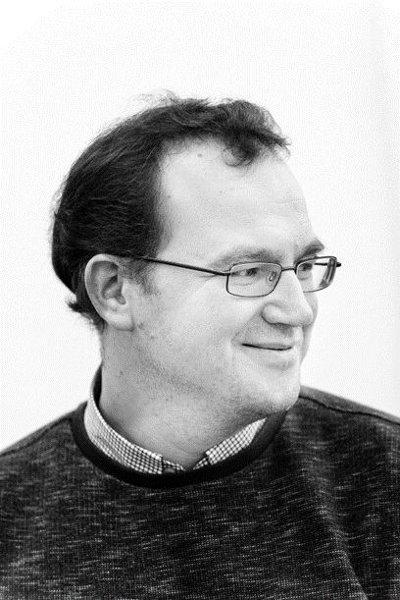
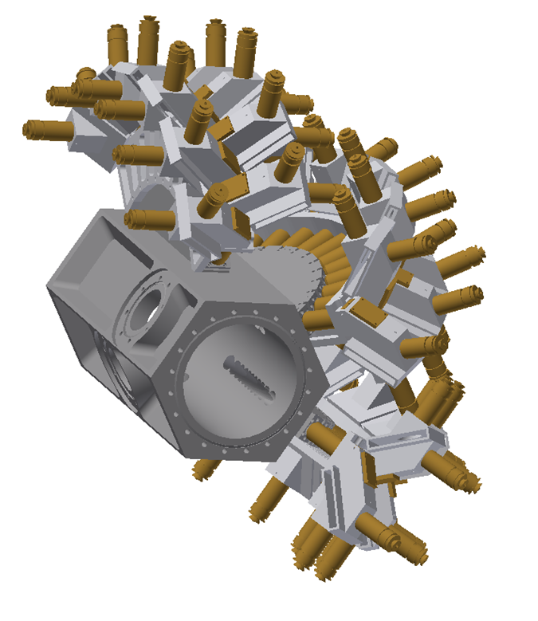
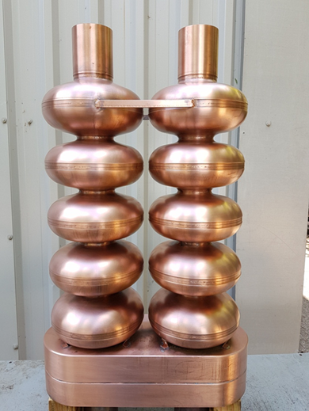
Outline
cSPr single shot non-destructive beam monitor
SRF Dual axis asymmetric cavity for ERL
Ivan V. Konoplev

Slide 4


Introduction
Nizhny Novgorod, Russia
Education:
1990-1994: B.Sc. in Physics (First Class, Distinction) Nizhny Novgorod State University, Russia
1994-1996: M.Sc. in Physics of Plasmas and High-Power RF (First class, Distinction) Nizhny Novgorod State University & Institute of Applied Physics, Russian Academy of Science (RAS), Russia
1996-1997: M.Phil. in Physics University of Strathclyde (UK) & Institute of Applied Physics, Russian Academy of Science (Russia)
1997- 2001: Ph.D. in Physics: “Free-Electron Maser with two-dimensional distributed feedback” University of Strathclyde (UK)
Volga
Oka
Volga
Oka

Slide 5
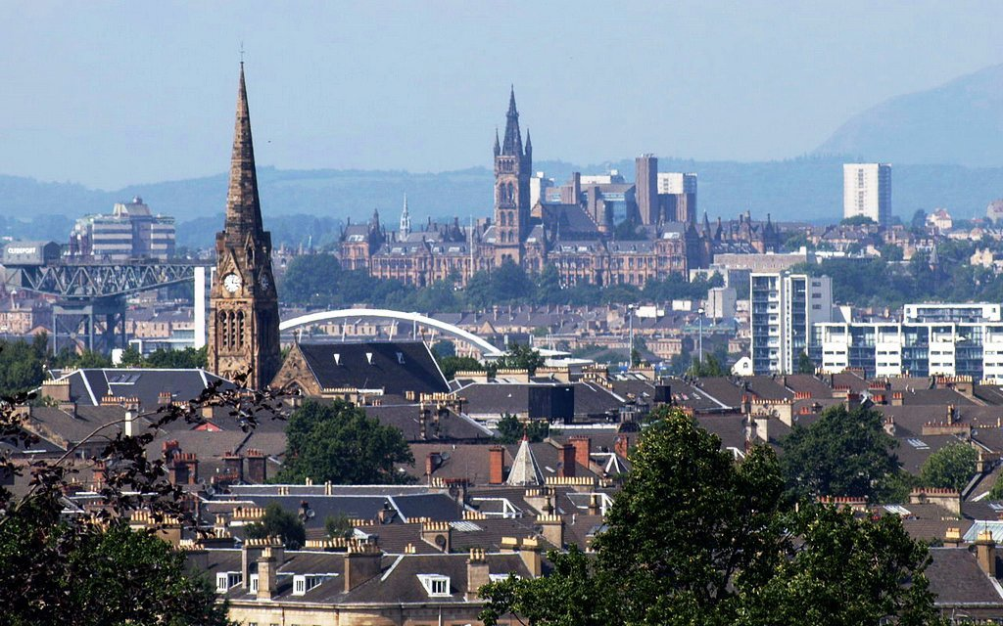

Introduction
Glasgow, Scotland, UK Oxford, UK
Research Appointments:
02/2001 – 02/2003: Research Assistant, Department of Physics, University of Strathclyde (HP, 2D FEM)
02/2003 – 04/2005: Research Fellow, Department of Physics, University of Strathclyde (HP, 2D FEM)
04/2005 – 09/2011: Senior Research Fellow, Department of Physics, University of Strathclyde (RF Pulse compression; HP, 2D FEM)
09/2011 – 01/2013: University Lecturer of Accelerator Science, Department of Physics, University of Oxford (cSPr)
01/2013 – present: Associate Professor of Accelerator Science, Department of Physics, University of Oxford (cSPr, UH-FLUX, Medical LINAC)

Slide 6
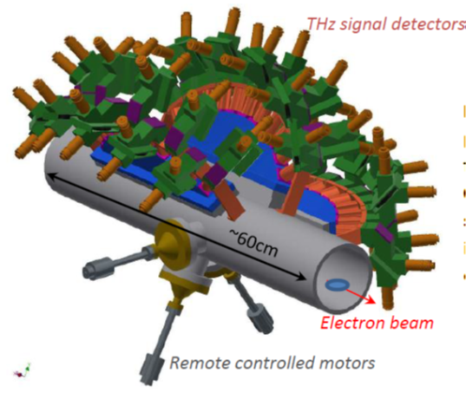
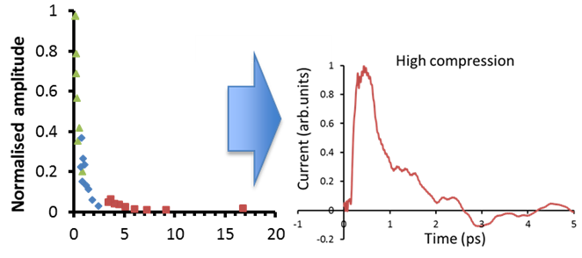
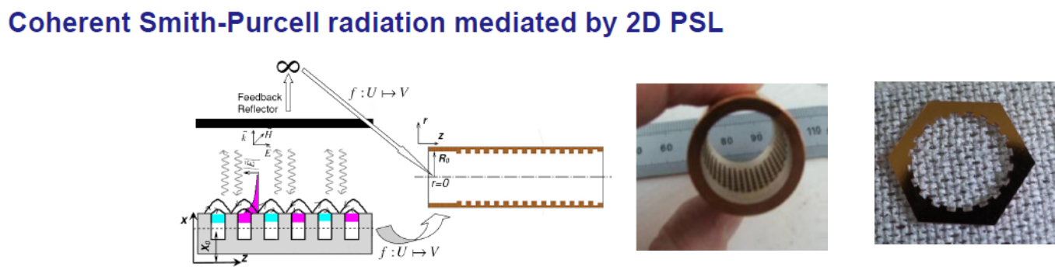
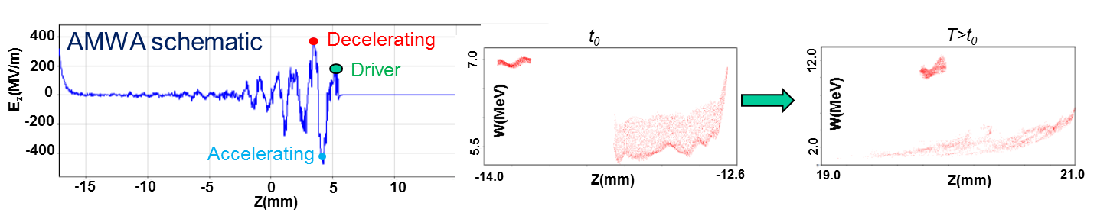
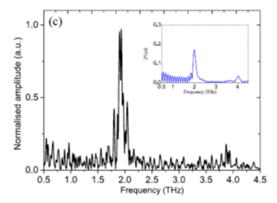
Introduction
cSPr single shot non-destructive beam monitor
a) Bunch profile and microbunched beam single shot non-destructive monitor based on coherent radiation spectrum analysis
Coherent EM fields mediated by 2D PSL
b) High impedance surface all metal structures for wakefield acceleration (All Metal Wakefield Accelerator AMWA) and generation of HP coherent THz radiation

Slide 7
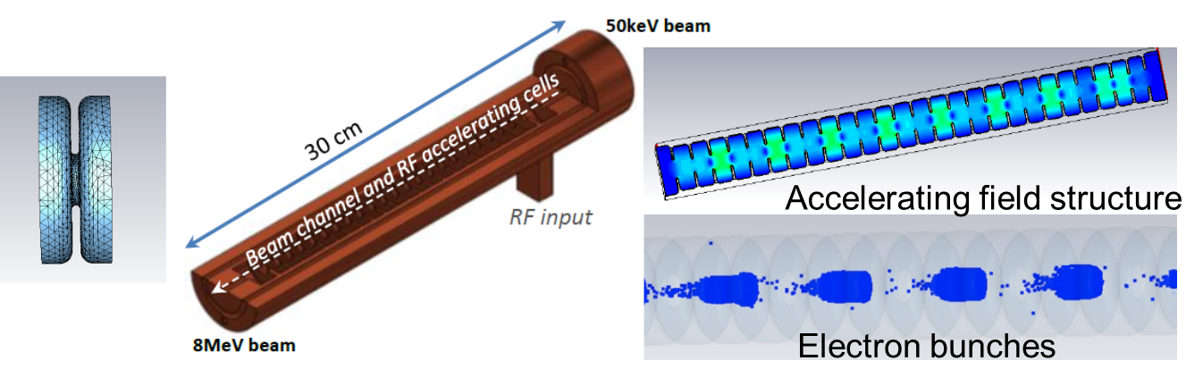
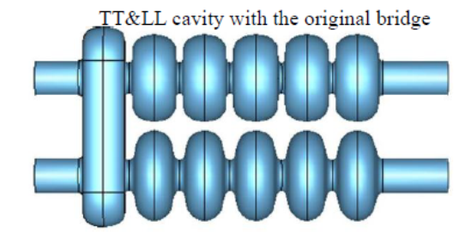
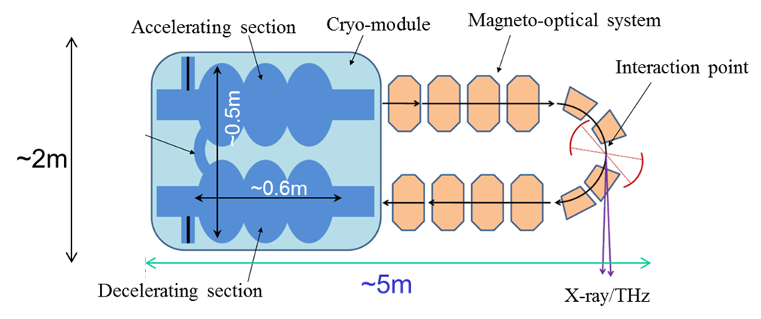
Introduction
12GHz TW accelerator for RT cancer treatment
c) “X-ray bulb” concept for medical (RT for cancer) and industrial applications.
Concept: vacuum sealed, cathode, PPM focusing and target inclusive system to generate up to 9MeV photons.
UH FLUX project
d) UH-FLUX project: ERL based on SRF dual axis asymmetric cavity to increase the beam transportation capability of the ERL

Slide 8
Outline
Non-destructive monitoring of a microbunched beam and longitudinal bunch profiling using coherent radiation spectrum analysis
Introduction and Motivations
Concept
Design of the beam monitor
Asymmetric dual axis cavity for ERL (UH FLUX project)
Motivations
Fundamentals and Conceptual design
Preliminary design and the first results of the studies of the Pass-Band and High-Order Modes
Conclusion

Slide 9

Microbunched beam monitoring and bunch profiling using coherent radiation spectrum analysis

Slide 10
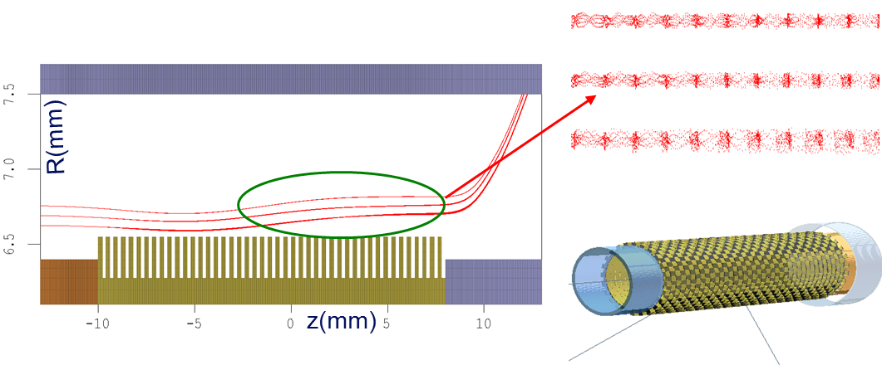
Radiation generated by electron beam
Coherent radiation
Incoherent radiation
Continuous beam L_{b}>>λ
Usually the radiation coherence is insured by modulation of the continuous beam via non-linear interaction of the beam with the EM-fields of the radiation;
cSPr – e-beam interaction

Slide 11
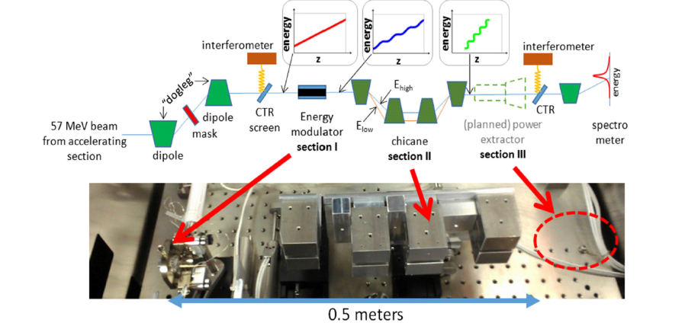
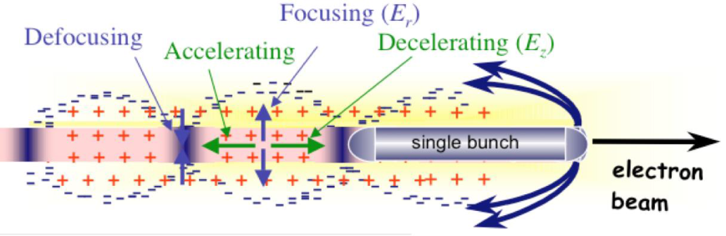
Radiation generated by electron beam
Bunched beam L_{b}< λ i.e.
“external” pre-bunching of the electron beam making dimensions of the bunches smaller as compared with the operating wavelength.
(2)
(1)
1/ Beam modulation inside plasma channel
2/ Sub-picosecond Bunch Train Production via wakefield energy modulation in dielectric lined structure - S. Antipov et al.,
3/ Direct modulation of bunch using photocathode and fs laser - A. Aryshev et al.,

Slide 12
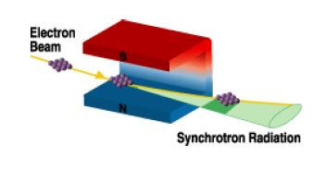
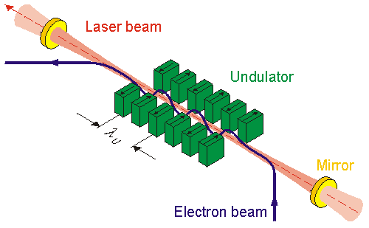
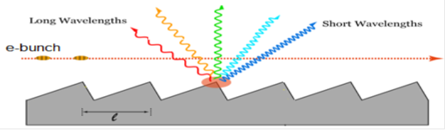
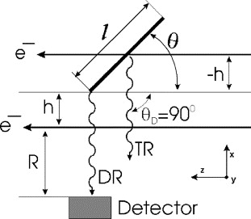
Sources of Coherent Radiation
Coherent Synchrotron radiation
sources
Free Electron Lasers
Coherent Smith-Purcell radiation
(cSPr)
Coherent Diffraction and
Transition radiation

Slide 13
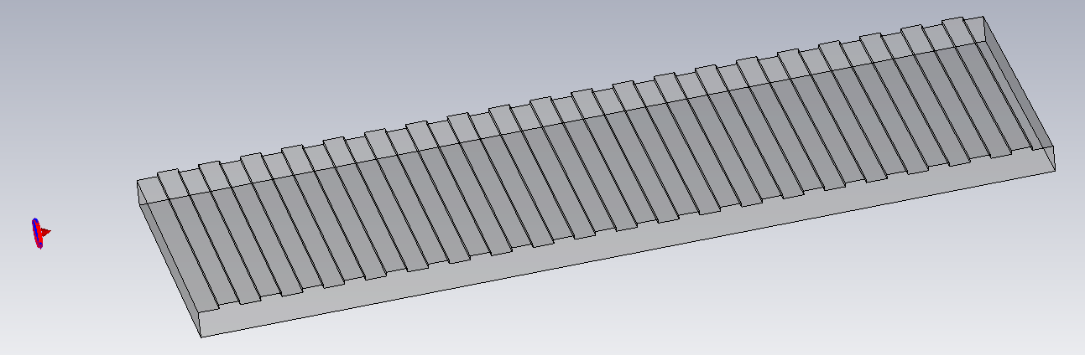
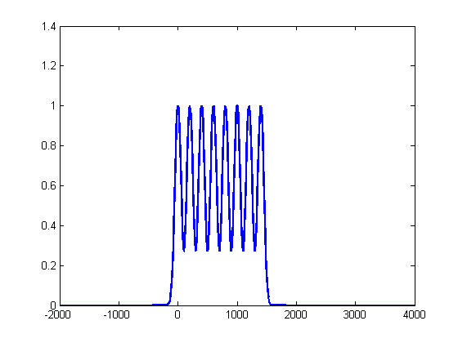
Coherent Smith-Purcell radiation (cSPr)
Planar 1D periodic structure
Electron beam
Metallic grating
x
observer
θ
e-bunch
y
z
Dispersion relation links radiated wavelength and observation angle θ
x₀

Slide 14
Pre-bunched electron beam
Single bunch
Coherent Radiation:
Bunch length < operating wavelength
Broadband spectrum
Limitation:
The tunability options are limited
Space charge limitations
Train of microbunches
Coherent Radiation:
Microbunch length < operating wavelength
Bunch periodicity ≈ central frequency of the spectrum i.e. operating wavelength
Number of microbunches ~ generated spectrum bandwidth
Limitation:
Lack of effective and compact beam modulation methods
Why do we need to have capabilities to measure the bunch profile or the distance between micro-bunches?

Slide 15
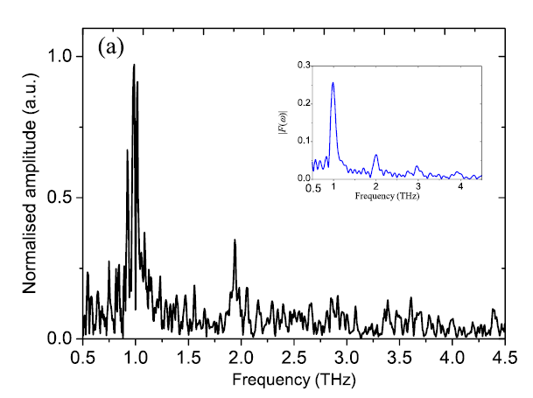
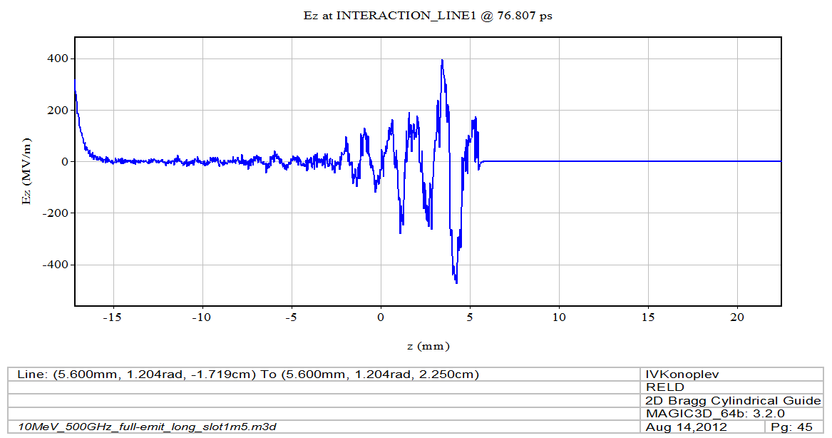

Motivations
The periodicity of the micro-bunches defines the generated frequency of the radiation
The distance between driver and witness
defines acceleration or deceleration
(i.e. EM radiation generation )
of the witness bunch
3. The longitudinal profile of the bunch
is an important parameter for particle
colliders and next generation FEL
THz radiation spectrum
Electron beam spectrum
Train of bunches had 300μm period and the fluctuations of the size and shape of the micro-bunches are possible reasons for the noise.
E
Decelerating bunch
E_{z}(MV/m)
Accelerating bunch
z(mm)
z(

Slide 16
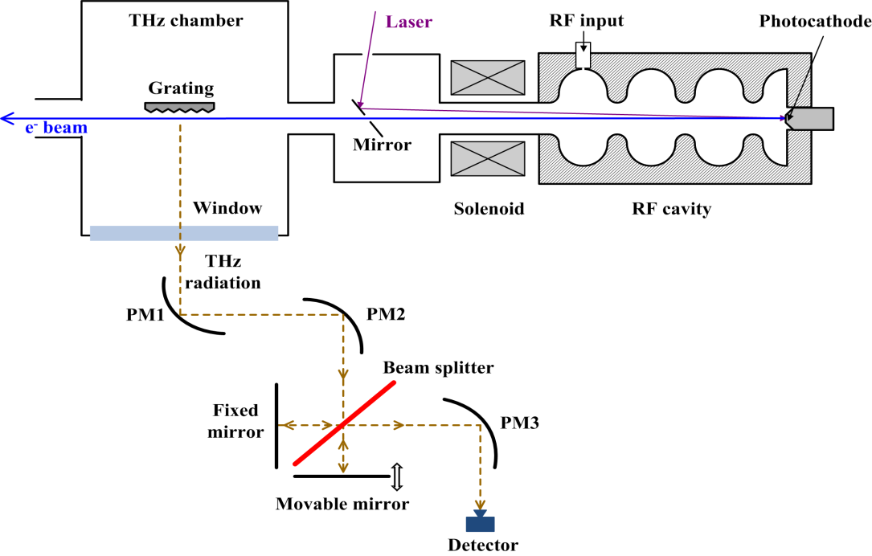

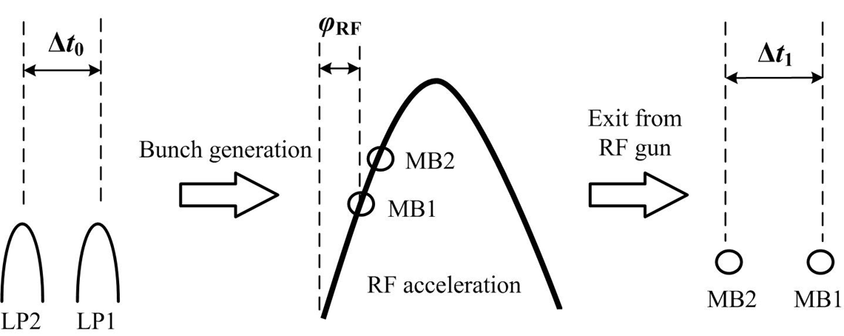
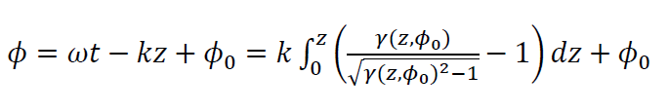


Example: Electron beam modulation at the photocathode
The model can be defined :
Position of the individual bunch in respect with the wave
Change of the single micro-bunch energy
Distance between micro-bunches

Slide 17
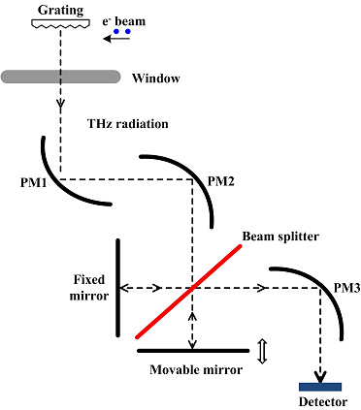
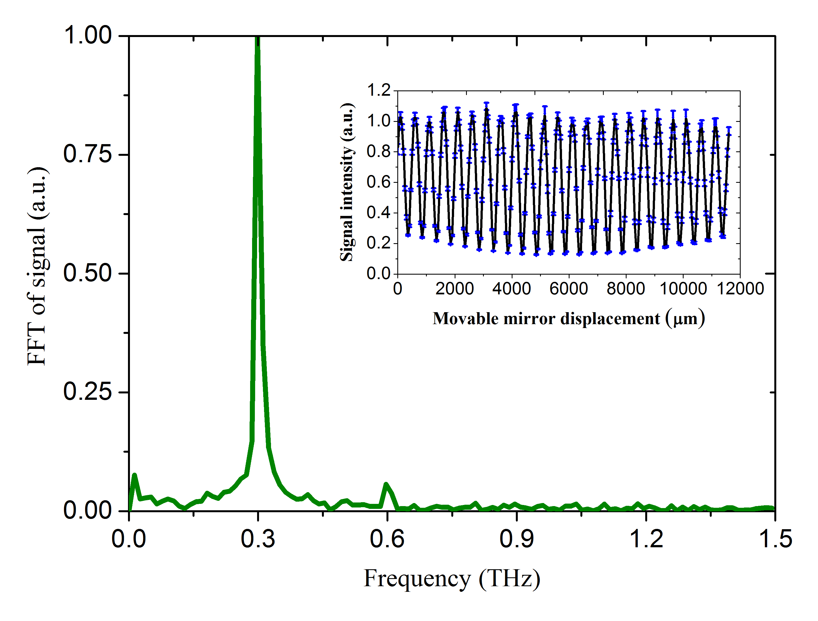
Monitoring the distance between two microbunches using cSPr
Two identical bunches and 1mm period grating
Spectrum measurements
Frequency (THz)

Slide 18
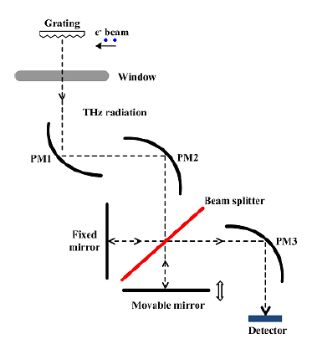
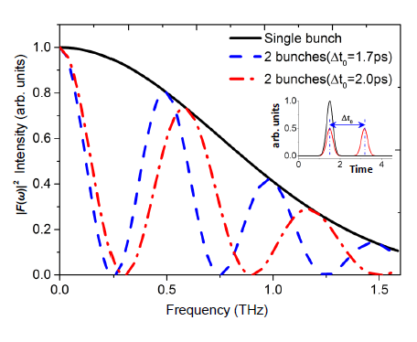
cSPr experimental data
1mm period grating, two identical bunches, changing the distance
Theoretical concept: amplitude modulation (AM) of the spectrum
0.3THz

Slide 19
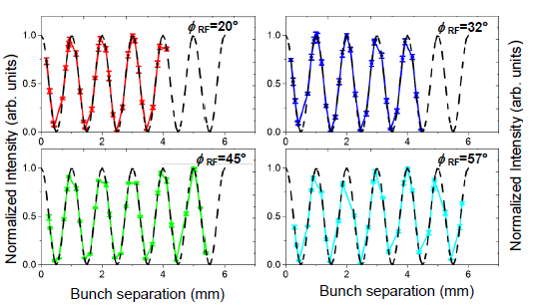
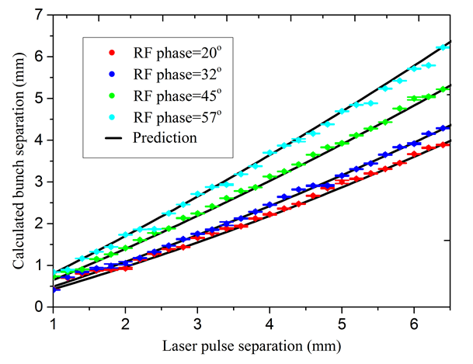
Monitoring the distance between microbunches via signal AM
Theoretical curve (black line) is defined by the model :
Position of the individual bunch in respect with the wave
Change of the single micro-bunch energy
Distance between micro-bunches
Intensity only depend on the bunch-bunch separation

Slide 20
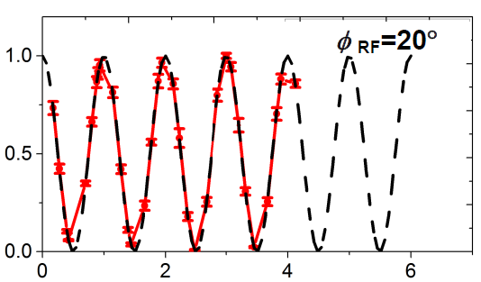
Monitoring the distance between the two microbunches via signal AM
To make measurements we need:
- a reference point ;
- second frequency measurements to resolve non-uniqueness
Distance (mm)
Solutions: 1. Zero point; 2. Two frequencies measurements

Slide 21
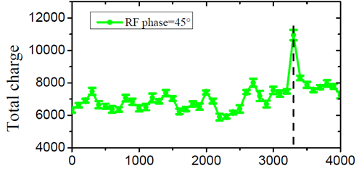
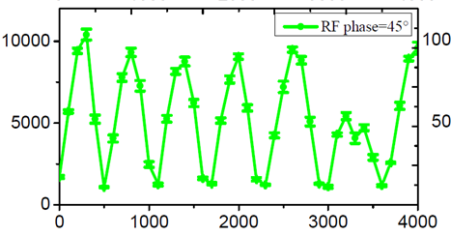
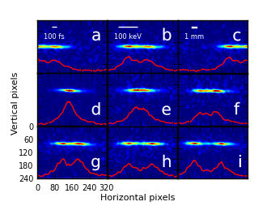
Experimental data: zero-reference point
Mirror position (um)
Mirror position (um)
Single bunch point
Mirror position defines the separation of the femtosecond laser pulses

Slide 22
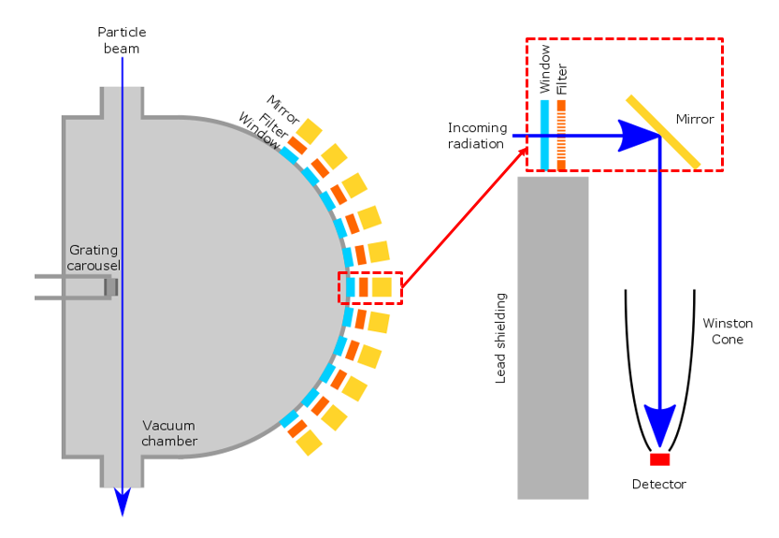
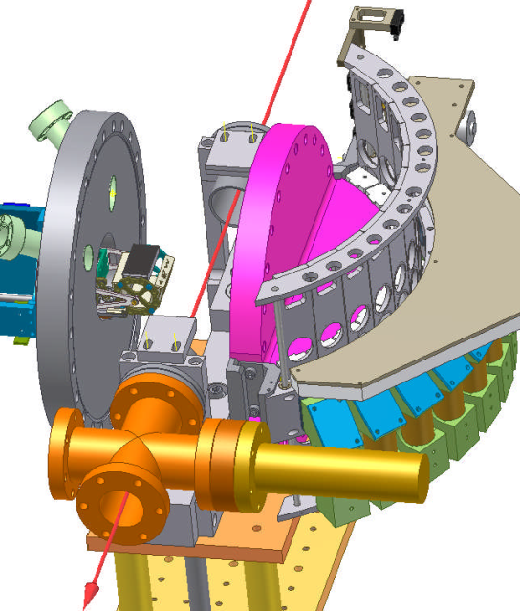
Multi-frequency monitor and multi-shot bunch profile monitor

Slide 23
Operation of single shot bunch profile monitor
Measure radiation output simultaneously in all detection channels
Remove background radiation from measured signal
Normalise the result for all other effects (e.g. transverse beam dimensions, grating profile etc.)
Phase reconstruction and FFT⁻¹ - Reconstruct longitudinal profile

Slide 24
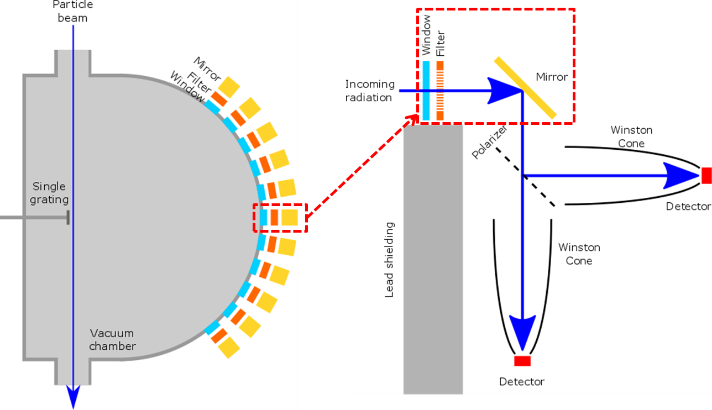
Single-shot monitor: Concept

Slide 25
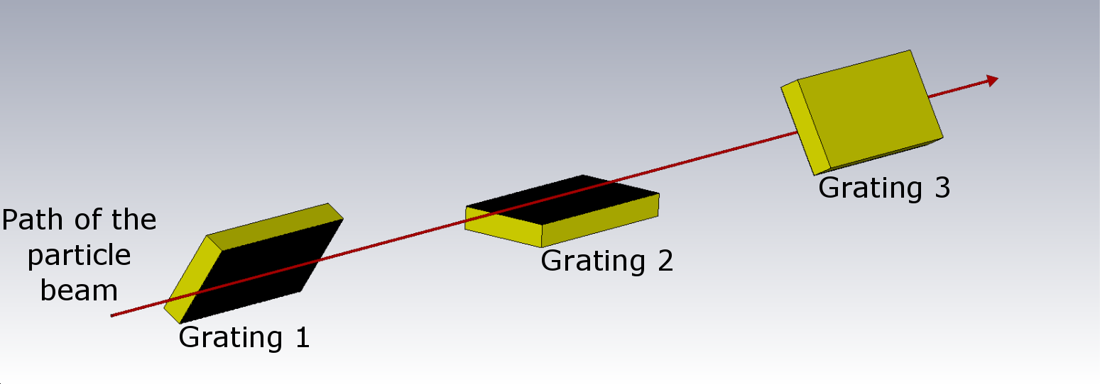
Multi-grating layout
Background radiation is subtracted via polarisation measurements and analysis
Gratings will be longitudinally spaced to avoid geometry problems
Rotated around azimuthal angle to reduce length of the apparatus

Slide 26
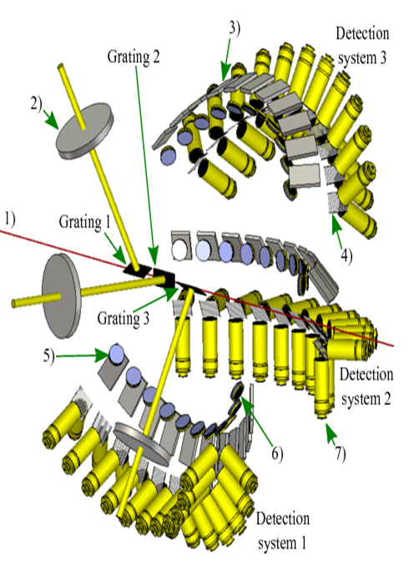
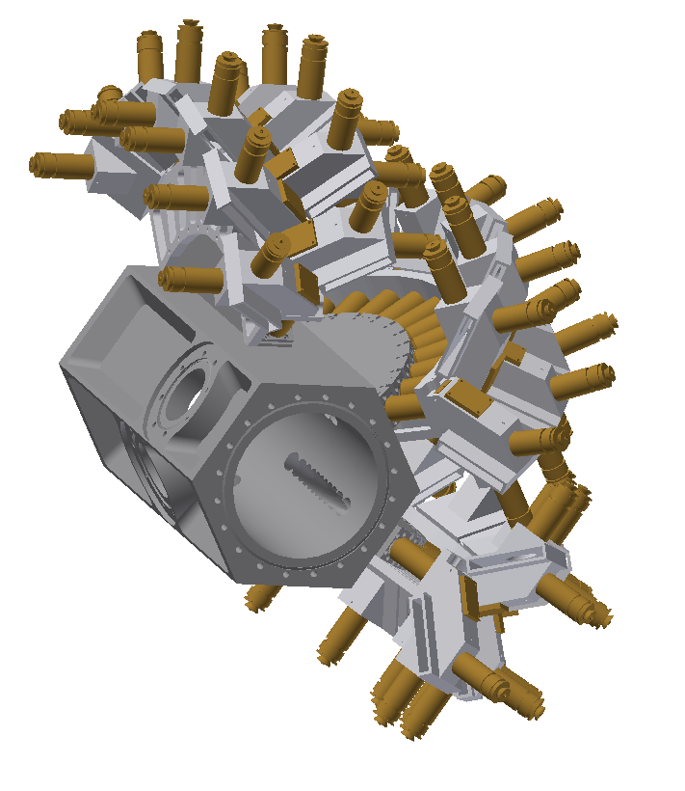

Single-shot design

Slide 27
Cost of the monitor with 33 channels
Part | Cost | Number of | Total (£)
Beam pipe | 15,367.68 | 1 | 15367.68
Support arm | 1,847 | 3 | 5541
Shield pipe | 20.25 | 33 | 668.25
Winston cone | 449 | 66 | 29634
Optics assembly | 898 | 33 | 29634
Mirror | 25.25 | 33 | 833.25
Filter mount | 157.75 | 33 | 5205.75
Vacuum window frame | 123 | 33 | 4059
 |  |  | 90942.93
Extras (guesstimates)
Electronics | 100 | 66 | 6600
Polarizers | 711 | 33 | 23463
Window | 300 | 33 | 9900
Pyro | 75 | 66 | 4950
Filter | 180 | 33 | 5940
 |  | Total: | 50853
 |  | Total with extras: | 141,795.93

Slide 28
Outline
Non-destructive monitoring of a microbunched beam and longitudinal bunch profiling using coherent radiation spectrum analysis
Introduction and Motivations
Concept
Design of the beam monitor
Asymmetric dual axis cavity for ERL (UH FLUX project)
Motivations
Fundamentals and Conceptual design
Preliminary design and the first results of the studies of the Pass-Band and High-Order Modes
Conclusion

Slide 29
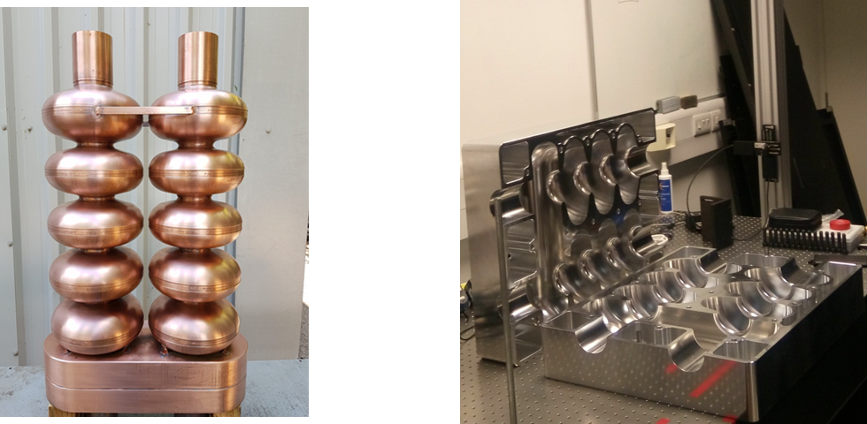
UH-FLUX: AERL
Aim
To surpass any existing designs of ERL in the e-beam current handling capabilities and footprint

Slide 30
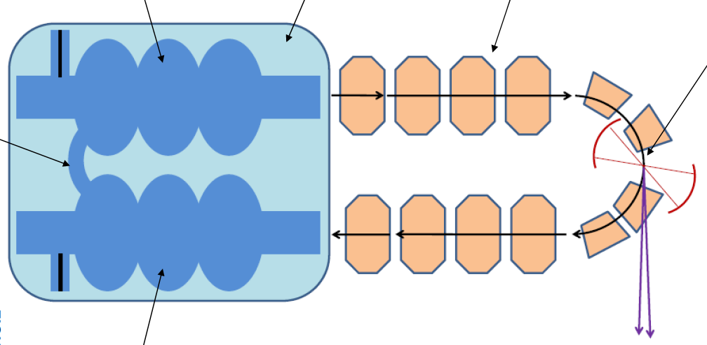
UH-FLUX project
Scientific Impact:
High Current ERL for Compton light source and FEL
Accelerating section
Cryo-module
Magneto-optical system
Interaction point
~0.5m
~2m
~0.6m
Decelerating section
~5m
X-ray, EUV/THz

Slide 31
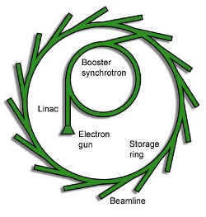
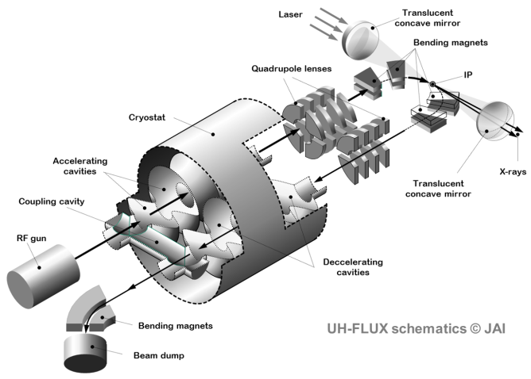
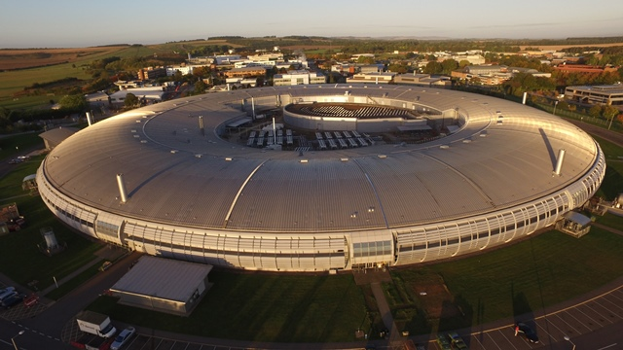
UH- FLUX: compact source of THz and EUV radiation
Very large current designs AERL
5 metre
100 metre +

Slide 32
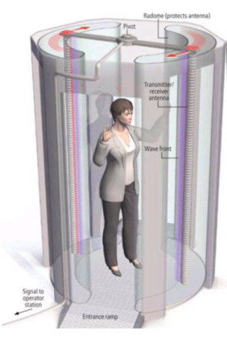
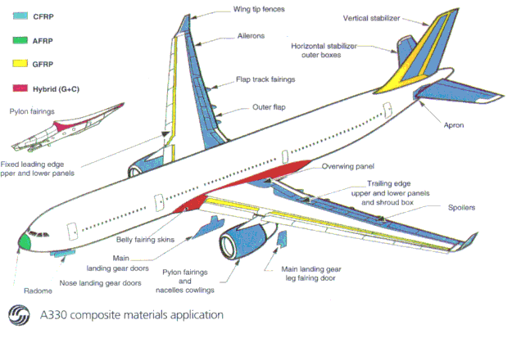
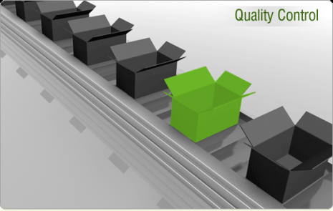


Motivations
Application in Ultra-High Intensity source of coherent radiation
THz Application: security Quality and contents control
EUV Applications: lithography - moving to ~10nm and QAs
>50% of advanced composite materials

Slide 33
Applications
THz Application: Produce radiation at high power (up to 1MW) from 0.1 THz to 10 THz
Markets (outside research laboratories):
Cargo Screening: The World Market for Explosives, Weapons, and Contraband Detection Equipment (EWC) is estimated to be some $2.1 billion annually¹
Replacing X-ray scanners: The global security screening market is expected to reach $9.10 Billion by 2020²
Non-contact imaging of coatings and composites, material quality control, drug formulation
¹The Market for Explosives, Weapons and Contraband (EWC) Detection Equipment – HIS Technology, 2014 Edition
²Security Screening Market - Analysis and Forecast 2013-2020 – MarketsandMarkets, 2014 Edition
EUV Applications: Generating electron beams of typical energy of 10-30 MeV and current above 1A to generate high flux (10¹⁸ -10²⁰ photon per second) of radiation from 1nm to 10nm wavelengths range
Markets (outside research laboratories):
Non-destructive sources and material/medical diagnostics research market
Lithography for the £332 billion Semiconductor Industry: $7 billion market in 2014³
³Investor Day, ASML Small Talk London - 2015

Slide 34
Proposal: UH-FLUX project
Challenges
Decelerated beam excites HOMs in the SRF cavity (if the same cavity cells are used accelerated beam will also contribute to the excitation of HOMs)
HOMs have high Q-factor leading to accumulation and gradual amplitude gain (balance between the amplitude gain and losses in the cavity – start current for the BBU instabilities)
If the e-beam current is high i.e. gain is above losses, the accelerated beam is affected by the accumulated HOMs (BBU instability)
Solutions
Separate accelerating and decelerating cells
Tune accelerating and decelerating sections to separate partial HOMs i.e. localise them
Accelerated and decelerating beams go always through separate accelerating and decelerating sections, after deceleration the beam goes to the dump
Connect the sections by resonant coupling cavity cell to allow accelerating mode to operate in both sections
Left challenges to resolve
HOMs are still excited in decelerating section and will limit the total current driven through the decelerating section.

Slide 35


UH-FLUX: AERL
Decoupling all partial modes except the accelerating mode
Acc. mode
One of the HOMs

Slide 36


Experimental studies
- 7 cell cavity prototype is machined using computer controlled lathe from 2 blocks of solid aluminium.
- The cavity is to develop RF techniques of such cavities study
- Conduct preliminary RF measurements
- 11 cell full scale cavity copper prototype is machined using conventional technology.
- Machined using similar process developed for SCRF cavities.

Slide 37
Proof of the concept experimental studies
Aluminium 7 cells cavity

Slide 38






UH-FLUX: AERL 7 Cell cavity
$$f=1.300144 GHz$$
$$f=1.279688 GHz$$
$$f=1.099712 GHz$$
Operating mode
Parasitic asymmetric mode
Coupling bridge mode
Results observed using CST- Microwave studio

Slide 39

Experimental studies: proof of the concept
Aluminium 7 cells cavity
Aim:
- to identify the cavity modes: operating and HOMs
- to compare with numerical data

Slide 40


Scaled down prototype of the cavity
7 cells cavity: 3- accelerating; 3 decelerating and coupling cavity
Bead pull pillars
7 cells asymmetric cavity made from 2 blocks of solid aluminium
Accelerating section
Decelerating section
Resonant coupler
VNA
Bead pull RF measurements test bench

Slide 41


Starting measurements
Measuring S₁₁ and S₂₁ parameters as well as field structure
2
4
5
1
3

Slide 42

S₂₁ measurement
2
4
1
3

Slide 43

Close up of PB modes
Experimental measurement dashed line and fitted data solid line

Slide 44


Eigenmodes of the 7- Cell cavity
Predicted by CST Microwave studio
Field structures of the eigenmodes predicted by CST

Slide 45


Pass band modes: experiment and theory
First comparison of the pass band modes measured (solid line) with the numerical predictions dashed line. The measurements were carried out at a single axis.
LOM

Slide 46

Pass band modes experimental studies at two axes
evanescent coupling
The RF coupler is located on one axis (active) while the field measurements are conducted on both axes
evanescent coupling
normal coupling
Red line active axis
Blue line passive axis
evanescent coupling
normal coupling
evanescent coupling
normal coupling

Slide 47



HOMs measurements
HOMs localisation at one or another axis
The RF coupler is located on one axis (active) while the field measurements are conducted on both axes
Red line active axis
Blue line passive axis

Slide 48

14 first HOMs and the Bridge mode
centre of the bridge

Slide 49


Cavity optimisation
Risk points due to high field intensity on the surface
Other risk factors:
Multipacting
Proximity on modes to operating mode
Cost
Tesla like cavity (TT)
Low Loss like cavity (LL)

Slide 50
Cavity optimisation
TT&LL+TT cavity
TT&LL cavity
LL&TT+LL cavity

Slide 51



Cavity optimisation
- Improved but did not resolve completely high field risk
- Improved but did not resolved the modes proximity
- Did not resolve the challenge with multipacting

Slide 52
JLAB dual axis cavity
The cavity was used as a prototype during the optimisation
It was considered as an indication that such structure can be machined

Slide 53

Bridge optimisation
- Resolved high field risk
- Improved the modes proximity
- Resolve the challenge with multipacting

Slide 54
Outline
Non-destructive monitoring of a microbunched beam and longitudinal bunch profiling using coherent radiation spectrum analysis
Introduction and Motivations
Concept
Design of the beam monitor
Asymmetric dual axis cavity for ERL (UH FLUX project)
Motivations
Fundamentals and Conceptual design
Preliminary design and the first results of the studies of the Pass-Band and High-Order Modes
Conclusion

Slide 55
Conclusion: Plans and Collaborations
Demonstrate operation of a single shot cSPr bunch profile monitor
Demonstrate operation of the microbunch monitor to study beam microbunching and THz radiation generation.
Collaborations: INFN Frascati, CLARA Daresbury Laboratory (UK), Tsinghua University (China), and we are looking for other possible partners
….
Continue studies of the RF properties of the cavity
Design, construct and study the SRF dual axis asymmetric cavity
Build the ERL based on such a SRF cavity
Collaborations: The main partner at this stage is JLab (USA) but we are looking for new partners (including MEPhI, Russia; Tsinghua University, China) and happy to collaborate and work together

Slide 56
Conclusion
We designed and constructed (90% ready) the single short cSPr monitor for profiling the sub-picosecond electron bunches
The proof of principles experiments showing the measurements of the distance between two microbunches were carried out and the results were published
……
The aluminium (7-cells) and copper (11-cells) dual axis asymmetric cavities were constructed
Preliminary studies of HOMs and path-band modes were carried out
The first design of the SRF dual axes asymmetric cavity has been completed
I am looking for collaborators and funds to continue this work
Thank you

Slide 57

Injection
dump

Slide 58


Preliminary experiments at LUCX
The detector bandwidth is from 0.3 THz to 0.5 THz, which limits the transition radiation spectrum.
Grating period 1mm, radiation at 90 degrees, the
Smith-Purcell radiation frequency is 0.3 THz.
0.27
0.46
Transition radiation
Smith-Purcell radiation

Slide 59

Introduction

Slide 60

Experiment 1: Bunch separation measurement
Aim to validate bunch train periodicity measurements
Observe at a single position (frequency)
Vary:
Measure:
Calculate:
Bunch number (2 to 4+?)
Bunch separation (0.6 to 2 ps, steps of 0.1 ps)
Radiation intensity
Radiation frequency
Observe the grating at 90 degrees
with a Fabry-Perot interferometer
Bunch separation

Slide 61

Experiment 1: Bunch separation measurement
For example: 4 and 8 bunches
f=1 THz
Control beam parameters
Bunch charge;
Bunch modulation depth;
Bunch transverse profile;
Normalised intensity (a.u.)
Δt
Bunch separation (ps)
FWHM (Full width at half maximum) Δt ∝ 1/N (N: bunch number)

Slide 62

Experiment 2: Radiation characterization
Aim to confirm SPR as a
suitable THz radiation source
Observe at several positions
Vary:
Measure:
Multiple frequencies of radiation
Bunch separation (0.6 to 2 ps)
Radiation intensity
Radiation frequency
Radiation polarization

Slide 63




(f=1.5THz, θ=70º)
(f=1.25THz, θ=78º)
(f=1THz, θ=90º)
(f=1.5THz, θ=70º)
(f=0.75THz, θ=110º)
(f=2THz, θ=60º)

Slide 64
Single-shot longitudinal bunch profile monitor
Challenges
Background Radiation
Use the polarisation of Smith-Purcell to separate the signal from the background
The cSPr “cross-talk” – Previously three gratings were on a carousel
Have separate inclined gratings with separate arrays of detectors located at different azimuthal angles
Broad-band signal: calibration and finding appropriate detectors and optics very big challenge
Each detector channel is tuned for a specific frequency

Slide 65

Proposal: UH-FLUX project
Scientific Impact:
The bunched beam electron cooling for Electron Ion Collider:

Slide 66




Eigenmodes of the 11 Cell cavity
axis
1
2
1
2
1
2
axis
1
2
1
2
1
2
axis
1
2
1
2
1
2
Different for different axes
Different for different axes

Slide 67



PB modes structure comparison
Operating mode – solid line
Neighbouring modes dashed lines
Solid line – experiment
Dashed line - predictions
6
7
5
6

Slide 68

Cavity optimisation
TT&LL cavity with the original bridge
Original cavity TT&TT
& - indicate bridge

Slide 69

UH-FLUX: AERL

Slide 70

Results of the Q-factor measurement
6
1
2
4
3
7
5
Multiple dots indicate slightly different positions of the couplers. The “blue” shift of the eigenmode positions in the predictions as compared to the measurements can be due to machining accuracy and assumption of vacuum in case of the CST simulations

