Slide 1
First Direct Observations of Gear-Changing in a Collider
Edith Nissen
Jefferson Lab Accelerator Seminar
10/15/2020

Slide 2
Contents
Background on Gear-Changing
Background on DESIREE
Overview of the DODGE program
Methods used in the program
Measurements of the 4 on 3 system
Measurements of the 5 on 4 system
Signs of Interactions
Future Work
Conclusions

Slide 3
Gear Changing
Gear Changing
3
During low energy operations with the Jefferson Lab EIC design, the velocities of the electrons and ions would not have matched.
Allowing for different harmonic numbers in each ring would take advantage of this to keep the collisions synchronized.
We looked at testing this at RHIC, but it was considered too invasive.
This scheme would reduce systematic error, but could lead to destructive resonances.
4
2
1
a
b
c

Slide 4
Gear Changing Pattern
In a gear-changing system each bunch interacts with each other bunch
This can reduce systematic errors
This also increases the amount of time it takes for the bunches to equilibrate with each other
There was a resonance condition theorized as:

Slide 5
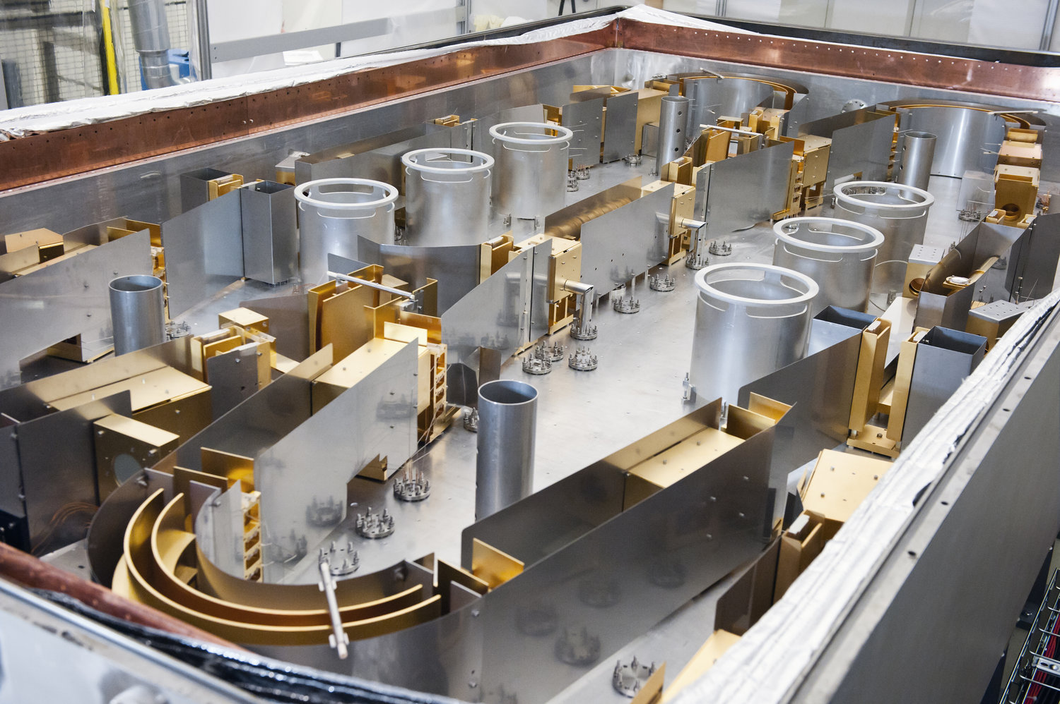
DESIREE Background
Double Electro-Static Ion Ring ExpEriment
Located at Stockholm University, in Sweden.
Up to 25 keV on up to 100 keV singly, oppositely-charged, ions.
Currently matches velocities to study neutralization reactions in the interstellar medium.
A part of the Swedish national infrastructure.

Slide 6
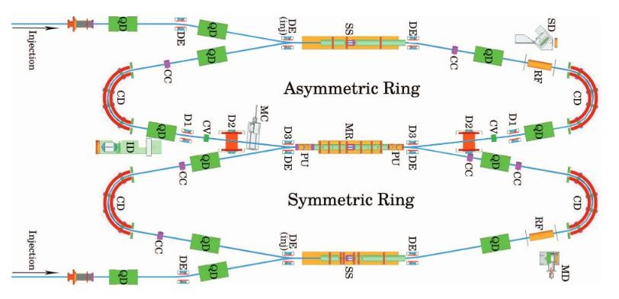
DESIREE: Layout
Pickups (BPMs) on either end of the merger region
RF is handled via a pair of Schottkey cavities

Slide 7
The DODGE Program
DODGE stands for Direct Observations in DESIREE of Gear Changing Events
Goals of the program
Demonstrate a gear changing system
Develop tools and techniques to fully understand this system
Determine the limits of research into gear changing that can be done using DESIREE

Slide 8
DODGE: History
At IPAC 2017 in Copenhagen the people at Stockholm University had a poster →
Later that summer, realized it could be used to show Gear-Changing
Several funding avenues were pursued
Go ahead given in Summer of 2019

Slide 9
DODGE: outline
Initial goal would be a 4 on 3 gear changing system.
Use 14.3 keV Nitrogen and 6.97 keV carbon
4 on 3 program
Setup of the bunched beam structure
Missing bunch experiment
Full bucket gear changing experiment
5 on 4 program
5 on 3 program
Future work

Slide 10
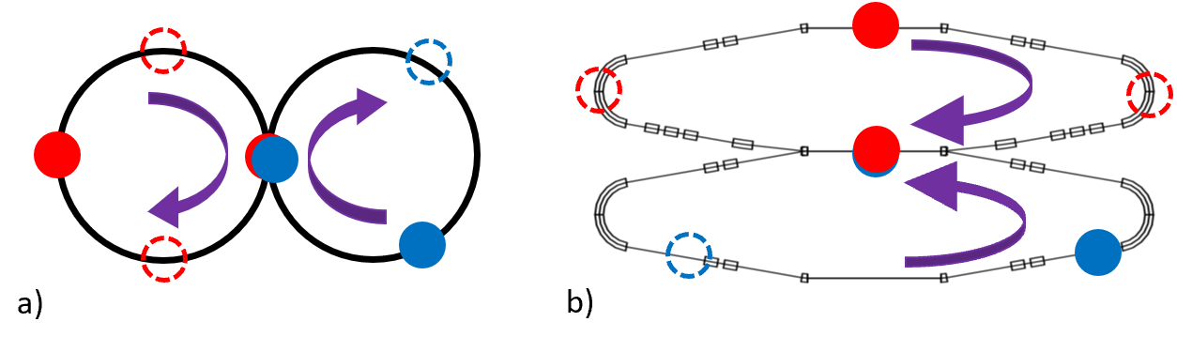
Missing Bunch Expectations
voltage
time

Slide 11
Full Bunch Experiment
The distance between the constituent peaks of the bunches is called the “overlap parameter”
In a properly synchronized system they will form a symmetric pattern
This is due to the nitrogen bunch passing though the carbon bunch

Slide 12
DODGE initial experiment
Two days were available in October of 2019, so we sought to answer some questions.
Performed remotely
Could bunch structures be made to perform the planned experiments
Both Missing Bunch and Full bucket
Was RF necessary for long term storage of the beams

Slide 13
Is RF Absolutely Necessary?
Yes

Slide 14
Bunch Lengths
4V RF
0 turns
1000 turns
0.4V RF

Slide 15
Missing Bunch Experiment

Slide 16
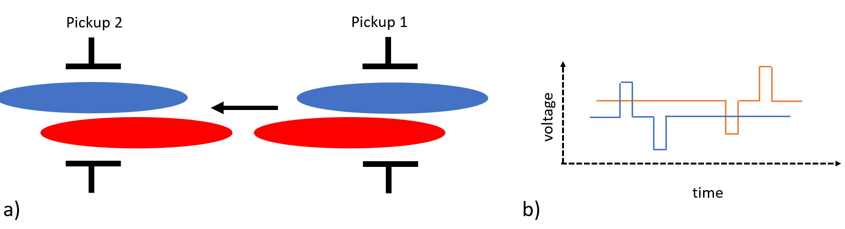
Full Experiment

Slide 17
Results of DODGE-0
The bunch structures we need are possible
RF is necessary
The timing is such that we should see the type of symmetric pattern we expected to see
Full experiment – DODGE 1, was scheduled for May of 2020

Slide 18
DODGE-1
Perform Missing Bunch Experiment 4 on 3
Perform Full bucket Experiment 4 on 3
If there is time
5 on 4 missing and full
5 on 3 missing and full
Due to COVID-19 travel restrictions this was performed remotely via zoom.

Slide 19
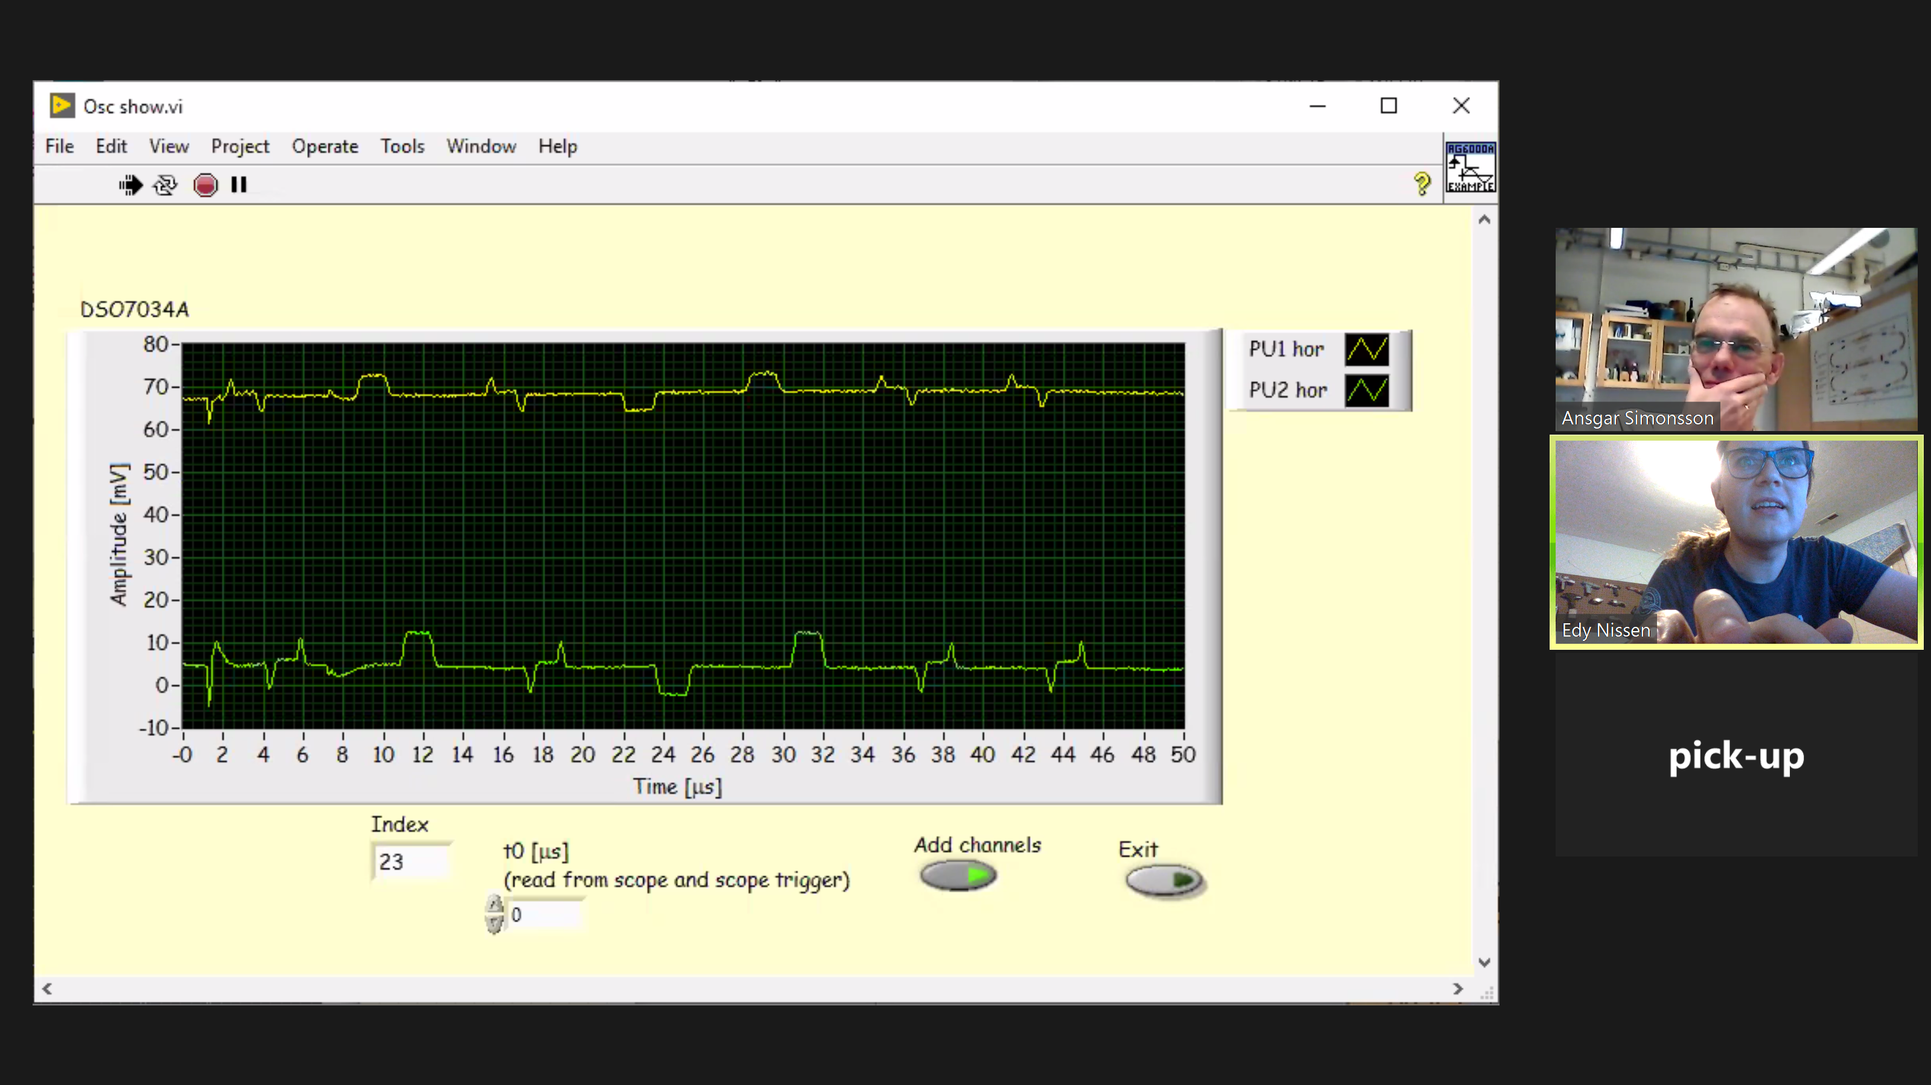
4 on 3 system

Slide 20
Missing Bunch Data (collisions)
475 Turns
Start
950 Turns

Slide 21
Missing Bunch Long Term
3500 Turns
Start
7500 Turns

Slide 22
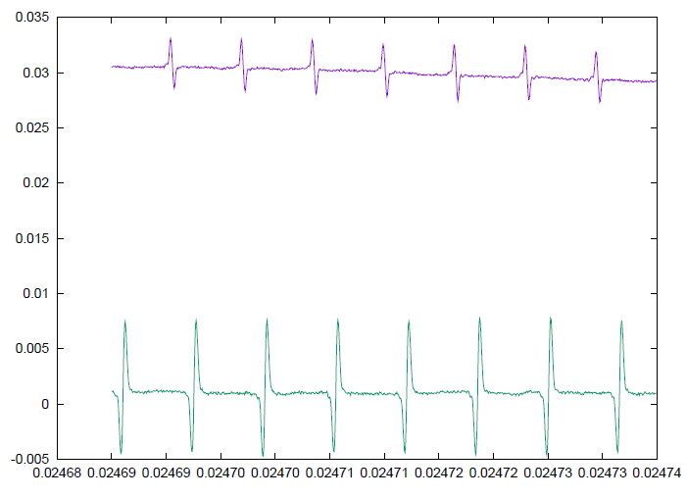
4 on 3 results
475 Turns
Start
950 Turns

Slide 23
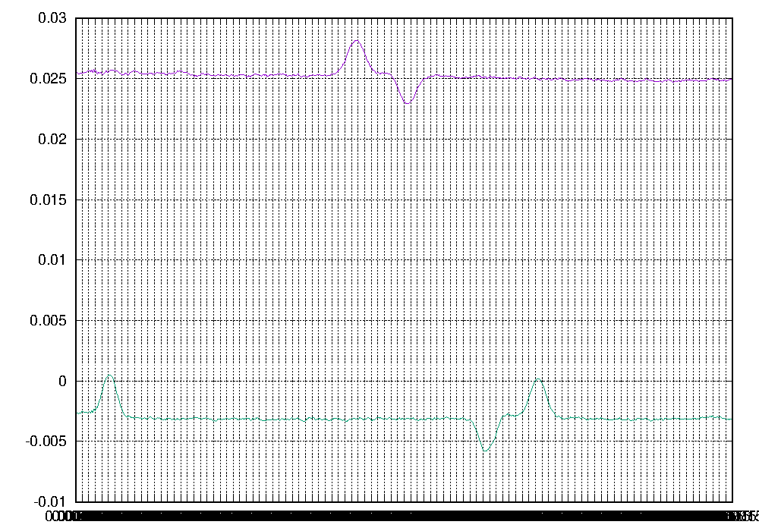
4 on 3 Zoomed in

Slide 24
5 on 4 results
475 Turns
Start
950 Turns

Slide 25
5 on 4 Results
3500 Turns
Start
7500 Turns

Slide 26
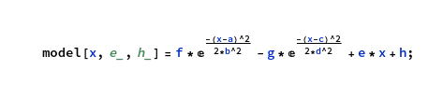
4 on 3: Fitting the data
The objective function used to fit the data is shown in:
It can be used both to determine the overlap parameter, and check the timing of uncollided bunches from the missing bunch experiment.
Fitted

Slide 27
4 on 3: evolution of bunch length

Slide 28
4 on 3: Synchrotron Motion
2.5 V C RF
3.0 V C RF
3.5 V C RF
4.0 V C RF

Slide 29
4 on 3: Fitting the timing
Swings occur due to the order of the uncollided bunches
Deviations occur because the snapshot didn’t have one or both of the uncollided bunches in them.

Slide 30
4 on 3: Fitting the timing part ii

Slide 31
4 on 3: fitting collisions
Unconstrained Fit
Uses maximum and minimum values in the area in question to place the carbon and nitrogen bunches respectively.
These values also act as the starting point for the magnitude of the bunches
A guess of 150 ns was used as the initial bunch σ
Constrained
Uses magnitude and beam σ measured from the uncollided bunches in the missing bunch model (interpolated if absent)
These are constrained to 10%
The initial distances between the carbon and nitrogen beams are taken from the min and max, and scaled to the theoretical value of 271 ns

Slide 32
4 on 3: Overlap Parameter for missing bunches

Slide 33
4 on 3: Overlap Parameter missing bunches (Cont’d)

Slide 34
4 on 3: Full Bunch

Slide 35
4 on 3: Full Bunch continued

Slide 36
5 on 4 system
a.k.a It’s better to be lucky/unlucky than smart

Slide 37
5 on 4: Timing
Blue and yellow denote pickup 1, red and green denote pickup 2
The wider swings for pickup 1 indicate that the nitrogen bunch enters the merger region late, and the collision takes place farther down the merger region than in the 4 on 3 version.

Slide 38
5 on 4: Collisions (missing bunch)

Slide 39
5 on 4 Collisions (missing bunch ii)

Slide 40
5 on 4 collisions full buckets

Slide 41
5 on 4 collisions full buckets ii

Slide 42
Why is this lucky/unlucky
This was helpful in that we still had a gear changing system (it just wasn’t centered correctly), but also showed that our analysis methods work.
There’s always a risk with these types of constrained metrics that it will give back what you ask of it, but we didn’t see that here.
This gives us a lot of confidence that the conclusions from the other data are correct.

Slide 43
Potential signs of Beam-beam Interactions
Originally a plan to have the GHOST program help with simulations of the system, however that did not happen.
We made an estimate of the interactions, since the bunches move in the same direction the integration length is much longer, in an n(n-1) system you get a beam-beam tune shift increase of approximately 2n.
For a 1 mm offset in one carbon bunch, there would be a 1.2 nm offset in one of the nitrogen bunches.
We did not expect to see incoherent beam-beam effects in these experiments

Slide 44
Potential Signs of Beam-Beam Interactions
There were some indications that there may be more going on. These energies are low enough that the EM interactions are 3-D, and are quite complex.

Slide 45
Potential Signs of Beam-Beam Interactions
Some attempts were made to quantify this effect
The tools are not sufficiently developed to pick them out of the current data set
We attempted to extract kurtosis and skewness from these distribution measurements to see if they showed a pattern
While there was a difference between bunches with collisions and those without, there was no pattern
A more sensitive Oscilloscope may help with this
Better simulations will also help

Slide 46
Potential Signs of Beam-Beam Interactions
Another potential way to detect interactions is a time of flight measurement.
Based on current numbers we would only expect <5 ns but with higher currents and different ions we could get above 10 ns which would be measurable with more sensitive

Slide 47
Future Work
Test uncollided bunches as a synchronization method
Significantly increase number of slices to look for potential interactions in the longitudinal oscillations due to synchrotron motion
Perform 5 on 3
More detailed time of flight measurements
May require new oscilloscope
Bunch Profile Evolution
Most likely requires a new oscilloscope
Could conceivably do a longitudinal tomography experiment
Increased number of bunches
Better simulations
Needed for most of the experiments
Currently investigating WARP as a possible code

Slide 48
Conclusions
Gear changing was demonstrated for the first time on May 27, 2020
Analysis of the data suggests using the missing bunch signals would be a more accurate method of synchronizing the beams
4 on 3 and 5 on 4 systems have been shown
There is some evidence of measurable beam-beam interactions, this deserves further study
There is a lot of room for more study of gear-changing using DESIREE

Slide 49
Thank You For Your Attention

