Slide 1
Performance, Reliability and Maintenance of the SNS Superconducting Linac and its upgrade
Presented at
Accelerator Seminar, Jefferson Lab.
June 18, 2020
Sang-ho Kim
Spallation Neutron Source
Oak Ridge National Lab.

Slide 2
Outline
SNS and SNS SCL overview
SNS operational statistics
SCL performance and maintenance
Proton Power Upgrade (PPU) Project
Summary

Slide 3
SNS and SNS SCL overview

Slide 4
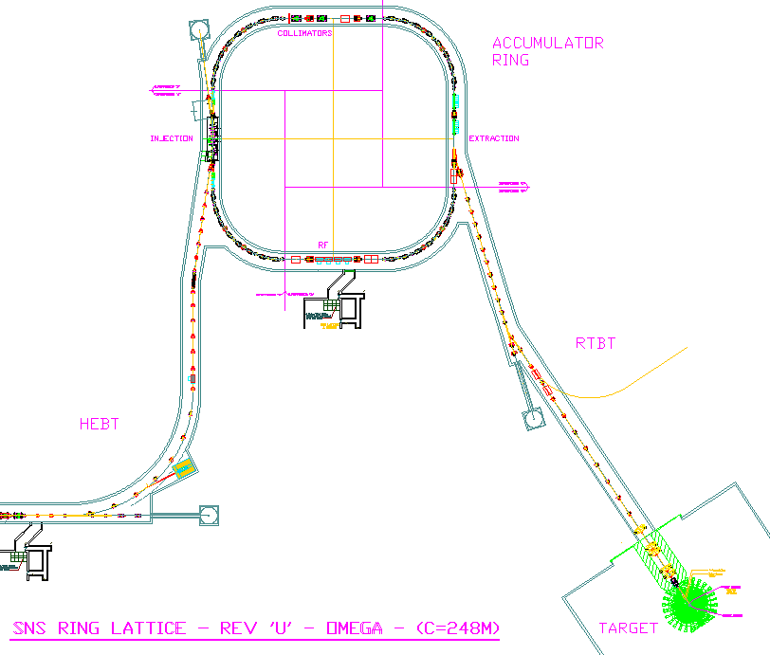


SNS machine layout
Ring: Accumulate 1-ms long pulse to 700 ns
Front-End: Produce
a 1-ms long, chopped, H-beam at 60 Hz
H- stripped to p
Linac; 1 GeV acceleration
402.5 MHz
805 MHz
DTL
CCL
SRF, β=0.61
SRF, β=0.81
upgrade
Liquid Hg Target
2.5
86.8
186
387
1000 MeV
259 m
157 m
71 m
Chopper system makes gaps
945 ns
mini-pulse
Current
Current
1 ms
1 ms macro-pulse
Average macro-pulse beam current: 26 mA

Slide 5
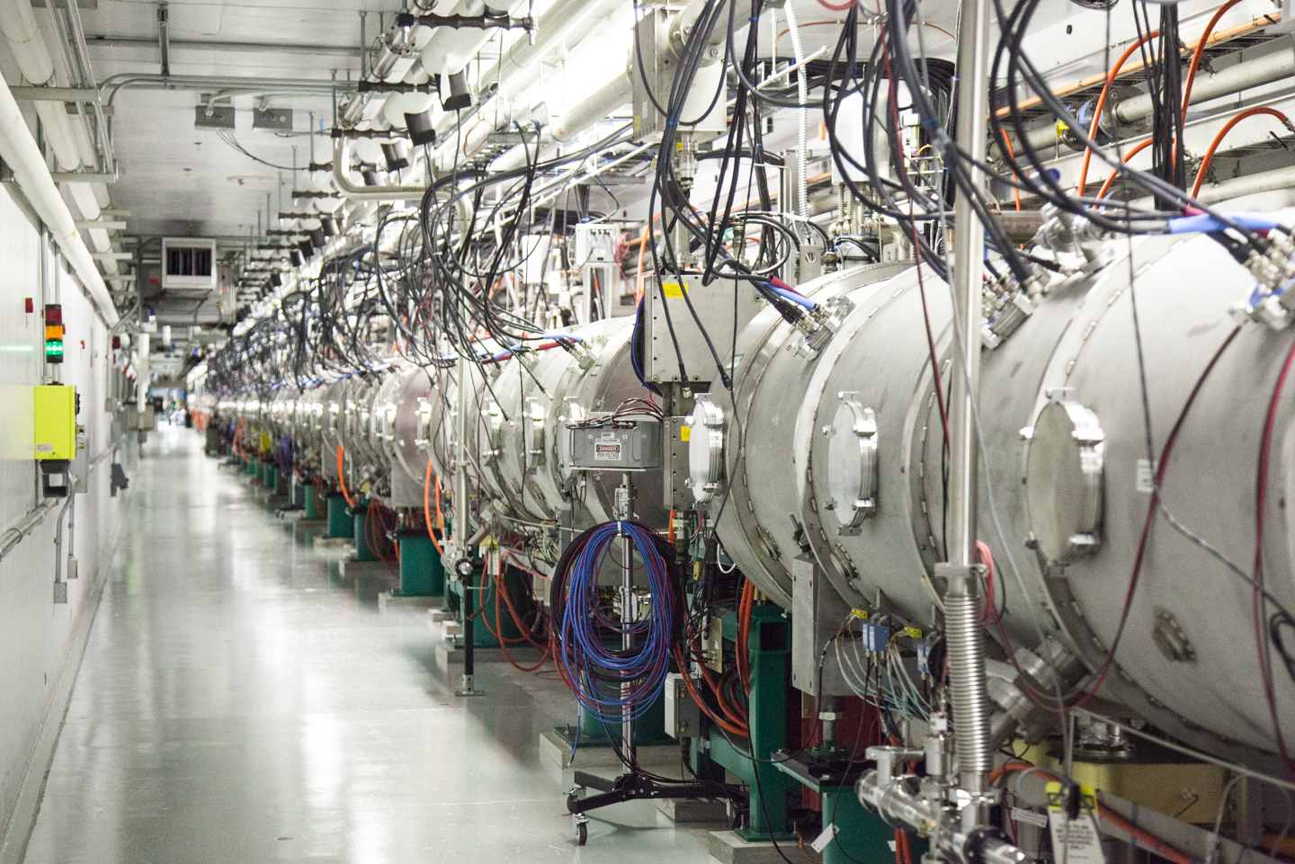
SNS superconducting linac
The first SRF technology for large scale pulsed proton machine
Designed for H- beam acceleration from 186 MeV to 1000 MeV
Two types of cavity geometries to cover board range of particle velocities
33 medium beta (β_{g}=0.61) SRF cavities
48 high beta (β_{g}=0.81) SRF cavities
157-m long, 81 independently powered 805-MHz SRF cavities in 23 cryomodules
71-m long space is reserved for energy upgrade

Slide 6
SNS cryomodule design basis
Cryomodule: similar construction arrangement employed in CEBAF (space frame, end-cans, etc.)
Cryogenics
Heat exchanger for primary in return end-can
FPC outer conductor cooled by 5-K supercritical helium
Fundamental power coupler (FPC): scaled from KEK 508-MHz coupler
HOM coupler: scaled from TTF HOM coupler in case of large HOM induced power
Mechanical tuner: adapted from Saclay-TTF design
Piezo tuner: adapted later. Integrated into one of tuner mounting legs in case of unexpected large LFD
End-group material: Reactor grade niobium

Slide 7
SNS Operation and operational statistics

Slide 8
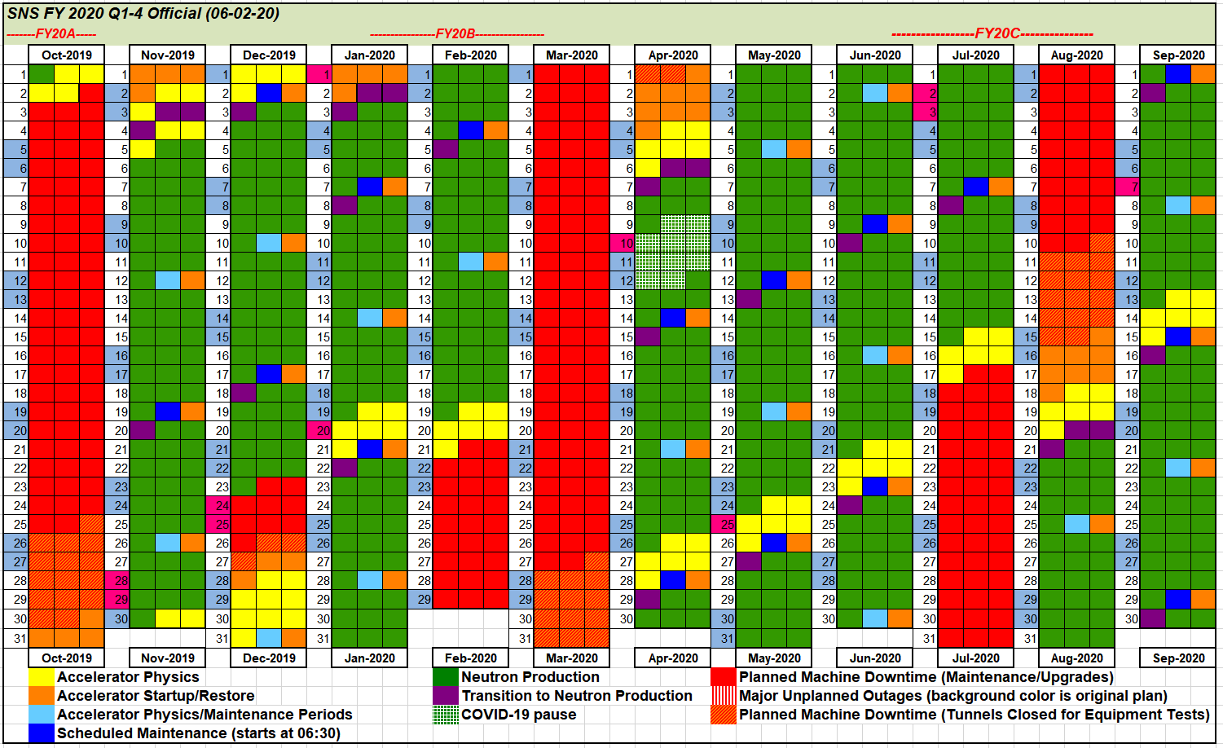
SNS operation schedule
Planned neutron production hours in recent years: 4,700~4,900 (green)
Input from ‘target management plan’ and major maintenance activities
Goal in near future: 5,000 planned hours at > 90% availability

Slide 9
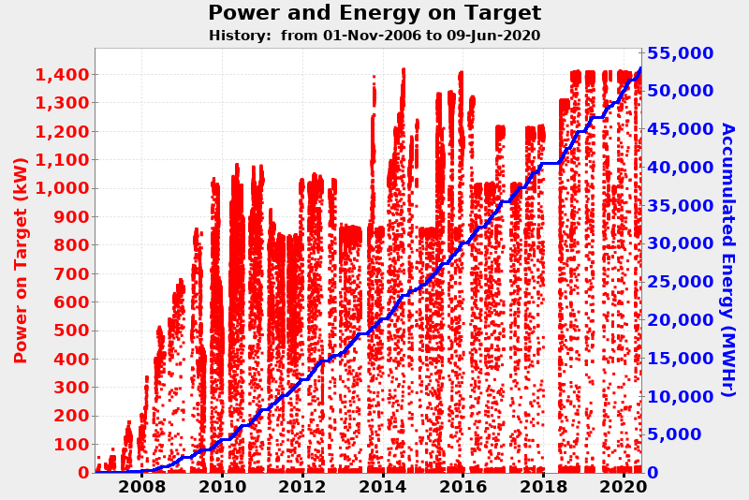
Beam power on target since FY07
Various issues has been encountered and addressed
SNS has achieved a stable operation at 1.4 MW

Slide 10
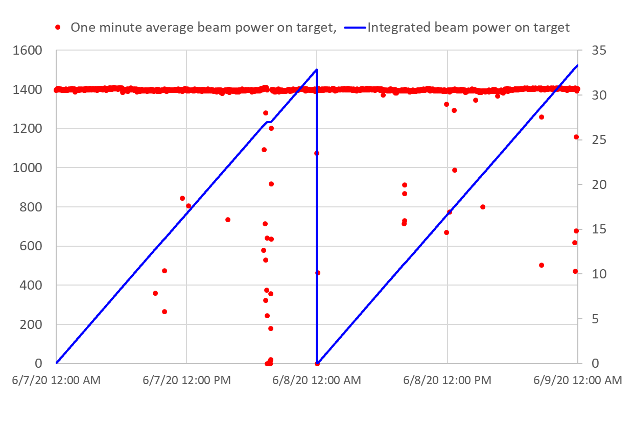
Overall machine performance in FY20
Operational reliability remains excellent
Overall machine availability for neutron production in FY20 to date: 95%
Beam Power on Target (kW)
Integrated beam power per day (MWh)

Slide 11
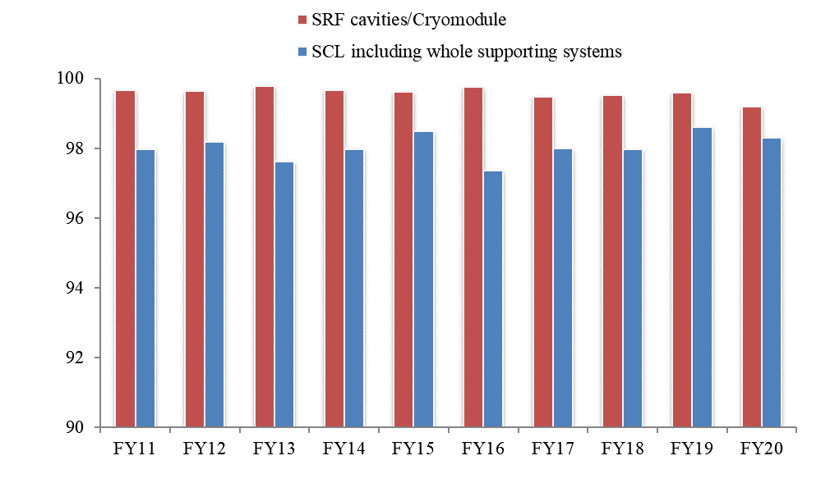
SCL Reliability
Availability last 10 years:
Whole SCL system including CHL, RF, HVCM, Control, Vacuum, etc.: 98.1 %
SRF cavities/cryomodules: 99.6%
Average trip or downtime: <1 trip/day corresponding to <5 min./day
Sustainability for the future and cavity performance improvement
In-situ and/or offline repairs
Developed spare cryomodules
Deployment of in-situ plasma processing
Availability (%)
Up to 6/9

Slide 12
SCL performance and maintenance

Slide 13
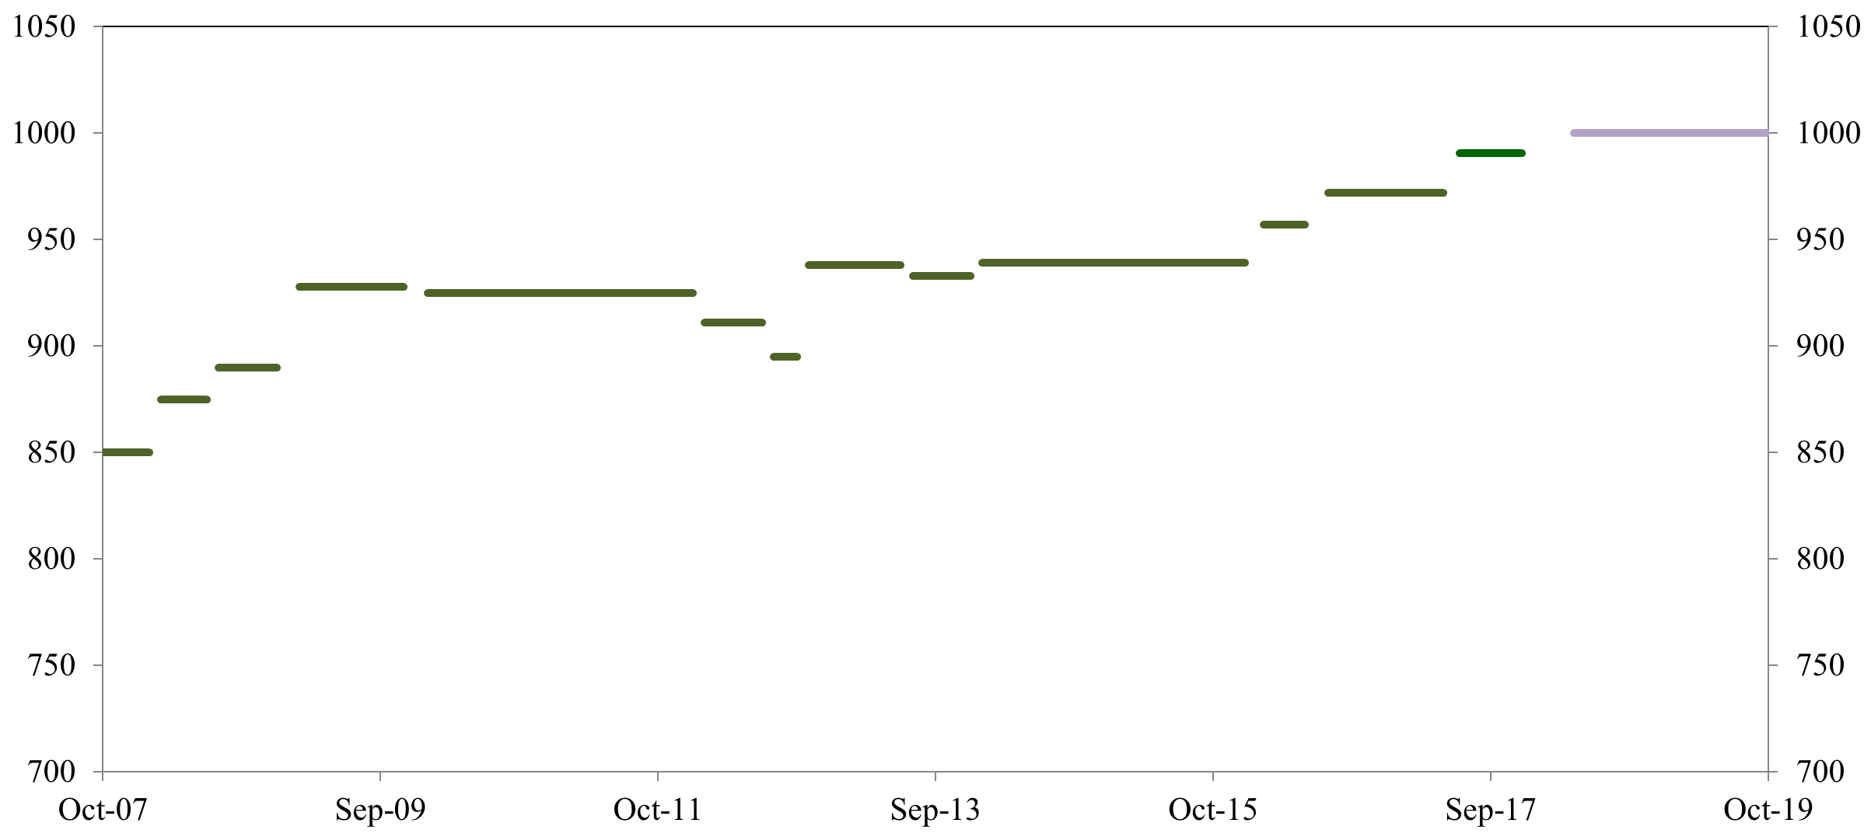
SNS SCL output energy at 60-pps operation evolved from 850 MeV
60-pps operation since 2008
SCL ready for 1.4 MW in 2011
First neutron production at 1.4 MW in June 2014
SCL output energy at 1 GeV since May 2018
Routine 1.4-MW operation since 2018
1 GeV
Linac output energy (MeV)
850 MeV

Slide 14
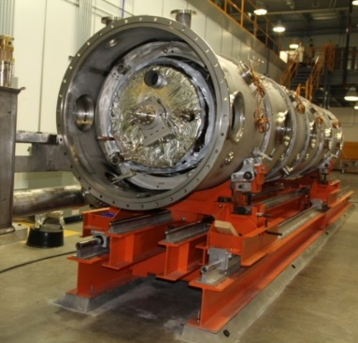
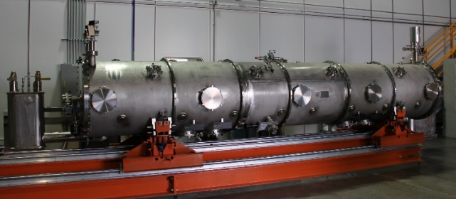
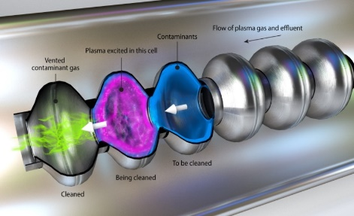
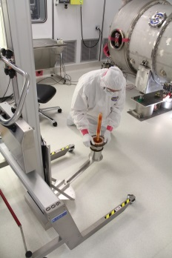
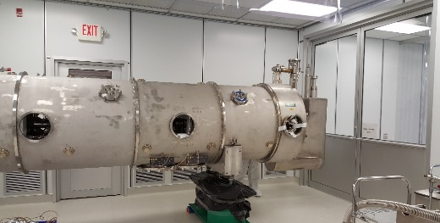
Performance improvement
by novel in-situ plasma processing
Early stage learning,
Cryomodule part repairs,
Supporting systems improvement, and overall system optimization
Spare HB cryomodule
development
Errant beam
Linac output energy (MeV)
Cryomodule rework

Slide 15
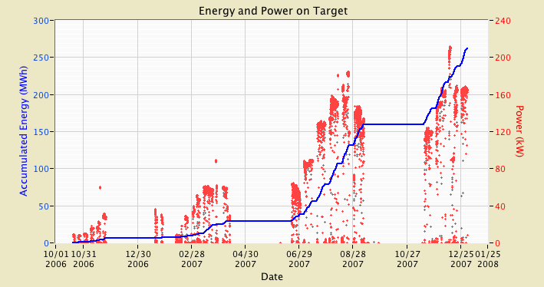
The first 1.5 years operation
Most of sub-systems were not commissioned for the operation at full duty factor
System learning at low repetition rate, short beam pulse and low beam current
60 Hz demo
5 Hz
15 Hz
30 Hz
30 Hz
30 Hz
890 MeV
890 MeV
890 MeV
850 MeV
18mA
18mA
20mA
25mA
500 µs
375 µs
500 µs
1-GeV demo run
at 15 pps

Slide 16
Early stage of operation
Performance of SRF cavities at < 20 pps was above design:
75 cavities out of 81 was used for the 1-GeV demo at 15 pps.
Some subsystems at the SNS were designed to be substantial improvements compared to existing accelerators while other subsystems were first of a kind.
Some performance and reliability aspects required a learning curve, and it took time to understand the systems as a whole and to determine the need for additional performance improvements.
Superconducting linac output energy was 850 MeV for early 60-pps operation
Reduced operating E_{acc} due to thermal instability at 60-pps by electron activities
E_{acc} of a dozen of cavities was limited by available RF power due to lower operating voltage of high voltage converter modulator (HVCM)
In 2009 one additional HVCM was installed to relieve loads on HVCMs and increase the HVCM voltages
One or two cryomodules were out of service for repair
Addressed issues with sub-components and control/LLRF systems
Achieved 930 MeV at ~90% of the design duty factor in 2009

Slide 17
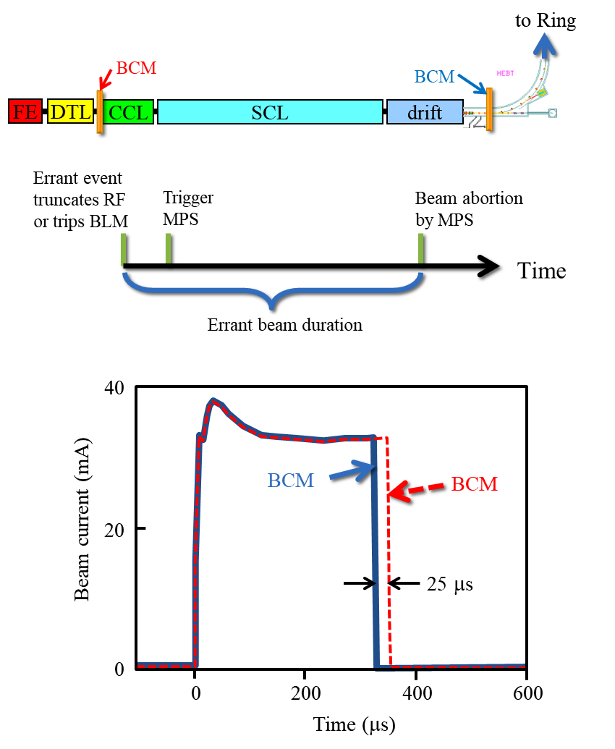
Errant beam
In 2009, ‘Errant beam’ was first recognized.
‘Errant beam’ is an off-energy beam created
Mostly by upstream warm linac RF cavity faults or oddly shaped beam pulse from ion source
Beam lost in SCL till beam abortion by MPS system
Errant beam hitting SRF cavity surface desorbs gas:
Can create discharge condition and lead to performance degradation
SNS MPS speed requirement was originally set to avoid copper damage against off-normal condition

Slide 18
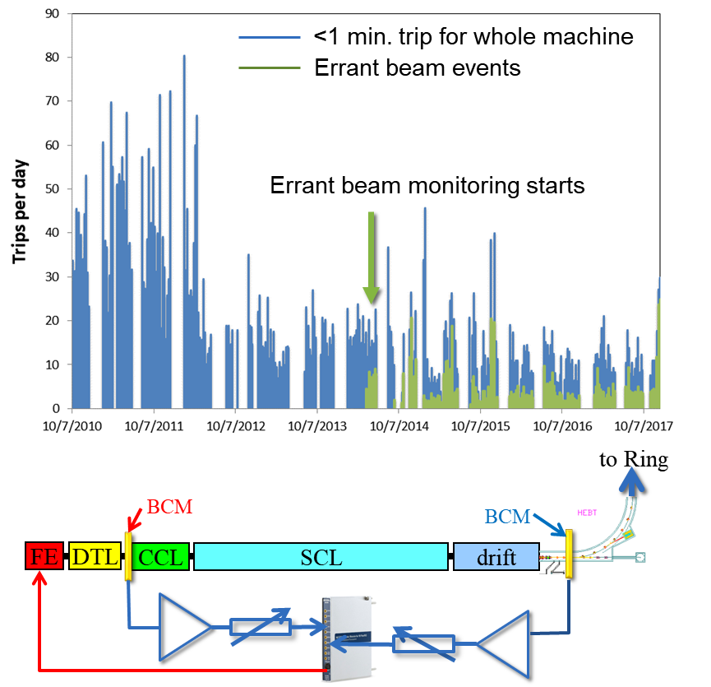
Reduction of errant beam events and duration
Severity depends on location where the beam is lost, on frequency of events and on duration of errant beam
Frequency of events is associated with warm linac and ion source conditions. More careful conditioning and vacuum system improvement helped
Duration of errant beam
New dedicated MPS monitors the loss of beam current
MPS response time shortened to ~7 μs

Slide 19
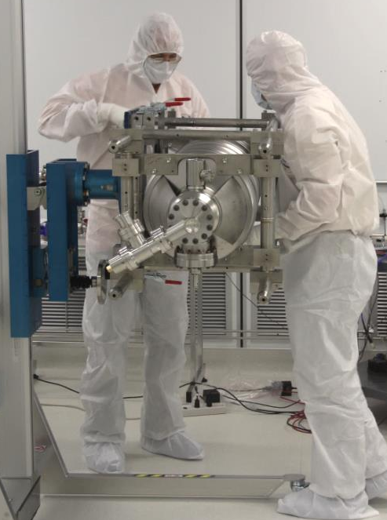
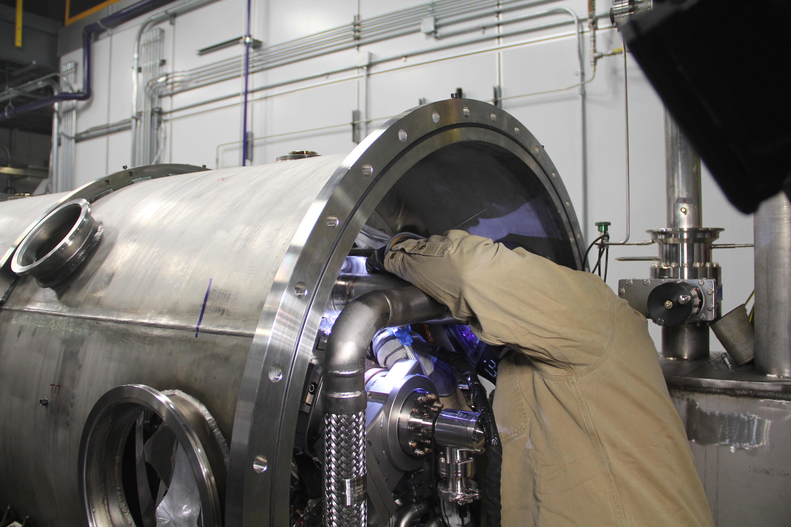
Cavity performance recovery, cryomodule repair and spare cryomodule
Recovery of cavity performance to previously attained operating gradients
RF conditioning and/or thermal cycling: successful so far
Cryomodule repair activities critical to sustain cryomodule performance and reliability
Rework (in-situ or off-line) is necessary for unrecoverable damage
Spare cryomodule development in-house
High beta spare: installed in the tunnel in Aug. 2012
Medium beta spare: installed in the tunnel in Feb. 2020
Both are one of highest performing cryomodules
Allows offline repair of high beta cryomodules
Prototype for PPU cryomodule

Slide 20
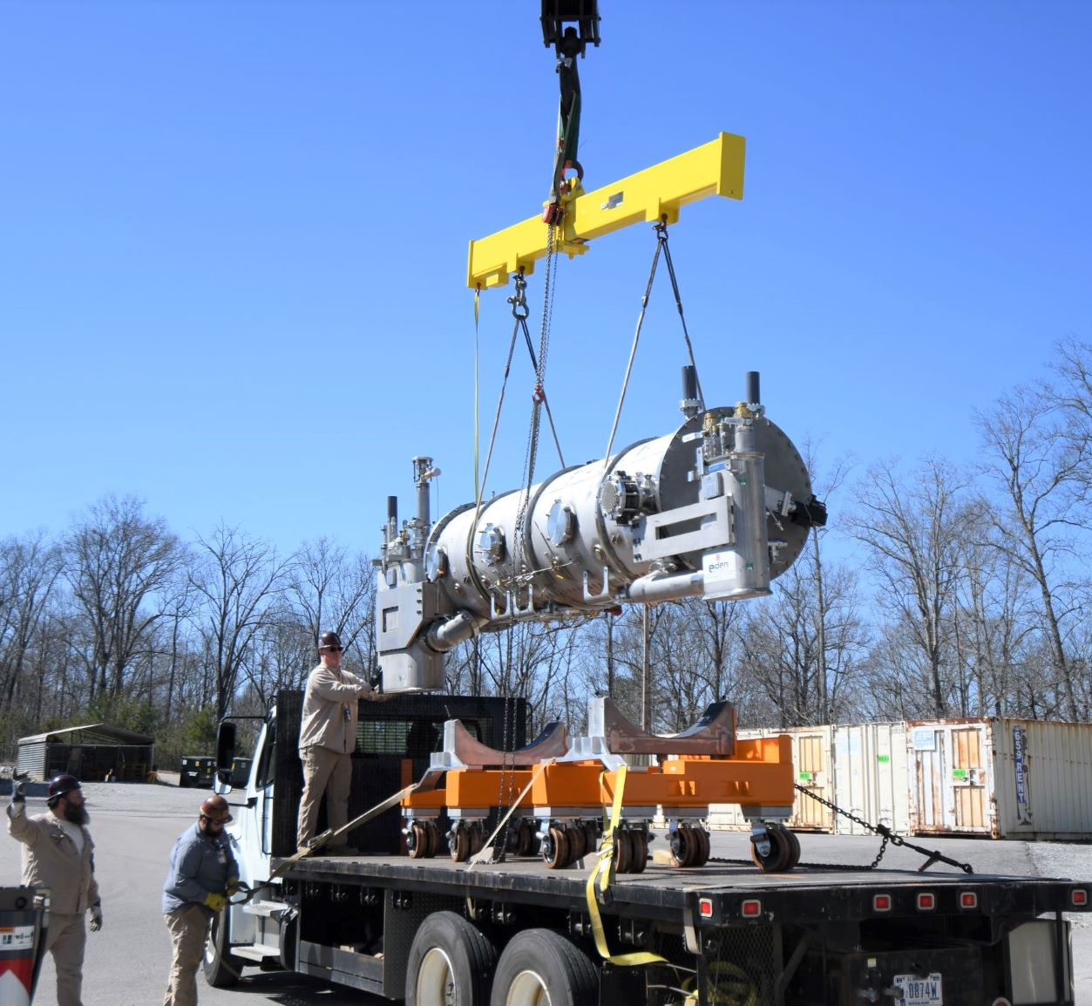
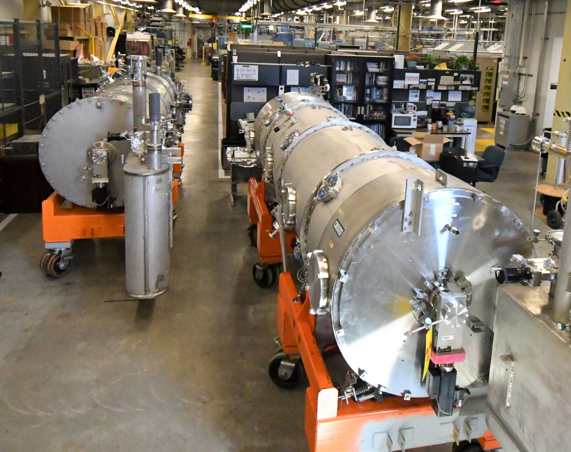
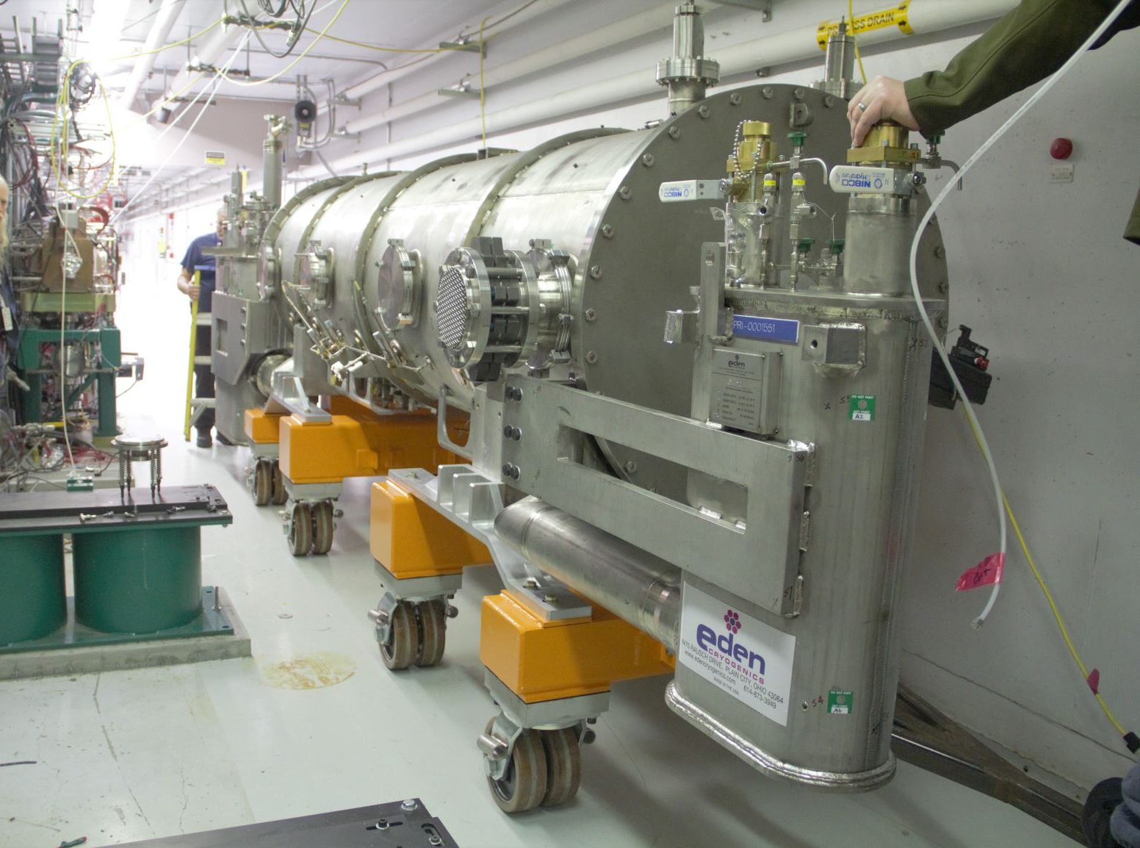
Offline repair rework since 2009
Seven cryomodules have been removed from the tunnel for repairs since
One due to HOM coupler
One due to large leak in helium line in end can
One replaced with high beta spare cryomodule
Low performer (large x-rays). Used for first plasma processing offline
Four due to leaks at fundamental power couplers (FPCs)
FPC leaks so far were not catastrophic
Leak rate: high 10⁻⁷ or low 10⁻⁶ torr l/s scale leak
turn off and wait until the next outage
Two medium beat cryomodules waiting on offline repairs
5a: arcing around FPC but no leak
11b: HOM coupler (never operated at SNS)

Slide 21
Other cryomodule repairs since FY07
Instruments (PT, CCG, TC, TD): >100
JT valve actuator: ~20
Thermal cycling to remove gaseous contamination: ~12
Tuner repair: >20
Mostly between FY06 and FY13. Only one in 2018 since FY14.
Tuner controller failures become more frequent recently (1~2 per year)
Insulating vacuum repair/upgrade: 10 CMs require active pumping
RF component (water condensation at coupler air side, loosen connectors in CM): 3
HOM couplers: removed feedthroughs from 7 CMs

Slide 22
Plasma processing
From 2009 to 2015, linac output energy for the stable neutron production was 925-940 MeV
E_{acc} of each cavity was set based on collective limits at 60 pps.
SNS looked for cost-effective method to decrease electron activities and thus to increase E_{acc}
In 2009, during attempt for helium processing for SNS cryomodule, observed RF glow discharge with very low RF power. Large reduction of field emission was measured.
In-situ plasma processing was identified as an important area of R&D
R&D started in 2012

Slide 23
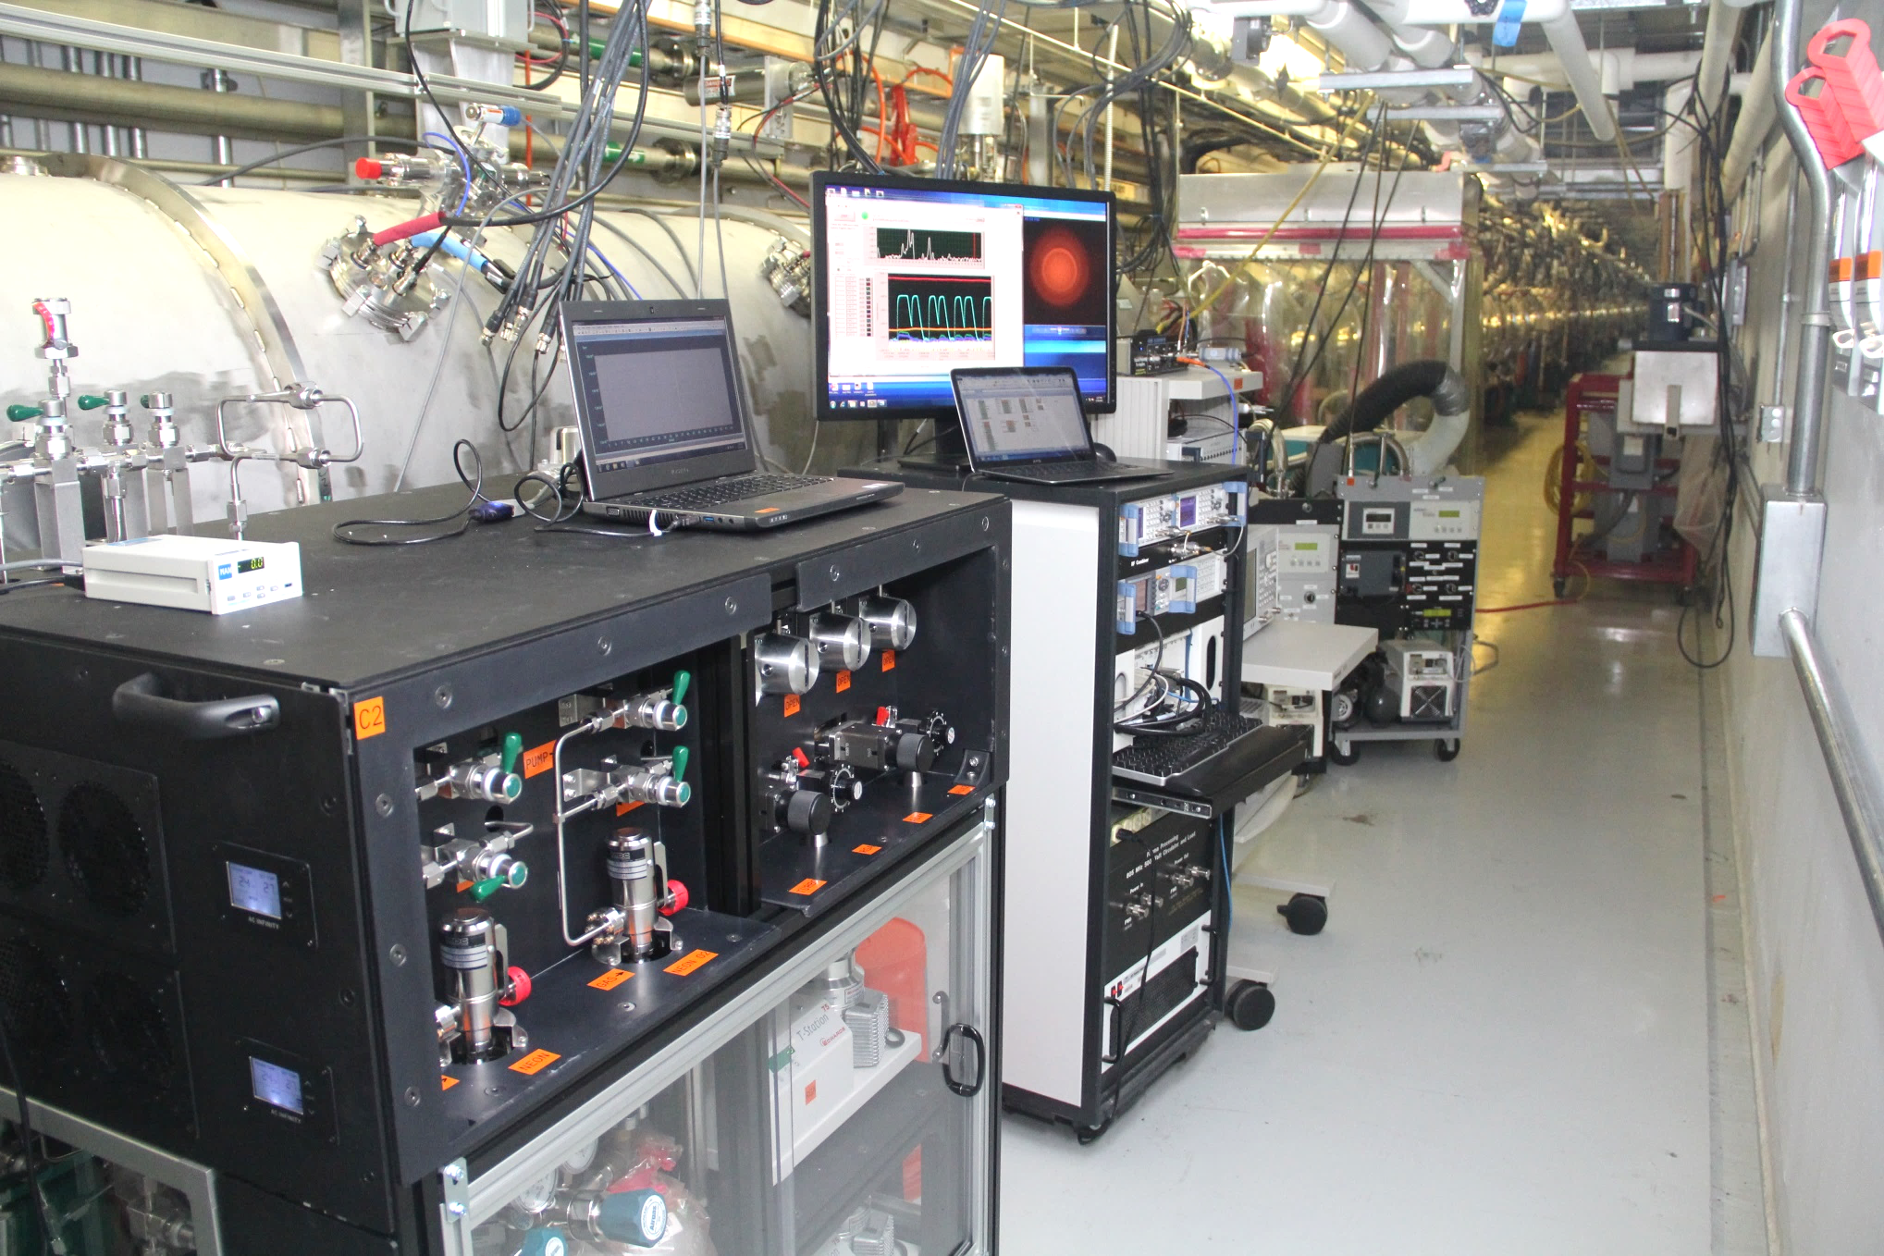
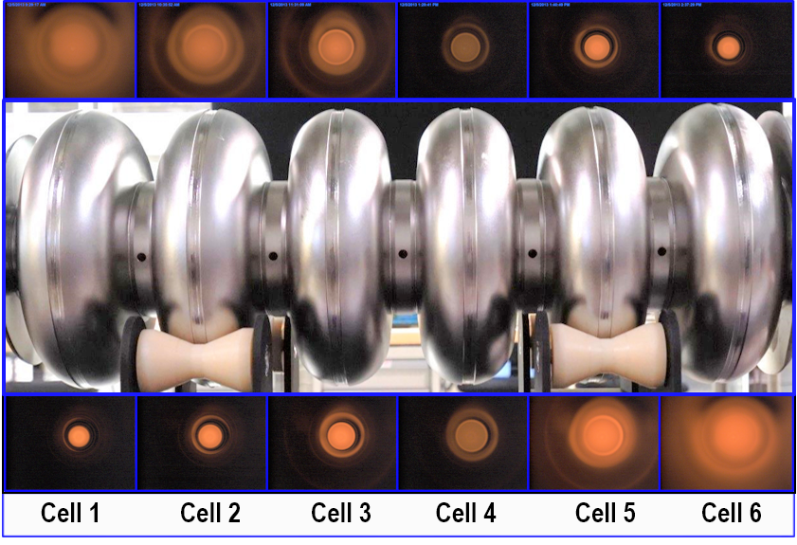
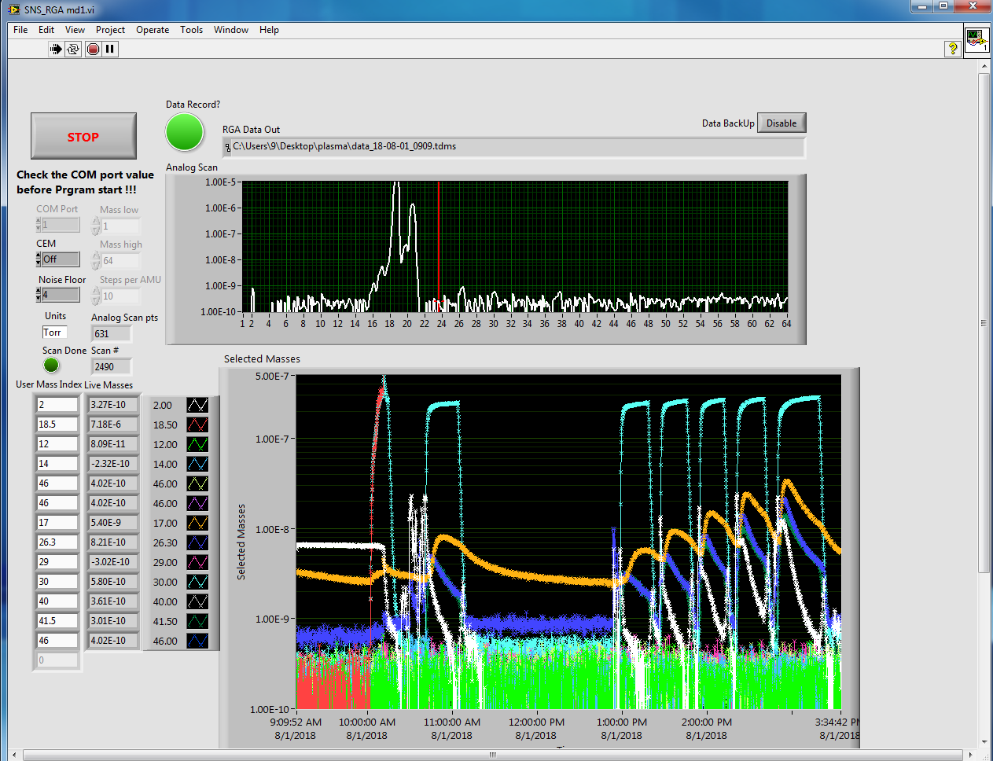
In-situ Plasma Processing R&D
R&D started in 2012 to develop a reliable technique for in-situ plasma processing for high beta cavities
Focused on removal of residual contamination using low density reactive oxygen plasma to decrease electron activities (Field emission and multipacting)
Successful recipe development for high beta cavities

Slide 24
Plasma boosts to 1 GeV
8 high-beta cryomodules successfully plasma processed
1 cryomodule offline
7 cryomodules in the tunnel
Accelerating gradient increased by 20% on average
Improvement of E_{acc} ranges from 0 to 6.5 MV/m
No performance degradation from plasma processing observed
Also plasma processing is ready for medium beta cavities
Will be deployed to offline medium beta cryomodule after repair

Slide 25
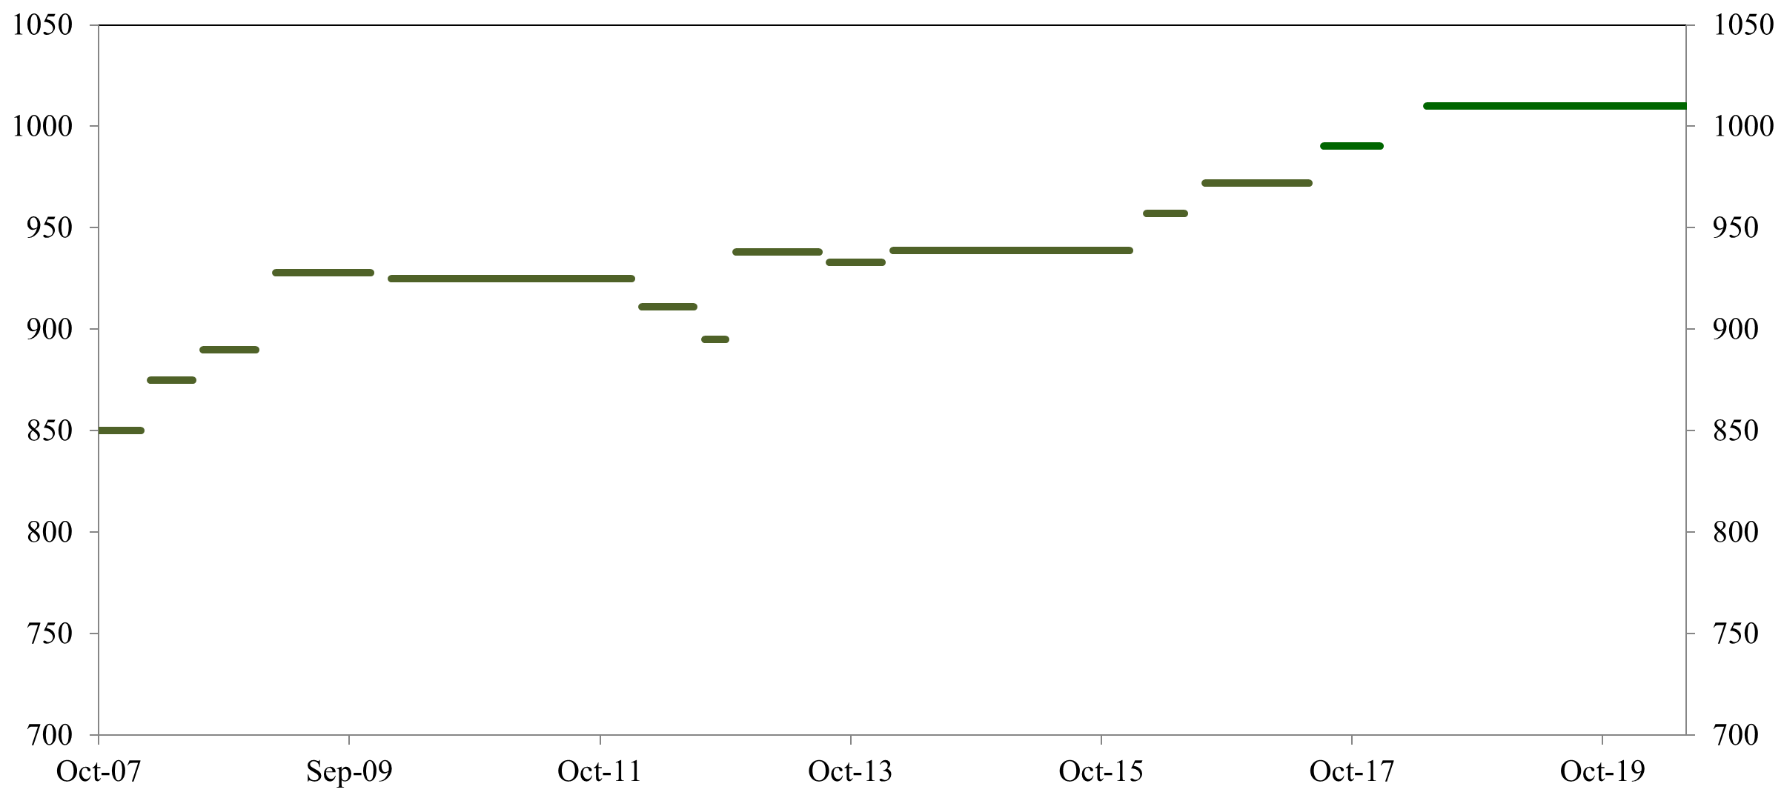
Summary of SNS SCL history
1010 MeV with
increased
energy margin
Second in-situ
plasma
processing
CM18
990 MeV
Recognized
Errant
Beam
972 MeV
MB Spare CM in
3 cavities
Turned off
(errant beam)
MB CM in
(slot 6)
after repair
1
2
957 MeV
Fourth in-situ plasma processing CM21, 22 & 23
939 MeV
Third in-situ
plasma
processing
CM16 & 17
928 MeV
925 MeV
Additional
HVCM
First in-situ
plasma
Processing (CM19)
&
Performance recoveries of degraded cavities (thermal cycling, RF conditioning)
Linac output energy (MeV)
CMs out
from slot 6 and 20
for repair
Linac output energy (MeV)
High beta
spare CM in
for slot 20
RF/Control improvement
Two CM Repairs
Other misc.
1. Full pulse length
for 1.4 MW
2. Worst performing
HB CM out (slot 19),
HB CM from slot 20 in
after repair

Slide 26
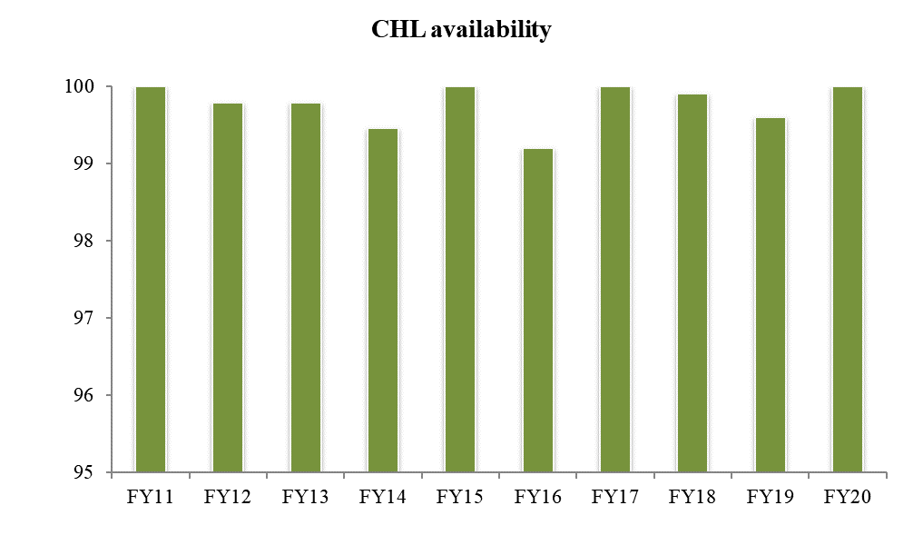
CHL Reliability
Availability: 99.8% last ten-year average
Sustainability for the future
Active preventative maintenances
Developed CHL spare carbon bed
Plan for replacing CHL helium purifier
Plan for new 2K cold box
Several people has been qualified for CHL operation including 2-K pump-down
Qualification program for technicians in place
Continue to develop procedures for operation and maintenances
Availability (%)

Slide 27
Previous issues in CHL
VFD fault and 2K cold-box trip
Had nuisance trips (during operation and during pump-down to 2K) and became more frequent.
Root cause was the sinus filter* for CC3 wired incorrectly from day one
*sinus filter: LC filter between VFD and transformer for cold compressor motor
Since this fix, no nuisance trips
2K cold-box trip due to loss of power to Mag bearing cabinet for CC4
Root cause was a failed DC filtering capacitor
Resulted in 22-hours down time to verify whether cold compressor was safely shut down or not
Additional preventive actions were implemented to ensure magnetic bearing levitation and soft-landing using back-up battery power at loss of power
So far, we believe that there has been no hard-landing of cold compressors

Slide 28
Proton Power Upgrade (PPU) Project

Slide 29
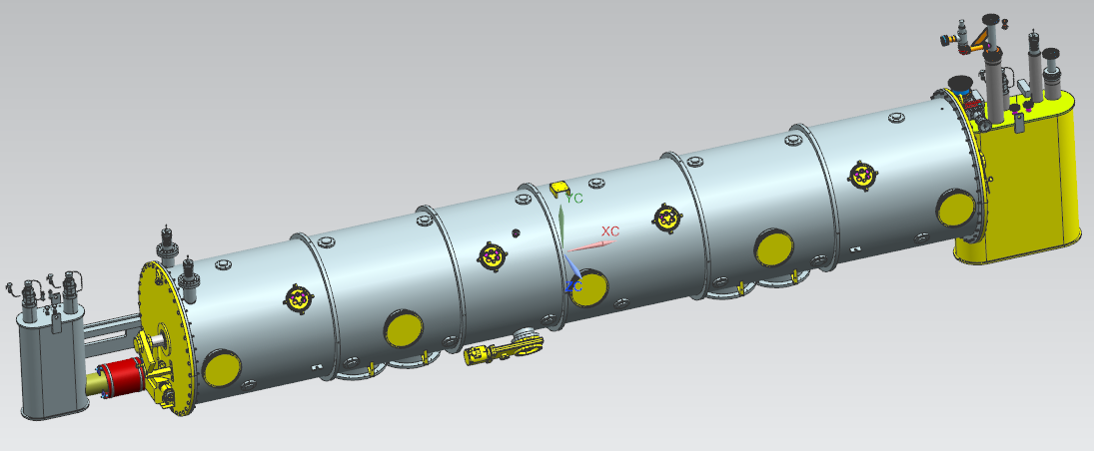
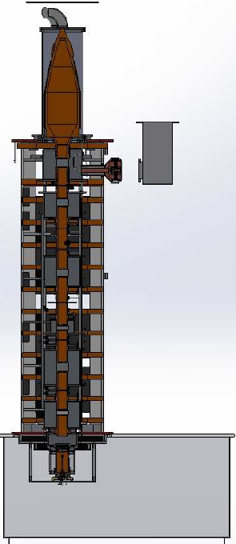
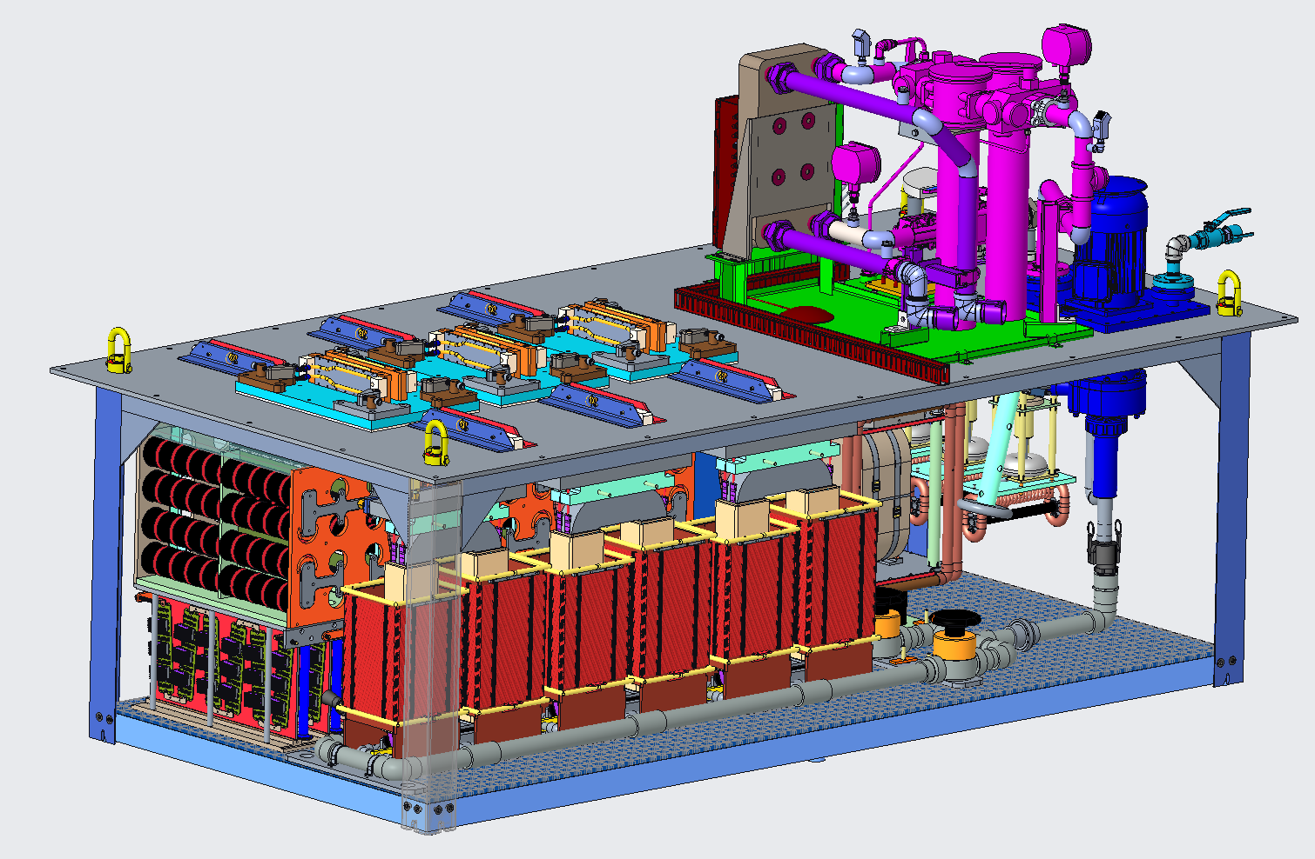
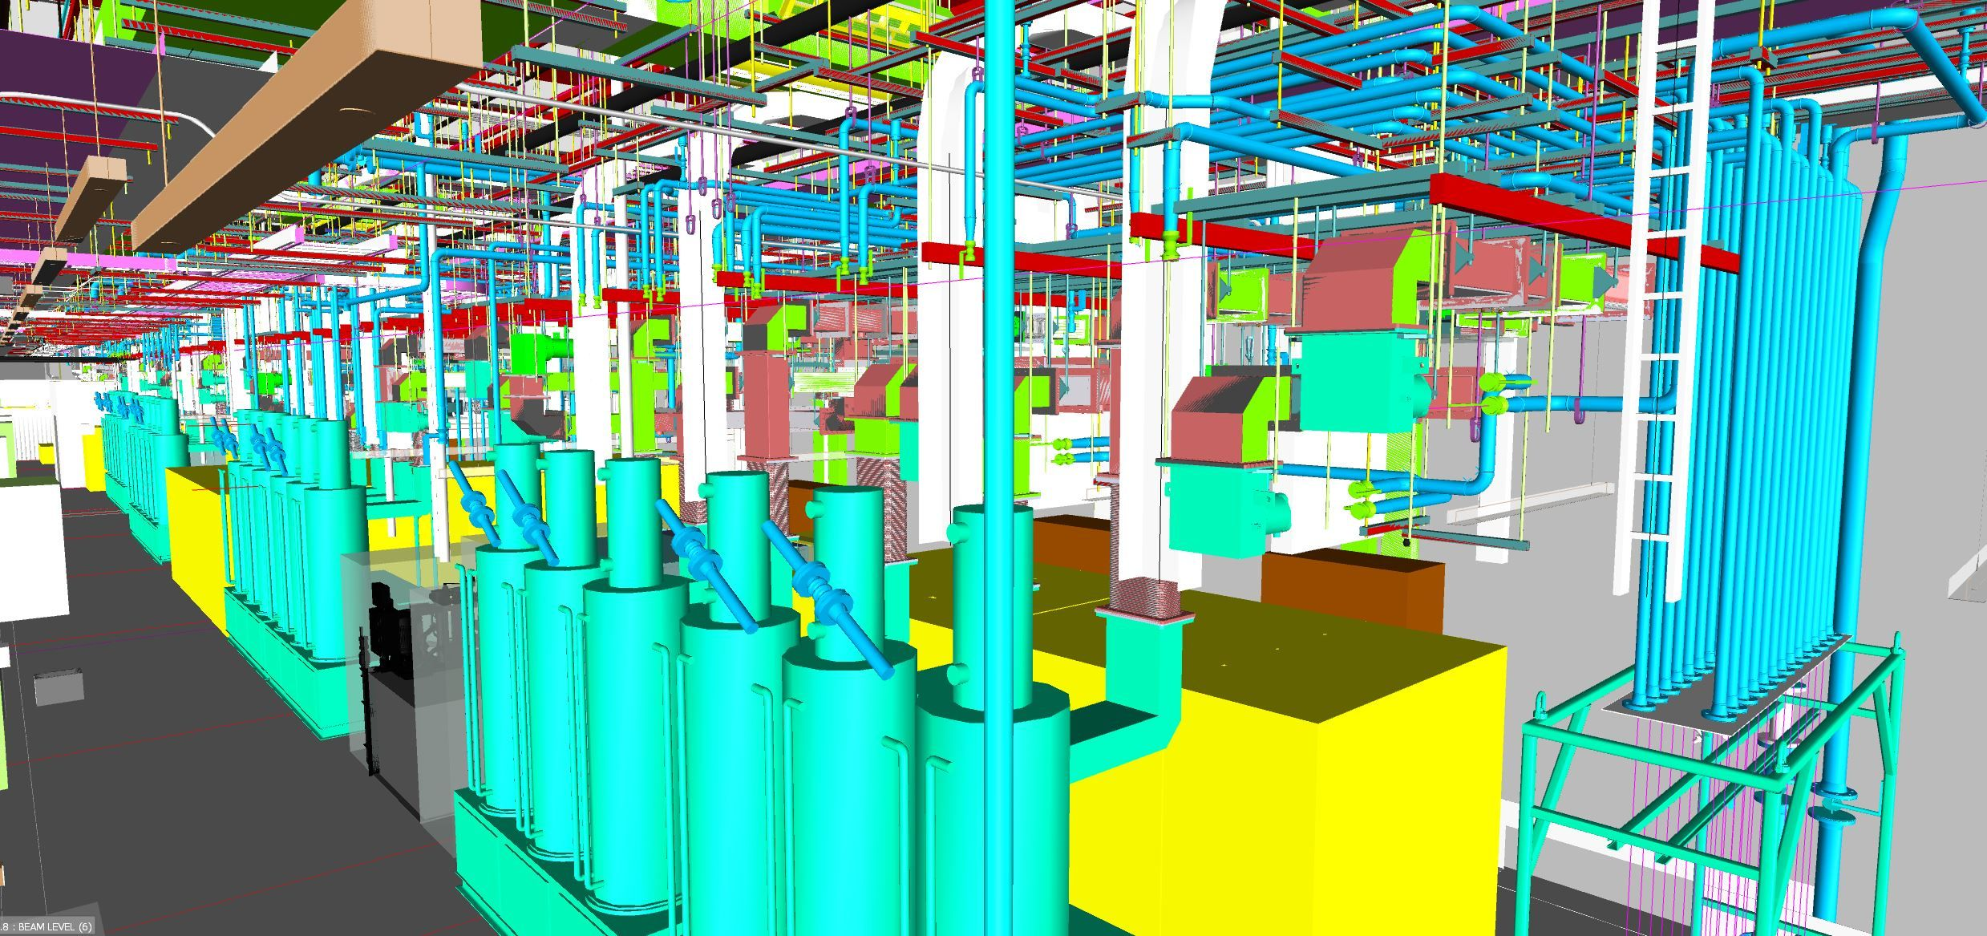
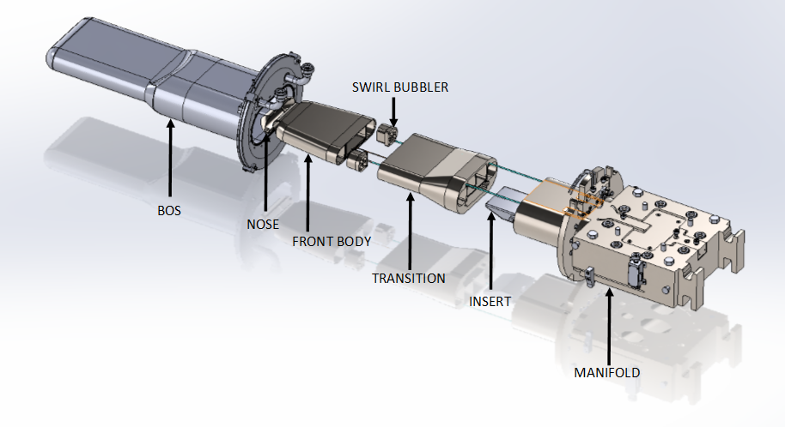
Proton Power Upgrade project
Ring injection
& extraction
upgrade
Accelerator capability from 1.4 MW to 2.8 MW
Beam energy increase by 30%
Beam current increase by 50%
2-MW First Target Station
7 new
cryomodules
Existing linac
upgrade
HPRF
HVCM
LLRF
Gallery extension
2-MW target

Slide 30
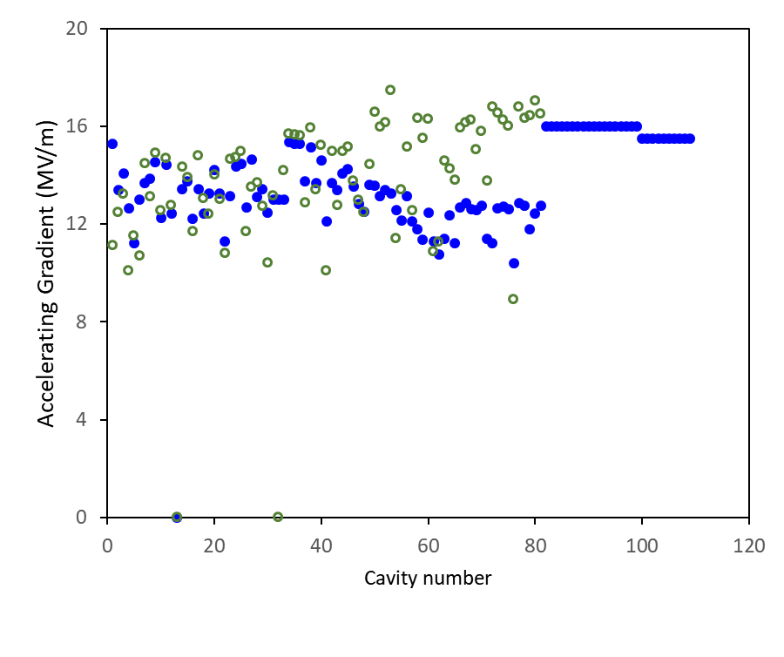
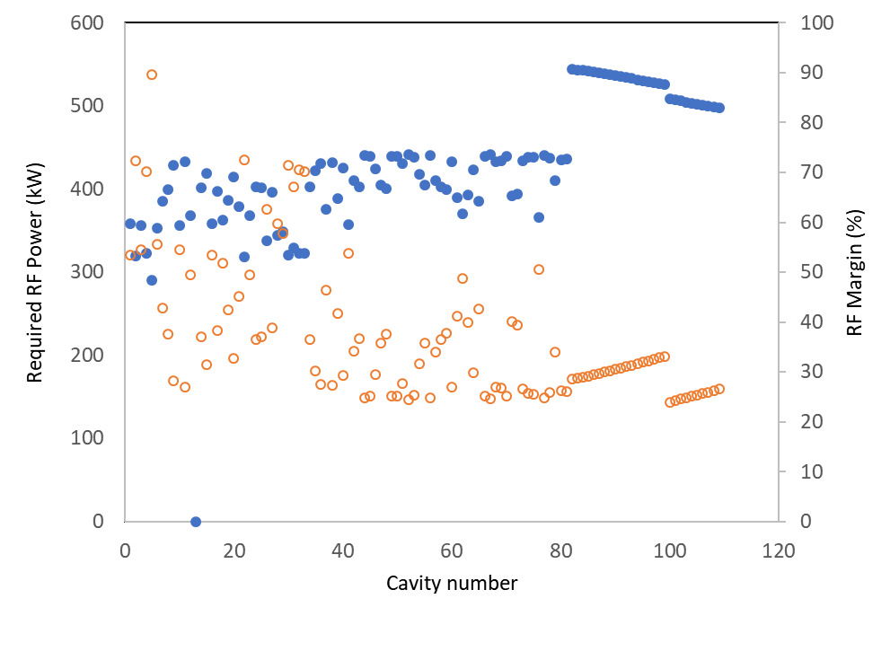
SCL setup for 1.3 GeV for 2.8 MW
1.3 GeV is a built-in energy limit due to Lorentz stripping in HEBT
No upgrade or replacement for existing cold linac
Accelerating gradient for PPU cavities: 16 MV/m, and seven new cryomodules
1.3 GeV and 2.8 MW
1.0 GeV and 1.4 MW
Required RF power
RF power margin
Comparison of accelerating gradients
Required RF power and RF margin
for 1.3 GeV and 2.8 MW

Slide 31
PPU cavity/cryomodule design specifications
Lessons learned are incorporated into the design
Parameters | Original SNS high-beta cryomodule design | PPU high-beta cryomodule | Demonstration of Performance
E_{acc} (MV/m) | 15.8 (14.8*) | 16.0 | Demonstrated with spare HB CM in operation since 2012
FPC rating. Peak, Average (kW) | 550, 50 | 700, 65 | Demonstrated with FPC qualification on test stand
Q₀ | > 5 × 10⁹ at 2.1 K | > 5 × 10⁹ at 2.1 K | No change
External Q of FPC, Q_{ex} | 7 × 10⁵ (±20%), fixed type | 8 × 10⁵ (±20%), fixed type | Verified on test bench
Material of cavity | RRR>250 for cells, RRR~70 for end groups | RRR>250 for both cells and end groups | Developed 3 new medium beta cavities with RRR>300
Higher-order mode coupler | Two (one at each end group) | None | Demonstrated through HOM measurement and operation
Tuner | One mechanical tune, one fast piezo tuner | 1 mechanical tuner (no fast piezo tuner) | Demonstrated through operation
Pressure vessel | Good engineering practice | Code stamp required | Developed spare HB CM
* Average HB cavities in operation as of Sept. 2018

Slide 32
Summary
SNS has conducted a multi-faceted approach for 1.4-MW operation at 1 GeV while keeping the machine highly reliable
Significant testing and operational experience has led to a better understanding of systems
There will be always machine-specific issues and nuisances especially in ‘first of a kind’ machine:
keep design simple, keep enough margin, keep room for upgrade
Lessons learned for reliable operation and high performance
Operational flexibility is one of the critical aspects for high availability of SNS SCL
Run with adequate energy margin to shorten downtime
Balanced performance between all sub-systems, lead to the most reliable and efficient system
Weakest-link limits overall performance

