Slide 1
SRF Challenges for the EIC Project
Qiong Wu
Brookhaven National Laboratory
Jlab Accelerator Seminar, March 4th, 2021

Slide 2
Outline
Introduction to EIC and its current SRF systems
Challenges
  Beam Dynamics
  SRF Technology
  Production and Installation
  Operation and Controls
  …
Summary

Slide 3
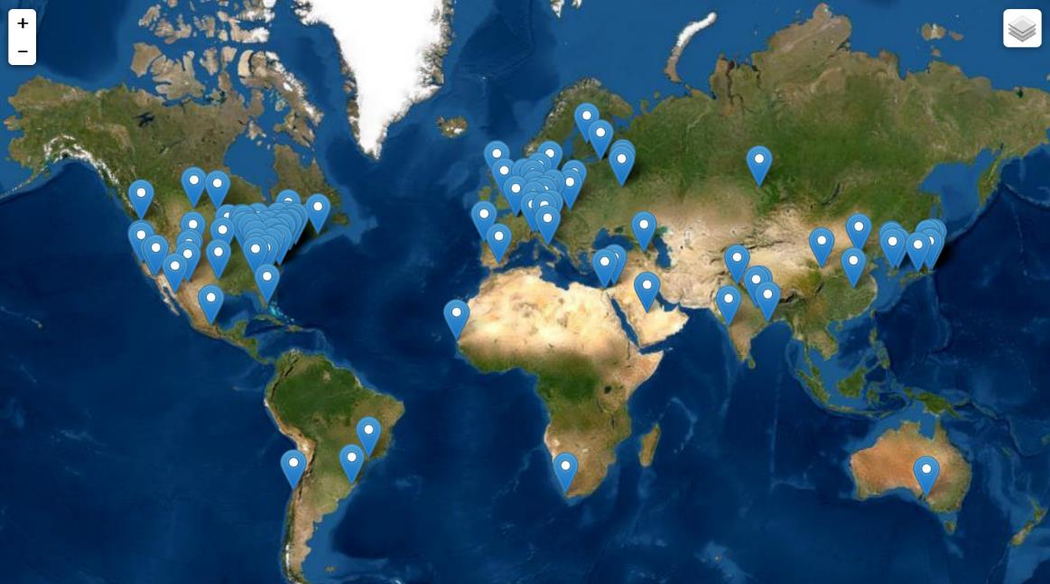
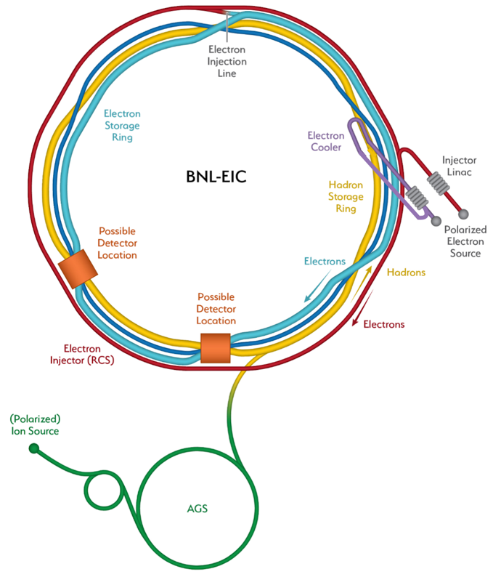

Electron Ion Collider
EIC User Group
1186 members
245 institutes
33 countries
J. Yeck, EIC Director’s Review, December 8-10, 2020
“The EIC will be a discovery machine, providing answers to long-elusive mysteries of matter related to our understanding the origin of mass, structure, and binding of atomic nuclei that make up the entire visible universe.”
F. Willeke, EIC Director’s Review, December 8-10, 2020
High Luminosity: L=(0.1 – 1)∙10³⁴cm⁻²sec⁻¹, need 10 – 100 fb⁻¹
Collisions of highly polarized e and p ( and light ion) beams with flexible spin patterns of bunch structure: 70%
Large range of center of mass energies: E_{cm} = (20 – 140) GeV
Large range of Ion Species: protons – Uranium
Possibility to accommodate a 2nd detector
Large detector acceptance
Good background conditions (hadron particle loss and synchrotron radiation in the IR)
Hadron Storage Ring (40-275 GeV) – HSR
Electron Storage Ring (2.5-18GeV) – ESR
Electron Rapid Cycling Synchrotron (accelerating ring 400MeV-top energy) – RCS
High Luminosity Interaction Region(s)
Strong Hadron Cooler System – SHC

Slide 4
The Origin of Challenges
Beam parameter table for current EIC design
EIC Conceptual Design Report
PARAMETERS |  | Proton | Electron |  | Proton | Electron |  | Proton | Electron |  | Proton | Electron |  | Proton | Electron
Energy [GeV] |  | 275 | 18 |  | 275 | 10 |  | 100 | 10 |  | 100 | 5 |  | 41 | 5
Bunch intensity, ×10¹⁰ |  | 19.1 | 6.2 |  | 6.9 | 17.2 |  | 6.9 | 17.2 |  | 4.8 | 17.2 |  | 2.6 | 13.3
Number of bunches |  | 290 |  |  | 1160 |  |  | 1160 |  |  | 1160 |  |  | 1160
Beam current [A] |  | 0.69 | 0.227 |  | 1 | 2.5 |  | 1 | 2.5 |  | 0.69 | 2.5 |  | 0.38 | 1.93
Beta, h/v [cm] * |  | 80/7.1 | 59/5.7 |  | 80/7.2 | 45/5.6 |  | 63/5.7 | 96/12 |  | 61/5.5 | 78/7.1 |  | 90/7.1 | 196/21.0
IP beam size, h/v [μm] * |  | 119/11 |  |  | 95/8.5 |  |  | 138/12 |  |  | 125/11 |  |  | 198/27
rms bunch length [cm] |  | 6 | 0.9 |  | 6 | 0.7 |  | 7 | 0.7 |  | 7 | 0.7 |  | 7.5 | 0.7
rms energy spread, ×10⁻⁴ |  | 6.8 | 10.9 |  | 6.8 | 5.8 |  | 9.7 | 5.8 |  | 9 | 6.8 |  | 10.3 | 6.8
Piwinski angle [rad] |  | 6.3 | 2.1 |  | 7.9 | 2.4 |  | 6.3 | 1.8 |  | 7.0 | 2.0 |  | 4.2 | 1.1
Luminosity, ×10³³ |  | 1.54 |  |  | 10.00 |  |  | 4.48 |  |  | 3.68 |  |  | 0.44
*: h/v – horizontal / vertical

Slide 5
The Origin of Challenges
Beam parameter table for current EIC design
Incomplete List of challenges:
PARAMETERS |  | Proton | Electron |  | Proton | Electron
Energy [GeV] |  | 275 | 18 |  | 275 | 10
Bunch intensity, ×10¹⁰ |  | 19.1 | 6.2 |  | 6.9 | 17.2
Number of bunches |  | 290 |  |  | 1160
Beam current [A] |  | 0.69 | 0.227 |  | 1 | 2.5
Beta, h/v [cm] * |  | 80/7.1 | 59/5.7 |  | 80/7.2 | 45/5.6
IP beam size, h/v [μm] * |  | 119/11 |  |  | 95/8.5
rms bunch length [cm] |  | 6 | 0.9 |  | 6 | 0.7
rms energy spread, ×10⁻⁴ |  | 6.8 | 10.9 |  | 6.8 | 5.8
Piwinski angle [rad] |  | 6.3 | 2.1 |  | 7.9 | 2.4
Luminosity, ×10³³ |  | 1.54 |  |  | 10.00
One machine, multiple operation schemes
Limit on cavity impedance → cavity + HOM damping design
High current → high input power
Small beta @ IP →
large crab cavity aperture
Large Piwinski angle → crab cavity
Long luminosity lifetime → noise control
*: h/v – horizontal / vertical

Slide 6
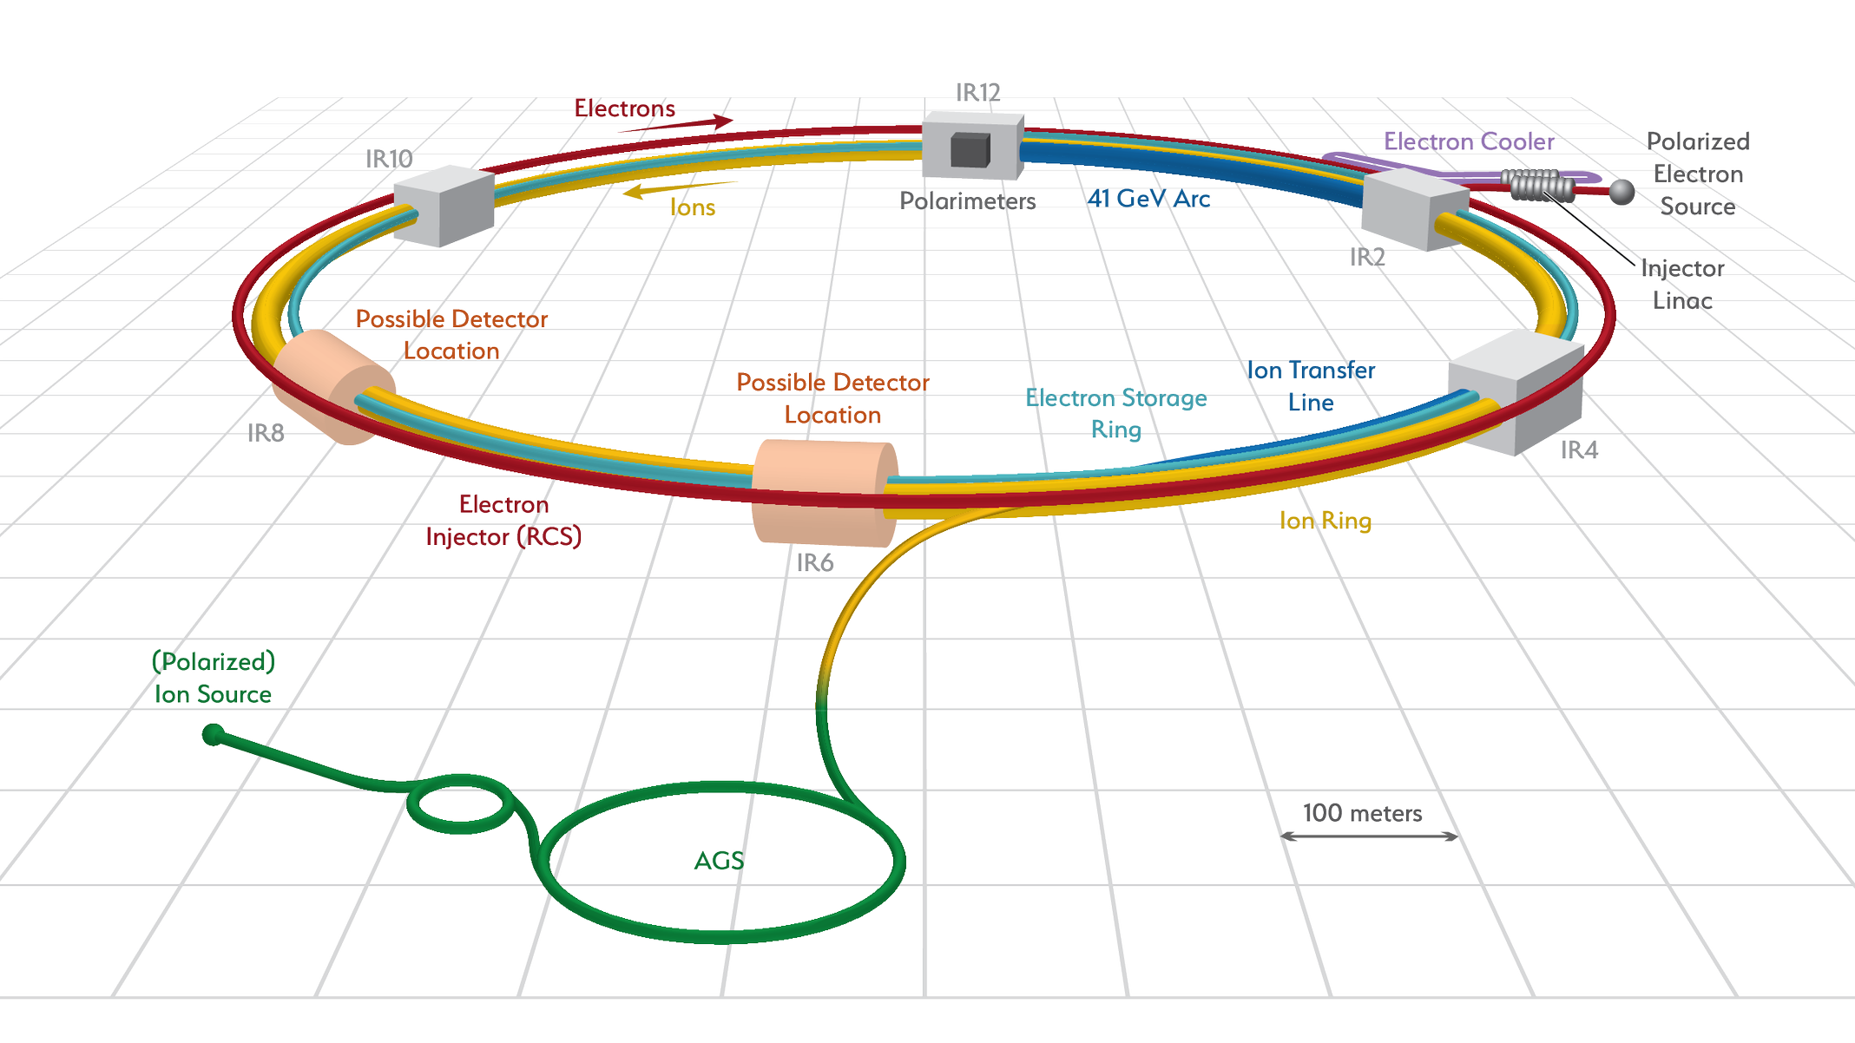
Electron Ion Collider (S)RF Systems
Hadron Storage Ring (40-275 GeV)
Electron Storage Ring (2.5-18GeV)
Electron Rapid Cycling Synchrotron (accelerating ring 400MeV-top energy)
High Luminosity Interaction Region(s)
Strong Hadron Cooler System
K. Smith and J. Preble
EIC Director’s Review, December 8-10, 2020
IR-10: SRF Systems
IR-2: Strong Hadron Cooler
RCS SRF Systems
Electron Storage Ring SRF Systems
Hadron Ring Storage SRF
Energy Recovery Linac (ERL)
The RF systems of the EIC grouped in four sections, with functions that serve for different purposes.
Three out of four are Superconducting RF sites with 4K and 2K liquid helium capabilities.
IR-4: NCRF Systems
Hadron NCRF Systems
RCS NCRF Systems
IR-6: Crab Cavity SRF Systems

Slide 7
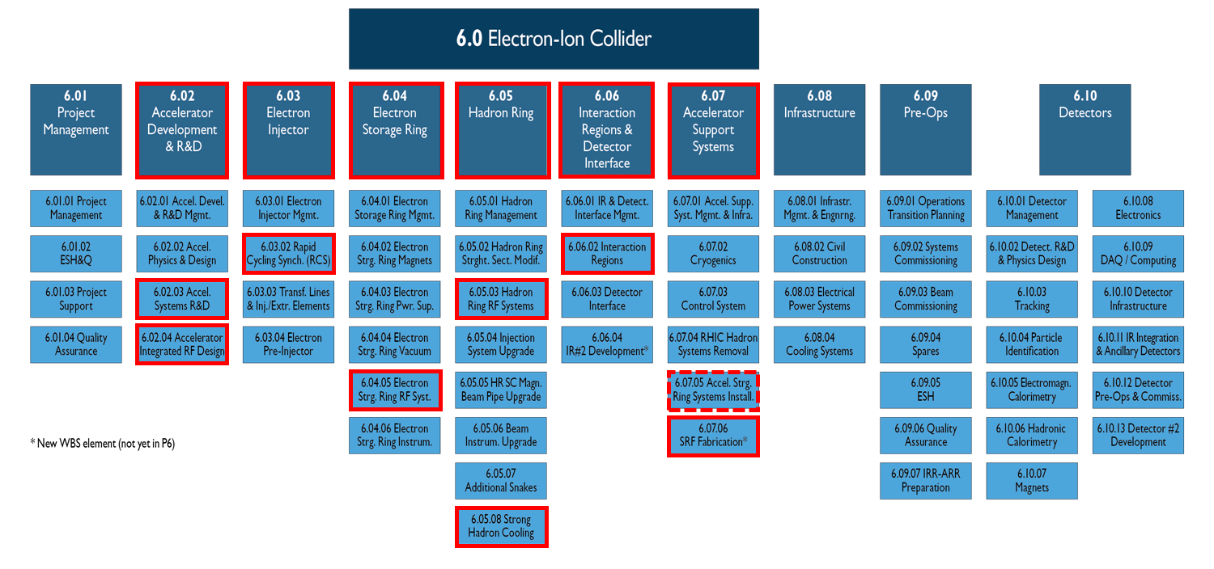
SRF systems in the EIC WBS
K. Smith and J. Preble
EIC CD-1 Review, January 26-28, 2021
RF related

Slide 8
Sub RF System | Frequency [MHz] | Harmonic Number | Type of Cavity | Total Number of Cavities | Max Voltage per Cavity [MV] | Location
RCS Accelerating Cavity | 591 | 7575 | SRF, 5-cell | 3 | 20 | IR-10
RCS Bunch Merger 1 | 296 | 3780 | Copper | 2 | 0.65 | IR-4
RCS Bunch Merger 2 | 148 | 1890 | Copper | 1 | 0.7 | IR-4
ESR Fundamental Cavity | 591 | 7560 | SRF, 1-cell | 17 | 3.65 | IR-10
HSR Capture/Accelerating | 24.6 | 315 | Copper, QWR | 2 | 0.3 | IR-4
HSR Bunch Split 1 | 49.2 | 630 | Copper, QWR | 2 | 0.3 | IR-4
HSR Bunch Split 2 | 98.5 | 1260 | Copper, QWR | 2 | 0.35 | IR-4
HSR Store fundamental | 197 | 2520 | Copper, QWR | 6 | 1 | IR-4
HSR Store third harmonic | 591 | 7560 | SRF, 5-cell | 1 | 20 | IR-10
Proton Crab Cavity | 197 | 2520 | SRF, Deflecting | 8 | 8.5 | IR-6
Proton 2nd Harmonic / Electron Crab Cavity | 394 | 5040 | SRF, Deflecting | 6 | 2.9 | IR-6
SHC Pre-Buncher | 197 | 2520 | Copper, QWR | 1 | 0.2 | IR-2 Stub
SHC Booster Cavity | 197 | 2520 | SRF, QWR | 3 | 2 | IR-2 Stub
SHC Fundamental Cavity | 591 | 7560 | SRF, 5-cell | 8 | 20 | IR-2 Stub
SHC Third Harmonic | 1773 | 22680 | SRF, 5-cell | 3 | 3.5 | IR-2 Stub

Slide 9
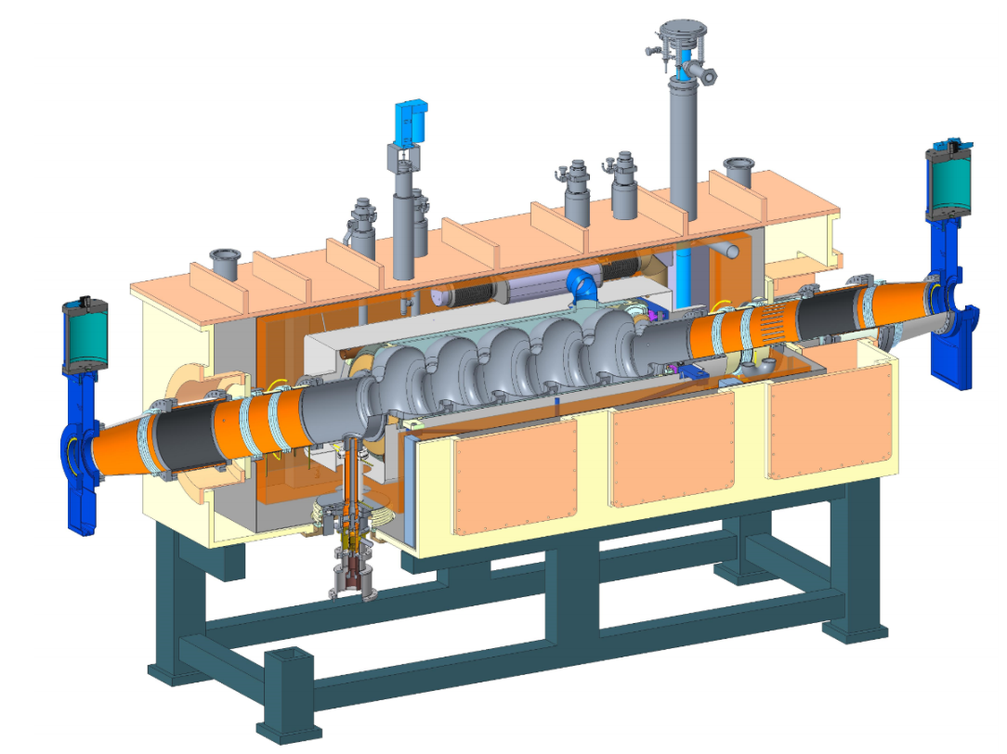
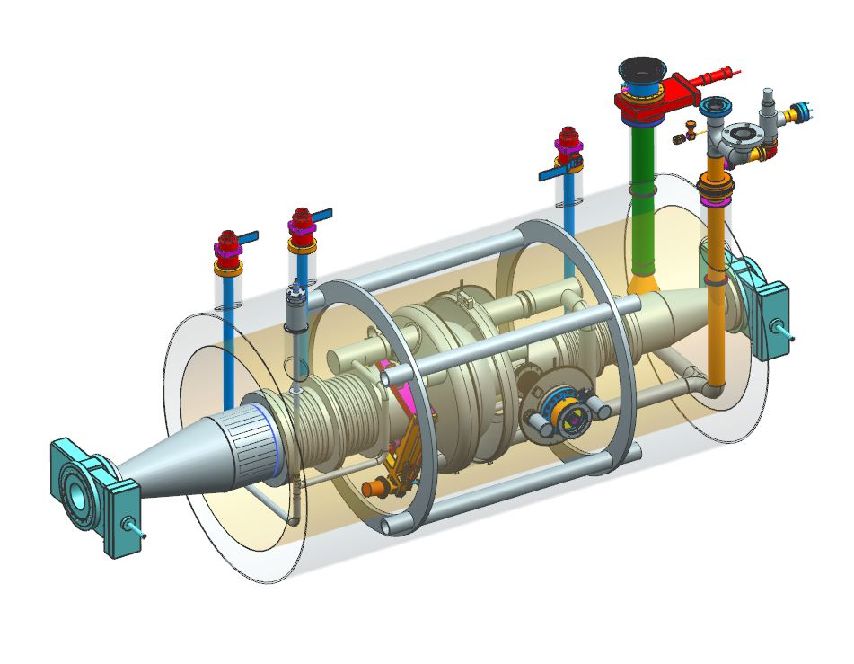
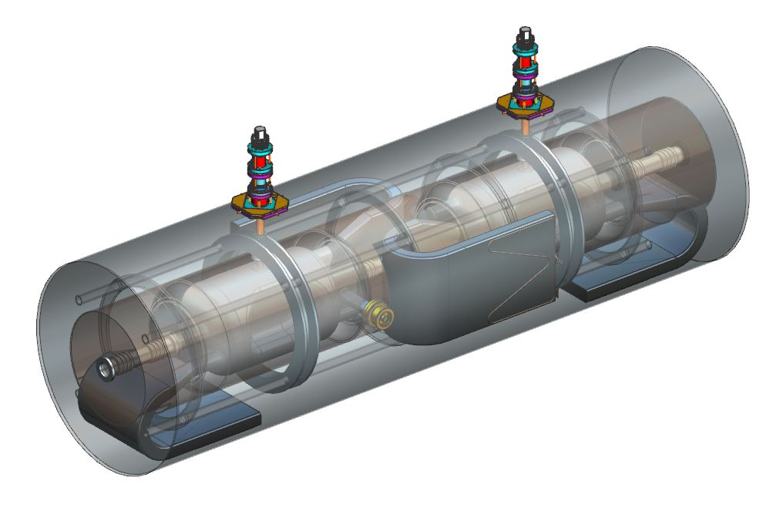
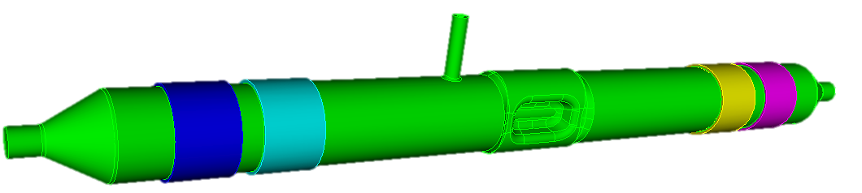
The SRF System Distribution
591 MHz 5-cell, total 8
197 MHz QWR
Total 3
591 MHz 5-cell, total 4
1773 MHz 5-cell
Total 3
591 MHz 1-cell
Total 17
197 MHz Crab Cavity
Total 8
394 MHz Crab Cavity, total 6

Slide 10
SRF Challenges
01
02
Beam dynamics
Cavity and RF couplers
EIC
SRF Systems
  Working point of the ESR cavities
  Crab cavities
  Impedance threshold for ESR and HSR
Cavity design
RF couplers
Preparation
Performance reduction during assembly
RF power supply
Cavity alignment
Feedback system
HSR energy ramp
Production and Installation
Operation and Controls
03
04

Slide 11
Challenges from Beam Dynamics
01
Beam dynamics

Slide 12
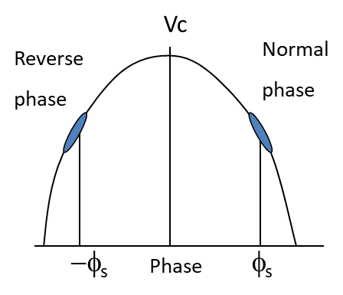
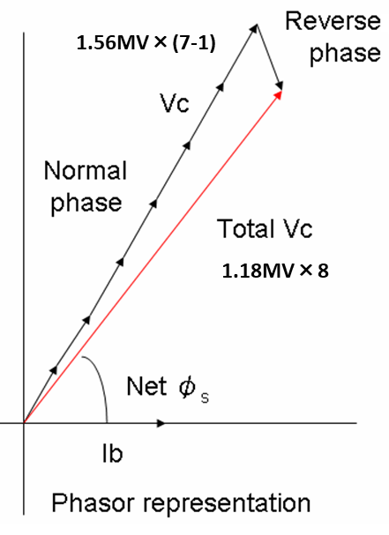
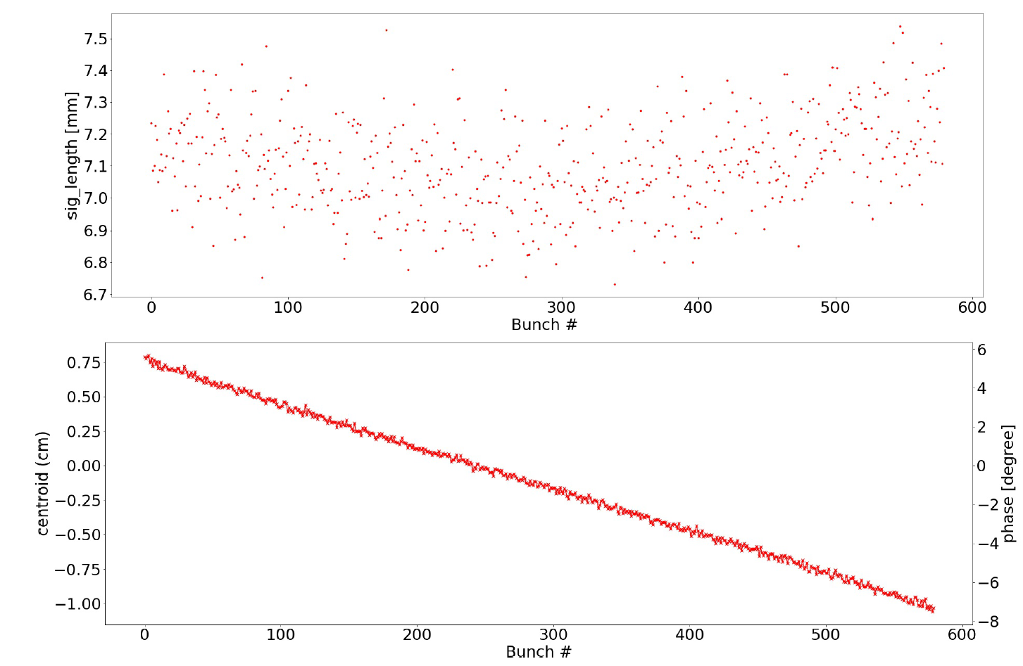
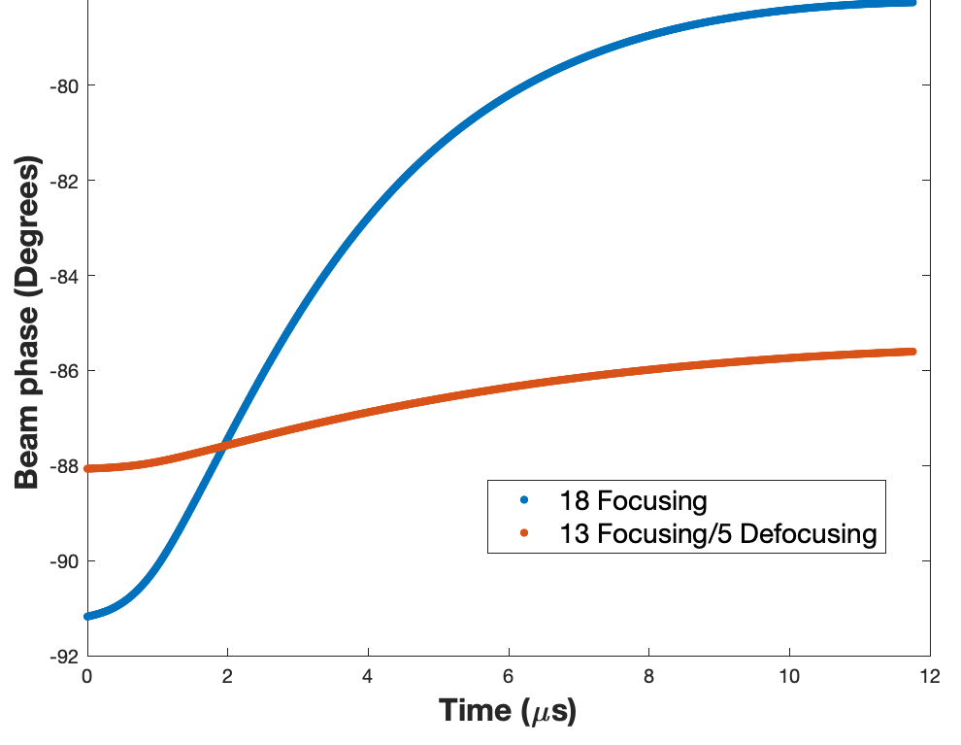
Challenge from Beam Dynamics 1 – Working Point for ESR Cavities
When beam power is high, but the voltage required is relatively low in an electron storage ring, traditionally, the cavities would need to operate with very low loaded Q or large detuned frequency.
These ideas introduce complexity to the system, not energy efficient, and may excite coupled bunch instability.
Y. Morita, EIC Workshop – Promoting Collaboration on the Electron-Ion Collider, 2020
Reverse phase operation study @KEKB
The ESR currently adopts the Reverse Phase Operation method to take advantage of the extra voltage from the SRF cavity capabilities.
The electron bunch length distribution and phase slip along the train @ 10GeV with RPO
Transient beam loading effect on beam phase for different working scenarios
M. Blaskiewicz
Stable solutions at 5,10 and 18 GeV have been found with power levels at 5% above absolute minimum and radiative damping only (G. Bassi, T. Mastoridis, T. Xin).
T. Mastoridis
T. Xin
Simulation done with 18 cavity assumption

Slide 13
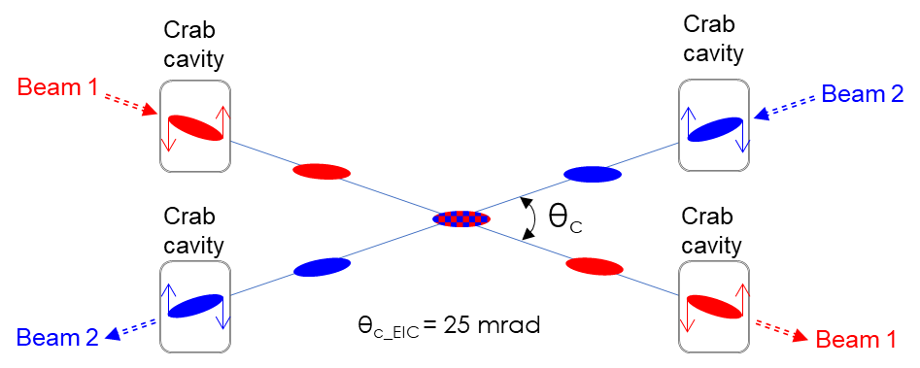
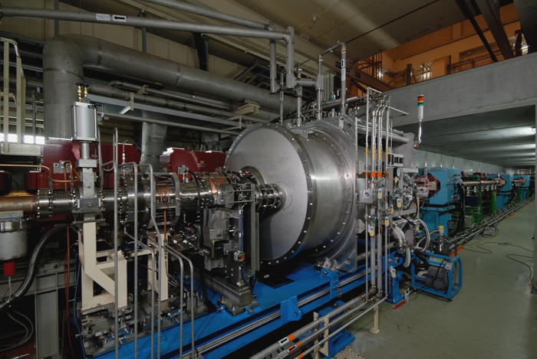
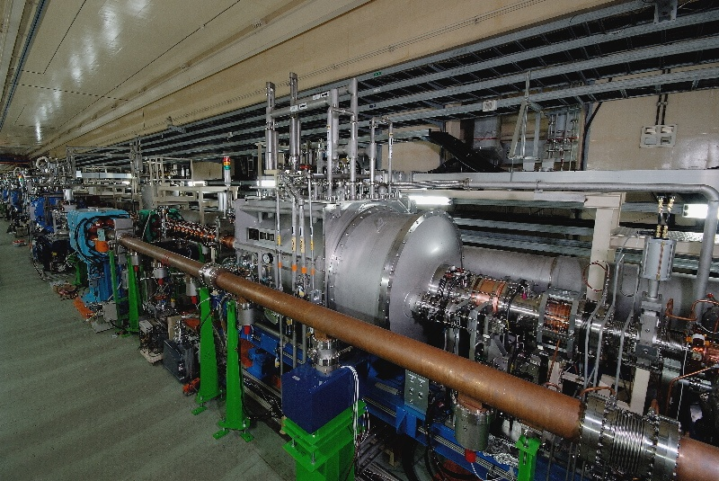
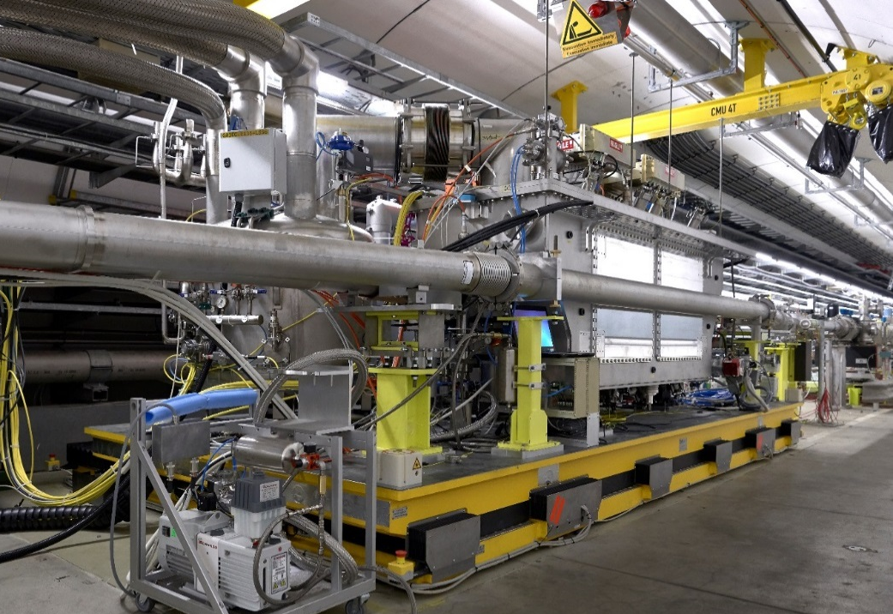
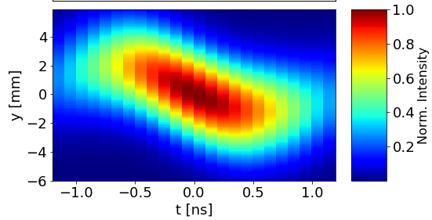
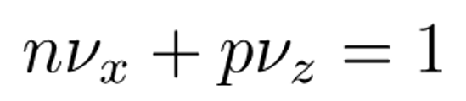

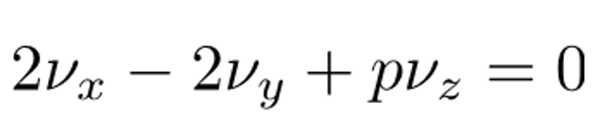
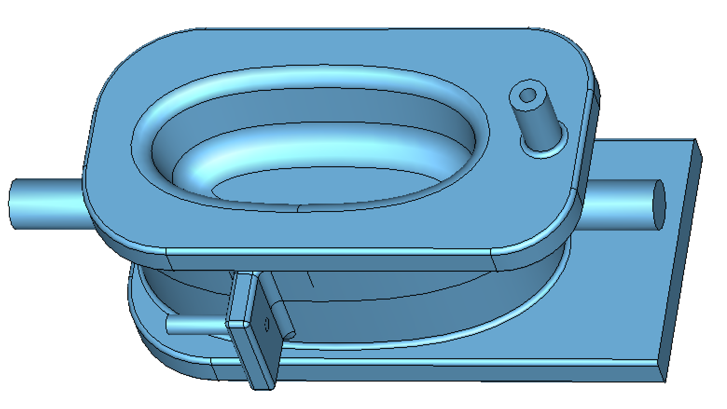
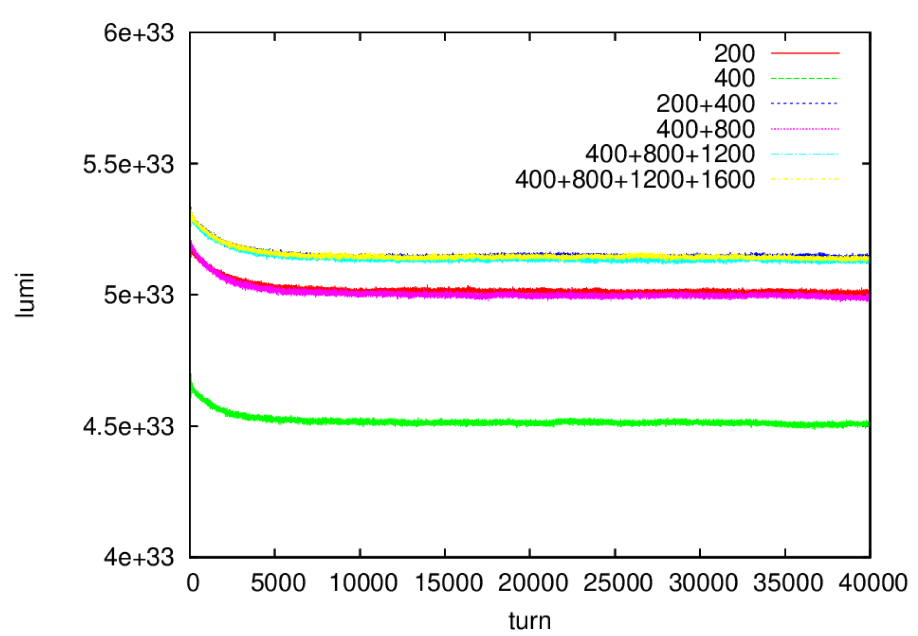
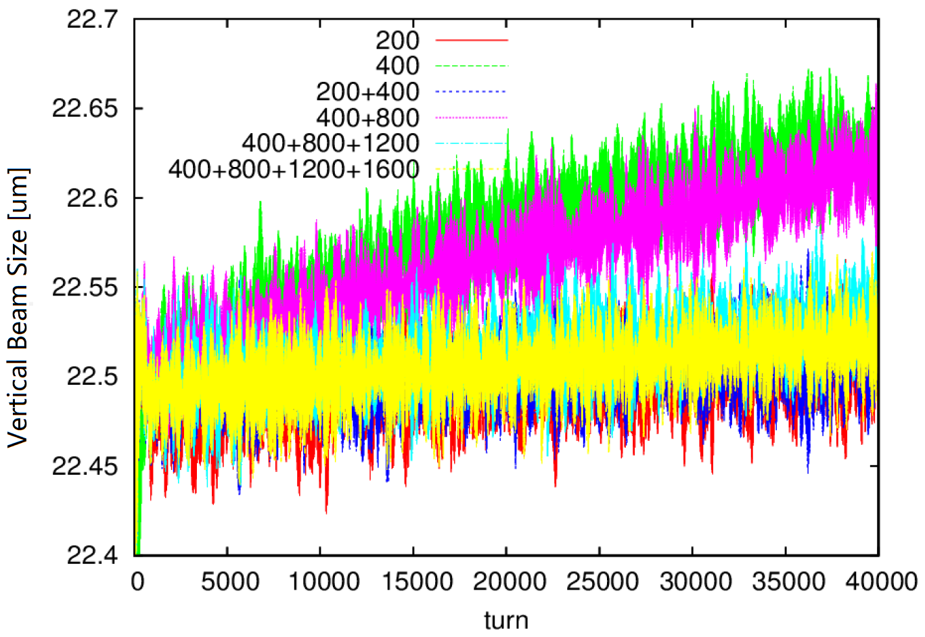
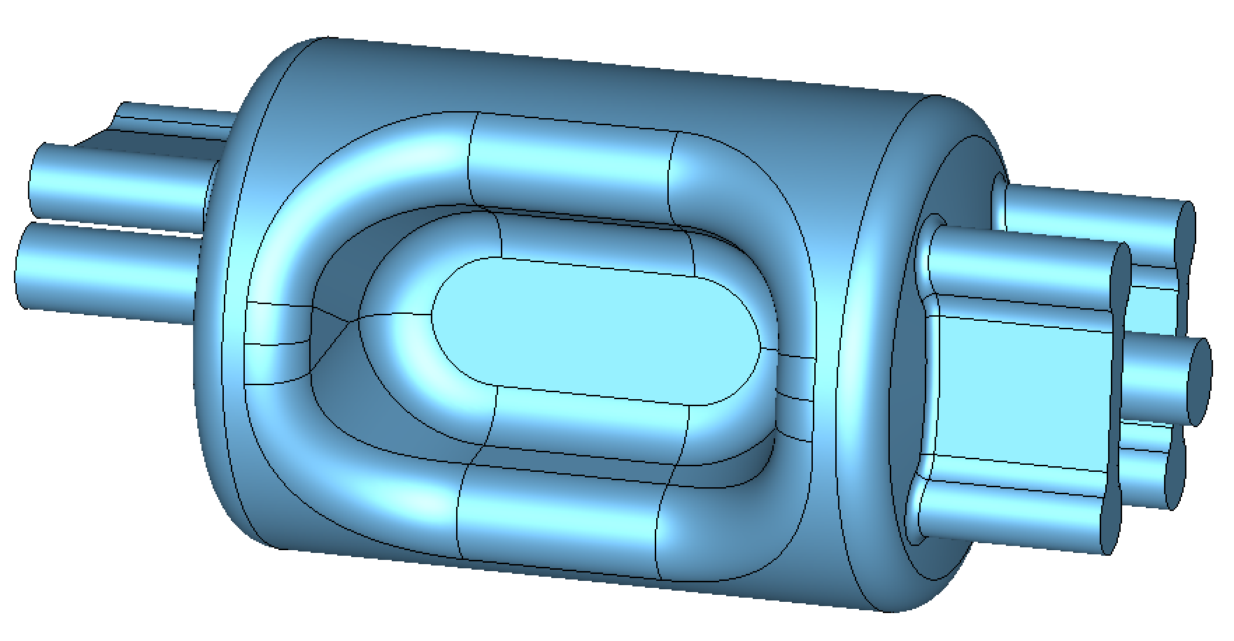
Challenges from Beam Dynamics 2 – crab cavity
Successful operation of first crab cavity in KEKB for 3 years (2007 -2010)
Successful operation of proton crab cavity in SPS, CERN (2018)
K. Hosoyama, CC2010
R. Calaga, HL-LHC Collaboration Meeting 2018
For current EIC parameter, the following couplings are observed through beam-beam simulations, and need to be reduced:
x, z coupling –
x, y, z coupling –
The x-z coupling can be corrected by lowering the frequency of crab cavity, and/or adding higher harmonic cavities. The frequency choice was balanced among beam-beam effect with crab cavities, EIC revolution frequency, and production and manufacturing capability for Niobium cavities.
DQW type, B. Xiao (BNL)
197 MHz is the final choice for our fundamental SRF proton crab cavity
Y. Luo (BNL)
RFD type, S. De Silva (ODU)
Current selection for both frequencies.
Y. Luo
Back up solution for 2nd harmonic crab cavity, Z. Li (SLAC)

Slide 14
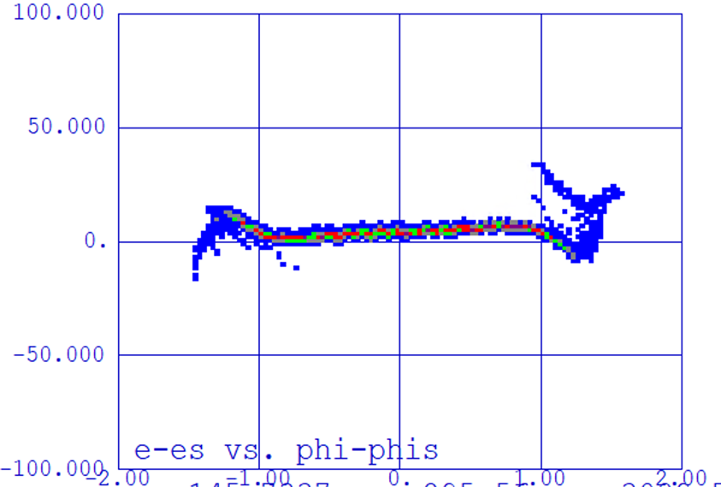
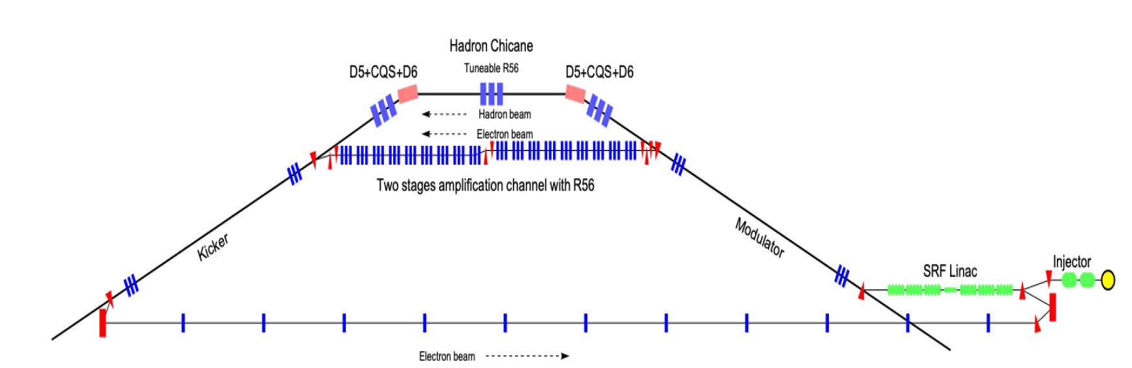
Challenges from Beam Dynamics 3 – Lattice
E. Wang
Longitudinal phase space
150 MeV
5 MeV
197 MHz buncher
400keV
Overview of the EIC coherent electron cooler injection region
591MHz SRF x4
1.77 GHz SRF
591MHz SRF x 4
Merger
Dogleg
197 MHz SRF
DC gun
Candidates for the cooler injector cavities after buncher and before the Dogleg:
197 MHz SRF quarter wave resonator x 3
197 MHz Cu quarter wave resonator x 6 + 591 MHz Cu 1-cell elliptical cavity
591 MHz SRF 2-cell elliptical cavity + 1.77 GHz SRF 1-cell elliptical cavity
Using the EIC Cooler Injection region as an example, the choice of RF device is always a compromise, usually starts with the lattice design, and extends to
Effective shunt impedance / average gradient
Field stability
Impedance
Cost (fabrication + operation)
Surface requirement (beam halo)
BBU
…

Slide 15
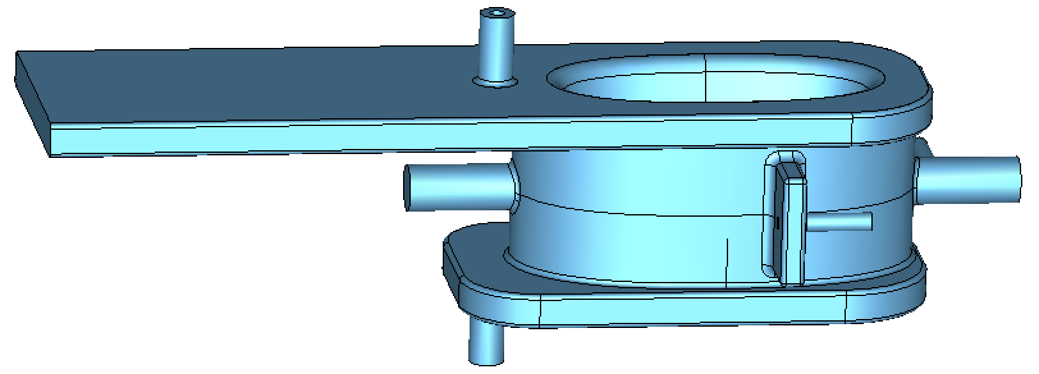
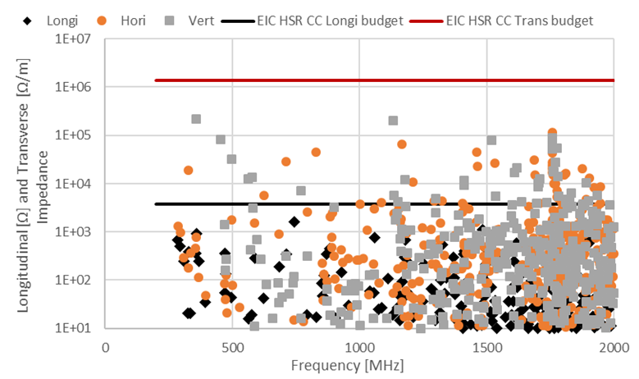
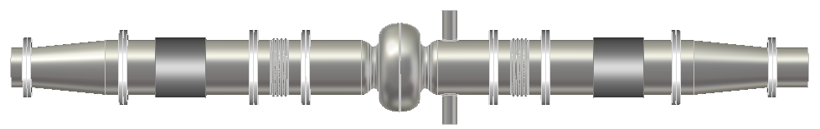
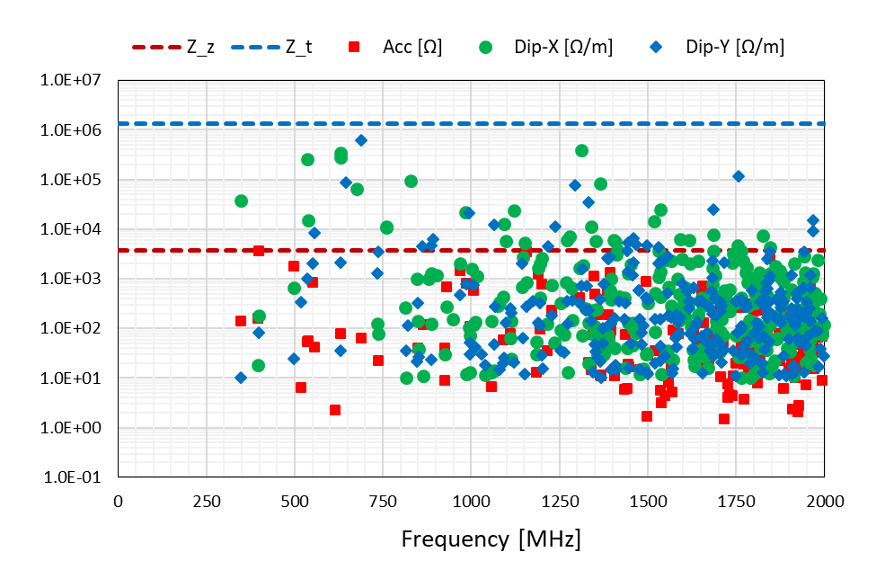
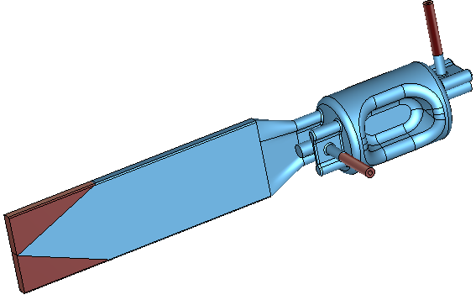
Challenge from Beam Dynamics 4 – Impedance
Keep the summation of the impedance of all elements through out the ring under a certain threshold helps to decrease the beam collective effect, and is one of the key elements of reaching high intensity.
The ESR cavities at 591 MHz, with a total number of 17, are not on the main player list in the ESR Impedance field, after extensive designing work.
The challenge comes from the RF power extracted when damping the Higher Order Modes (HOM) to the threshold limit set by beam instability study.
The HOM damping design provided sufficiently low impedance but resulted in high RF power absorption in the Beam Line Absorbers (BLAs).
The HSR has a very strict longitudinal narrow band impedance threshold around 300 MHz, which is < 320 kΩ (still under study).
Proton crab cavities at 197 MHz, with a total number of 8, have their first HOM resonant in this frequency neighborhood.
A combination of waveguide and coaxial coupler are used to maximize the HOM damping capability within a limited space for cryomodule installation.
F. Marhauser
DQW type, B. Xiao
Monopole
Dipole
RFD type, S. De Silva

Slide 16
Challenges from SRF Technology
02
Cavity and RF couplers

Slide 17
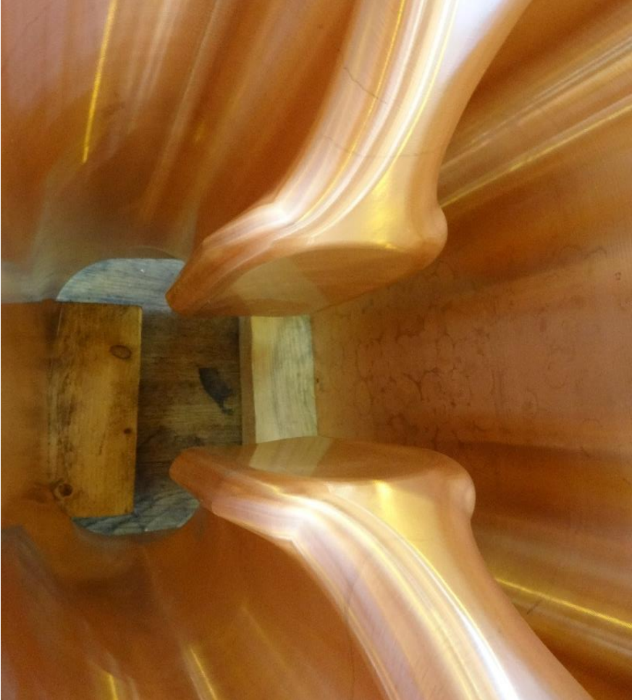
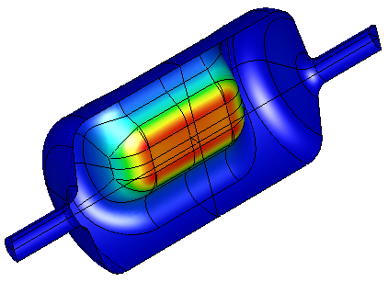
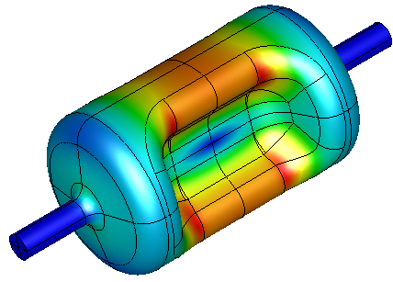
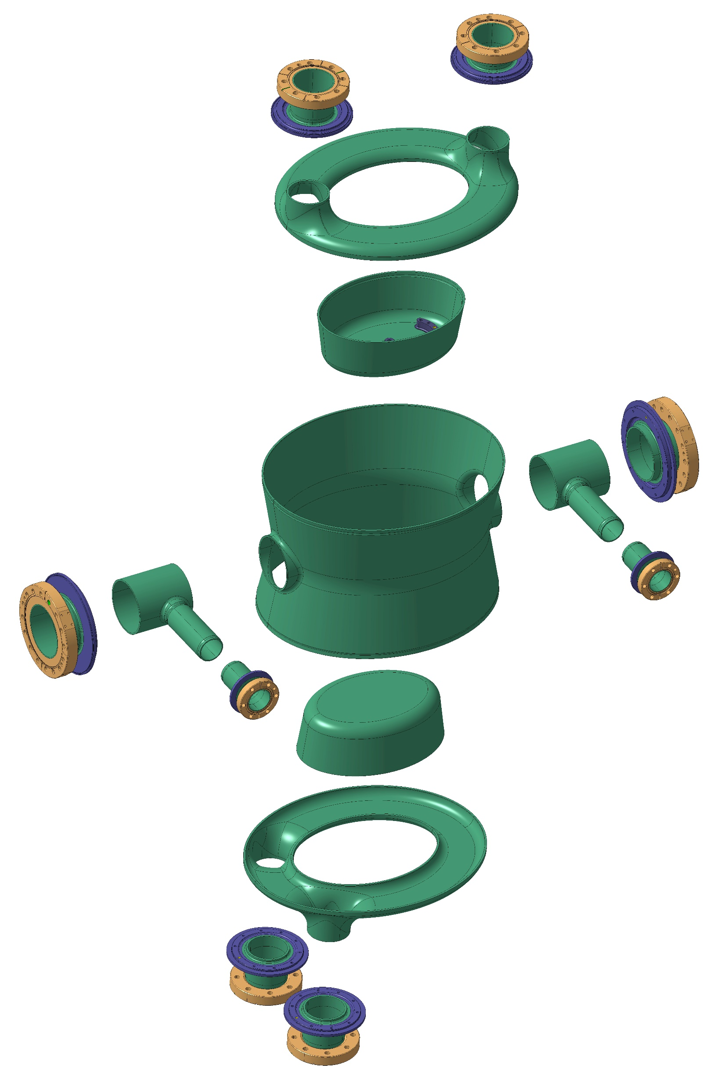
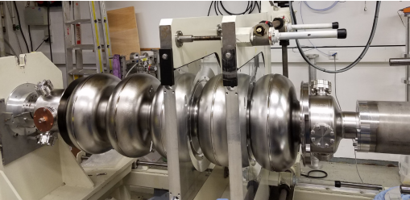
SRF Technology Limitations 1 – Cavity Design
Projects prefer mature cavity systems, but there are always motivations for innovative designs
The EIC SRF cavities, like all cavities, must
Fulfill the requirements from beam dynamics studies
Be constrained by our routine SRF cavity limitations at nominal operation point
  Peak surface field
  HOM damping
  Sufficient tuning (pre-tuning + active tuning)
  High input RF power
  None or only soft multipacting barriers
  Low multipole components
  etc.
EIC RFD Crab Cavity @ 197 MHz
Peak E
Peak B
S. De Silva (ODU)
LHC DQW Crab Cavity @ 400 MHz
EIC DQW Crab Cavity @ 197 MHz
Balloon cavity at Triumph
Z. Yao, LINAC2018
Wide Open Waveguide Crab Cavity for FCC
A. Grudiev, FCC Week 2018
Prototype 5-cell elliptical cavity @ 650 MHz
W. Xu (BNL)
EIC 5-cell cavity for RCS and HSR @ 591 MHz
M. Garlasche, Laurene Giordanino (CERN)
D. Holmes (BNL)

Slide 18
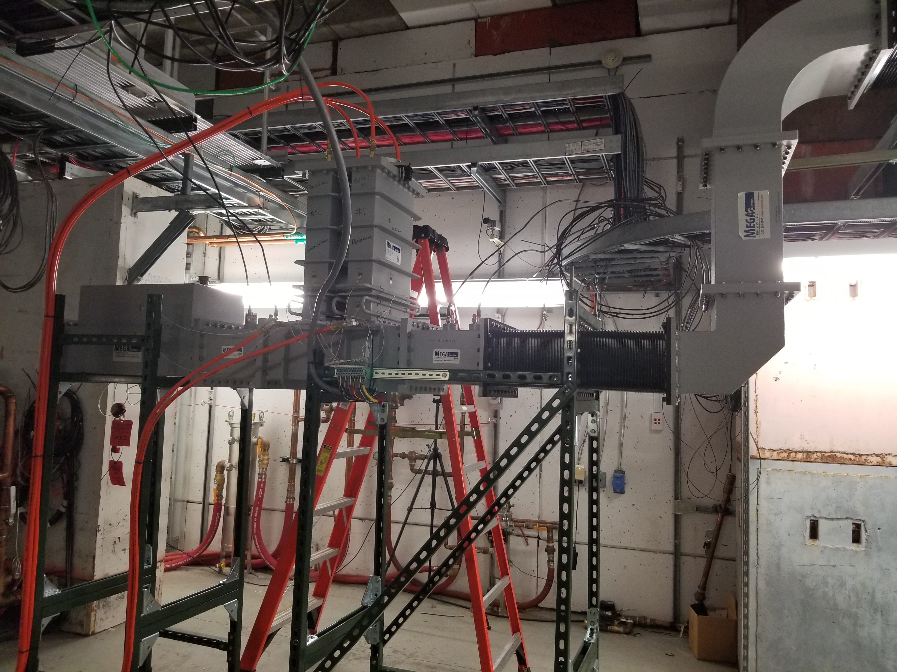
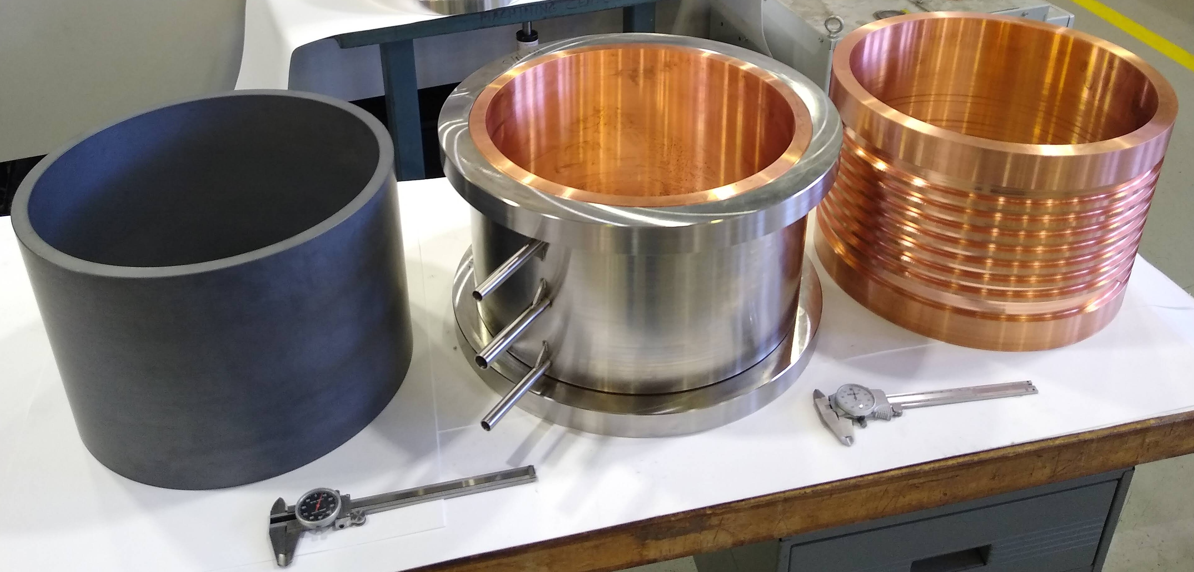
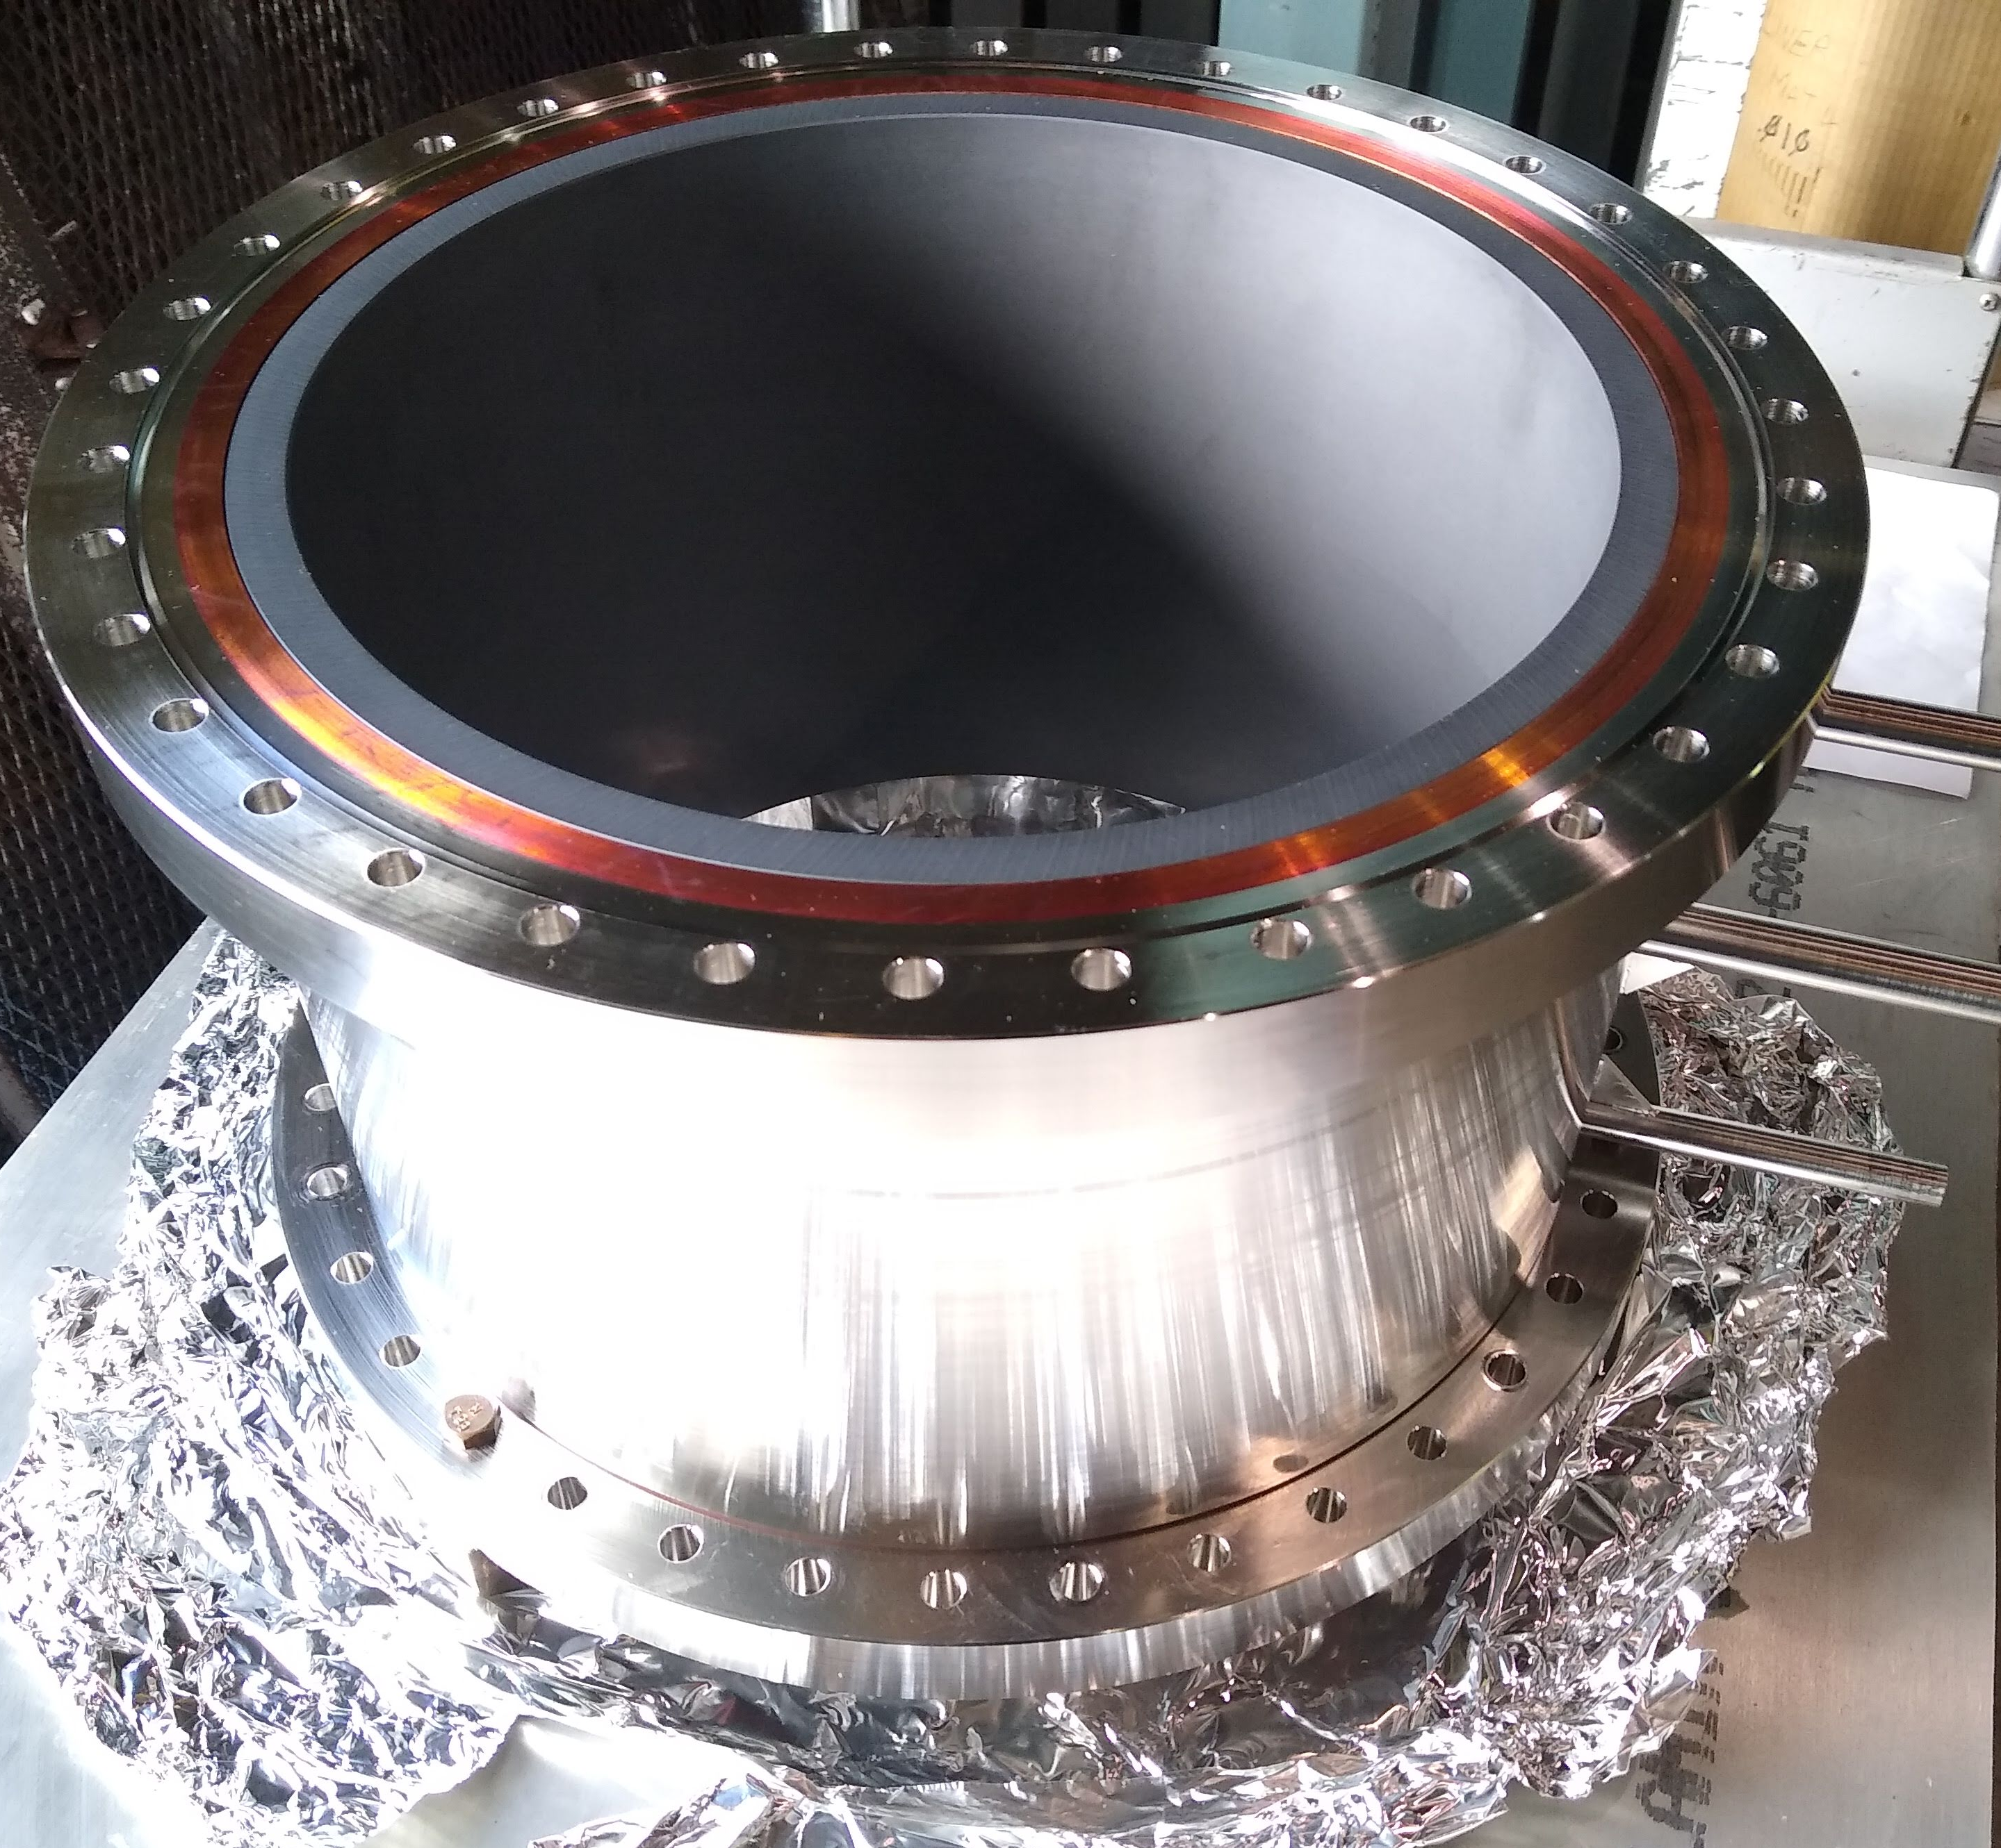
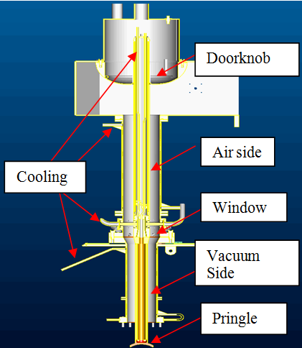
SRF Technology Limitations 2 – RF Couplers
Producing a high performance, reliable, and cost-effective coupler is a highly multidisciplinary task. On the other hand, a failed coupler design would have a serious impact on the accelerator operation.
In the ESR, there are two challenges associated with the RF couplers of the 17 SRF cavities:
12.6 MW input power to compensate the synchrotron radiation and HOM loss → 800 kW per cavity → 400 kW per FPC
830 kW HOM power absorption to achieve the required impedance → 48.6 kW per cavity → 24.3 kW per beam line absorber
High Power BLA Components
Fully Completed shrink-fit Assembly
W. Xu (BNL)
D. Holmes (BNL)
20 kW Beamline HOM Absorber for ESR SRF Cavity @ 591 MHz
80 kW HOM power/cavity distributed onto 4 absorbers
Room temperature with water cooling
Mechanical and thermal FEA simulations completed
Final machining of first high power assembly is finished
Vacuum outgassing tests of SiC material and final high power BLA test is under way
Low-power testing with copper cavity and high-power testing with 1MW klystron are planned
Prototype FPCs are designed and fabricated
Demonstrated proof-of-principle of the Waveguide Tuner (Q_{ext} adjustable by a factor of 20) and FPCs (400 kW CW, full reflection, various phases)
Testing 500 kW waveguide tuner with a 500 kW fixed power coupler.
Solution to long lifetime of RF window is planned next.

Slide 19
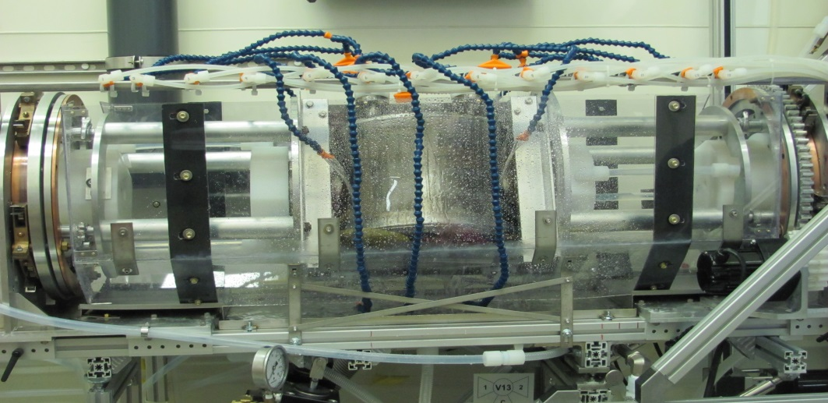
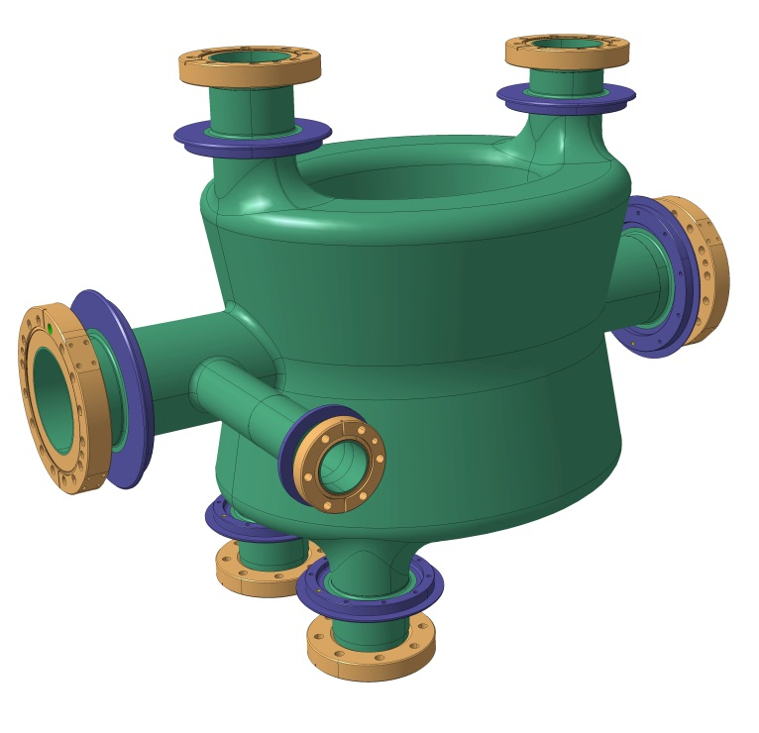
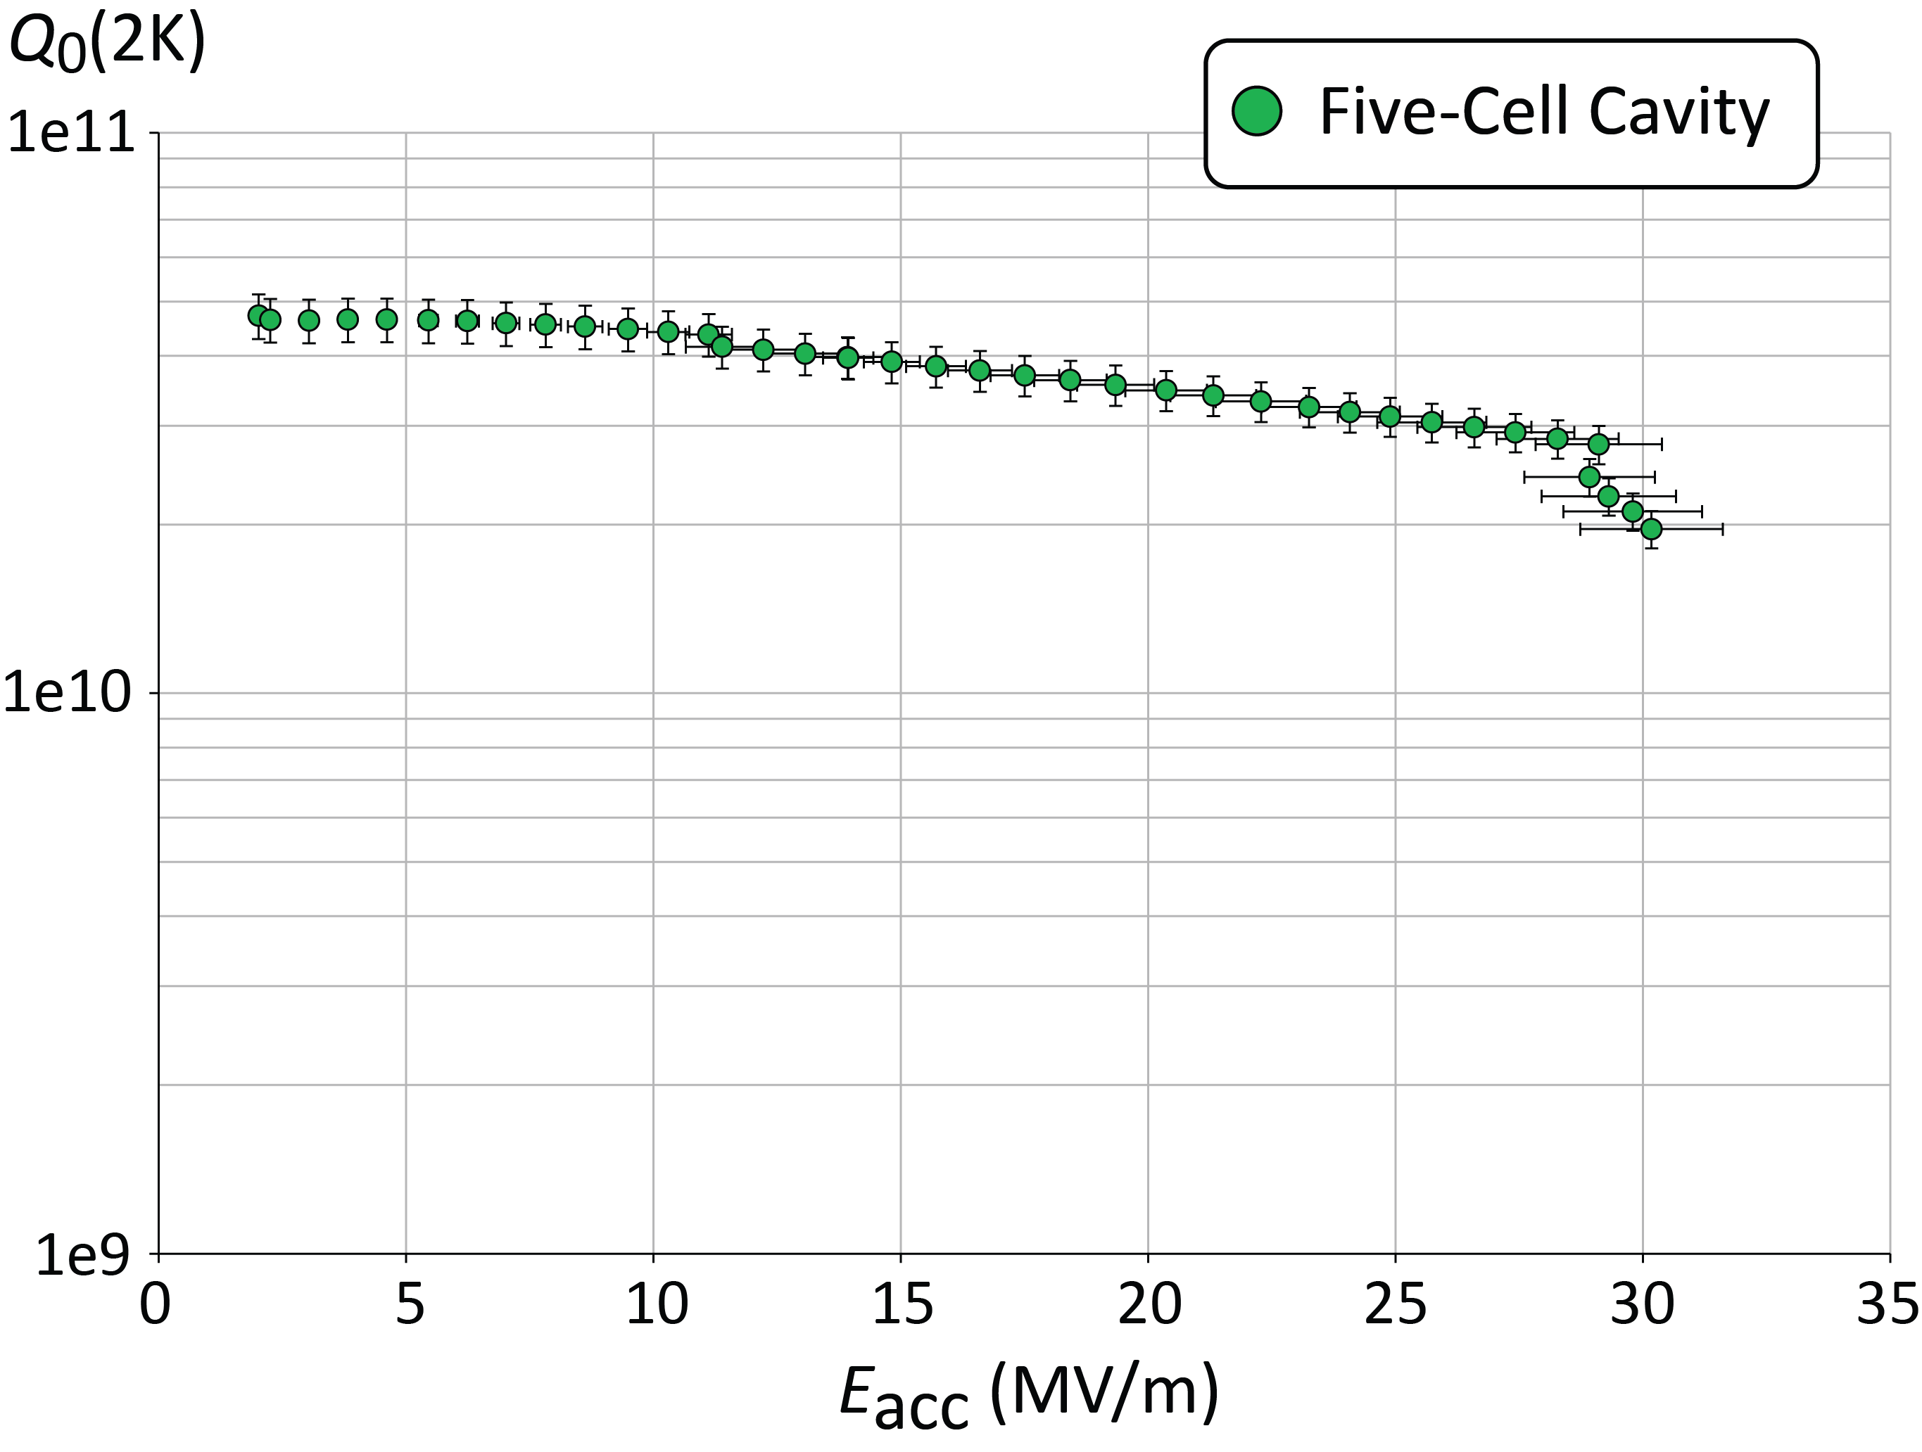
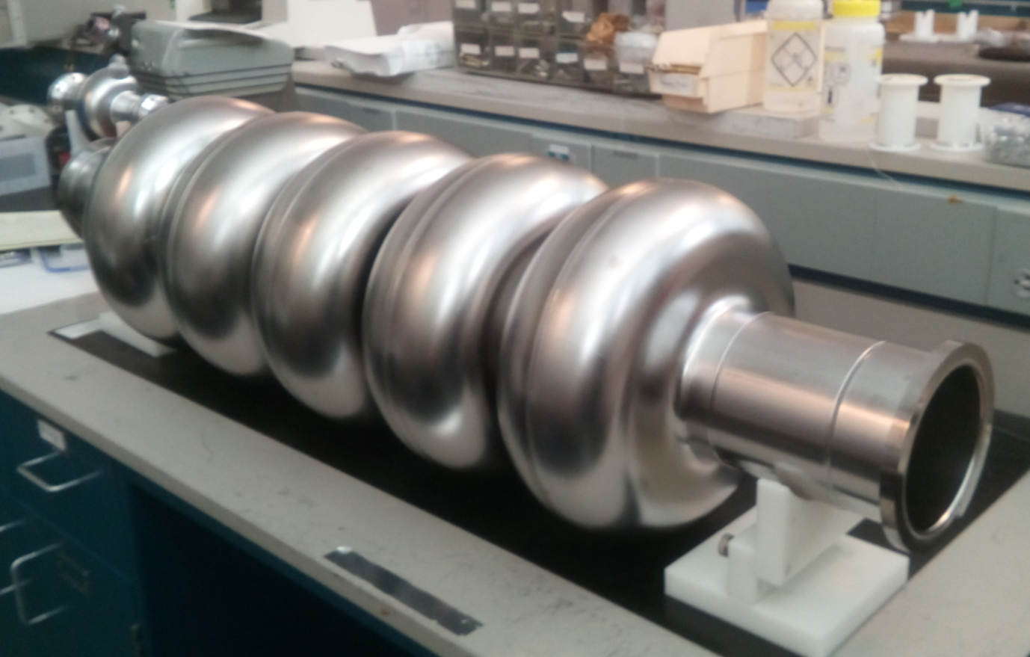
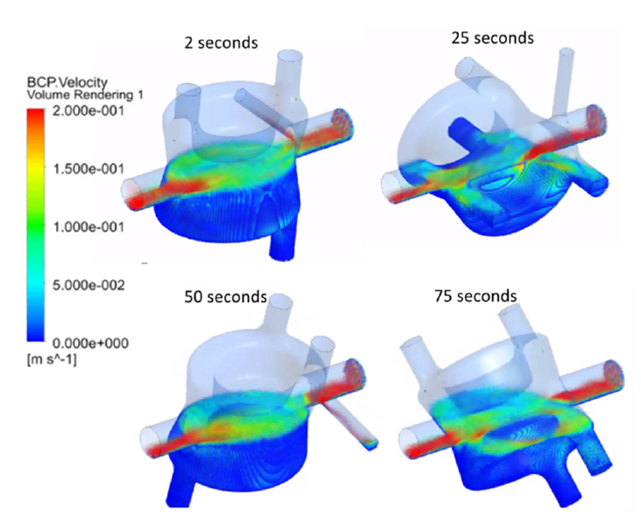
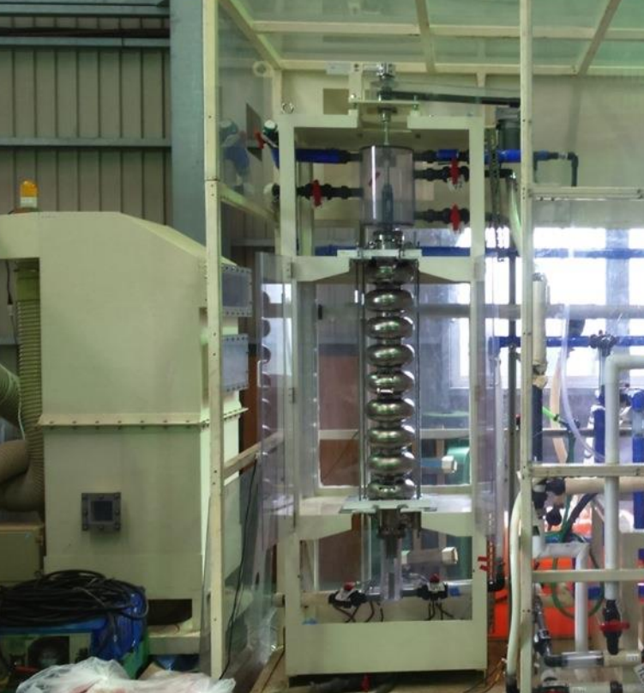
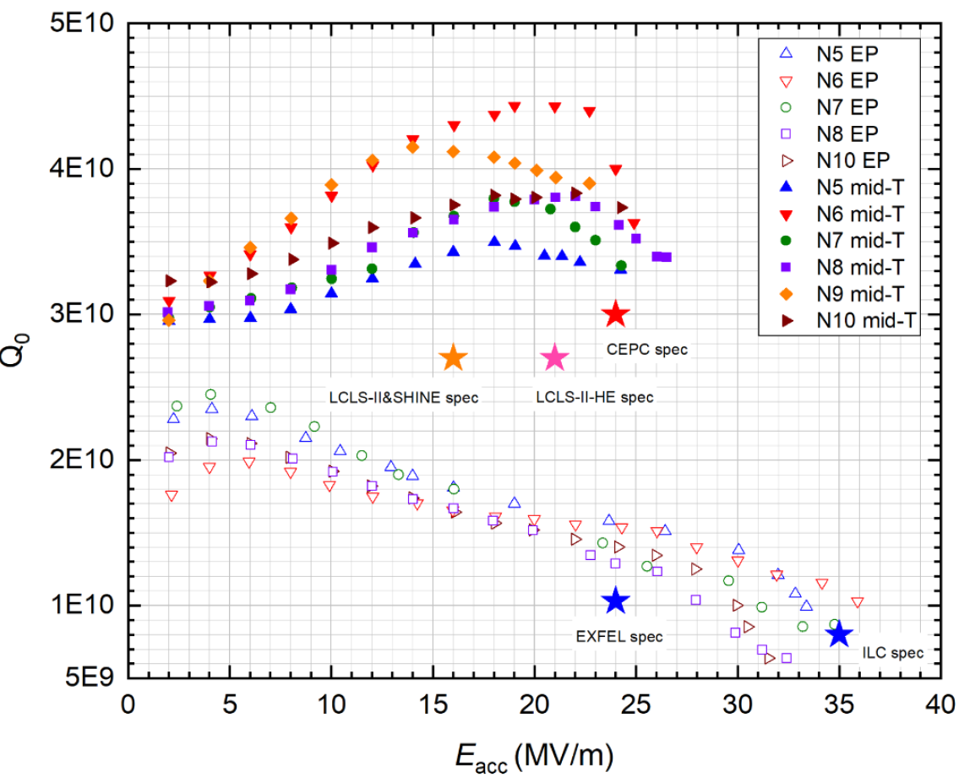
SRF Technology Limitations 3 – Preparation
PoP and Prototype LHC DQW Crab Cavity
The goals for EIC SRF cavities are not trivial
Maximum surface magnetic field → 80 mT
Maximum surface electric field → 40 MV/m
Continuous CW operation for months
M. Kelly (ANL)
JLab/CERN initiative towards SRF cavity development for high beam current machines
2013
DQW crab cavity under rotational BCP at ANL.
Benefit EIC crab cavities
F. Marhauser, FCC Week 2018
2017
Ongoing collaboration
802 MHz 5-cell Nb cavity with
bulk BCP
800C bake
final EP
HPR x 4
120C bake
T. Jones, SRF2017
V. Chouhan, AWLC2017
Benefit EIC ESR cavities
Q₀(2K) = 3e10 @ ~27 MV/m
Other technology might be established in time for EIC:
F. He, This Meeting
1.3 GHz 9-cell Nb cavity with
EP
High-temp bake
Air exposure
Mid-temp bake
HPR
EIC ESR Cavity @ 591 MHz
Q₀ @ 2.0 K (Including 10 nΩ R_{res}) → 2.3×10¹⁰ @ E_{acc} = 15.8 MV/m
Flow speed analysis of rotating cavity.
Vertical EP at KEK

Slide 20
Challenges from Production and Installation
Production and Installation
03

Slide 21
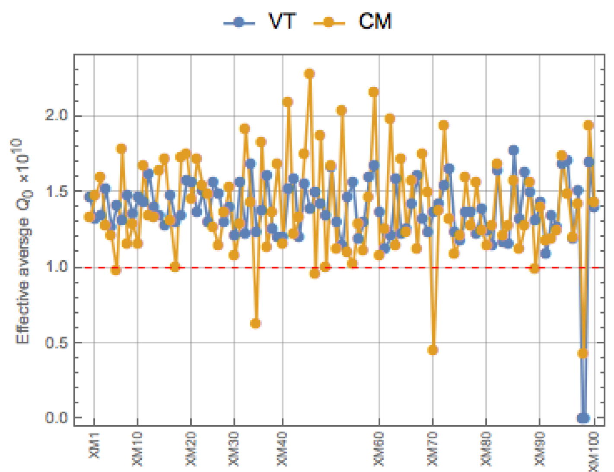
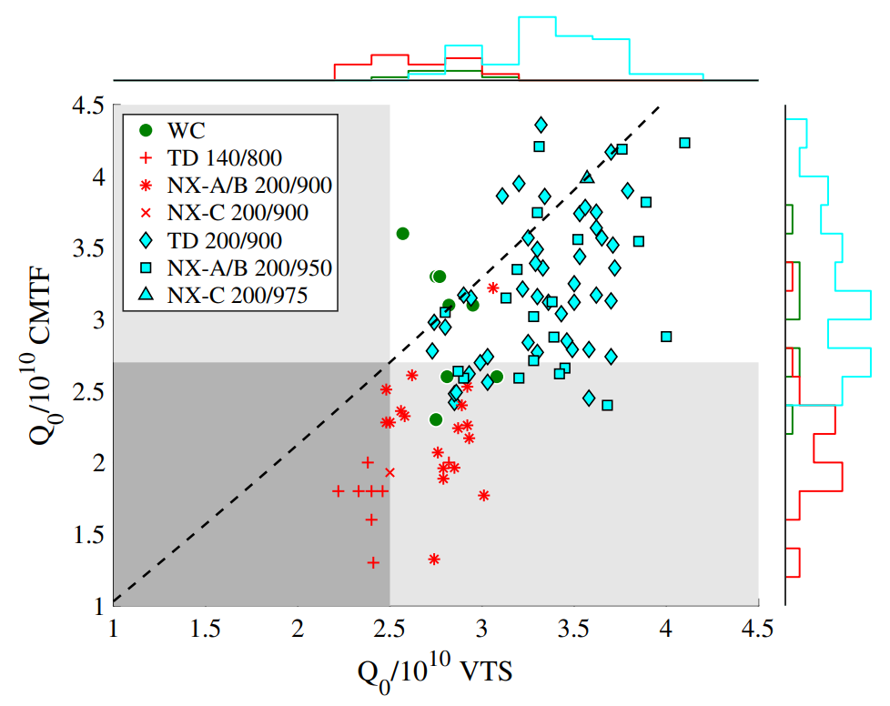
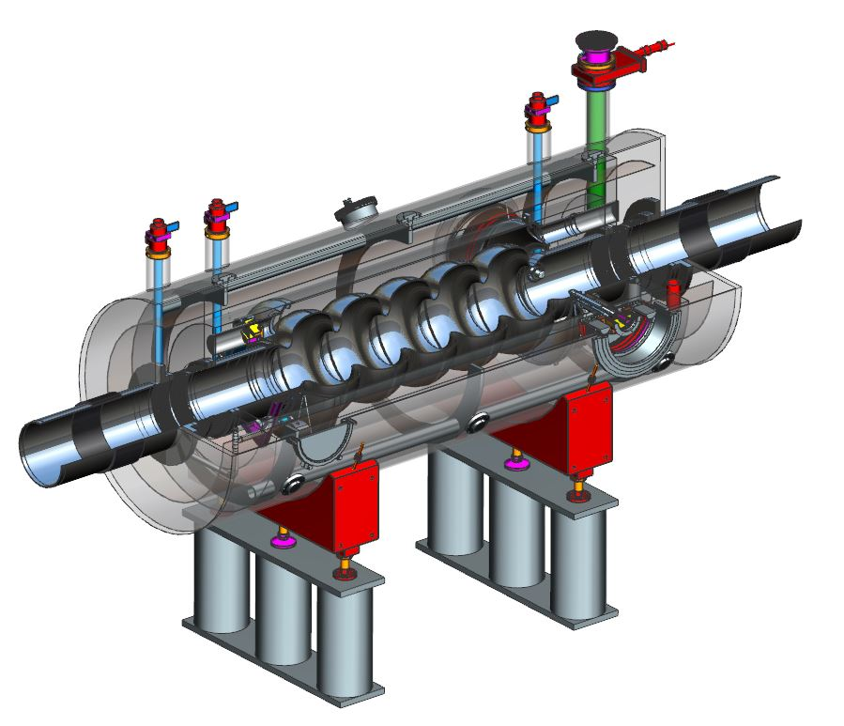
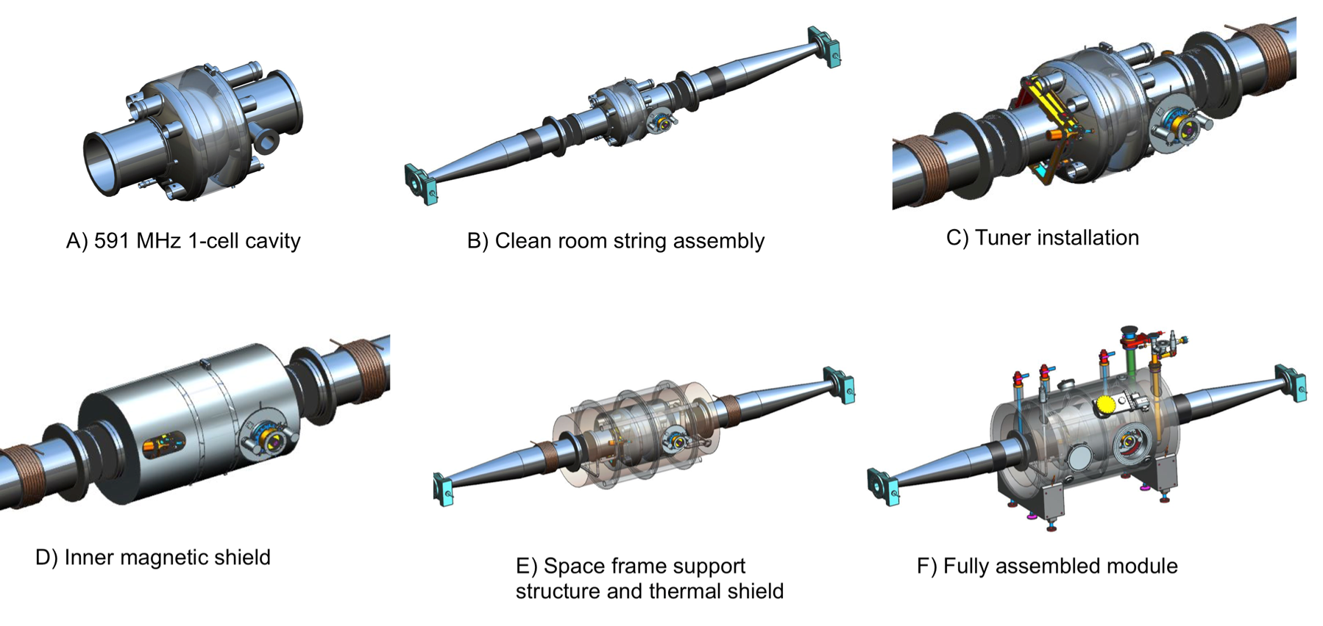
Production Bottle Neck 1 – Before and After Dressing Up
Recently projects have proven a high degree of modularity in designs to minimize production challenges.
N. Walker, LINAC2016
S. Posen, G. Wu, et.al., PHYSICAL REVIEW ACCELERATORS AND BEAMS 22, 032001 (2019)
The EIC project will face a variety of cryomodules, and each of them will introduce different design, fabrication, and assembly challenges.
HSR/RCS 5-cell cavity cryomodule options
J. Henry and D. Holmes
XFEL 9-cell cavity @ 1.3GHz
LCLS2 9-cell cavity @ 1.3GHz
197MHz crab cavity cryomodule
ESR cryomodule
sub-assembly view of EIC ESR cryomodule

Slide 22


Production Bottle Neck 2 – RF Power Supply
Solid state amplifiers will provide all the power demanded by the rings.
13MW of installed power planned final operation of ESR
Each ESR SRF cavity at 591 MHz has two fundamental mode couplers with each input 400kW to mainly compensate the electron energy loss from synchrotron radiation.
For 17 SRF cavities, a total of 34 solid state amplifiers at roughly 400kW rating are stationed in specialized building near the IR10
Each amplifier combining multiple modules of 6-10kW each
Cooling water and control panels will be connected to each amplifier cabinet.
The challenges focus on estimation of schedule, coordination between resources, and planning.
K. Smith and J. Preble
EIC Director’s Review, December 8-10, 2020
Alexander Zaltsman

Slide 23



Installation Bottle Neck 1 – Cavity Alignment
Cryomodule installation is challenging when cavity alignment has very small tolerance.
Q. Wu, T. Xin, B. Xiao, BNL Tech Report, BNL-220782-2021-TECH
H. Wang, NAPAC2016
Resolution of the stretch wire system is the key to achieve an accurate installation
Stretch wire method illustration for searching electric center of an RF cavity
A stretch wire method has been developed at Jefferson Lab to find the electrical center of the cavity after its fabrication. The electrical center defined by the final wire location can be surveyed with respect to the cavity end flanges.
 | X_stage1 | Y_stage1 | X_stage2 | Y_stage2
EC 1 | 1.81737 | 38 | -134.25 | -30.22
EC 2 | -22.95 | 37.33 | -130.13 | -30.22
EC 3 | -31.317 | 36.9875 | -123.473 | -30.4851
EC 4 | -34.2 | 37.3 | -139.6 | -30.5
Rotation angles between measured electrical center plane and cavity symmetry plane (green plane in figure above)
Rotation angle along X axis (deg) | Rotation angle along Y axis (deg) | Rotation angle along Z axis (deg)
-0.0017 | -0.3143 | 0.3067
Electrical Center locations set by stretched wire scanning. Coordinates are relative to a preset origin of the motor; unit is in centimeter.

Slide 24
Challenges from Operation and Controls
Operation and Controls
04

Slide 25


Operation and Controls 1 – Feedback System
Emittance growth rate due to crab cavity RF noise spectrum
In addition, the noise from electron bunches affects the proton counterparts through beam-beam effects at collision. This may cause emittance growth of the proton beam.
phase
amplitude
P. Baudrenghien, T. Mastoridis, "Transverse emittance growth due to RF noise in the High-Luminosity LHC Crab Cavities", Phys. Rev. ST Accel. Beams 18, 101001, October 2015.
T. Mastoridis
The currently proposed feedback system for proton beam would use the same pickup as the existing LHC Transverse Damper (ADT), but rather than just averaging the transverse position over the bunch, it will estimate the position of both the head and tail of the bunch.
P. Baudrenghien, T. Mastoridis, B. Miller, "Crab Cavity RF Noise Feedback and Transverse Damper Interaction", CERN-ACC-NOTE-2019-0006, February 2019

Slide 26




Operation and Controls 2 – HSR Energy Ramp
At the initial proton/ion accelerating stage of each operation period, the storage cavities and crab cavities must be transparent to the beam to avoid instabilities, which can be done by
      Fast, large range detuning
      Heavy damping
      Counter-phasing with feedback system control
Challenge – High current, MHz level tuning, and precise control at every injection.
N. Shipman, Electrons in the LHC 2019
Q. Wu et al., PHYSICAL REVIEW ACCELERATORS AND BEAMS 22, 102001 (2019)
R. Calaga, HL-LHC Collaboration Meeting 2018
0 Deg
RF phase scan w.r.t the beam phase with SPS crab cavity
90 Deg
Prototype Ferroelectric Fast Reactive Tuner (FE-FRT) for PERLE Cavity @ CERN
180 Deg
fundamental mode damper for SRF QWR @ 56 MHz

Slide 27
Challenges from …
Microphonics
Synchrotron radiation
Machine protection
100mA ERL for SHC
Cryomodule transportation
Cryomodule arrangement in existing tunnel
…

Slide 28
Summary
The EIC project explores the strongest force in nature by colliding electrons with proton and nuclei.
To prepare the particles for effective collision, the accelerator demands high performance from a variety of SRF cavities.
The SRF challenges fall into four major categories
  Beam dynamics
  SRF technology
  Production and installation
  Operation and control
These are challenges based on our experience.
There are more challenges beyond what has been listed in this presentation.
However, it is the part not expected that makes a project exciting.
Study the past if you want to define the future (温故而知新)
― Confucius

Slide 29
Acknowledgement
My deepest appreciation to those names mentioned in this presentation for providing materials and useful discussions.
Thank you

