Slide 1

Modeling Efforts for Integrable Optics Experiments
@ Fermilab
Stephen Webb, David Bruhwiler, Nathan Cook, Jon Edelen, Chris Hall
RadiaSoft, LLC., Boulder, CO
swebb@radiasoft.net
Thomas Jefferson National Accelerator Facility, 27 August 2019
Boulder, Colorado USA – www.radiasoft.net

Slide 2
The Integrable Optics Collaboration
RadiaSoft —
David Bruhwiler, Nathan Cook, Jon Edelen, Yuri Eidelman,
Chris Hall, Ilya Pogorelov, Stephen Webb
    FermiLab —
    Sergei Nagaitsev, Alexander Valishev, Alexander Romanov,
    Jeff Eldred, Sebastian Szustkowski (NIU), Giulio Stancari, Alexei Burov…
    Lawrence Berkley Lab —
    Chad Mitchell, Kilean Hwang, Rob Ryne
    RadiaBeam —
    Ron Agustsson, Alex Murokh, Finn O’Shea
and many others…
Boulder, Colorado USA – www.radiasoft.net

Slide 3
Outline
Integrable Optics: what is it?
the IOTA ring @ Fermilab
off-momentum single-particle dynamics
first nonlinear decoherence experiments @ FAST
impact of space charge
symplectic space charge algorithms
Boulder, Colorado USA – www.radiasoft.net

Slide 4
Integrable Optics — a primer
Boulder, Colorado USA – www.radiasoft.net

Slide 5
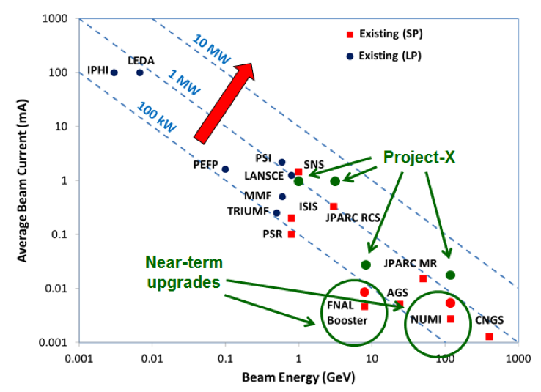
Hadron Accelerators at the Intensity Frontier
from 2013 Snowmass WG3,
“Issues and R&D Required for the Intensity Frontier Accelerators”
arXiv:1305.6917v1 [physics.acc-ph]

Slide 6
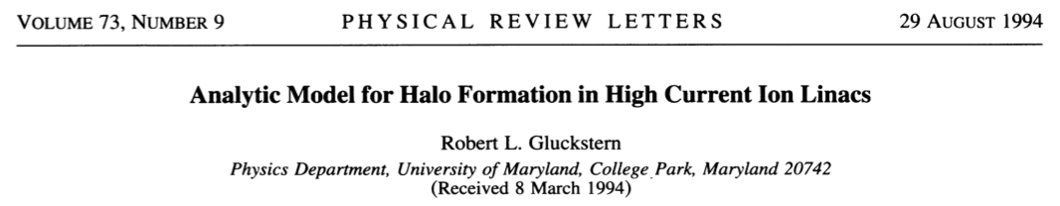
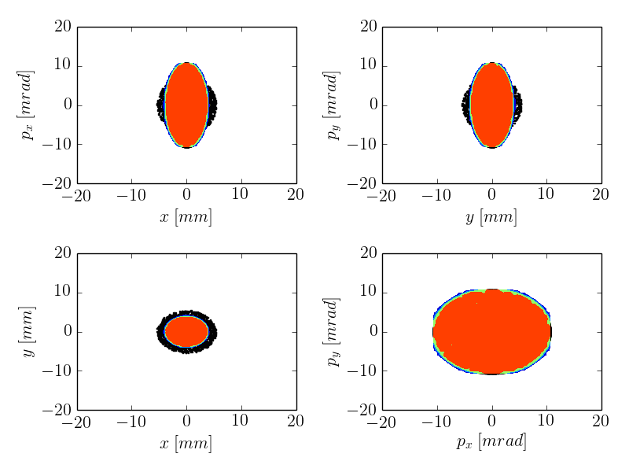
Beam Halo

Slide 7
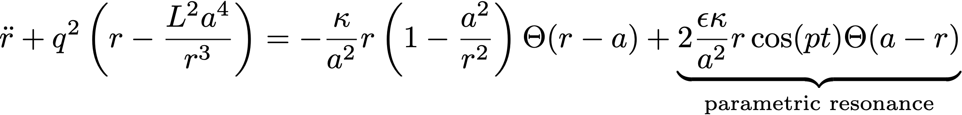
Parametric Resonances & Tune Spread
Nonlinear decoherence — frequency spreads in ensembles which suppress the forcing terms in parametric resonances. This is logically distinct from Landau damping, but has a similar effect.

Slide 8
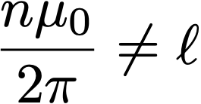


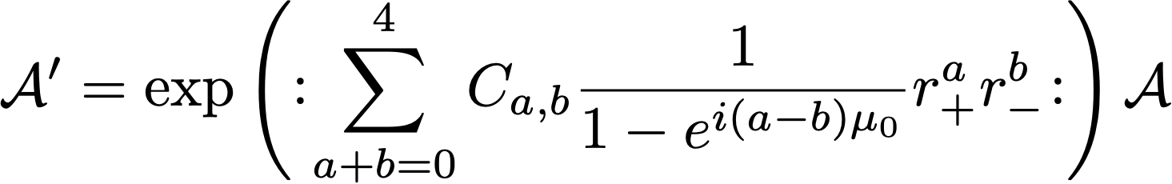

Conventional Nonlinear Schemes Induce Chaos
Perturbative single turn map
Tune spread w/ amplitude
Near a resonance…
Famous “small denominators”

Slide 9
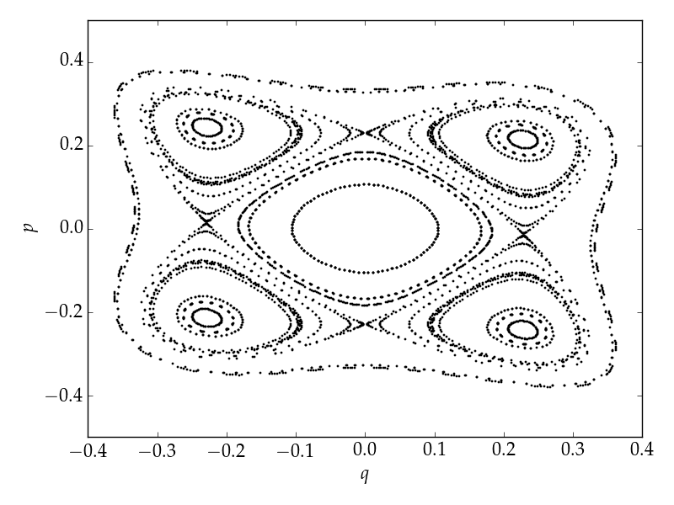

Conventional Nonlinear Schemes Induce Chaos
Resonance Condition

Slide 10
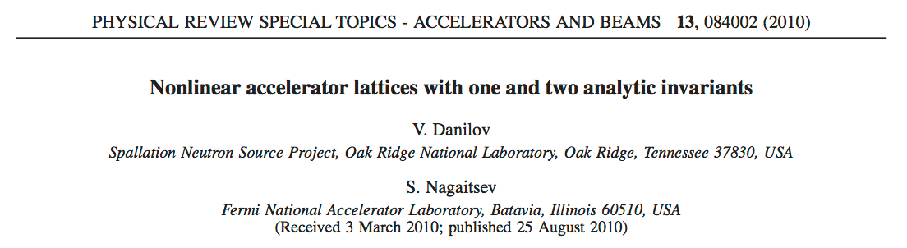
Nonlinear Integrable Optics

Slide 11
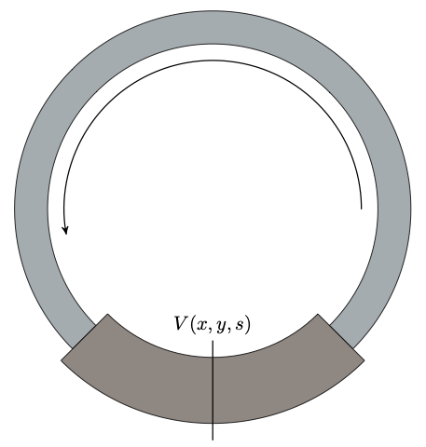
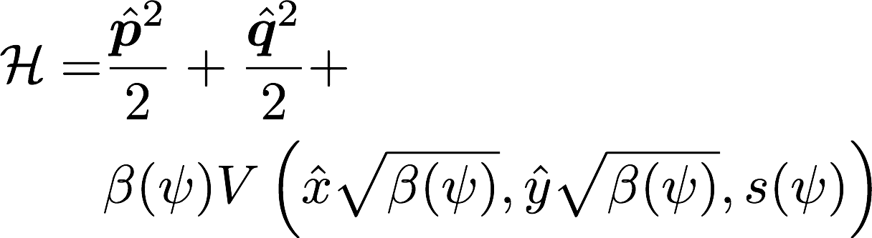
The Danilov-Nagaitsev Hamiltonian
The three main points of the Danilov-Nagaitsev paper:
if the potential is time-independent, then the Hamiltonian is an invariant
axisymmetric accelerator lattices can be designed in several ways (we have opted for the arc with the π phase advance, also suggests solenoids)
it is possible to find a potential U that satisfies both the Laplace equation — the potential is realizable by magnets — and the Bertrand-Darboux equation
Boulder, Colorado USA – www.radiasoft.net

Slide 12
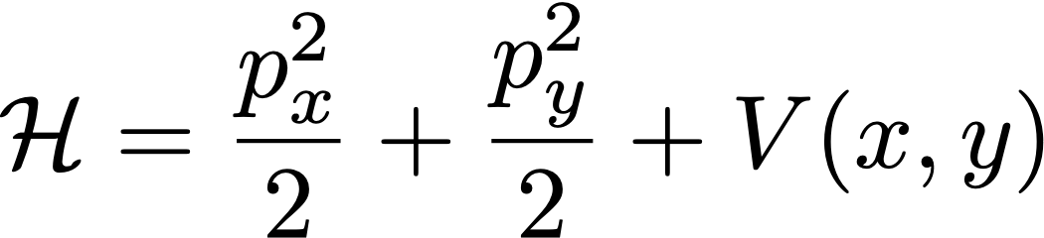
The Bertrand-Darboux equation
If we have a Hamiltonian of the form
then there is a second invariant, quadratic in the momenta, of the form
assuming the potential satisfies the PDE
Boulder, Colorado USA – www.radiasoft.net

Slide 13
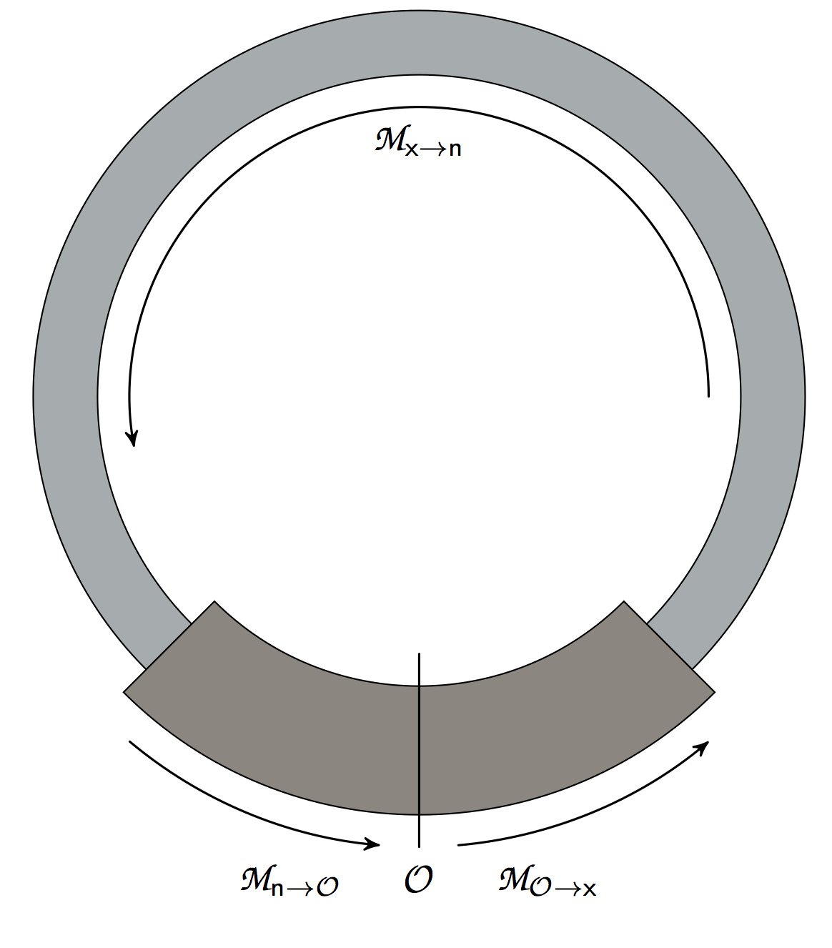
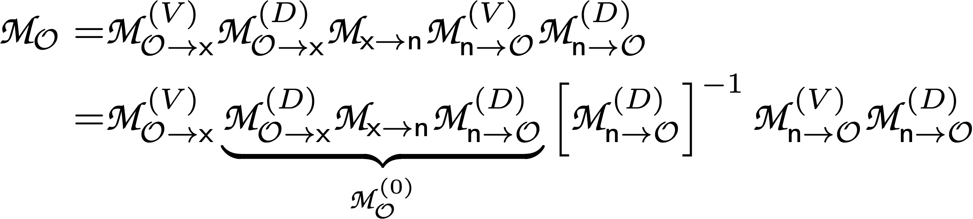
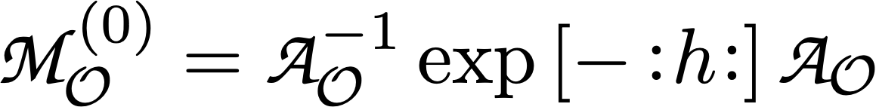
This manifests in real rings
Single-turn map
Factored map formalism isolates the elliptic potential and “bare” lattice
Get an ODE for a coordinate-transformed potential map:
where shaping the potential to the beta function appears
Boulder, Colorado USA – www.radiasoft.net

Slide 14
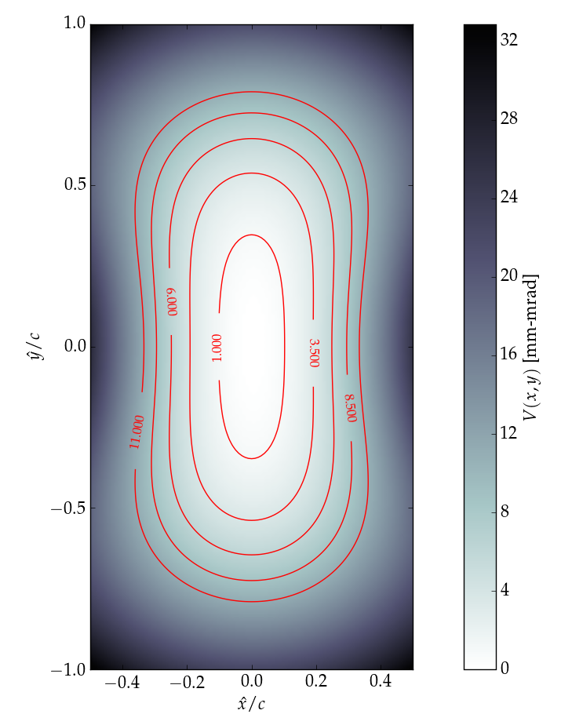
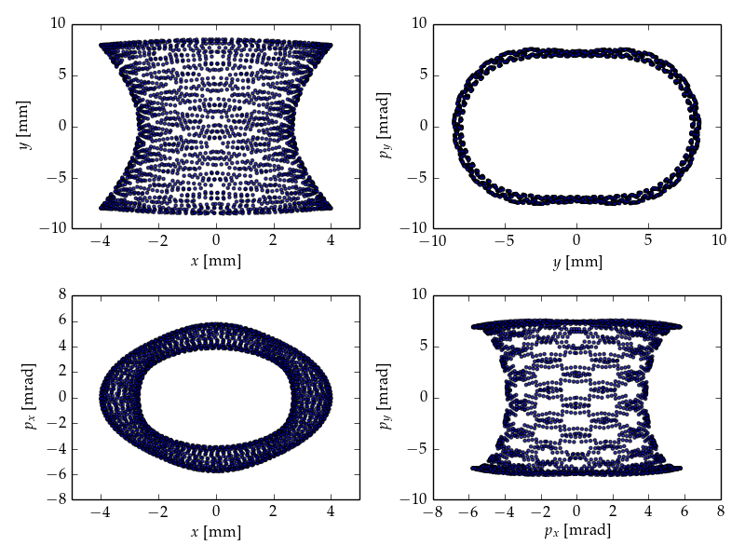
Elliptic Potential Properties

Slide 15
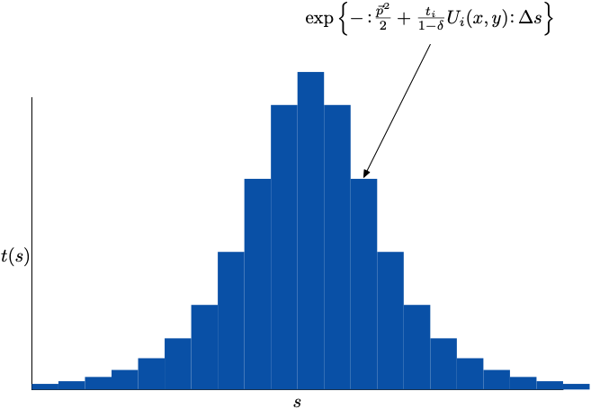
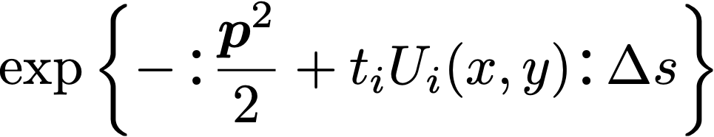
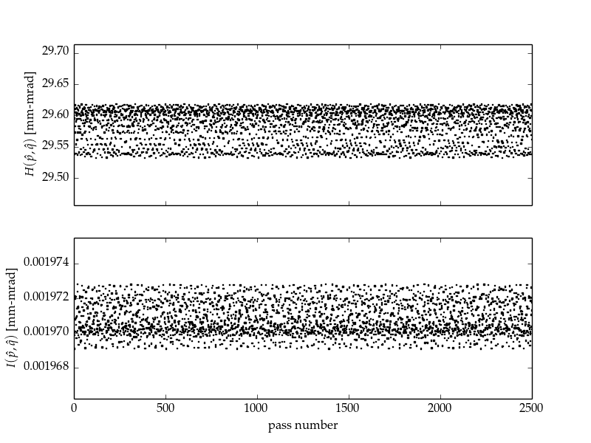
Lattice Design Requirements

Slide 16
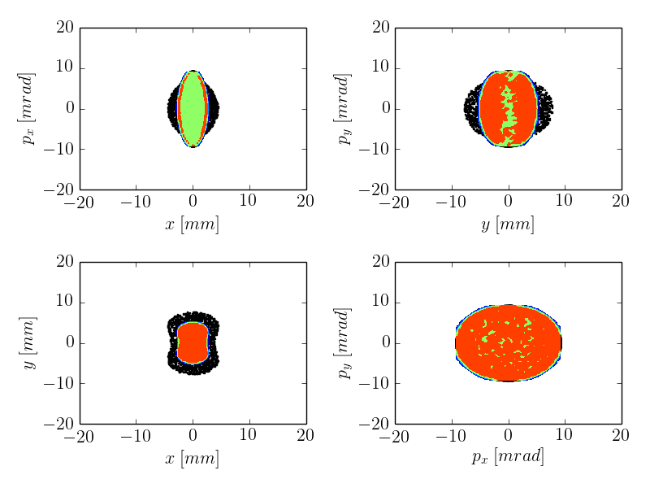
Preliminary Result (~2012) —
Nonlinear Integrable Optics Suppresses Halo

Slide 17
The FAST/IOTA Facility
Boulder, Colorado USA – www.radiasoft.net

Slide 18
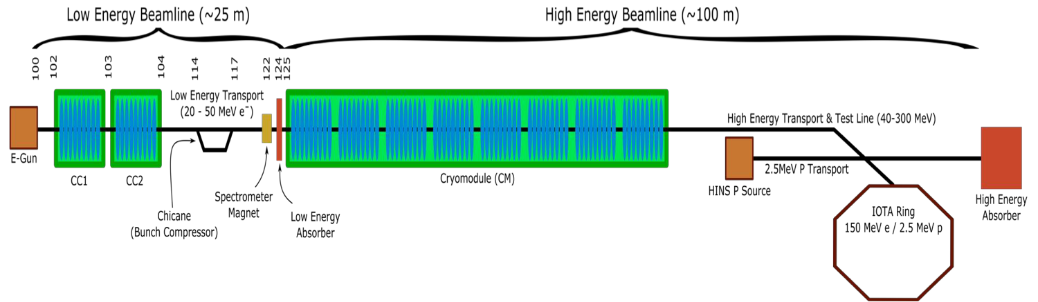
IOTA/FAST Facility —
A Test Facility for Integrable Optics
Boulder, Colorado USA – www.radiasoft.net

Slide 19
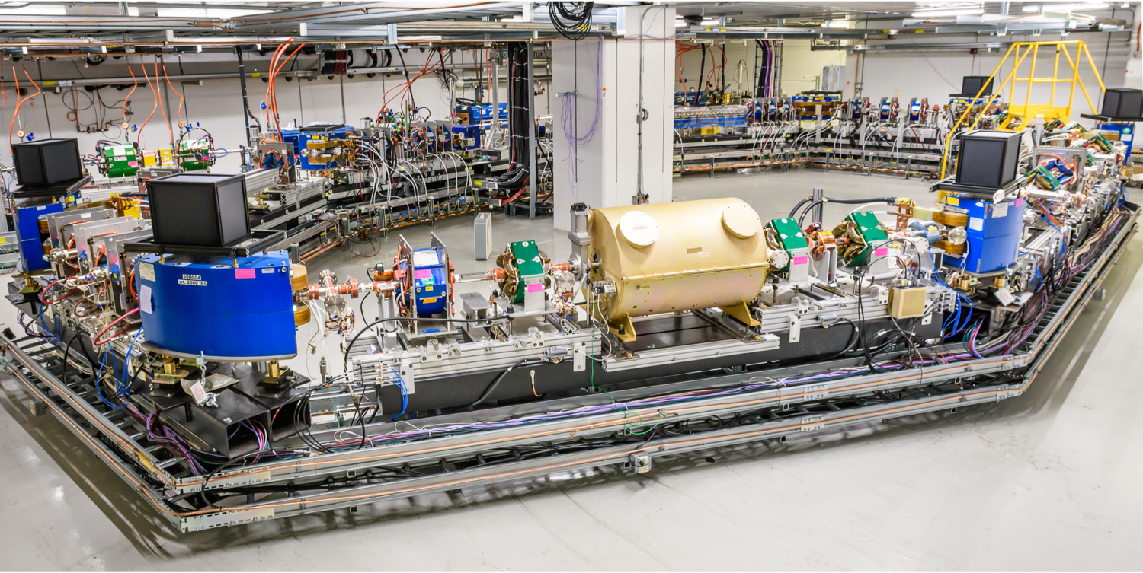
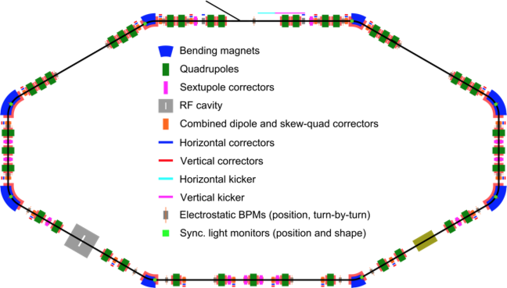
The IOTA ring lives
IOTA Ring, completed July 29, 2018
Schematic of the IOTA ring
Boulder, Colorado USA – www.radiasoft.net

Slide 20
Off-Momentum Dynamics
&
Integrable Optics
Boulder, Colorado USA – www.radiasoft.net

Slide 21
Many years ago…
…or, during the initial RadiaSoft Phase I
We predicted a modified Danilov-Nagaitsev Hamiltonian that included chromaticity and dispersion.
this is the generic Hamiltonian for a lattice with the nonlinear insert in a region of equal vertical and horizontal beta functions. It becomes the Danilov-Nagaitsev integrable Hamiltonian if:
vertical and horizontal tunes are equal; and
the transverse tunes are 2π + ν0; and
the transverse chromaticities are equal (modifies the invariant); and
the dispersion is zero (modifies the invariant; does not break integrability)
Boulder, Colorado USA – www.radiasoft.net

Slide 22
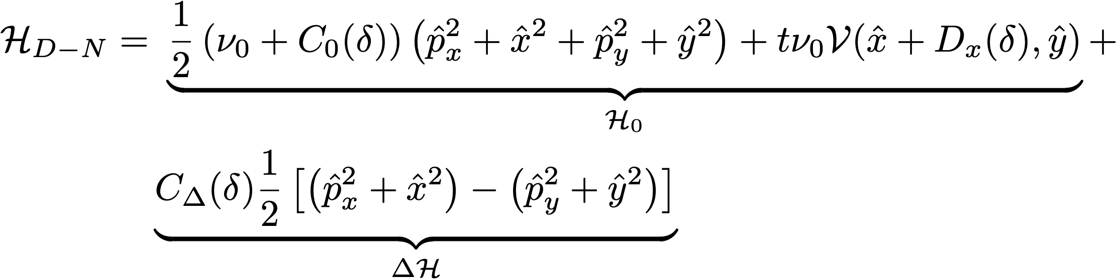
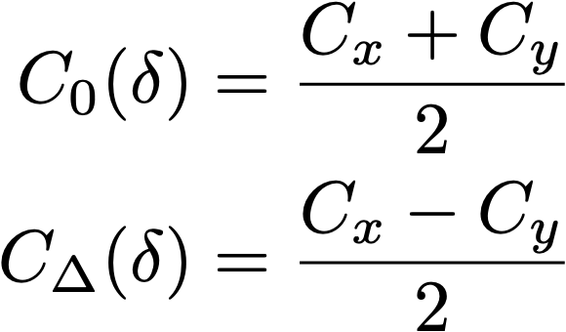
The fundamental picture to keep in mind is that the linear transverse motion is “round”.
Boulder, Colorado USA – www.radiasoft.net

Slide 23
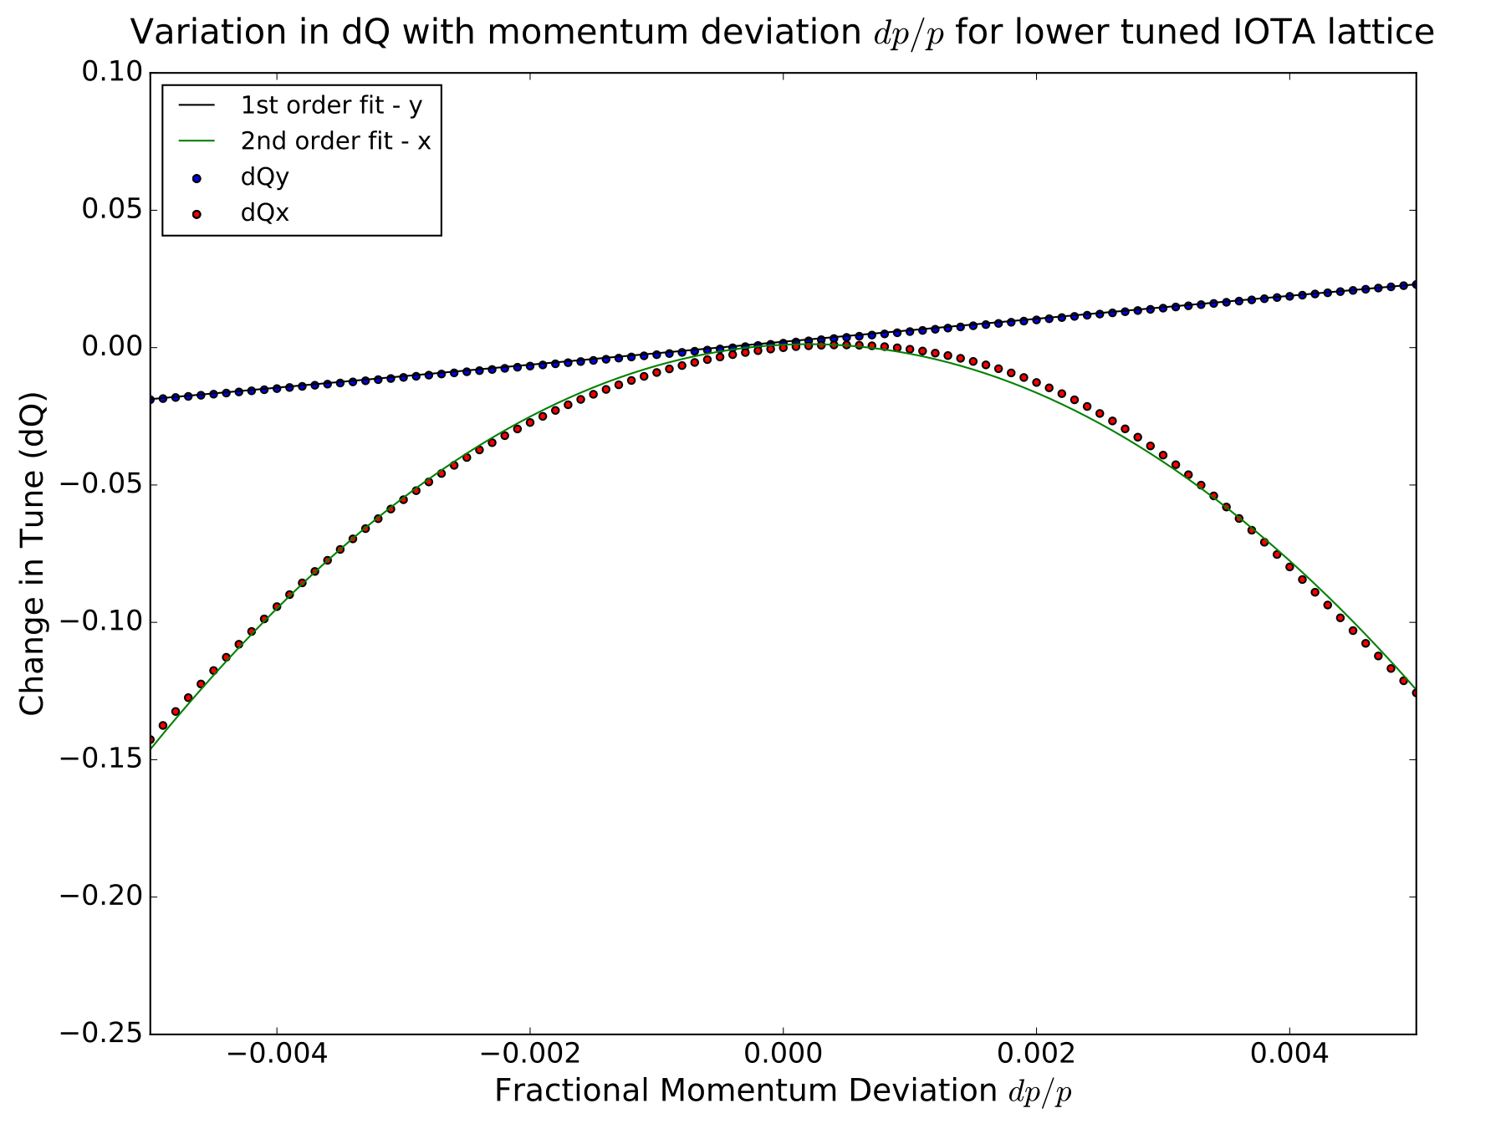
Testing this Hamiltonian proved difficult in simulations of the IOTA ring
The chromaticity is large, nonlinear and, unequal
Boulder, Colorado USA – www.radiasoft.net

Slide 24
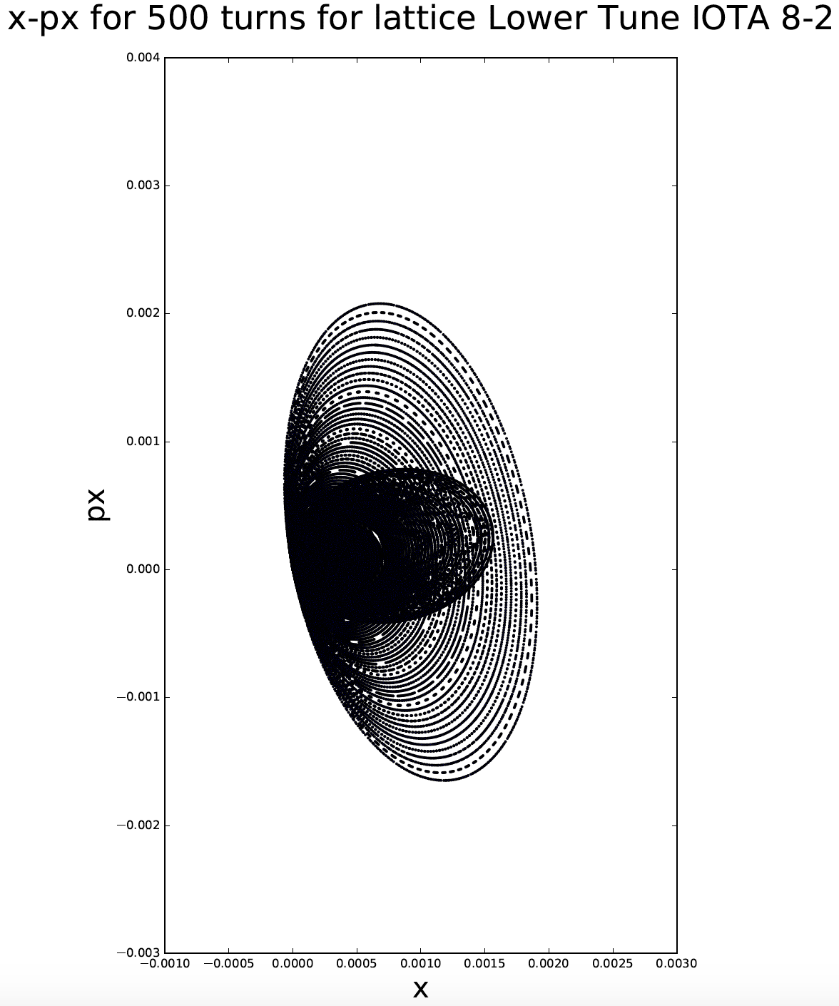
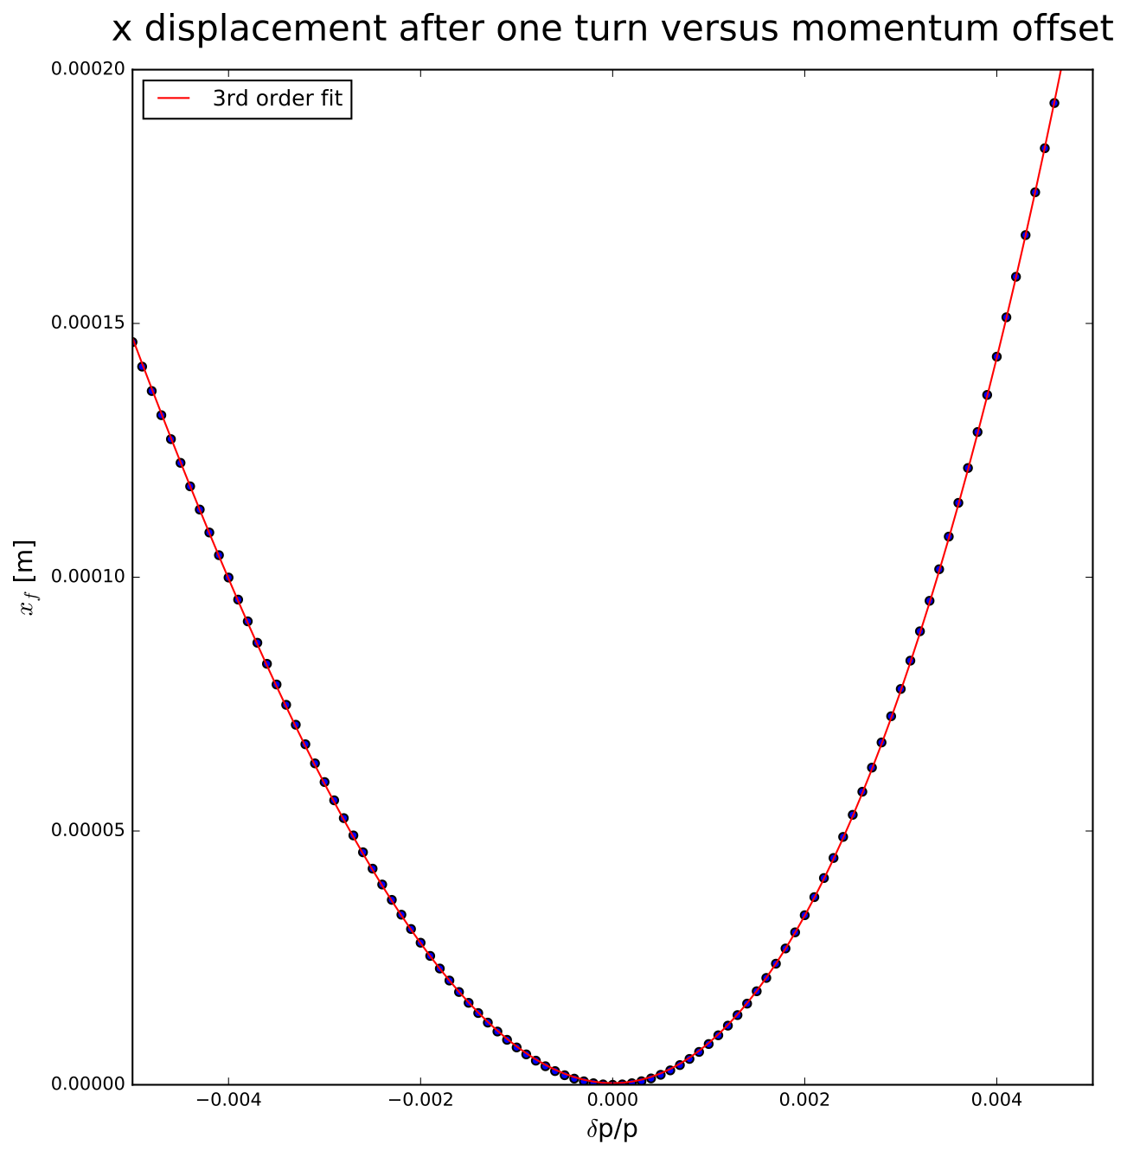
Testing this Hamiltonian proved difficult in simulations of the IOTA ring
and there’s nonlinear dispersion in the nonlinear element insert
Boulder, Colorado USA – www.radiasoft.net

Slide 25
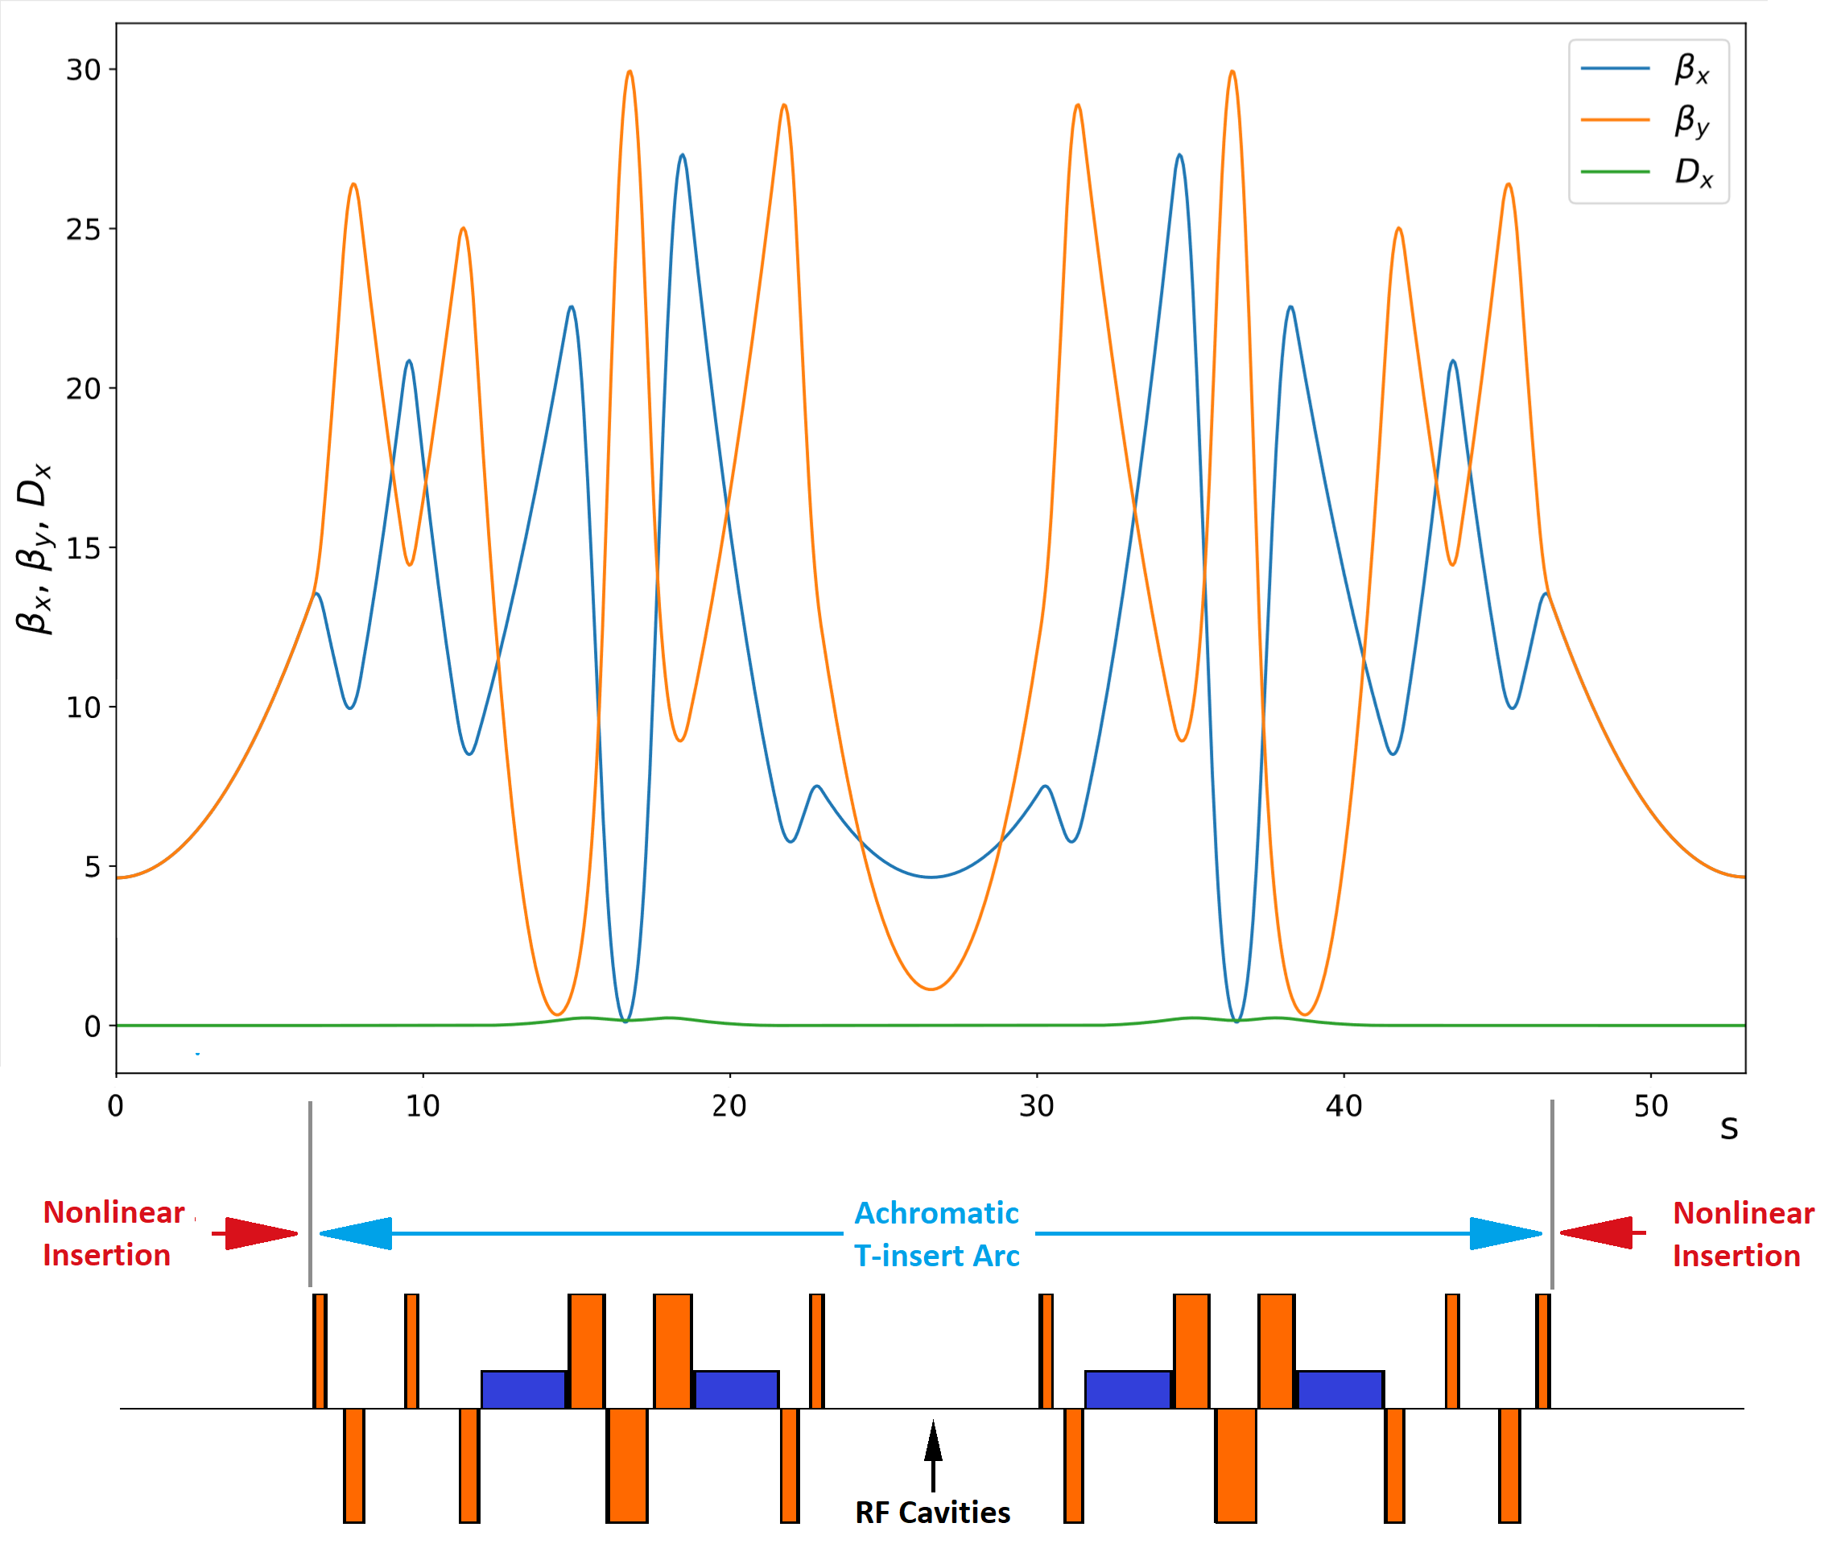
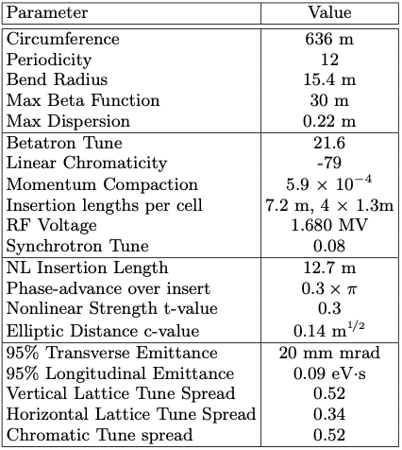
An integrable RCS lattice
Boulder, Colorado USA – www.radiasoft.net

Slide 26
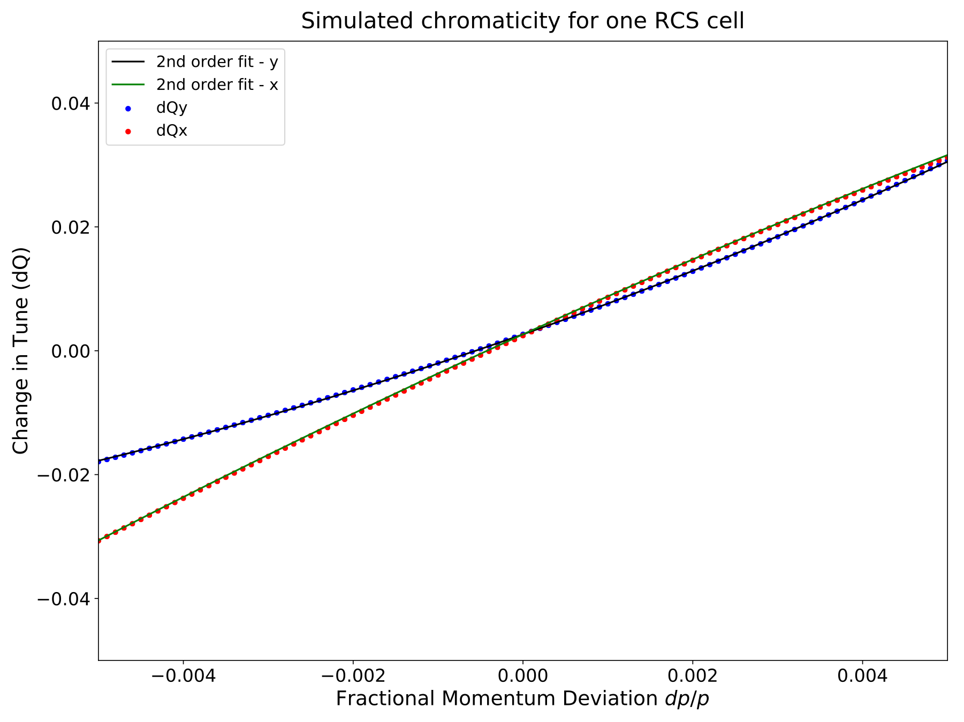
The iRCS lattice may be a better testbed for integrable optics predictions
there is a region of momentum space where the chromaticities are almost equal
Boulder, Colorado USA – www.radiasoft.net

Slide 27
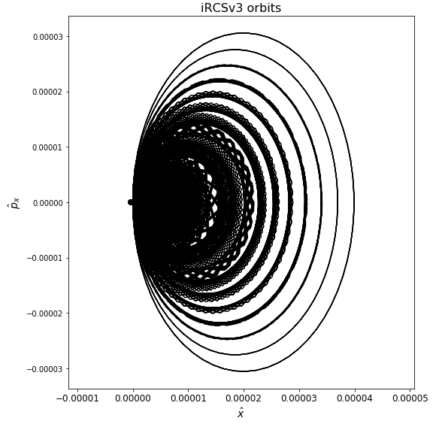
The iRCS lattice may be a better testbed for integrable optics predictions
Boulder, Colorado USA – www.radiasoft.net

Slide 28


With synchrotron oscillations, we expect better integrable behavior for positive momentum offset than negative
Boulder, Colorado USA – www.radiasoft.net

Slide 29
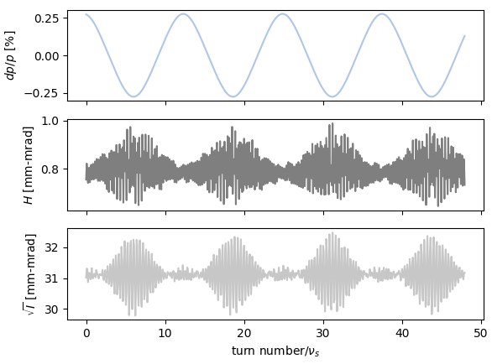
and that is indeed what we found
Boulder, Colorado USA – www.radiasoft.net

Slide 30
note the transition in behavior with the change of momentum sign
Boulder, Colorado USA – www.radiasoft.net

Slide 31
First Experiments at FAST/IOTA
Boulder, Colorado USA – www.radiasoft.net

Slide 32

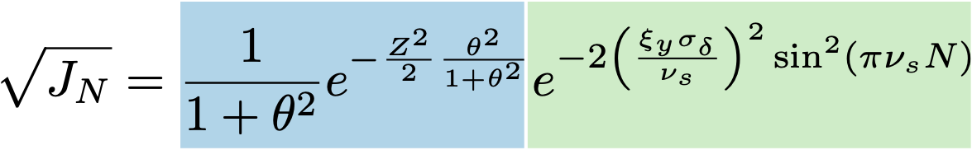
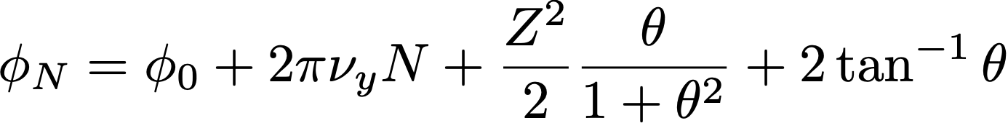


Theoretical predictions of centroid decoherence time
amplitude-dependent tune
chromatic decoherence
Octupole strength
Initial transverse kick
R. E. Meller et al., SSC-N-360
C. X. Wang, “Measurement and Application of Betatron Modes with MIA”,
in Proc. 20th Particle Accelerator Conf. (PAC'03)
Boulder, Colorado USA – www.radiasoft.net

Slide 33
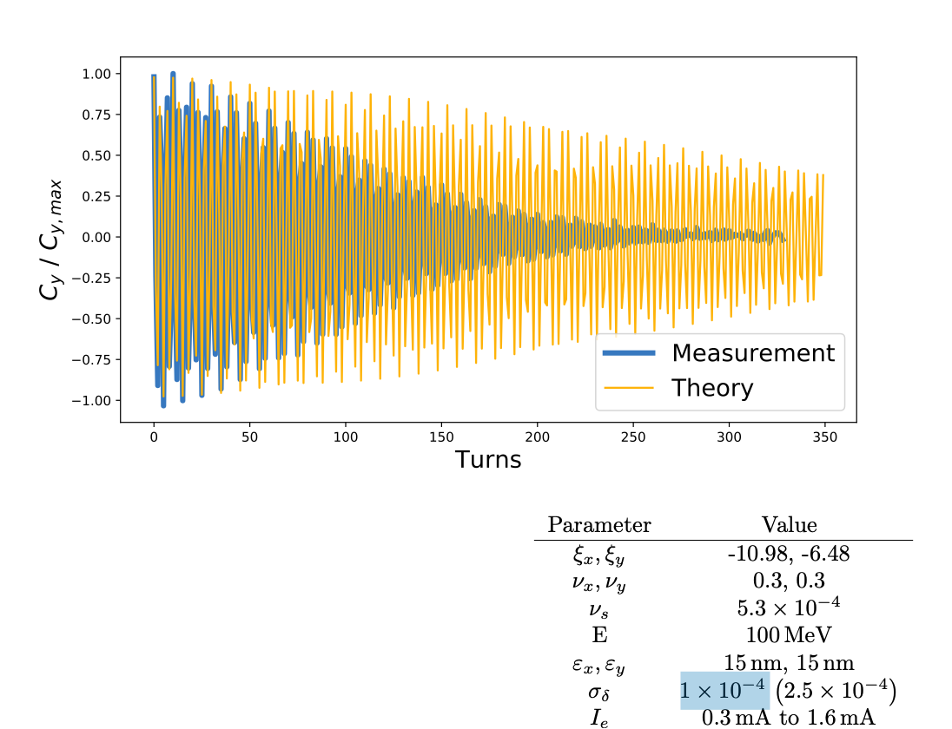
Prediction vs. data with nominal energy spread
Single-particle equilibrium energy spread does not match damping data
Boulder, Colorado USA – www.radiasoft.net

Slide 34
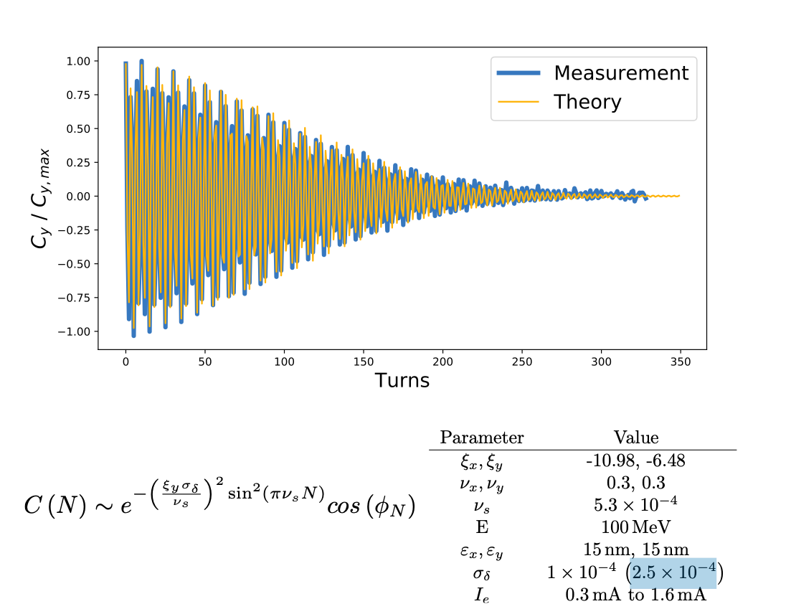
Prediction vs. data with larger energy spread
Assuming a higher energy spread yields excellent agreement with measurements, but where is the energy spread from?
Boulder, Colorado USA – www.radiasoft.net

Slide 35
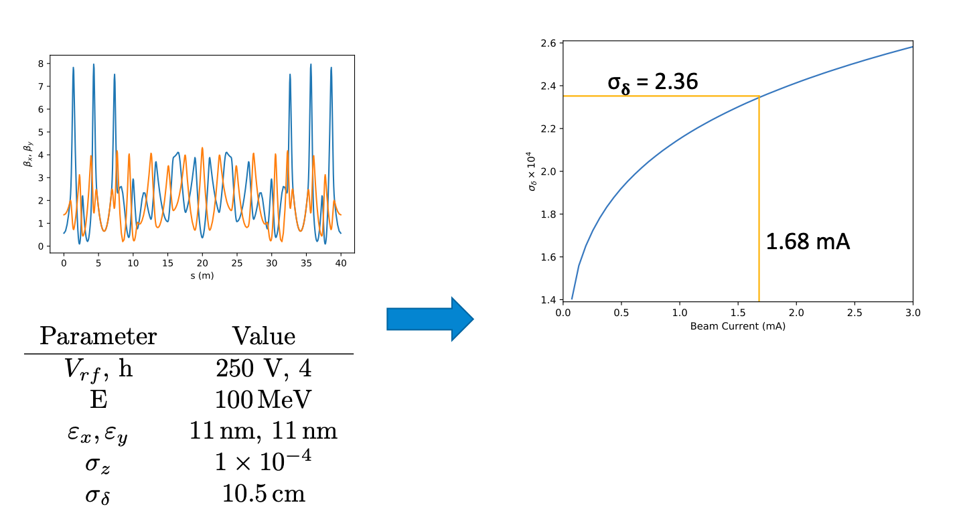
elegant simulations support IBS-derived energy spread
Boulder, Colorado USA – www.radiasoft.net

Slide 36
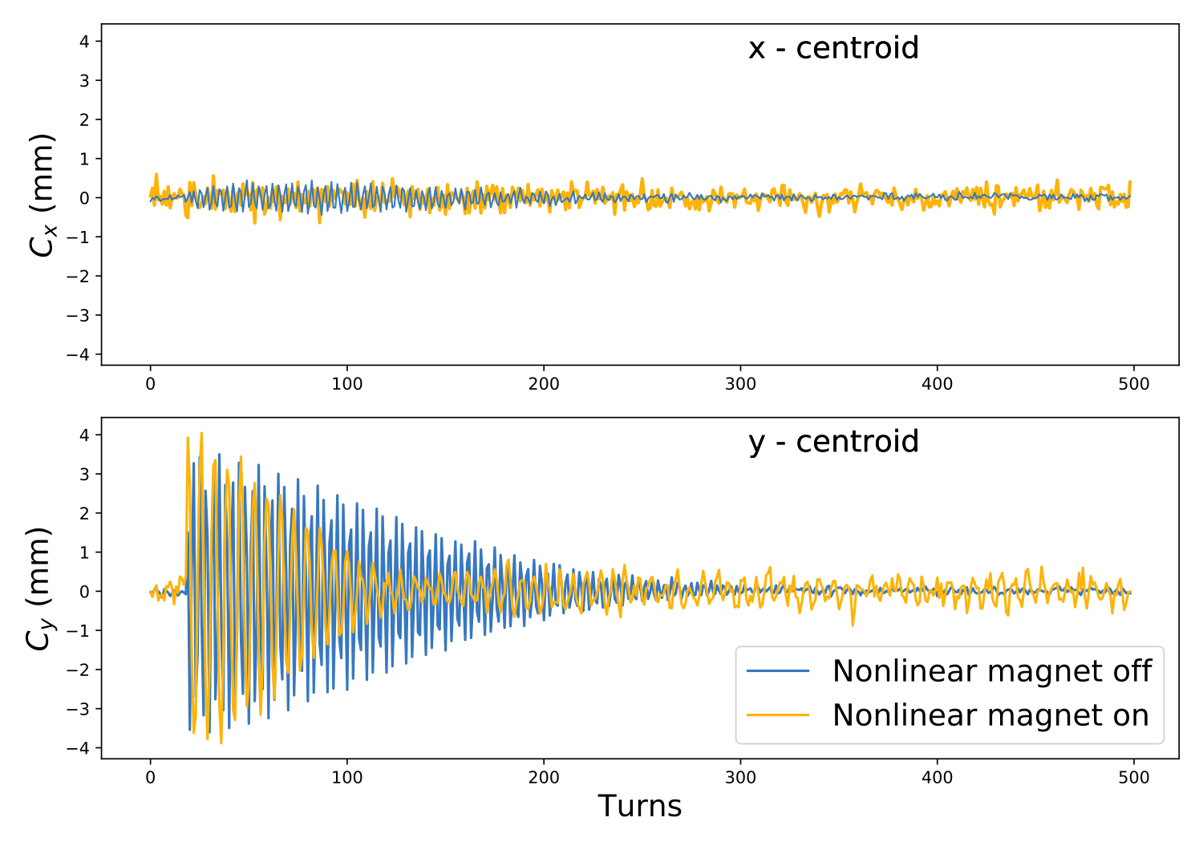
First nonlinear decoherence measurements with integrable optics
Boulder, Colorado USA – www.radiasoft.net

Slide 37
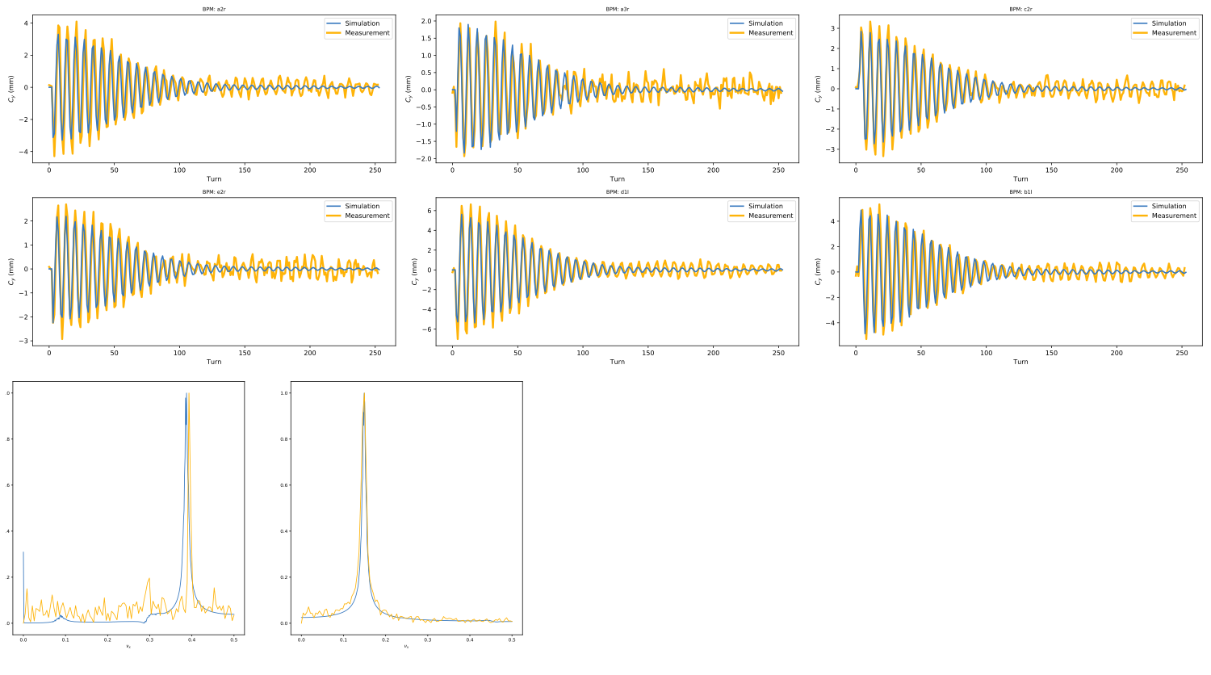
Favorable comparison with Synergia simulations
experimental t = 0.433
simulation t = 0.431
Boulder, Colorado USA – www.radiasoft.net

Slide 38
The Influence of Space Charge
Boulder, Colorado USA – www.radiasoft.net

Slide 39
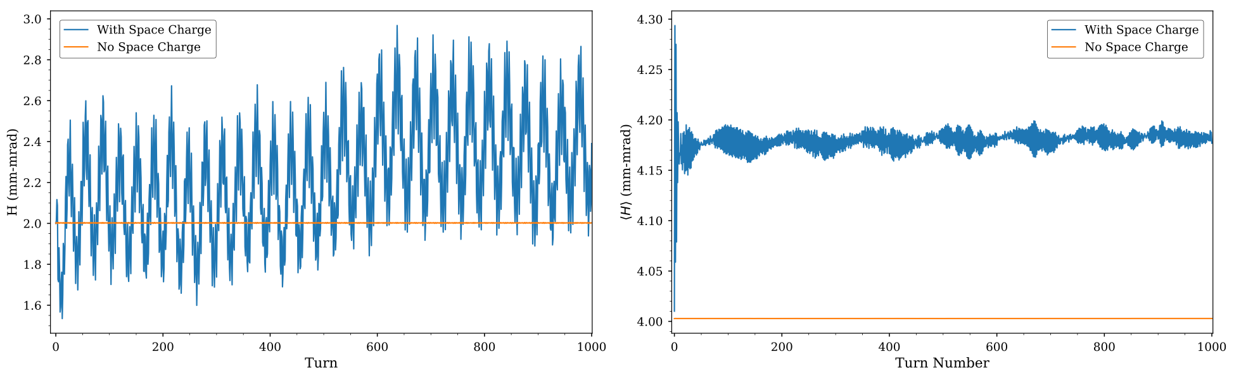
Introducing space charge changes the picture
Boulder, Colorado USA – www.radiasoft.net

Slide 40
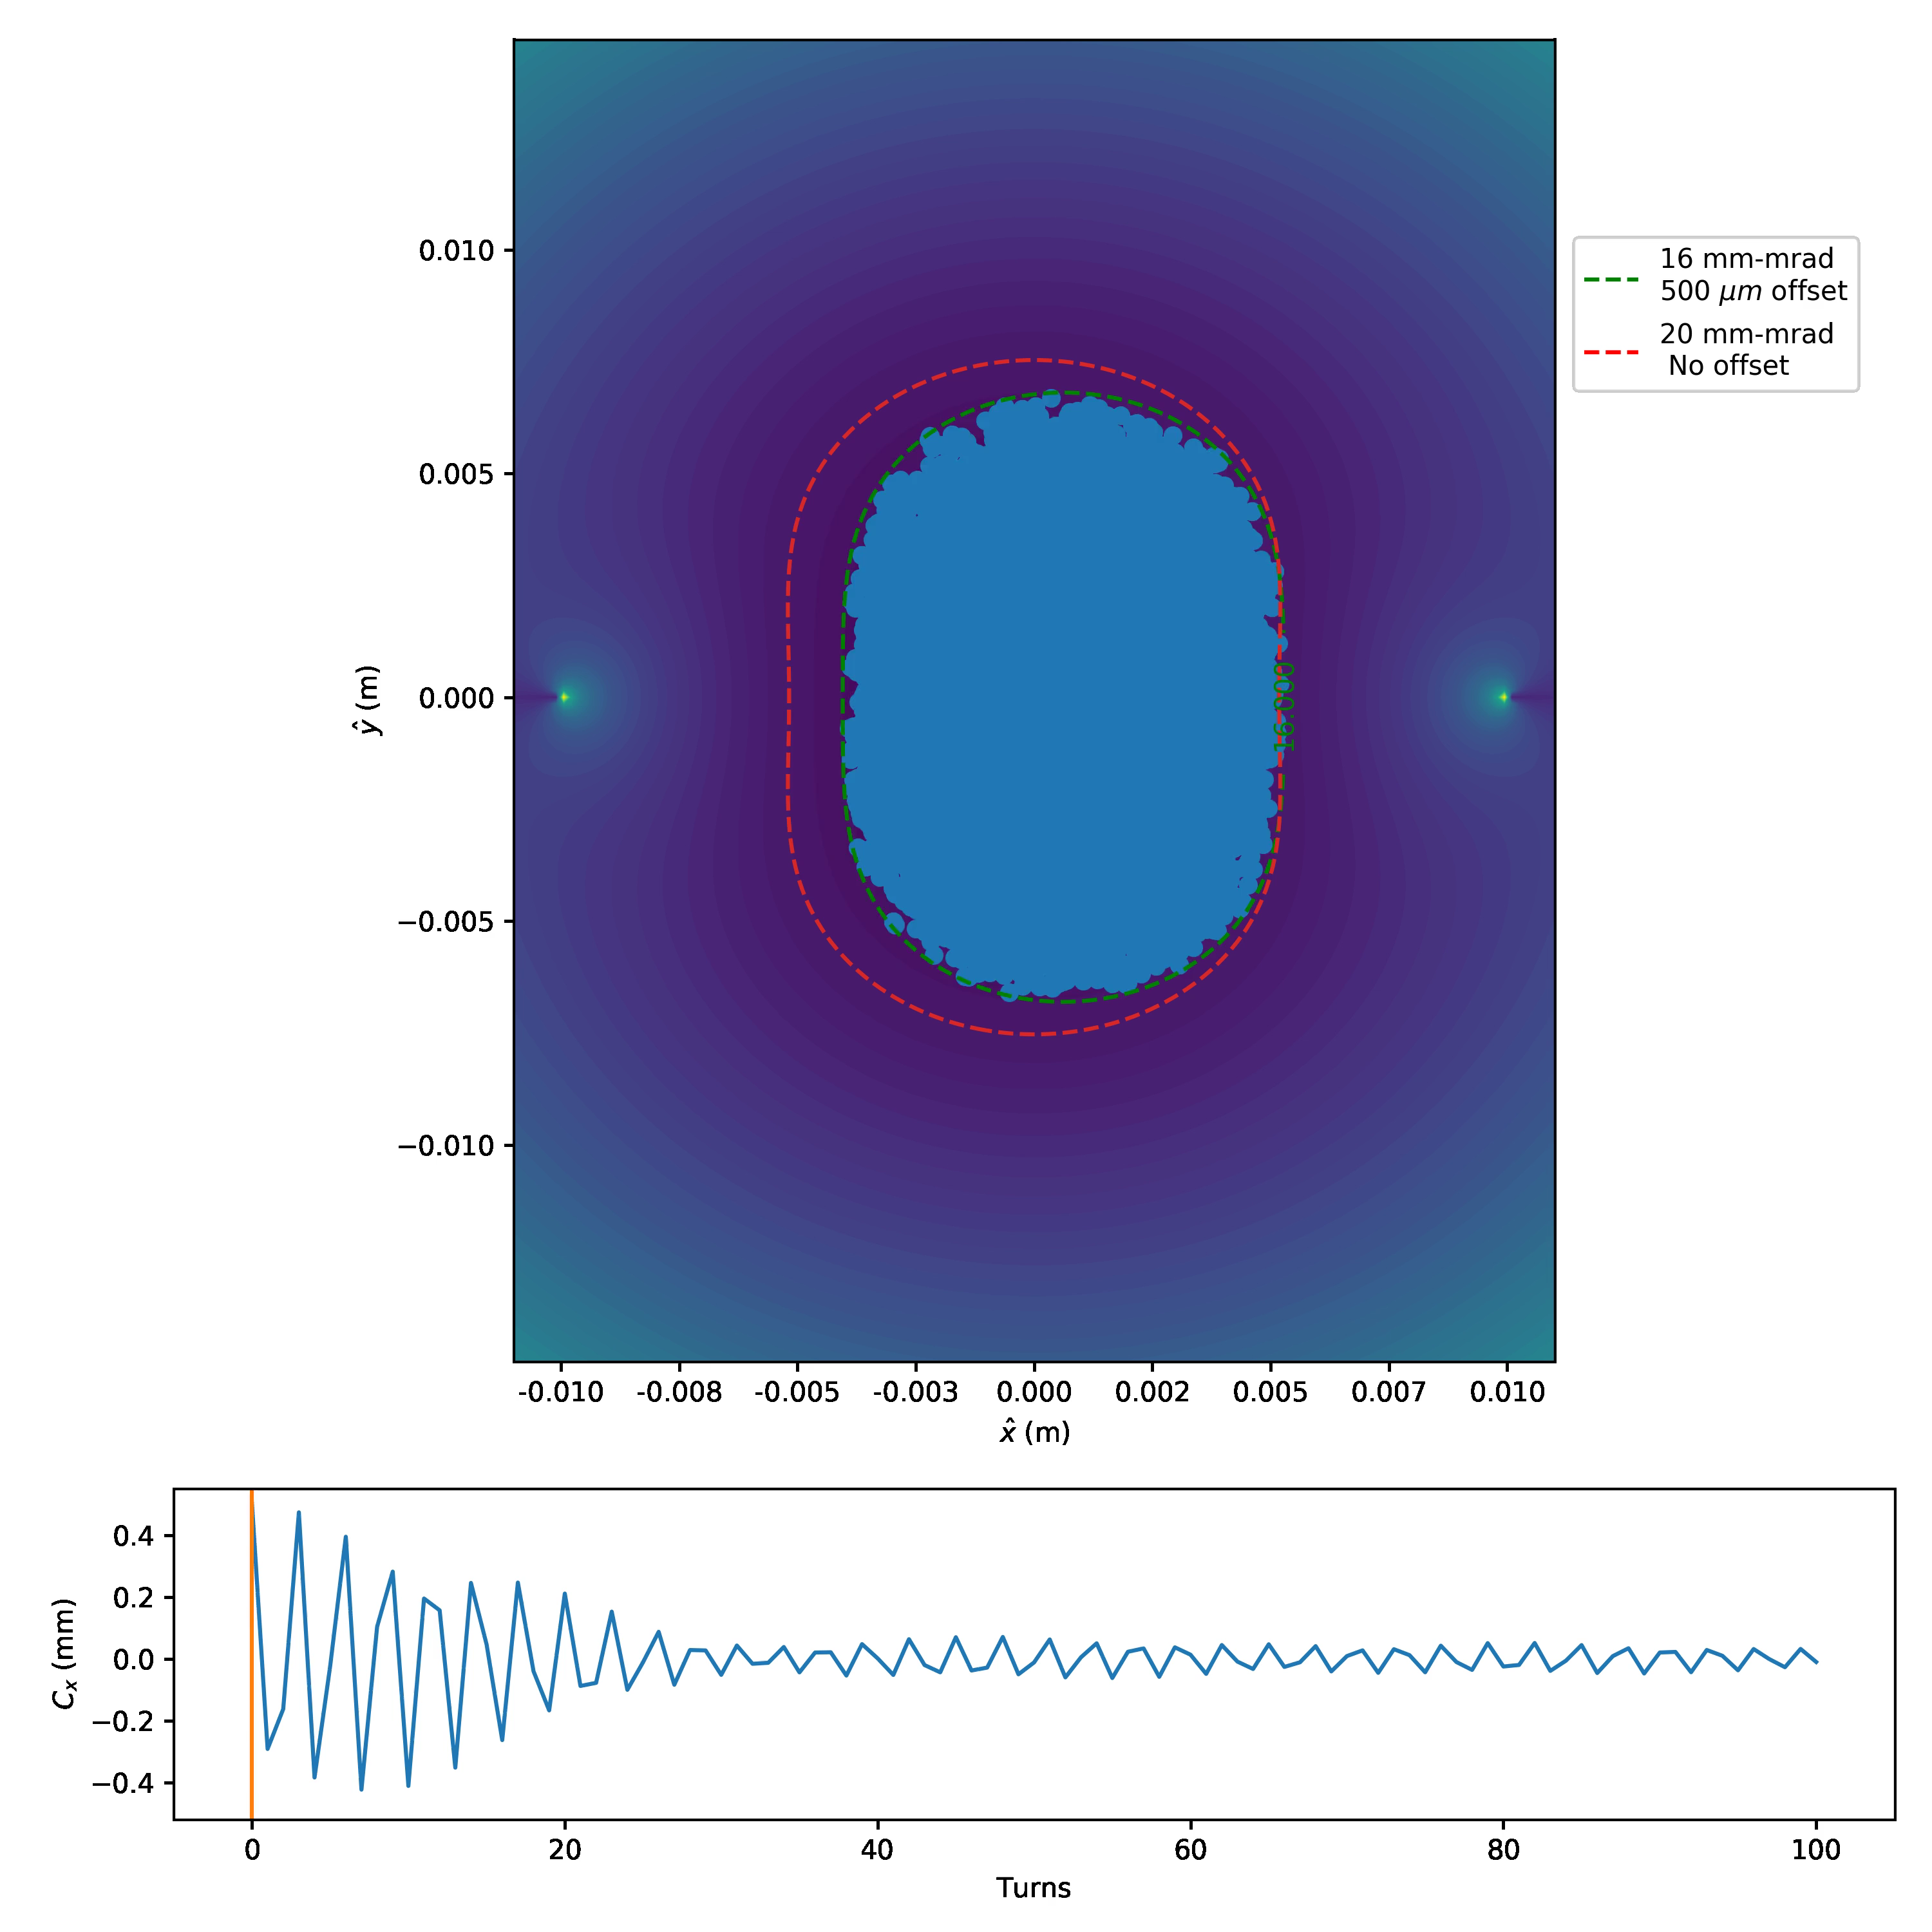
Nonlinear decoherence without space charge damps centroid oscillations
Boulder, Colorado USA – www.radiasoft.net

Slide 41
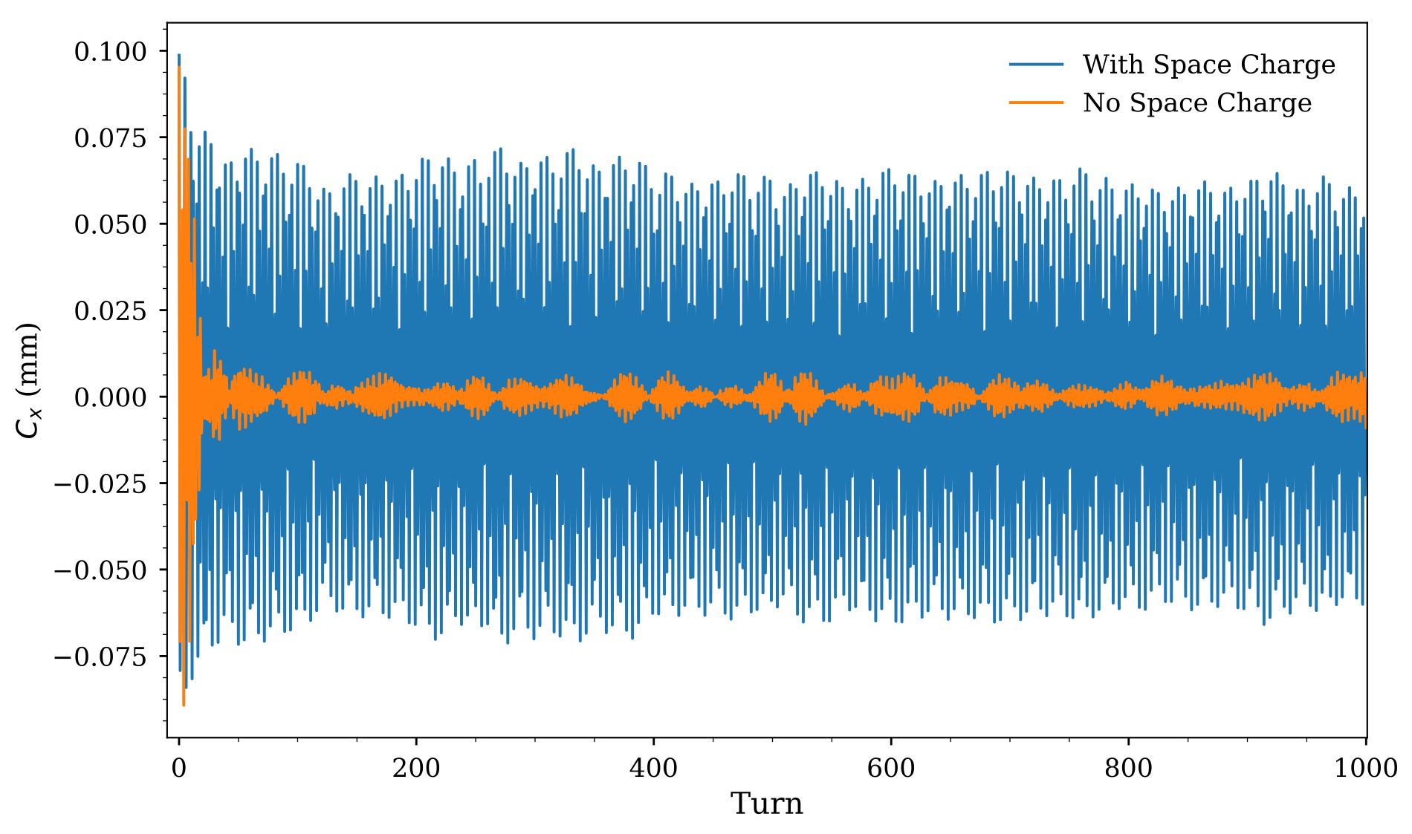
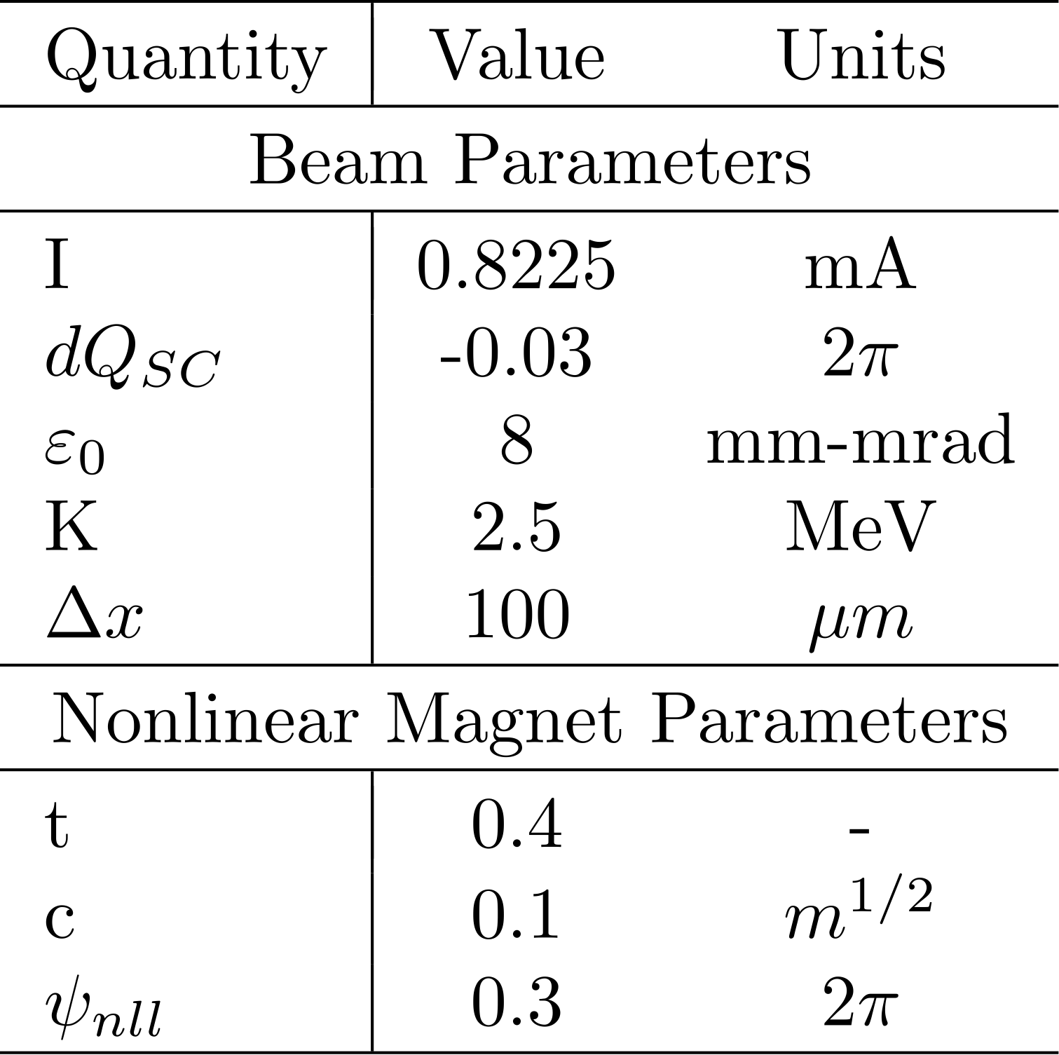
Space charge damps nonlinear decoherence
Boulder, Colorado USA – www.radiasoft.net

Slide 42
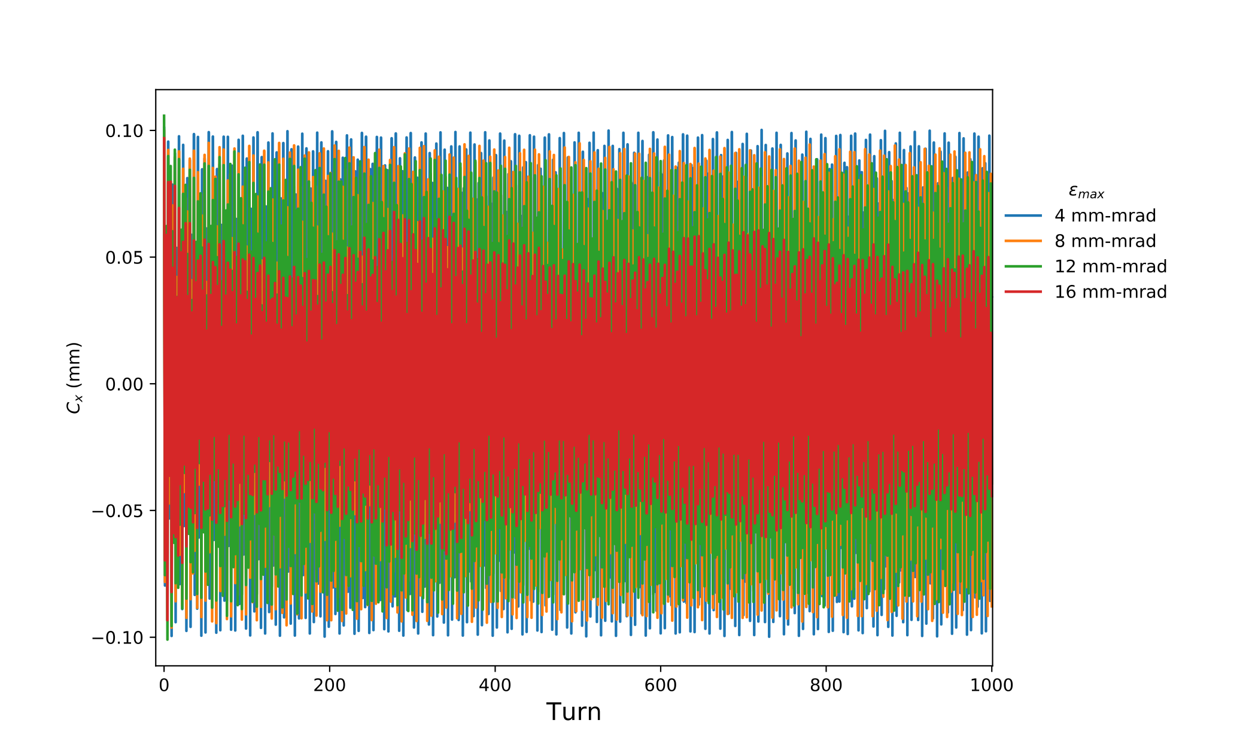
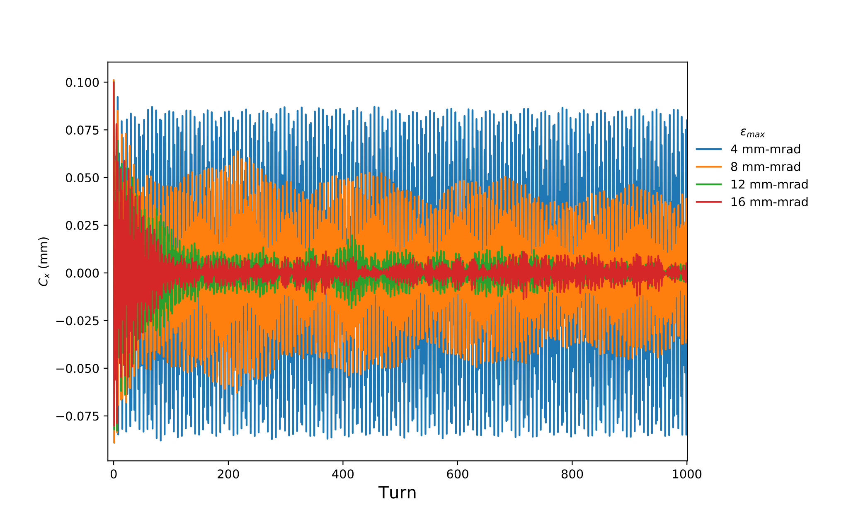
Space charge damps nonlinear decoherence
t = 0.2
t = 0.4
Boulder, Colorado USA – www.radiasoft.net

Slide 43
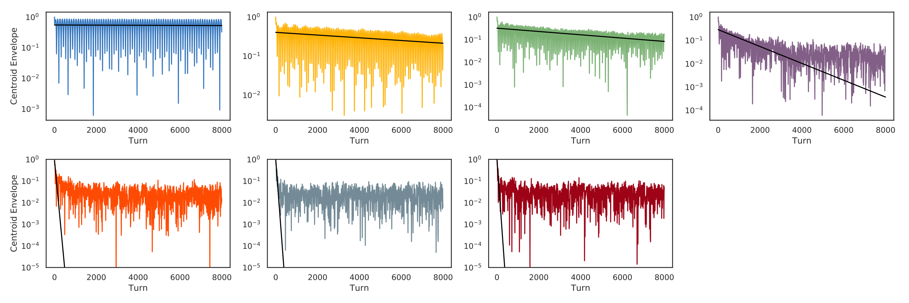
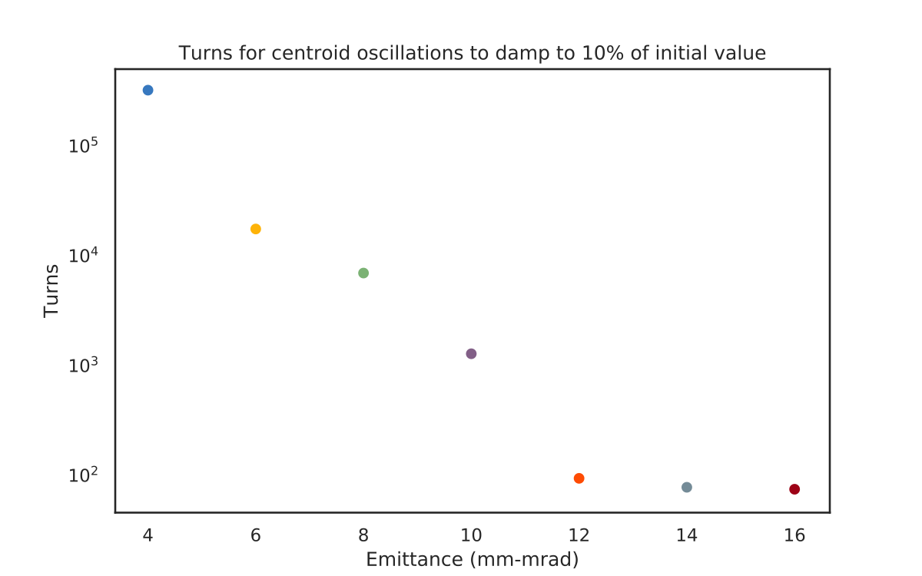
Space charge damps nonlinear decoherence
damping rate improves for larger emittance until damping time ~turns
Boulder, Colorado USA – www.radiasoft.net

Slide 44
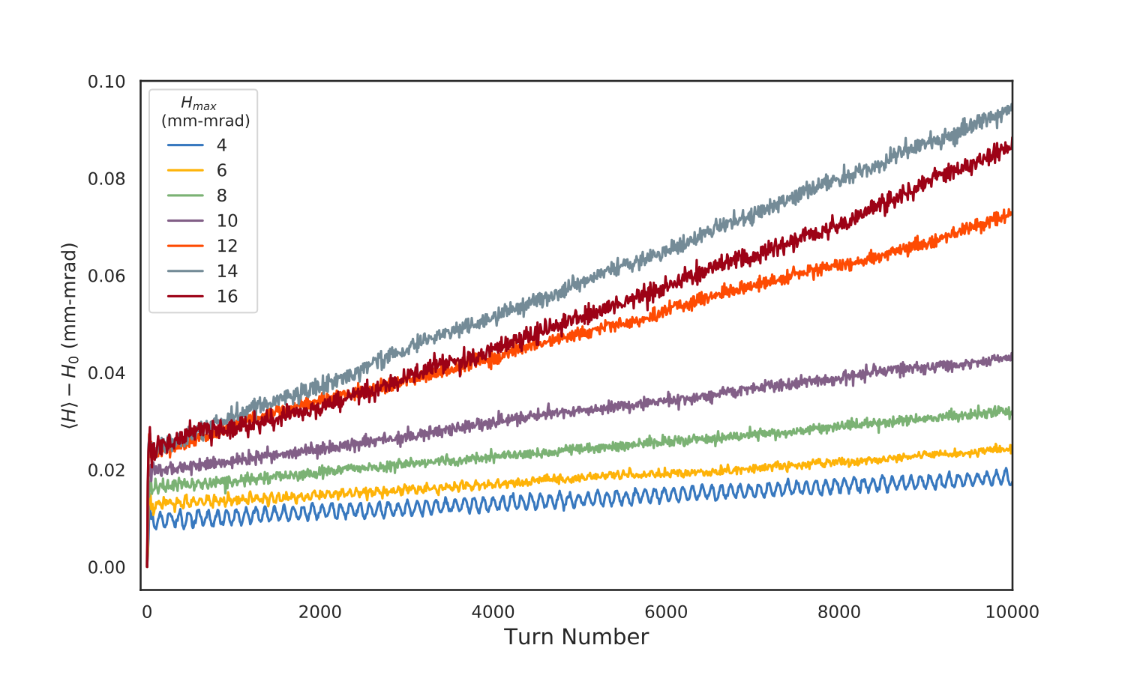
The invariants are broken with space charge
Boulder, Colorado USA – www.radiasoft.net

Slide 45
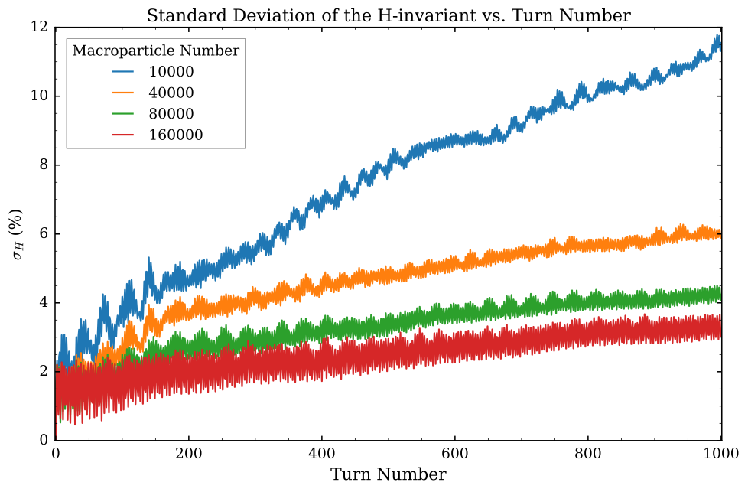
How “bad” the invariant breakage is depends on the number of macroparticles
Boulder, Colorado USA – www.radiasoft.net

Slide 46




Why the macroparticle dependence?
Macroparticle Noise
Grid Heating
amplifies the noise by a factor
from E. Cormier-Michel et al. PRE 78, 016404 (2008).
If you put a uniform thermal plasma in a simulation and run it, there will be spurious energy growth, dubbed “grid heating”. Originates from non-symplectic nature of the space charge kick
Boulder, Colorado USA – www.radiasoft.net

Slide 47
Symplectic Space Charge Algorithms
Boulder, Colorado USA – www.radiasoft.net

Slide 48




A symplectic space charge algorithm
Start with a discrete phase space distribution
Get a macroparticle Hamiltonian with a pseudopotential
J. Edelen et al., “A Novel S-Based Symplectic Algorithm for Tracking with Space Charge”, WEPTS068, IPAC ’19
Boulder, Colorado USA – www.radiasoft.net

Slide 49

Space charge driven octupole resonances
w/ space charge
Boulder, Colorado USA – www.radiasoft.net

Slide 50



Space charge driven octupole resonances
w/ space charge
same initial gaussian distribution
separatrix structures begin to form
saturation:
clear octupole structure in symplectic space charge
structure washed out by grid heating in conventional PIC
Boulder, Colorado USA – www.radiasoft.net

Slide 51


Slide 52
Fin
Boulder, Colorado USA – www.radiasoft.net

