Slide 1

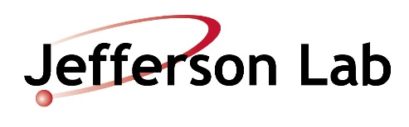
Neutral-Current Neutrino Scattering and Strangeness
J. W. Van Orden
Old Dominion University
and
Jefferson Lab
In collaboration with: T. W. Donnelly, MIT
Sabine Jeschonnek, OSU-Lima
Cake Seminar, 6/5/2019.

Slide 2
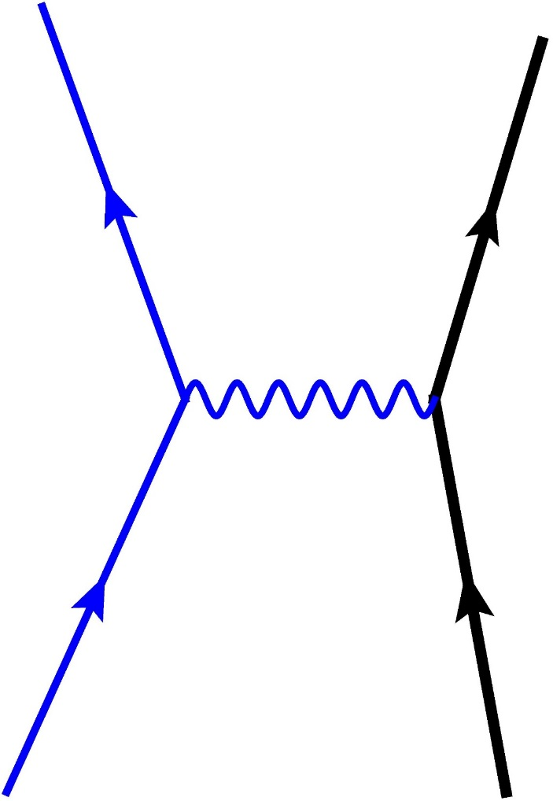
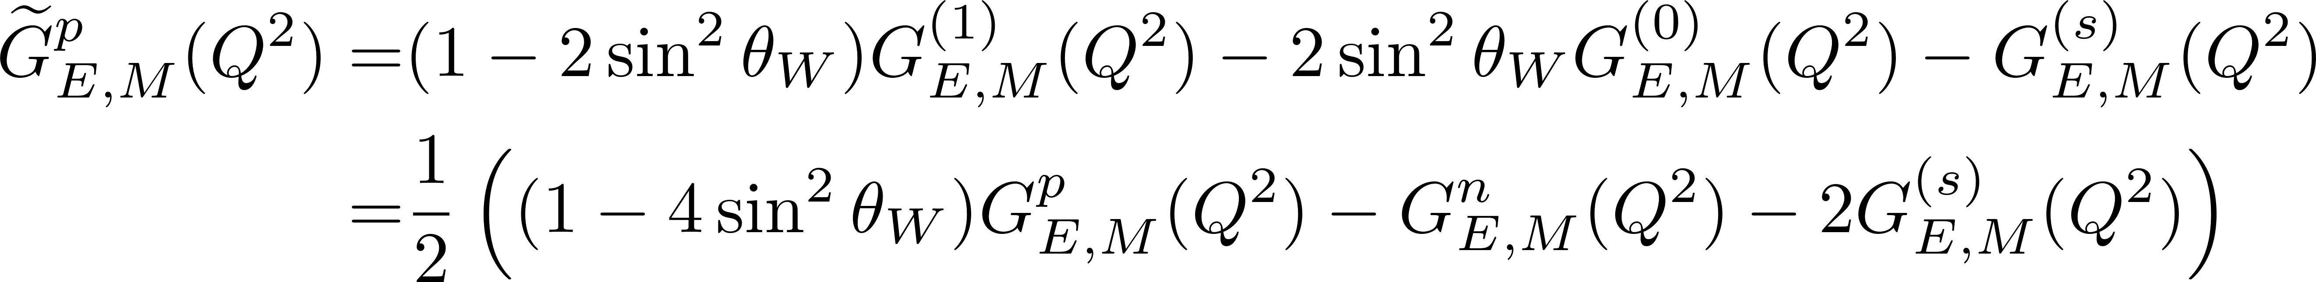
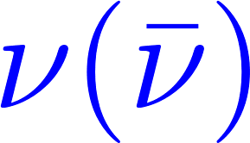
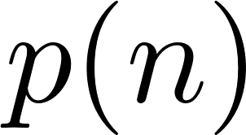
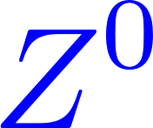
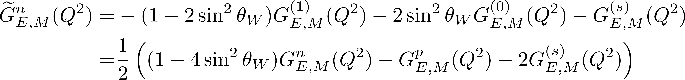
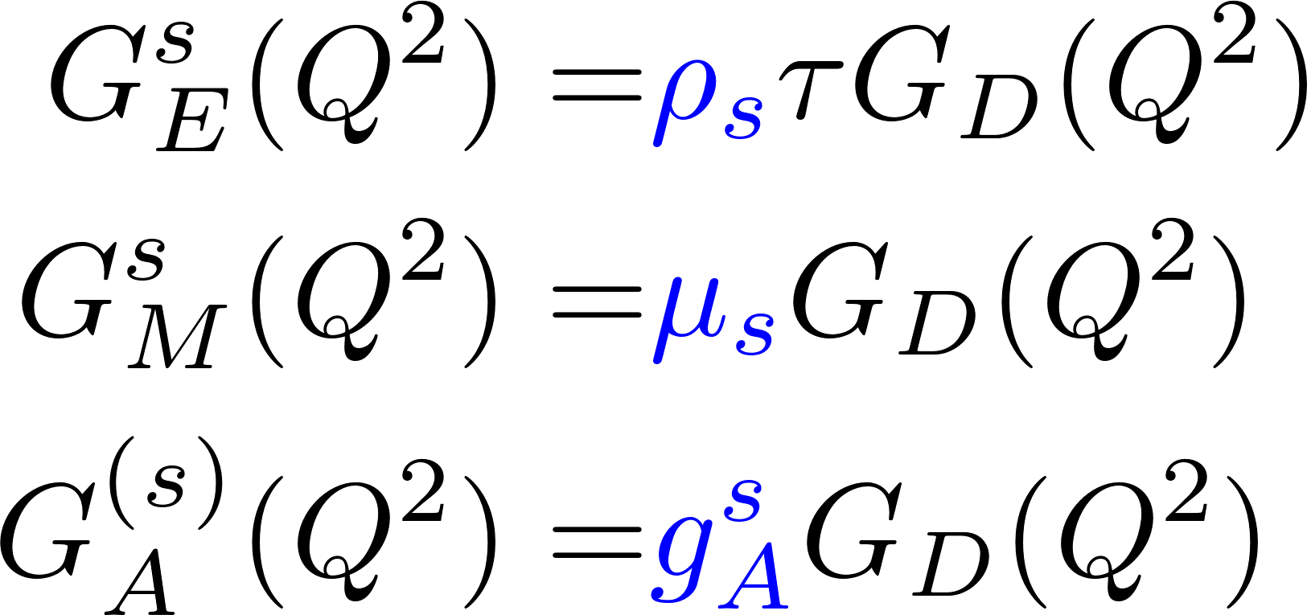
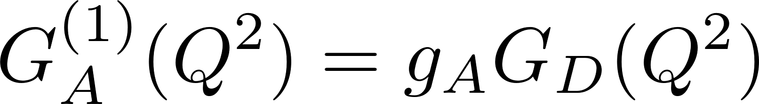
Neutral Current Neutrino Scattering from the Nucleon
Vector Form Factors
Axial Vector Form Factors
Strange Form Factors

Slide 3
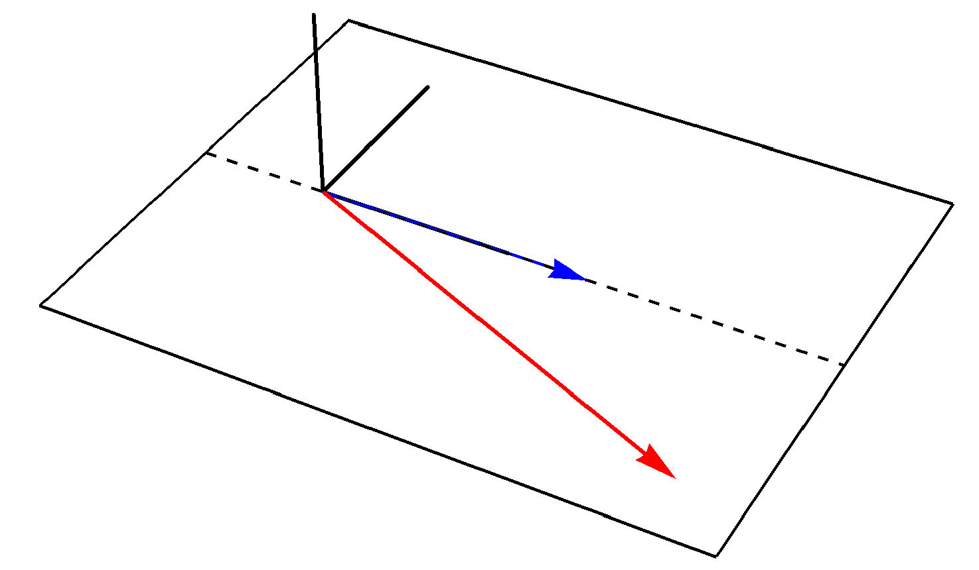
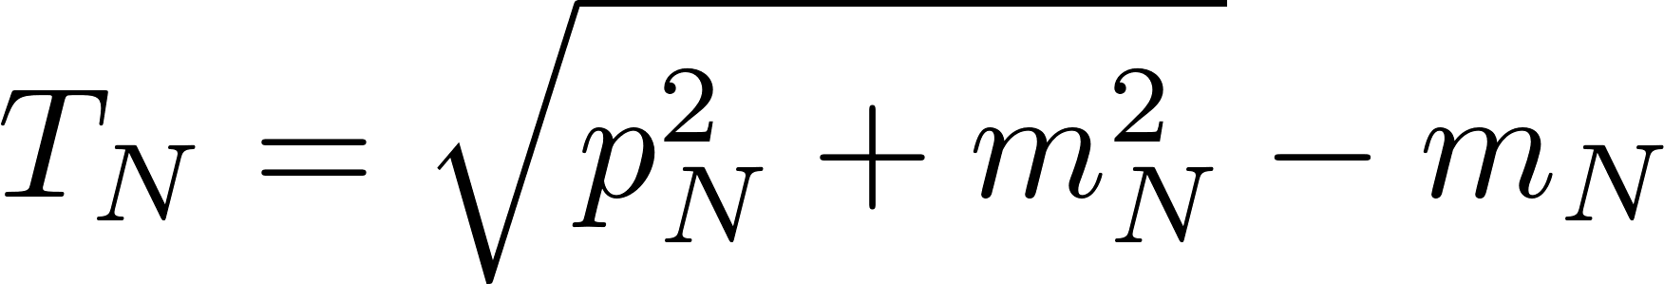

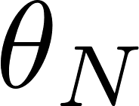
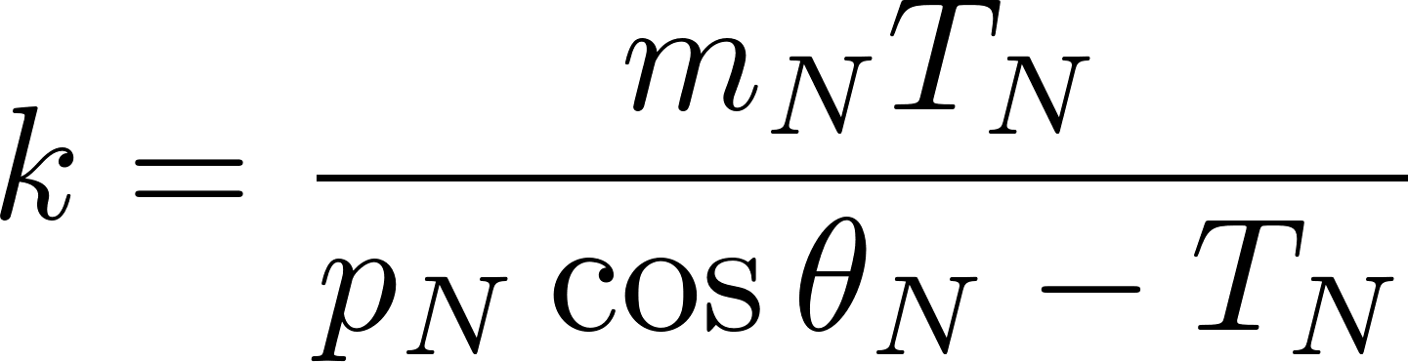
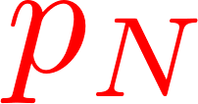
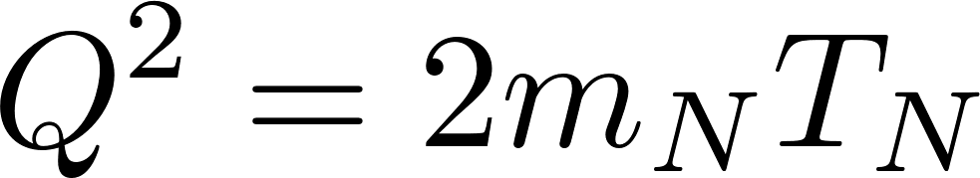
Neutral-Current Neutrino Scattering from the Nucleon
Kinematics
Nucleon Kinetic Energy
Neutrino Energy
x=1

Slide 4
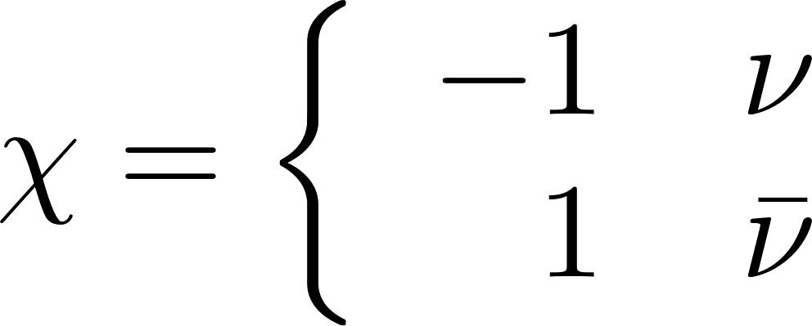
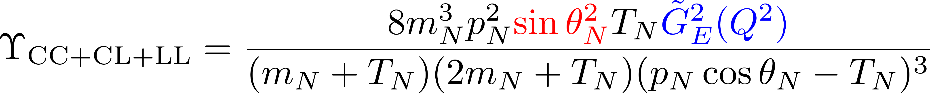
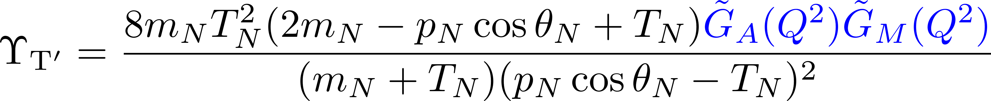
Neutral Current Cross Section of the Nucleon
Neutrino Flux Factor
where
Note that there is no axial contribution

Slide 5
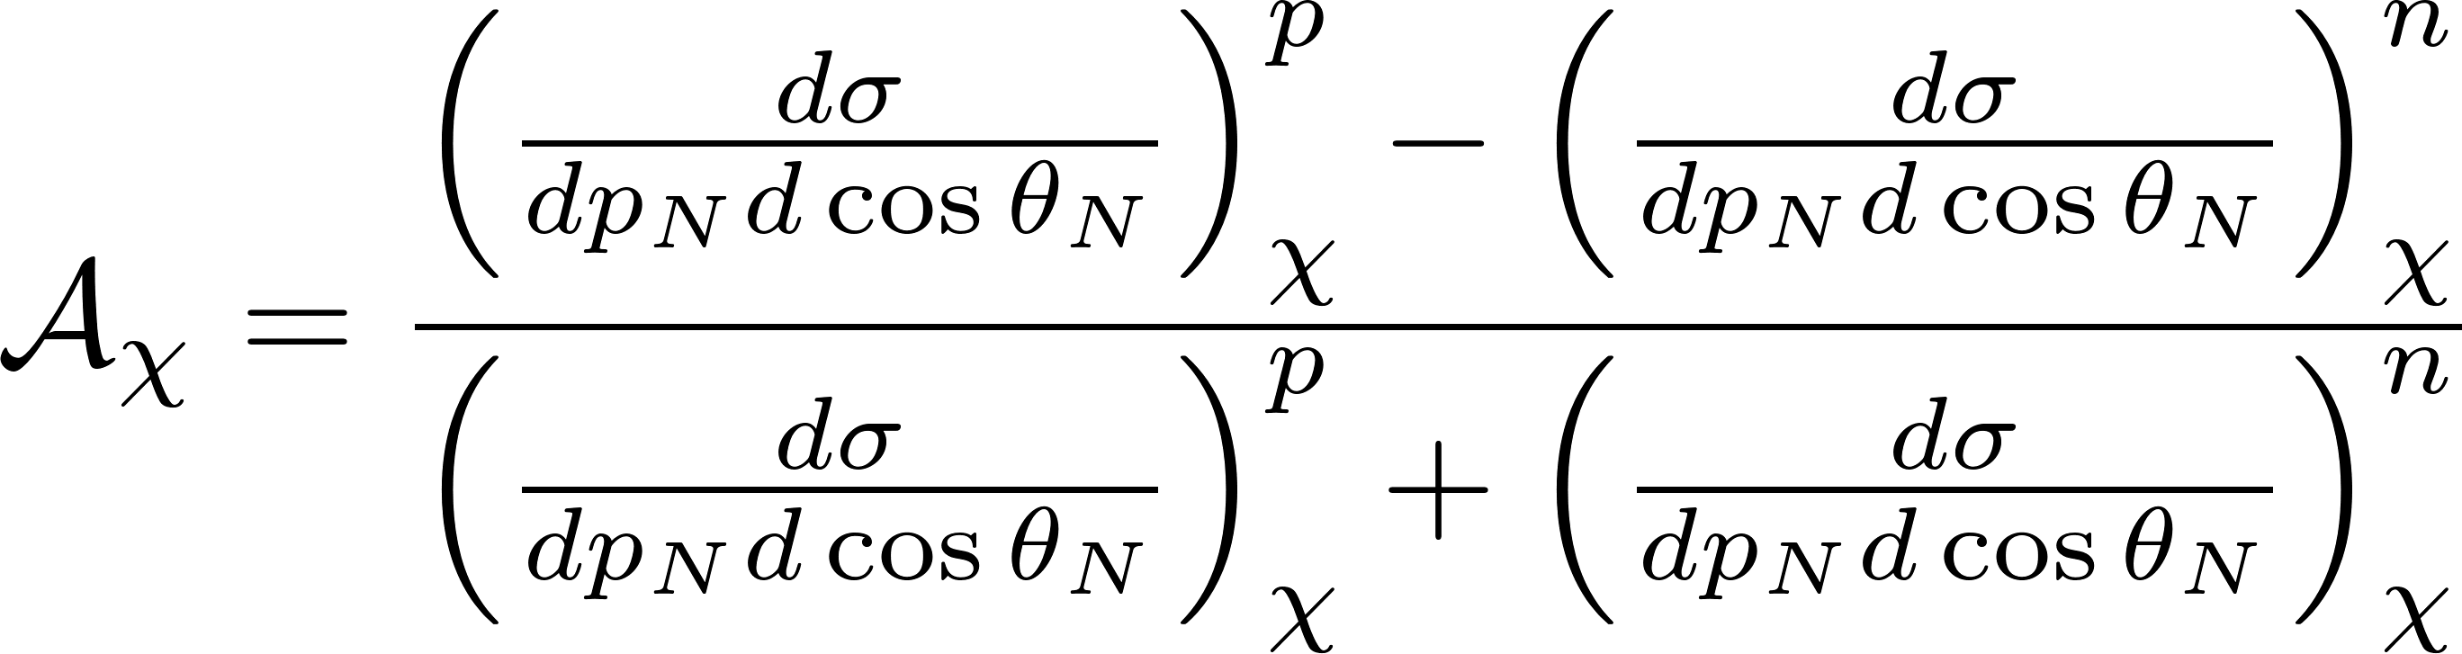
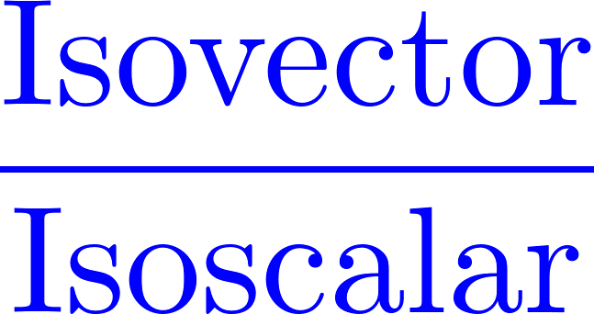
An Isospin asymmetry can now be defined as:
Note that the neutrino flux factors cancel in the ratio.

Slide 6
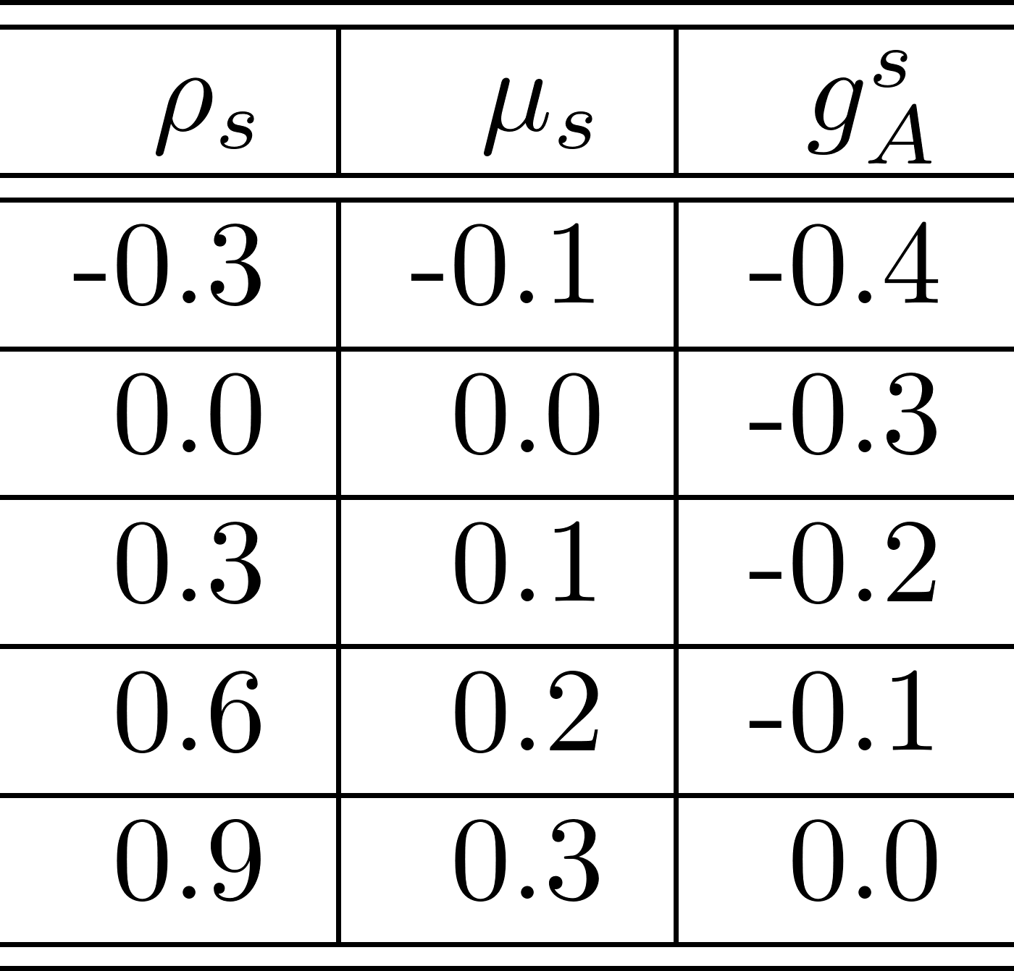
To determine the sensitivity of the cross sections and asymmetry to the strange form factor constants, we will scan over the following sets of parameters.
In order not to be overwhelmed with information we will fix two of the parameters at the mean values given by the third row of the table and then scan over the remaining parameter.

Slide 7
Neutrino momentum and for moment transfers for the kinematics to be used in the figures shown here.

Slide 8

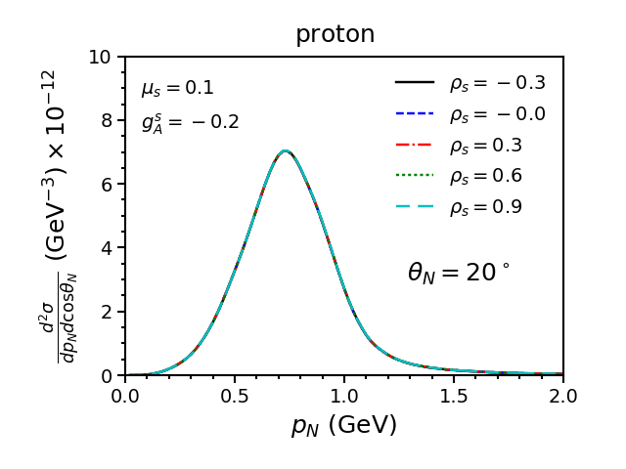
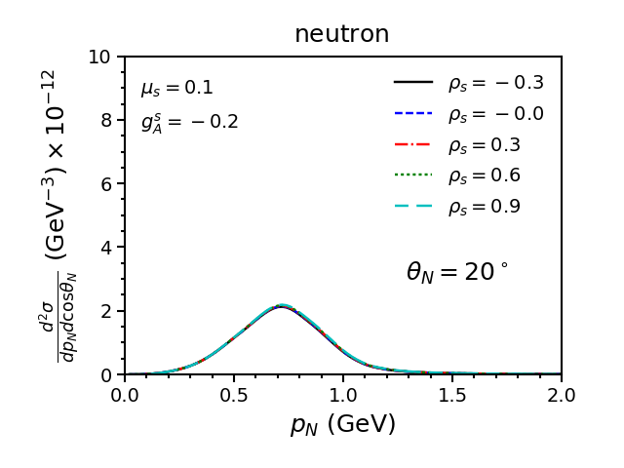
Vary

Slide 9
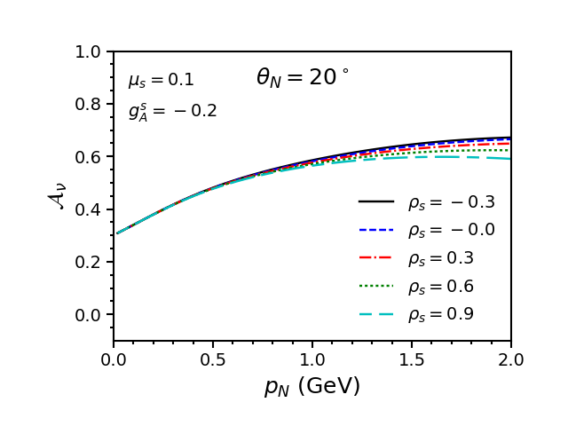
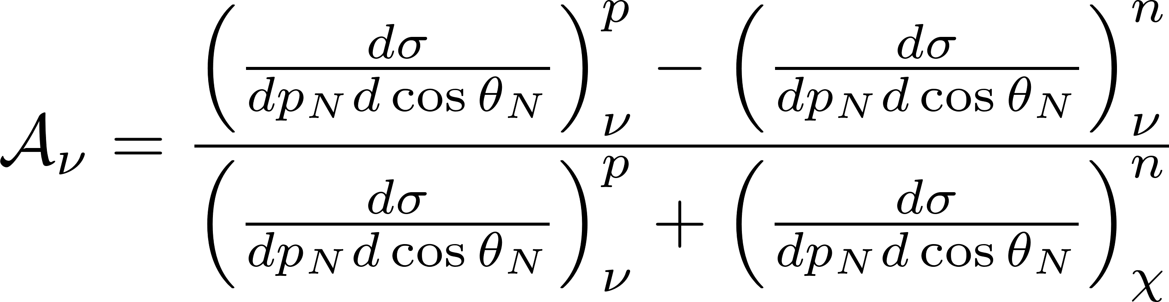

Slide 10
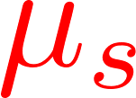
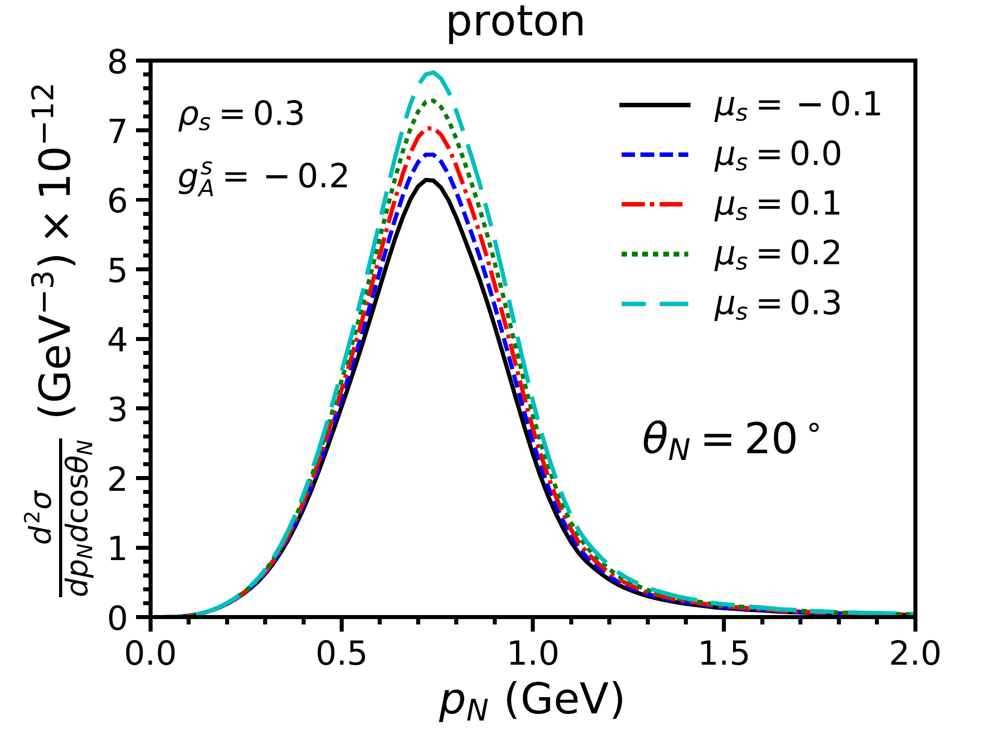
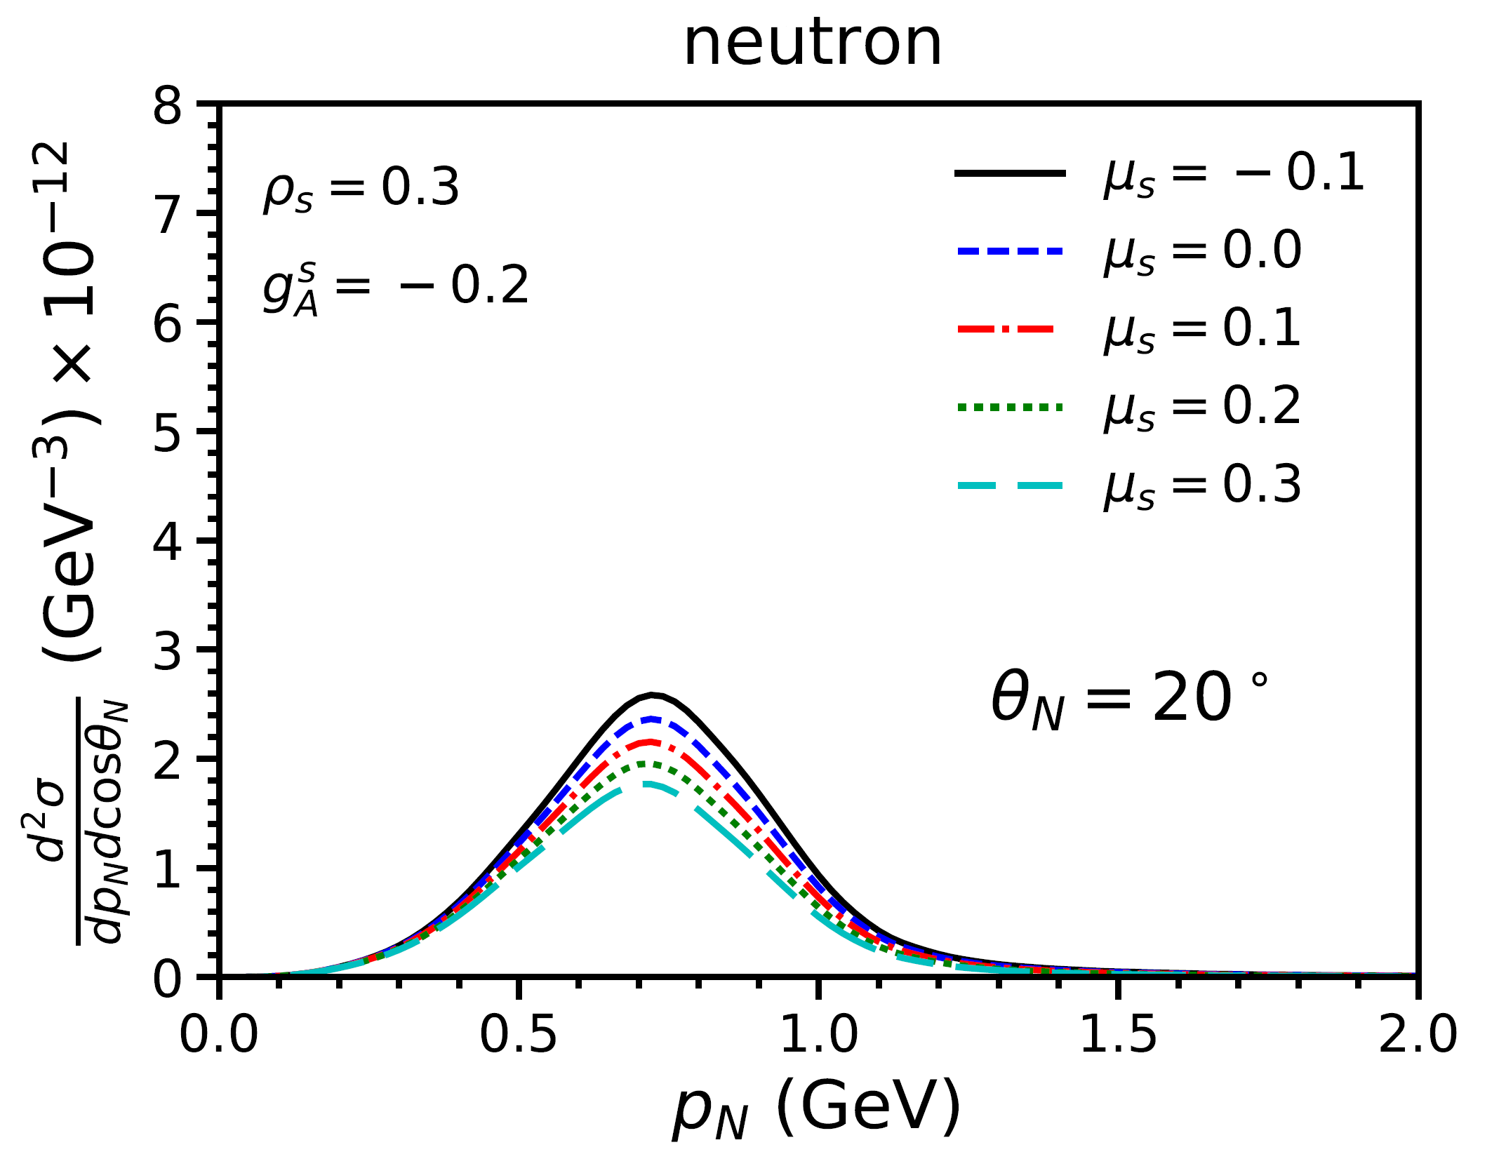
Vary

Slide 11
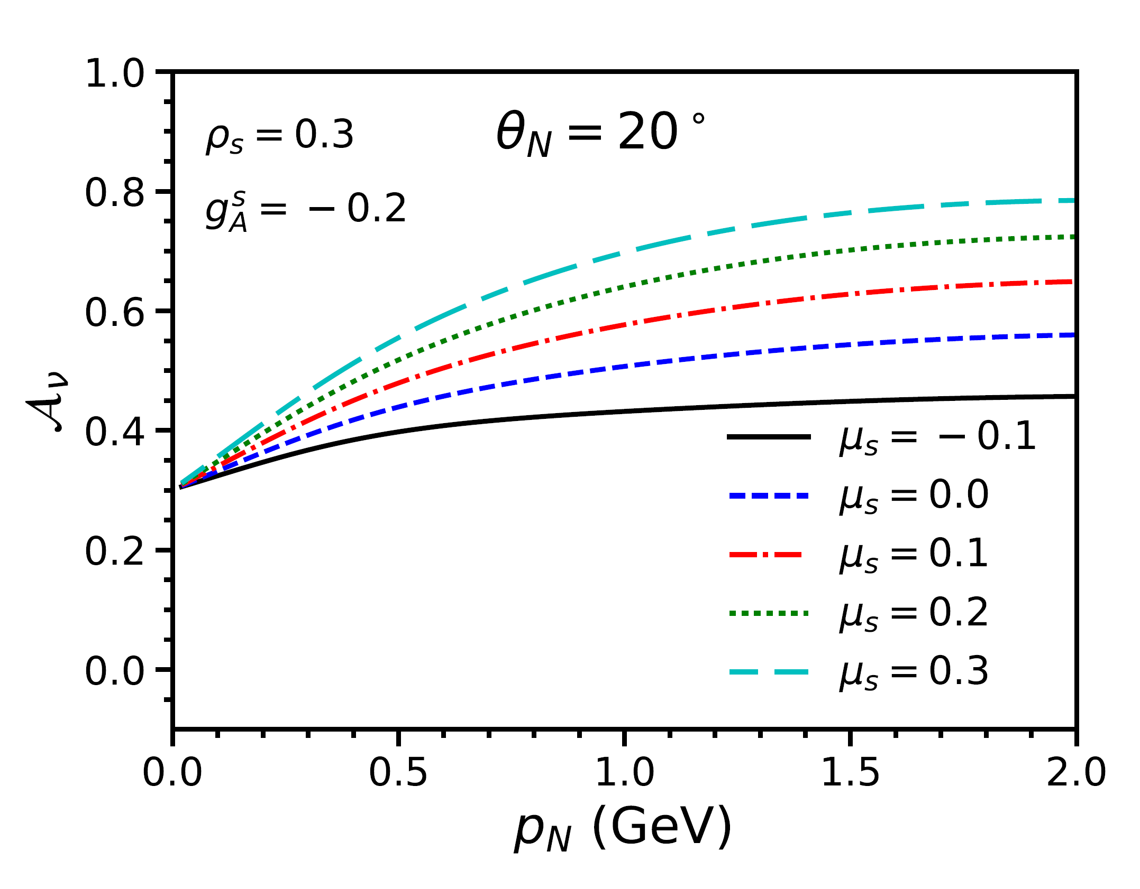

Slide 12
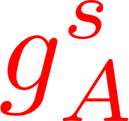
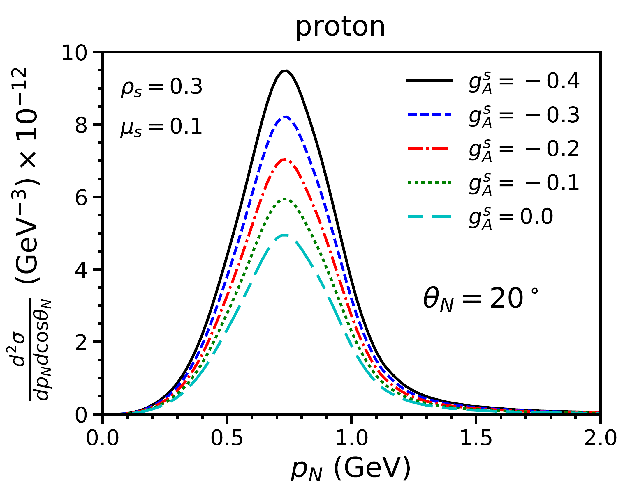
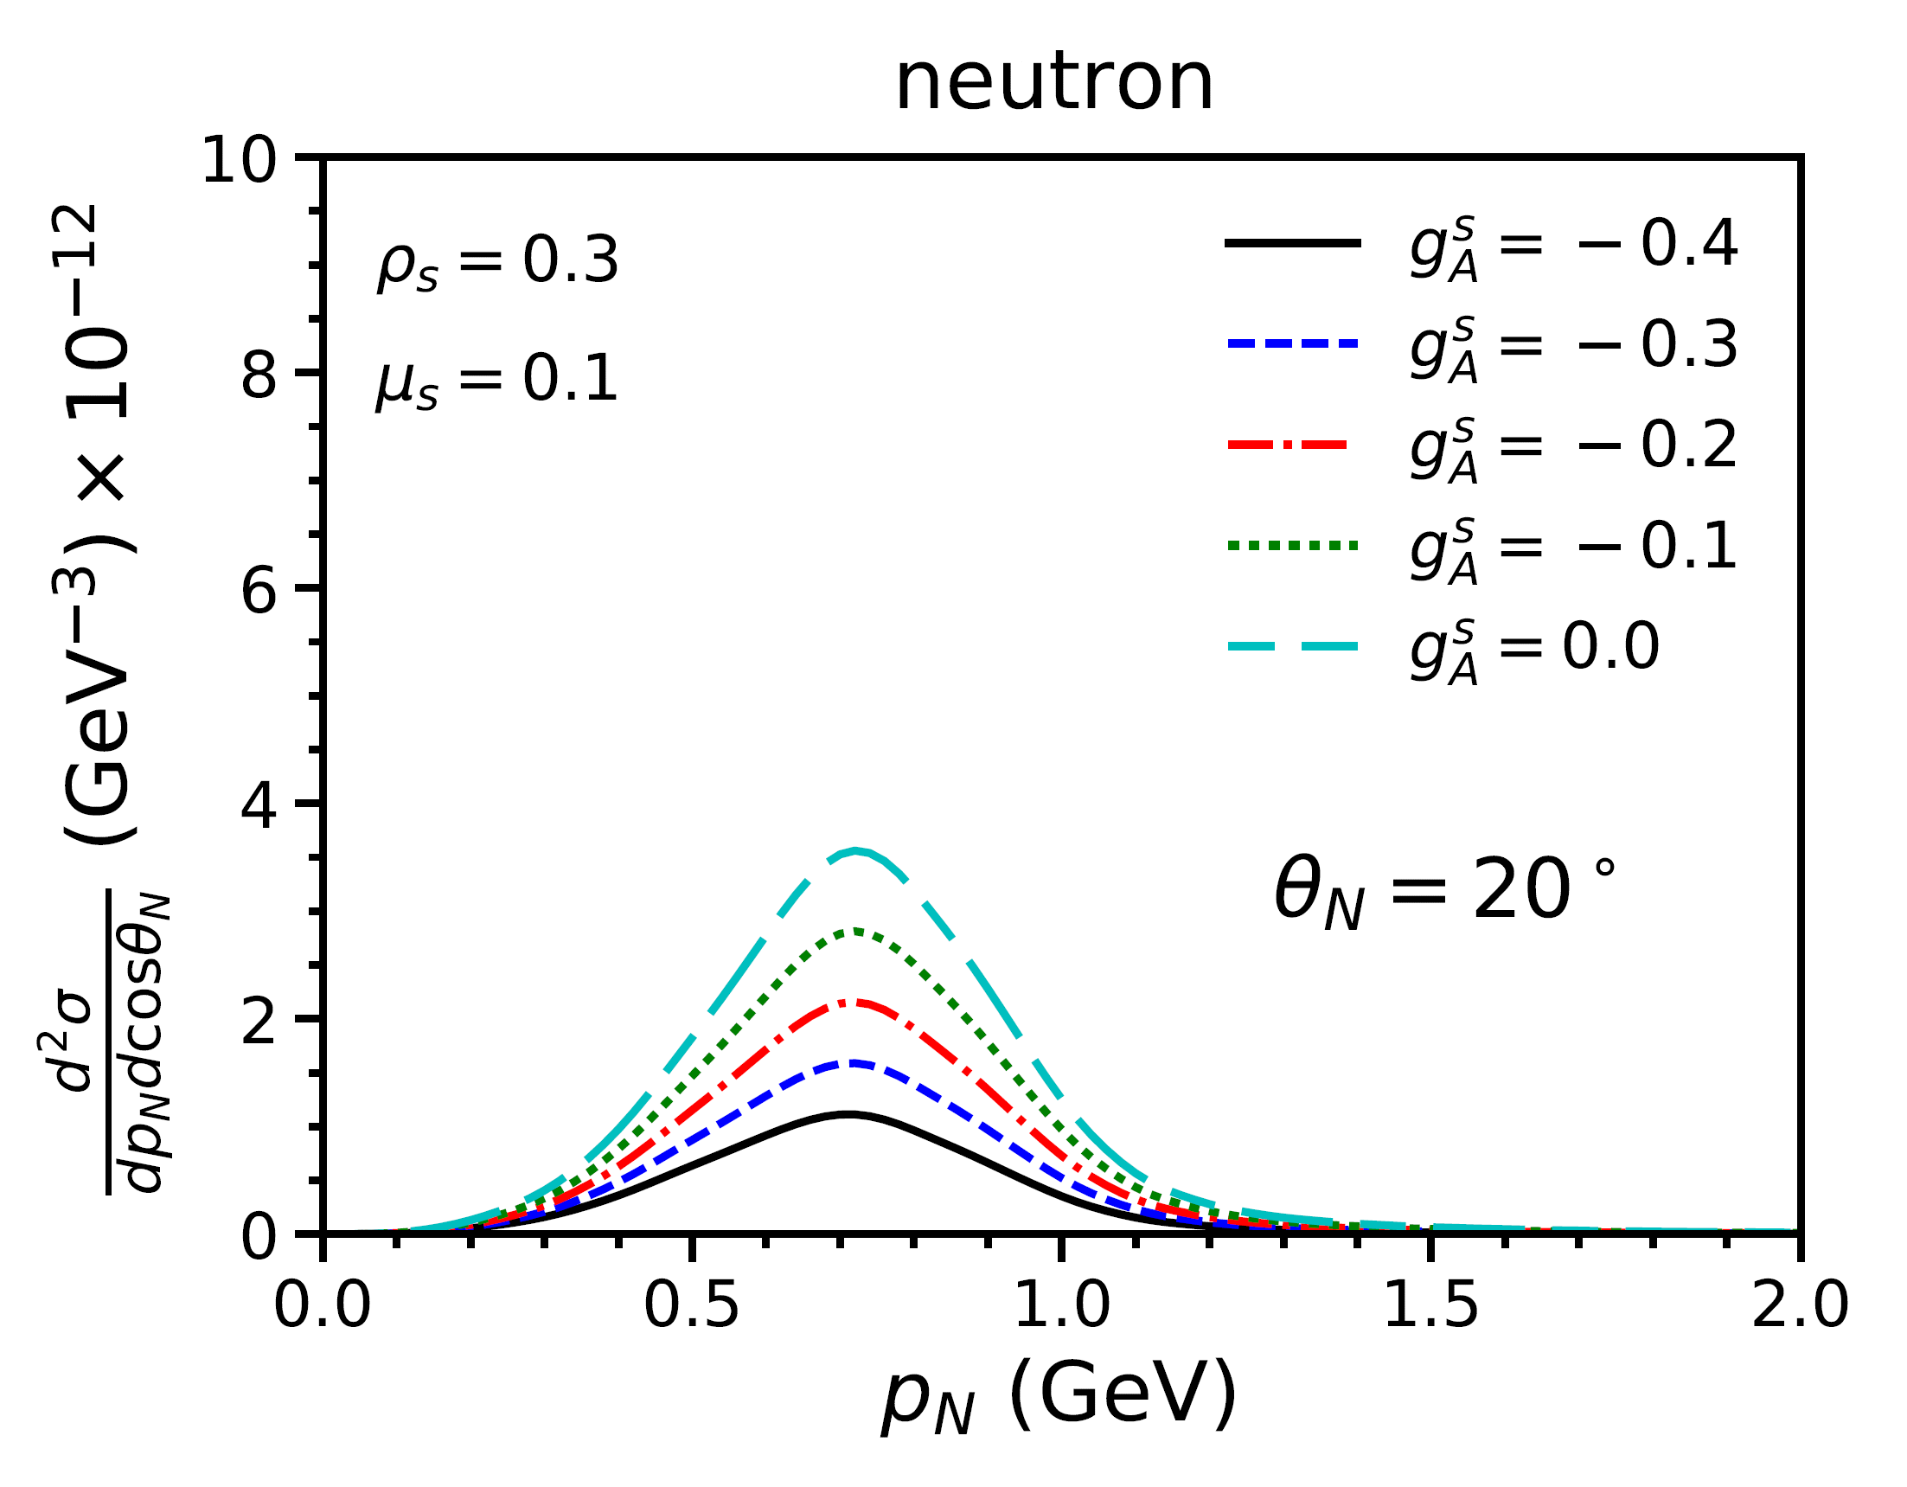
Vary

Slide 13
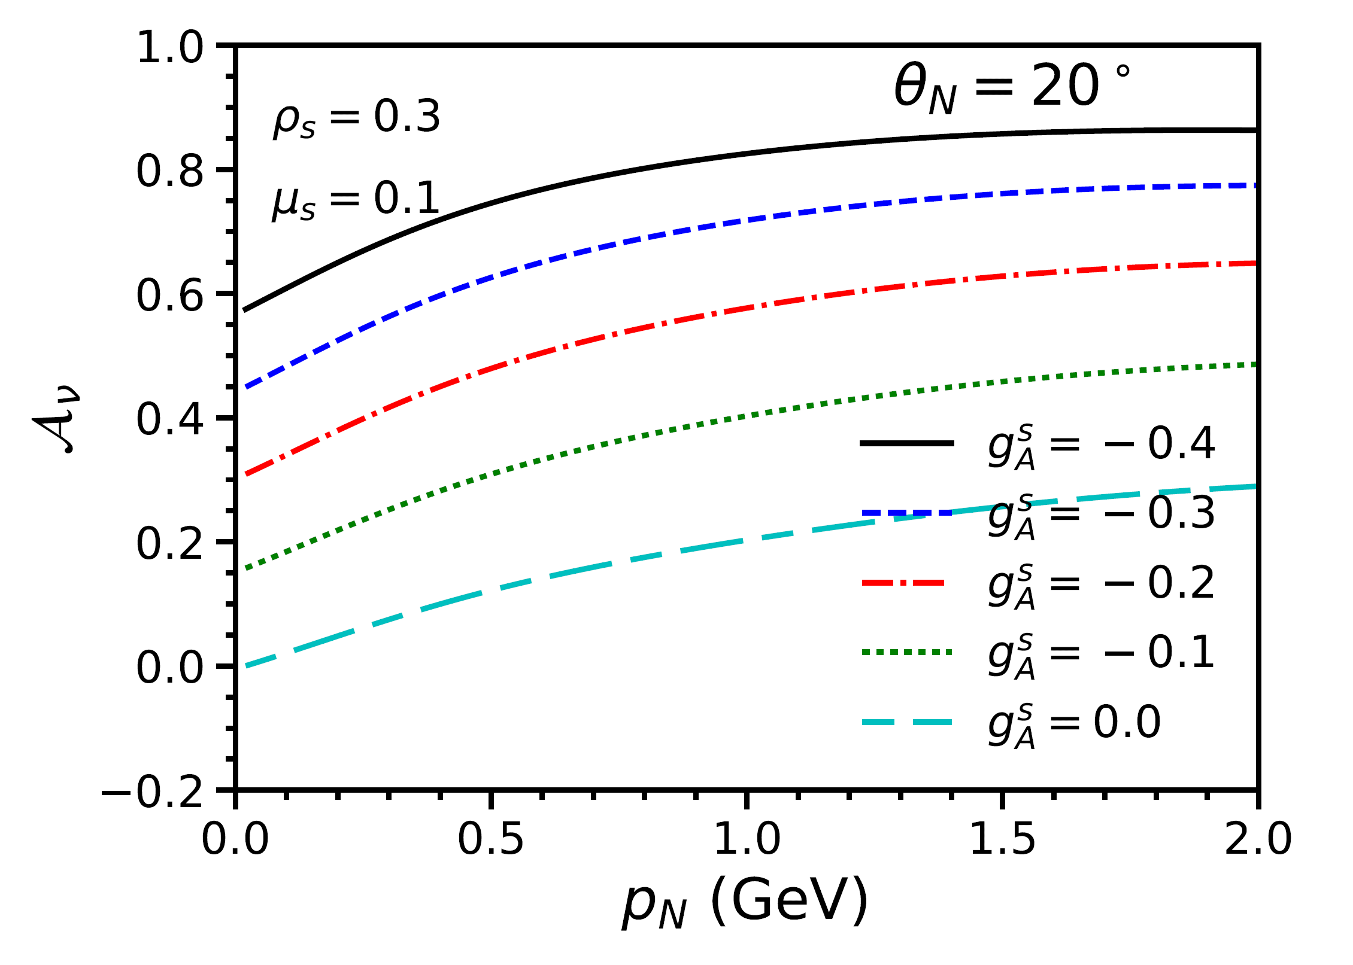

Slide 14
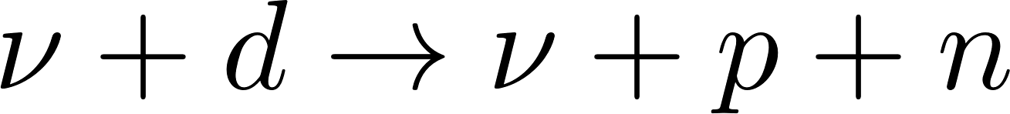
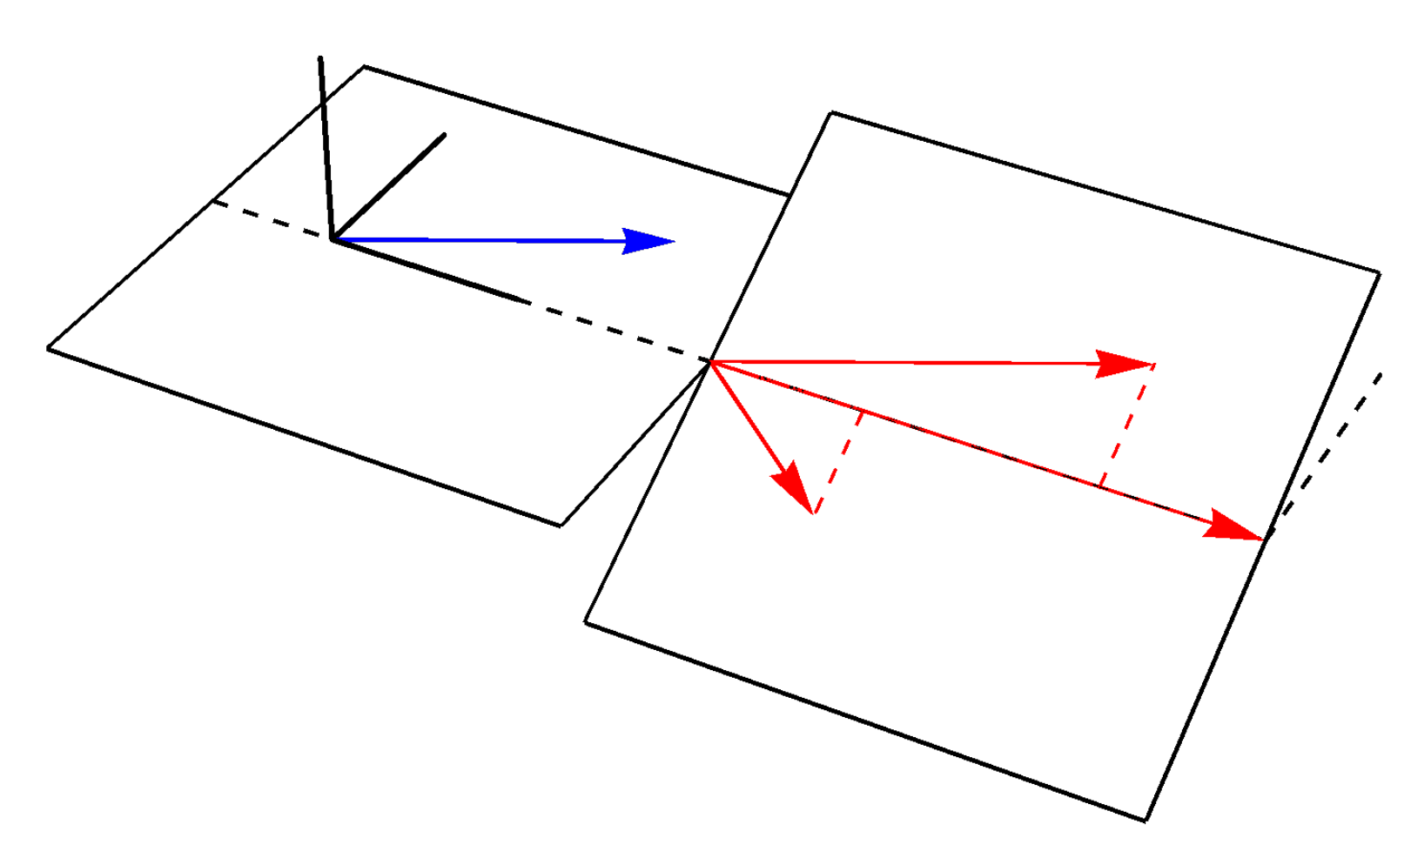

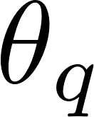
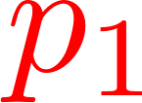

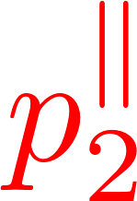
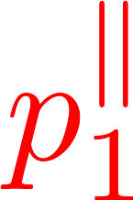
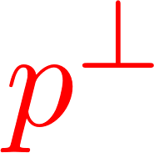
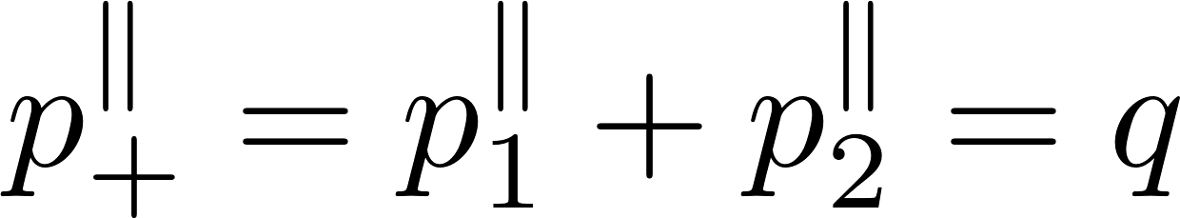
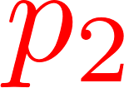
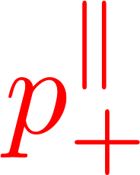
Neutral Current Scattering from the Deuteron
The practical problem faced by the preceding presentation is how to obtain cross sections for scattering from the neutron.
A possible solution is to consider scattering from the deuteron.
3-momentum transfer
Energy transfer

Slide 15
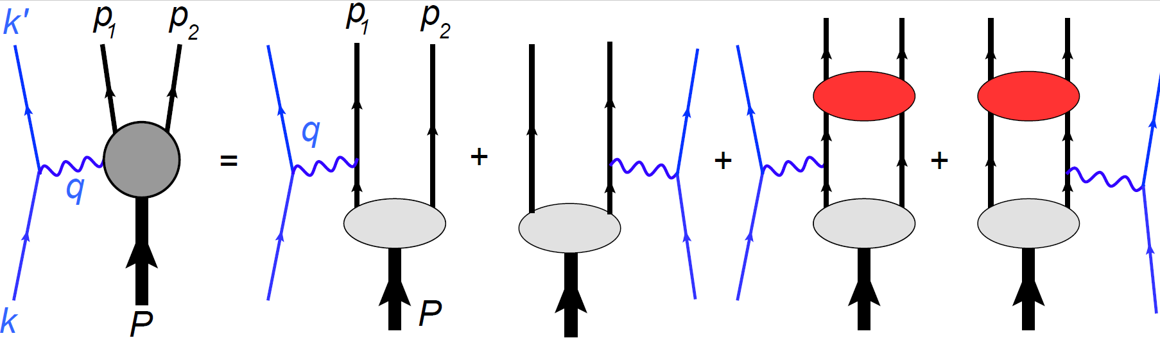
Contributions to the cross section:
Particle 1 is chosen to be the proton and Particle 2 to be the neutron.
Note that the kinematics are symmetric under the interchange of 1 and 2.

Slide 16
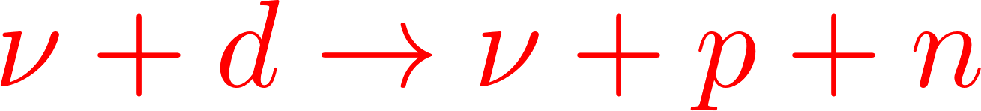
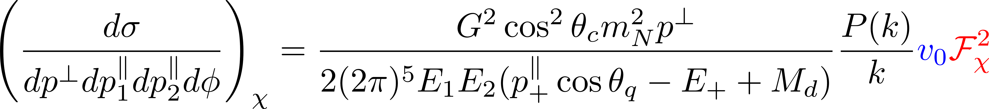
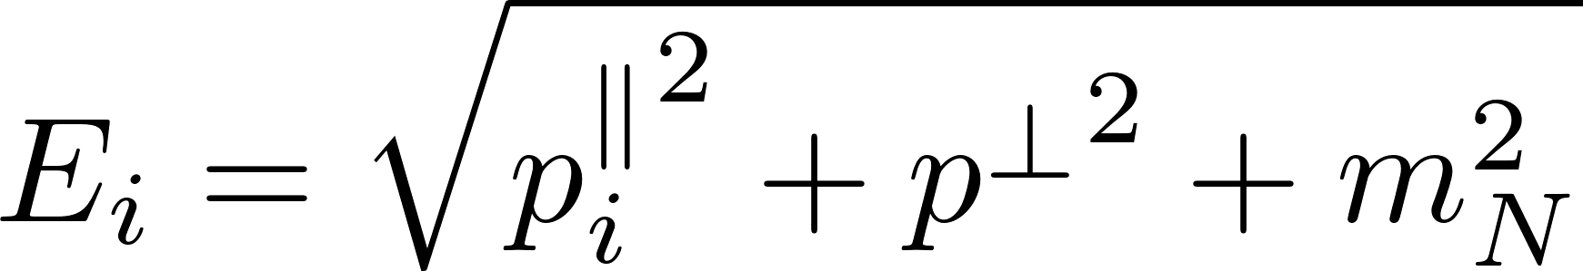
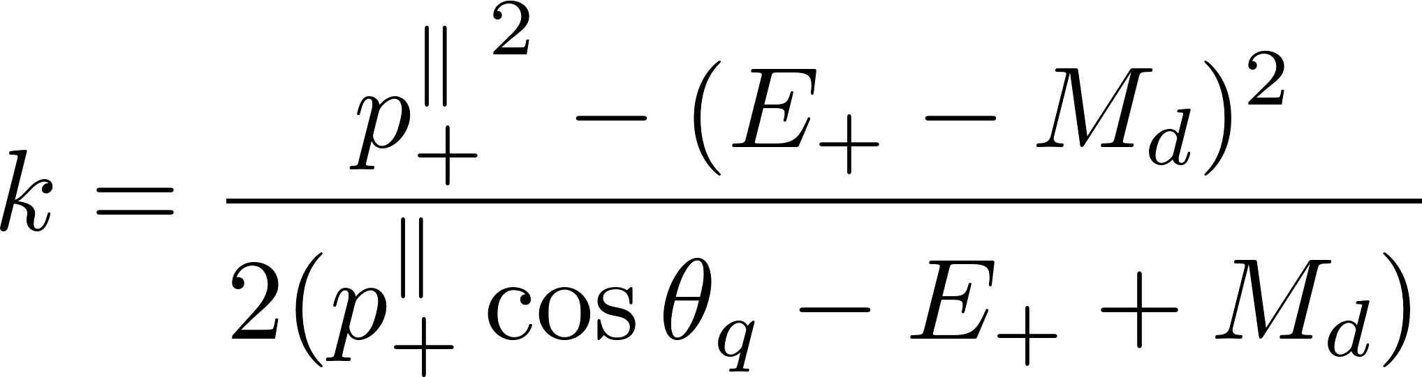
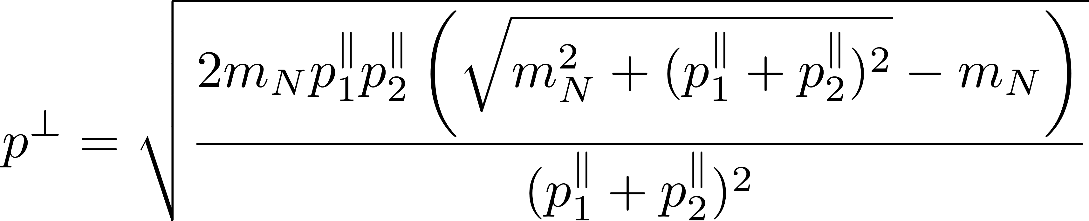
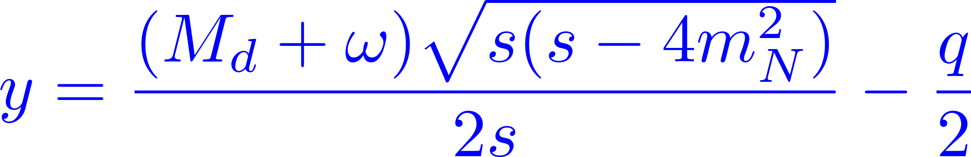
The
Cross Section
where
Uses constraint y=0

Slide 17

Reduced Cross Section

Slide 18



Kinematic Factors

Slide 19

PWBA
proton
neutron

Slide 20





Kinematics

Slide 21



Vary
Note: All deuteron calculations shown here are for

Slide 22


Slide 23


Vary

Slide 24


Slide 25


Vary

Slide 26


Slide 27


Kinematics

Slide 28


Vary

Slide 29


Slide 30


Vary

Slide 31


Slide 32


Vary

Slide 33


Slide 34

Summary
It may be possible to use neutral current neutrino scattering from the deuteron to obtain the coupling constants for the strangeness contributions to the nucleon form factors.
The sensitivity of the measurements can be increased by constructing the isovector/isoscalar ratios.
These ratios are very sensitive to the strangeness contributions to the axial form factor.
They are moderately sensitive to the strangeness contributions to the magnetic form factor.
They are sensitive to the strangeness contributions to the electric form factor only at large values of .

