Slide 1

DSG Work at Elevated MedCon Conditions
Marc McMullen
Detector Support Group
6/8/2020

Slide 2
Contents
Preparation for return to work on campus
Training requirements
Returning to campus
Review and sign OSP
Perform daily self certification
Elevated MedCon working conditions
Working conditions > 6 ft.
Working conditions < 6 ft.

Slide 3
Training Requirements
Prior to returning to work on campus, all staff members must take training course SAF003 SAF-003 Working Safely at JLab During Elevated MedCon Levels
If staff members are required to perform work <6 ft. from other staff members, those members must be certified to wear a respirator (lab-provided N95 mask), completing Med013 : Respirator Training
Med013 requires two steps
Staff must fill out the Respirator Medical Evaluation Questionnaire and submit it to Occupational Medicine
Once reviewed, the member's training record will be updated, and Industrial Hygiene will arrange for a fitting and additional training on donning/doffing the JLab provided respirator
DSG STAFF MEMBERS HAVE COMPLETED THE NECESSARY TRAINING AND WILL SCHEDULE FITTING PRIOR TO RETURNING TO WORK ON CAMPUS

Slide 4
Returning to the JLab Campus (OSP)
If notified by your supervisor to return to work on JLab campus, safety procedures provided by lab management must be followed
To ensure all staff are informed on safety procedures, all staff must review and sign
ESH-20-102494-OSP (COVID-19 Pandemic Controls)
DSG STAFF MEMBERS HAVE REVIEWED AND SIGNED THE OSP

Slide 5
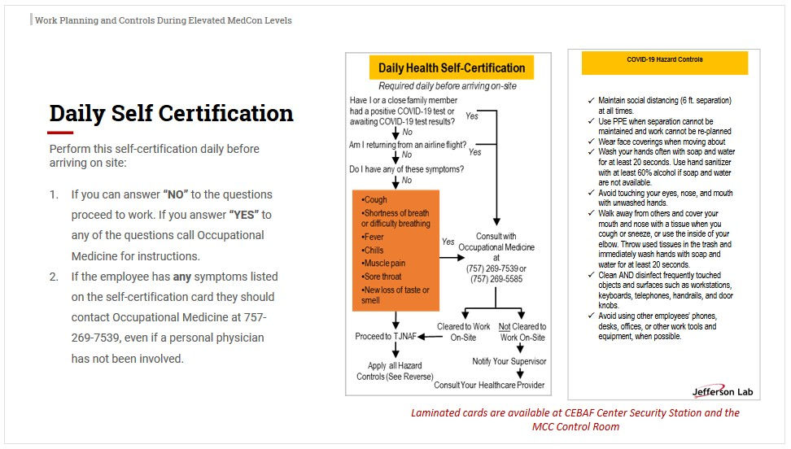
Returning to the JLab Campus (Daily Certification)
Once required training in completed, work may resume at the lab
Every member must perform a Daily Certification
DSG STAFF MEMBERS HAVE REVIEWED THE DAILY SELF CERTIFICATION DOCUMENT

Slide 6
Elevated MedCon Working Conditions, >6 Ft.
Work from home when possible
If at lab, stay >6 ft. apart. Extra precaution should be taken to avoid close encounters.
Avoid talking
Face away from other staff (when in close proximity)
No congregating in common inside areas (including restrooms)
Cloth masks must be worn any time staff member is not alone in private office
DSG work areas EEL 121C and 231 have been arranged to ensure > 6 ft. of separation

Slide 7
Elevated MedCon Working Conditions, < 6 feet
All work which requires staff members to be within 6 ft. requires formal pre-job briefing
Task Hazard Analysis will be performed
Scope of task and PPE requirements will be preplanned
Either by Bluejeans meetings or phone conferences
COVID-19 related PPE examples: N95 respirator, gloves, Tyvek suite
DSG Manager must approve all work <6 ft. prior to commencement (NO EXCEPTIONS)
N95 respirators must be provided by Jlab (Med013 training required, NO EXCEPTIONS)

Slide 8
NPS CAEN HV Testing
DSG (George Jacobs) has been approved to resume stability testing of NPS CAEN HV System starting 6/15/2020
Testing will be done in DSG cleanroom, adhering to all cleanroom and COVID-19 protocols
DSG has conducted pre-job briefing to ensure staff member's time on site will be minimized
Staff member will work alone
On-demand staff will be available for remote assistance
Data analysis will be done remotely
Test Procedure
Turn off CAEN HV
Connect HV connector to new module-under-test
Set up GECO program and testing script
Start test
Make logbook entry
DSG-List 695 will be updated to reflect any additional hazards
DSG requests information on air circulation system of DSG cleanroom and percentage of fresh air

Slide 9
Conclusion
DSG has completed all required training and reviewed Jlab OSP concerning returning to work on Jlab campus
DSG management has implemented a strategy to maximize DSG staff personal distance to minimize the potential spread of COVID-19, while continuing to provide full support for all detectors, magnets, and instrumentation systems

Slide 10
END
Thank You

Slide 11
Backup (DSG MedCon 5 Phased Return Schedule)
Week 1 None
Week 2 - G. Jacobs (NPS HV Testing)
On-demand
T. Lemon, P. Campero, B. Eng (Hall B magnet/UITF)
M. Antonioli, M. Leffel, M. McMullen, A. Brown, P. Bonneau, A. Yegnewaran

Slide 12
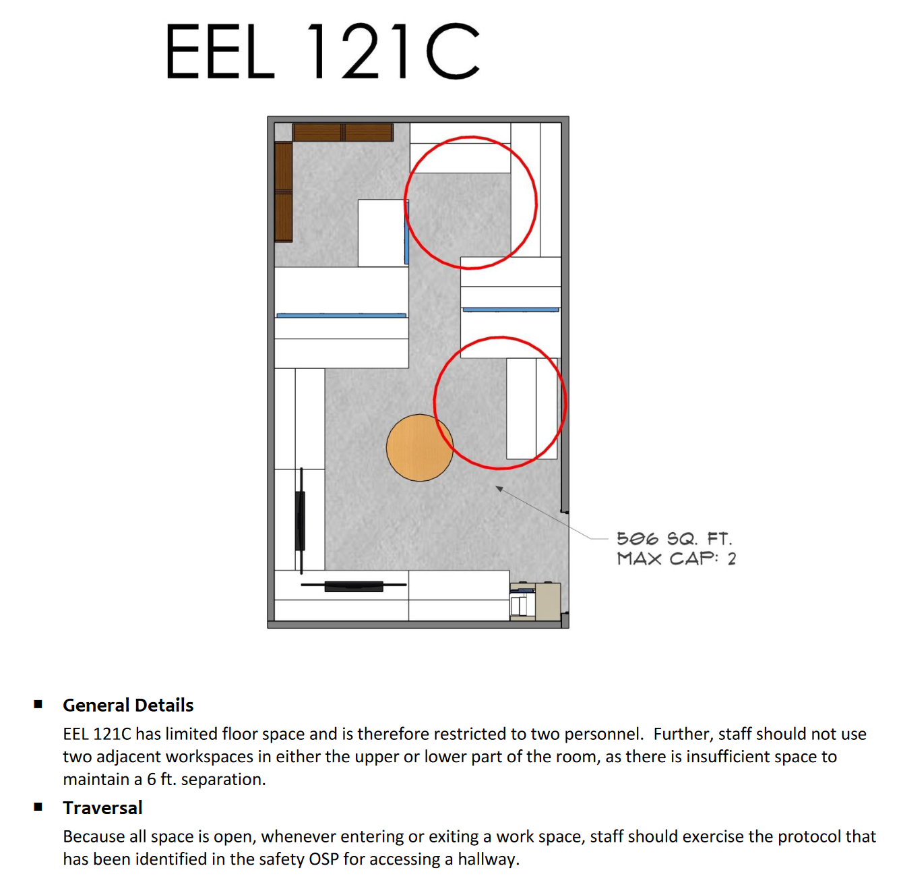
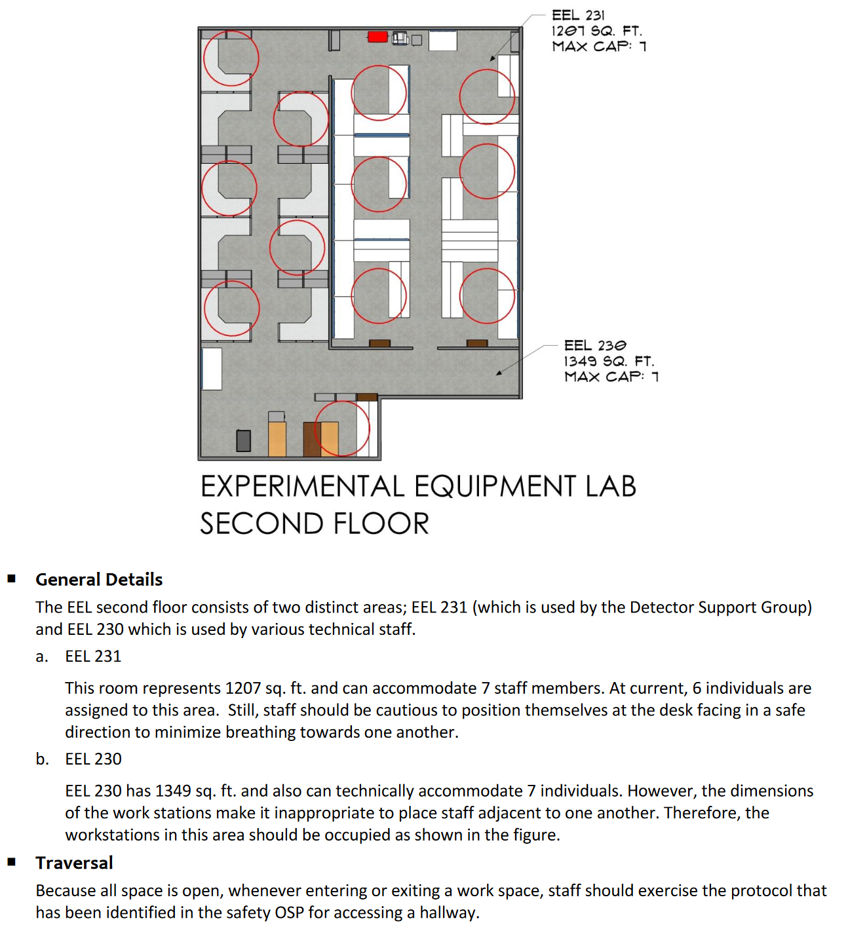
Backup (DSG Work Areas)
DSG Area

