Slide 1
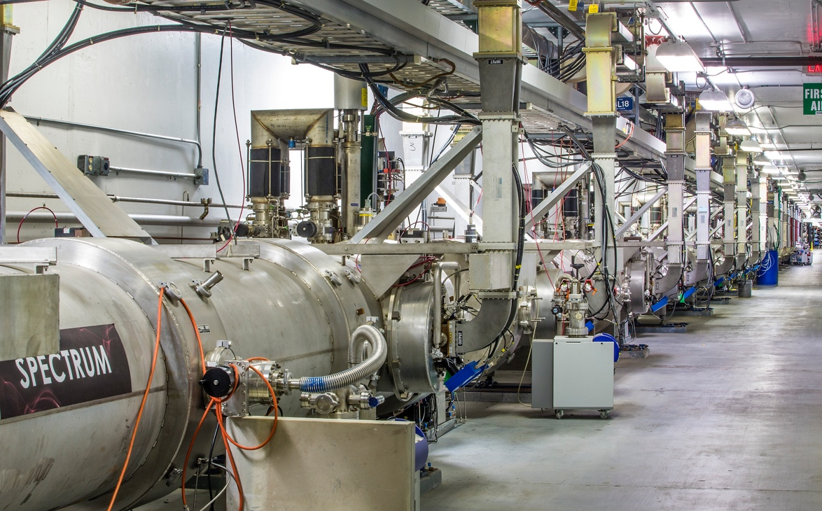
Engineering Departmental All Hands Meeting
February 26/27, 2020

Slide 2
Purpose – In Coordination with Accelerator Division
Why we are here today
  Increased number of safety issues. In the last 2 months:
    Three violations of tunnel access control
    Electrical shock 120V
    LERF administrative controls violation
What went right
  Immediate self reporting – thank you
    This helps to enhance our Reporting Culture and Just Culture – the ingredients of Operational Excellence
  Prompt action by Director of Accelerator Operations that prioritized understanding administrative controls violation over operations – good job
The purpose of today’s meeting – discuss the issues and their common themes, discuss how we can mitigate the trends

Slide 3
Importance
Safety is number one priority always
Previous safety incidents in the lab
  Summer 2019 electrical shock, laser near miss
  Office of Enforcement finishing investigation and report
  A Consent Order will be signed, to follow on OoE actions
Most recent cluster of several safety issues
  On top of OoE investigation, aggravate the situation
  Diminish the confidence of DOE that the lab is getting safety situation under control
Similar trends in other labs in the past
  Resulted in shut-down of all work for a large fraction of a year

Slide 4
Next
Department Heads– Details on recent safety issues
Steven Hoey – Perspectives from the new ES&H Director
Some Observations from Will
Open Discussion

Slide 5
Overview of Recent Events
3 Accelerator Access violations – No reportable exposure
  Hall A Access w/o a Radiation Survey/Escort
  North LINAC Access w/o a Radiation Survey/Escort
  South LINAC Access w/o a Radiation Survey/Escort
LERF Accelerator left unattended – No injury, violation, or exposure
SRF Shock event – No serious injury
SRF Knee Injury – No Serious Injury

Slide 6
Accelerator Access Violation 1 – Hall A w/o a Radiation Survey/Escort
What Happened:
Personnel accessed Hall A labyrinth several times to repair a software crate after beam delivery to Hall
No survey was performed prior to nor RCT/ARM escort used
10 CFR 835 protocols require a full or an escorted survey of any enclosure which received beam, regardless of location
What Went Right
  Quick investigation into issue
  New access protocols put in place to prevent recurrence
What Went Wrong
  Judgement made thinking no exposure danger to access personnel due to location, but…
  This judgement was in conflict with program requirements

Slide 7
Accelerator Access Violation 2 – NL w/o a Radiation Survey/Escort
What Happened:
Personnel accessed North LINAC to assist with SRF tasks
Full survey was not performed prior to, nor RCT/ARM escort used
10 CFR 835 protocols require a full or an escorted survey of any enclosure which received beam, regardless of location
What Went Right
  Entrant immediately contact MCC upon realizing something wasn’t right (expected personnel not present)
What Went Wrong
  Error made – Entrant had wrong location due to distraction
  Error made – Entrant given access during multiple access entries
  Error made – Procedure was not followed

Slide 8
Accelerator Access Violation 3 – SL w/o a Radiation Survey/Escort
What Happened:
Personnel accessed South LINAC to fix access camera
Escorted survey underway
10 CFR 835 protocols require a full or an escorted survey of any enclosure which received beam, regardless of location
What Went Right
  RCT personnel immediately contacted MCC
  SSO used questioning attitude
What Went Wrong
  Entrant given access during multiple entries
  Escort was not contacted to request permission to allow access
  New access protocols were not followed
    Judgement made thinking no exposure danger to access personnel due to location and history, but…
    This judgement was in conflict with program requirements

Slide 9
LERF Accelerator left Unattended
What Happened:
Issue with a magnet trim card during beam operations
No trim cards located within LERF to replace faulty card
Personnel secured beam by closing a laser shutter
Current Operations Directives require dropping the PSS State before last beam operator leaves the LERF Accelerator building
What Went Right
  Once error was realized, beam operation was ceased
  Chain of Command immediately contacted
  Beam authorization rescinded and LERF brought to safe condition
What Went Wrong
  Judgement made based on incorrect rule applied to LERF (loss of situational awareness)

Slide 10
Staff Shocked by Hidden Power Source
What Happened:
Worker was performing property validation
Worker inadvertently disconnected power to low voltage equipment during inspection of property
Worker came in contact with adjacent and hidden power source
What Went Right
  Worker immediately contacted local Safety Warden
  Worker contacted Supervisor shortly afterwards
  Coworker escorted worker to OccMed for medical evaluation
What Went Wrong
  Power source replaced with different source containing high voltage without communicating change to all stakeholders
  Workmanship of power connections – Less Than Adequate
  Judgement made by worker to place hand into hidden area based on incorrect assumption that no hazard could be present

Slide 11
Staff Injured during Non-routine Task
What Happened:
Worker contacted by coworker to assist with PPE replenishment in specialized area, and injured knee doing this
Worker interrupted what they were doing to assist coworker
What Went Right
  Worker helped coworker (worker was one of few trained individuals available to assist)
  Worker immediately contacted supervisor
  Coworker escorted worker to OccMed for medical evaluation
What Went Wrong
  Judgement made based on shortcutting area requirements
  Worker was distracted and had loss of situational awareness

Slide 12
Commonalities
During the investigation process for each event, several common factors became apparent
  Loss of Focus by a worker (directly involved or indirectly involved)
  Loss of situational awareness
  Perceived time pressure related to task at hand
  Not questioning: ”What’s the worst that could happen and how can it happen here?”
  Loss of professionalism* (directly involved or indirectly involved)
  *See next slide for definition

Slide 13
Worker Professionalism
What does this mean?
  Doing the job right the first time
  Planning enough time to complete the job completely
    Define the scope of the work
    Understand the hazards involved
    Place barriers between workers and the hazards
    Work the plan
    Reassess everything when the plan changes
    Clean up after the job is over
    Feedback what went right and what needs improvement before next task
  Letting supervisor know when there is not enough time to do the job professionally
What’s the last job you rushed or didn’t complete completely?
  What prevented you from completing it?
  What could we, as an organization, do differently?
  How could we, as an organization, set you up for success?

Slide 14
Steven A. Hoey
Director ESH
JLab

Slide 15
Background
Experience:
29 Years National Laboratory in ESH (INEL and BNL)
Aerospace (Space Shuttle and B1B bomber)
Chemical processing (highly toxic materials HCN)

Slide 16
Observations
What have I learned the past few weeks?
  Dedicated staff
  Strong culture of mission success
  Robust controls/processes in place
What have I seen the past few weeks?
  Three incidents (electrical shock, access control, LERF control) Incidents are repetitive
  Overall sense of ”too much” to do (everyone is very busy)
  JSA Review – track plans of action on most recent events, assessment of lab management actions to ensure corrective actions are impactful and aligned insuring safe and effective operations across the laboratory
  Office of Enforcement Conference – uncertain outcome

Slide 17
Events have Consequences
NREL – January 2020
  Two Shock incidents, (lab built and commercial) influenced OE look at broader programmatic deficiencies
Sandia – August 2019
  Electrical arc, no injuries, started fire
ANL – 2017
  Two Electrical shock incidents
  Lab shutdown for 7 days
BNL – 2012
  Linac Beam mis steering event
  NSLS-II commissioning delayed 3-4 months
SLAC – 2004
  Arc flash incident
  Accelerator shut down for over 6+ months

Slide 18
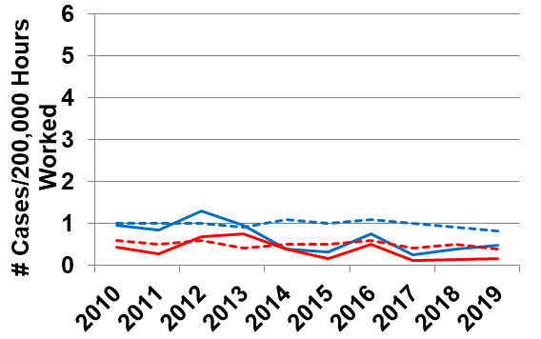
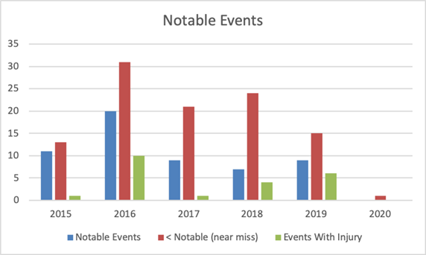
World Class Science Requires World Class Safety
Current State
TJNAF safety performance is statistically similar to SC Labs, but too many close calls
Recurring problems highlight past failures to isolate and treat root cause
Human Performance Improvement practices taking hold too slowly
Restoring a Robust Safety Culture
Major FY20 investments in:
  Expanding event investigation process, stood up a separate Performance Assurance Office
  Reengineered task hazard analysis process oriented to explicitly help workers do their jobs
  Expanding safety training to include skills demonstration
  Increasing our commitment to engineered controls to reduce reliance on administrative controls
  Expanding supervisor responsibilities for worker engagement and oversight
Integrating Lab Agenda Initiatives into a comprehensive, multi-year Operational Excellence Plan
Explicit subcontractor safety requirements and selection process
TJNAF SC Labs
TRC
DART

Slide 19
Observations – Path Forward
Restore DOE’s confidence that we can operate this lab safely and meet our mission goals
Learn from incidents to make sure we understand root causes and develop meaning full and effective corrective actions – prevent repetition
Develop a “Culture of Prevention” get away from “Culture of Reaction”
Stop and think before we do work – what are the hazards and consequences
Everyone needs to participate in this stand down and ongoing corrective action plans initiatives to prevent incidents
Need to stop hurting people – engage and use HPI concepts

Slide 20
Will Oren

Slide 21
Worker Professionalism
What does this mean here and at home?
  Doing the job right the first time – like you were paying for it
  Produce a product you will be proud of which means:
    Define the scope of the work
    Planning enough time to complete the job completely (Let your supervisor know when there is not enough time to do the job professionally
    Work the plan
    Reassess everything when the plan changes
  Have someone check your work
  Clean up after the job is over
  When appropriate, document what you did
  Above all stay safe throughout
At JLab what’s the last job you rushed or didn’t complete thoroughly?
  What prevented you from completing it?
  What could we, as an organization, do differently?
  How could we, as an organization, set you up for success?
I want to hear from you on the 3 above questions, discuss at your toolbox meetings & e-mail comments!

Slide 22
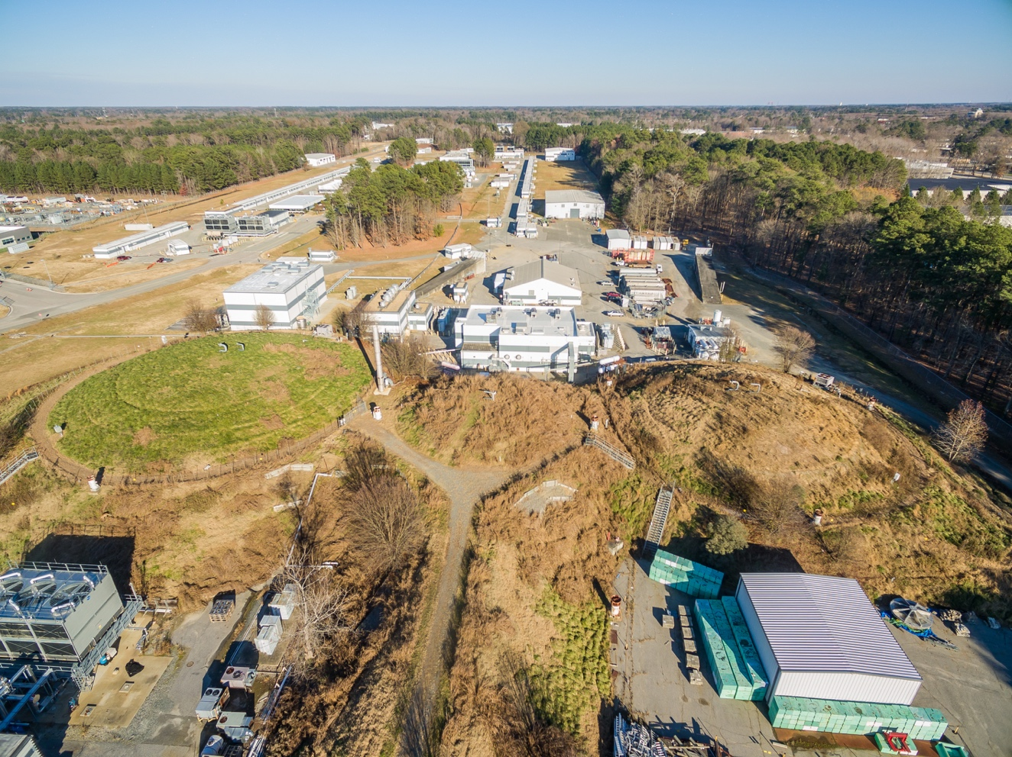
Discussion and Stand-Down plans
After this All Hands and for remaining time of Stand-Down:
  Safety related activities coordinated by Department Leads
Now open for discussion

