Slide 1

Heavy Baryons and Exotics from Holographic QCD
Jefferson-Lab19’

Slide 2
Outline
Introduction
Model: D4-D8-DH
Heavy Baryons
Heavy Meson Exotics
Summary

Slide 3
Motivation
LHCb:
Belle and BESIII:

Slide 4
Why Holography
Duality:
Symmetry:
Organize:

Slide 5
Model

Slide 6
Witten-Sakai-Sugimoto
Witten 98’; Sakai-Sugimoto 05’

Slide 7
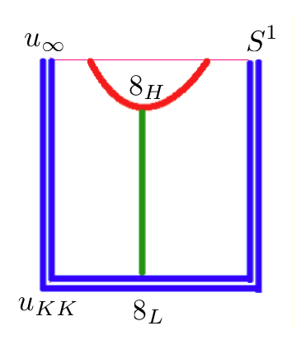
Liu-Zahed
HL symmetric: Isgur-wise

Slide 8
Heavy Baryons

Slide 9
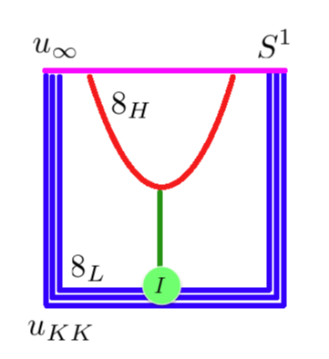
HL baryons in D4-D8-DH
Liu-Zahed 17’

Slide 10
Baryon stability

Slide 11
Zero Mode and Spin Transmutation
Liu-Zahed 17’

Slide 12
Quantization: SU(2) no H

Slide 13
Heavy-Light: SU(2)
Liu-Zahed 17’

Slide 14
Parameters

Slide 15
Single-heavy: NQ=1
Liu-Zahed 17’

Slide 16
Pentaquarks
Liu-Zahed 17’

Slide 17
Quantization: SU(3)
Liu-Zahed 17’

Slide 18
Heavy-Light: SU(3)
Liu-Zahed 17’

Slide 19
Single-Heavy Baryon with charm

Slide 20
Single-Heavy Baryon with bottom

Slide 21
Charm-, bottom-Pentaquarks

Slide 22
Mixed-Pentaquarks

Slide 23
Charm-, bottom-3-plets

Slide 24
Heavy meson exotics: Tetraquarks and Hexaquarks

Slide 25
O(4) Tunneling configuration

Slide 26
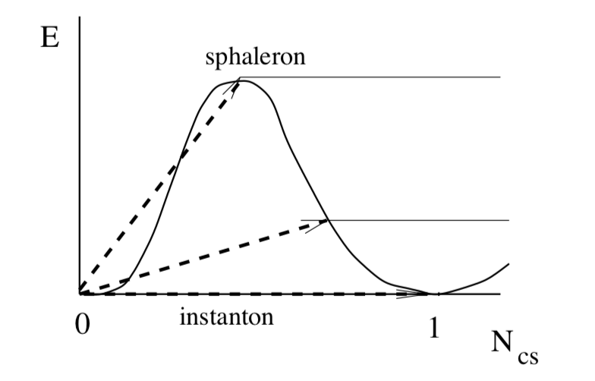
Sphaleron family

Slide 27
Mass and T-charge

Slide 28
Hamiltonian for Heavy-molecule

Slide 29
Quantum moduli

Slide 30
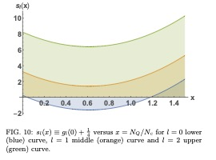
Multiquark exotics

Slide 31
Efimov states

Slide 32
Binding energy in heavy limit

Slide 33
Tetraquarks and Hexaquarks

Slide 34
Summary
D4-D8-DH: LxRxH
HL baryon: ZM+I
HL exotics: ZM+S
Many Multiquark states

