Slide 1
Self-Energies In a Relativistic Chiral Effective Theory
Marston Copeland, chueng-ryong ji, wally melnitchouk

Slide 2
Motivation
The structure of SU(3) octet and decuplet baryons in QCD
Fundamental low-energy properties (e.g. masses) described within chiral effective theory
Field theoretic description requires loop corrections
Use a relativistic chiral effective theory, finite size of baryons

Slide 3
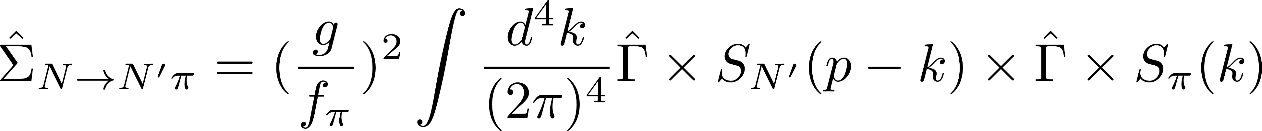
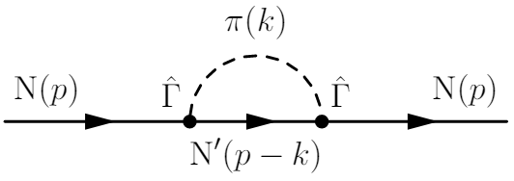
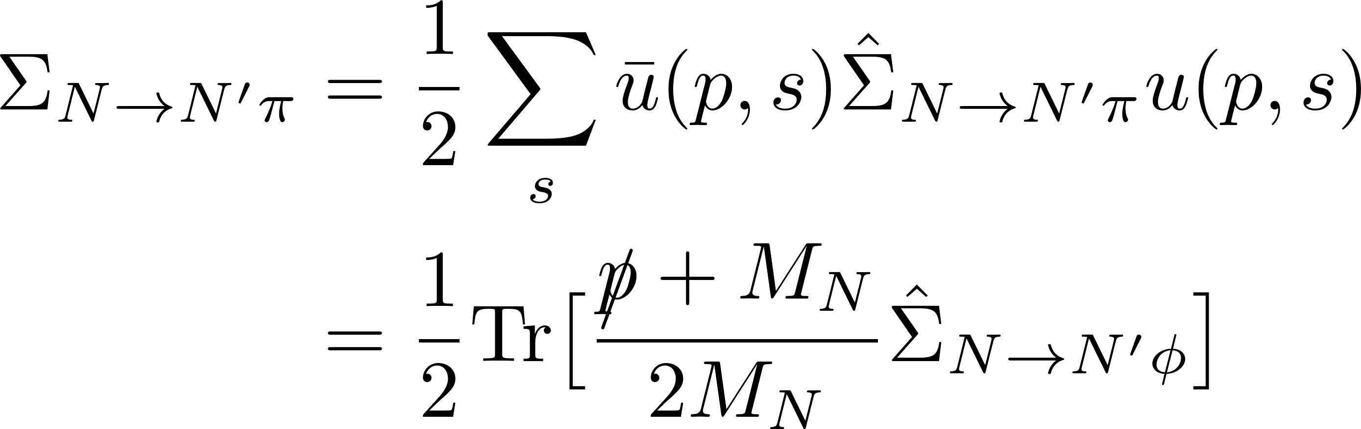
The Simplest Meson loop
Nucleon-Pion Loop

Slide 4
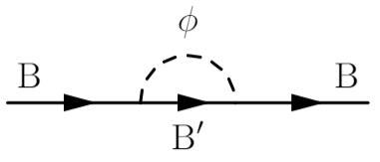
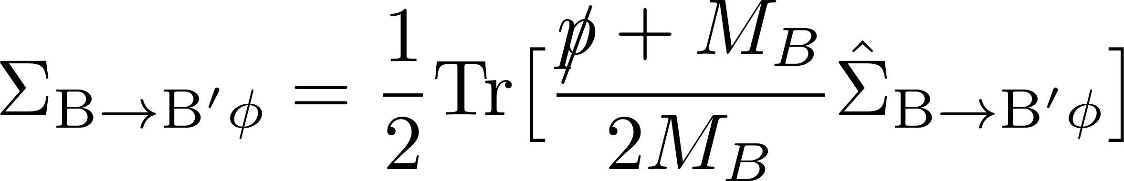
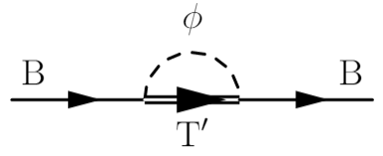
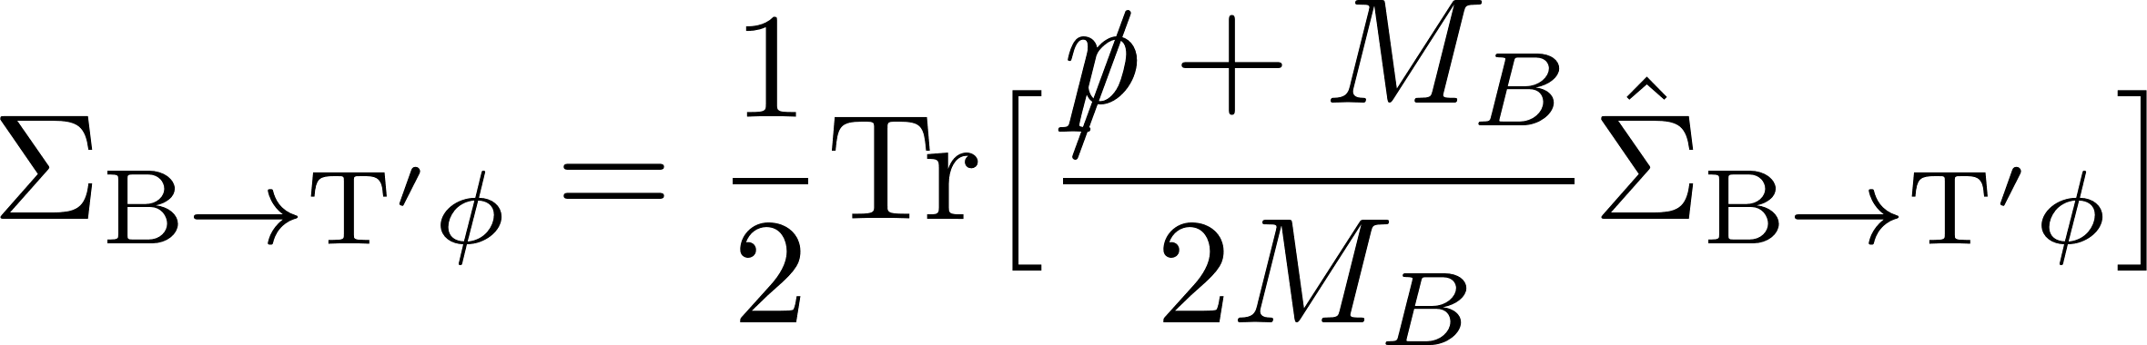
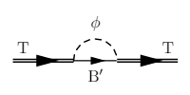
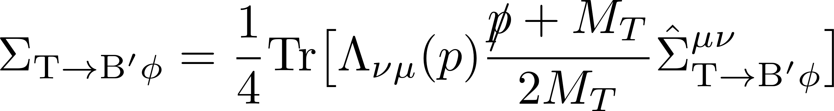

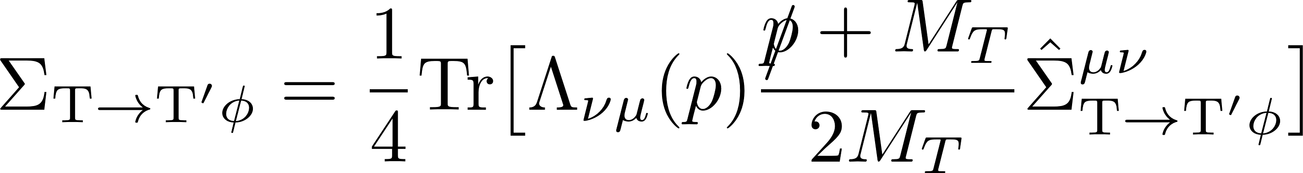
Different Cases
Octet to octet and meson
Octet to decuplet and meson
Decuplet to octet and meson
Decuplet to decuplet and meson
where

Slide 5
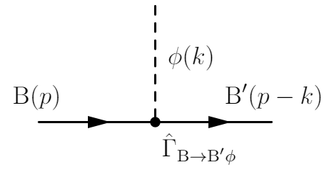
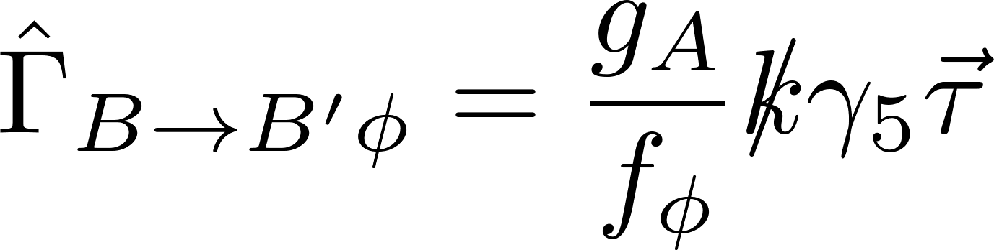
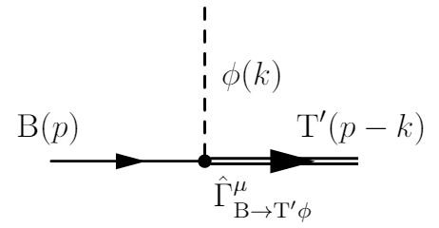
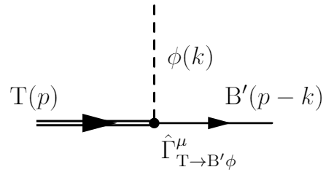
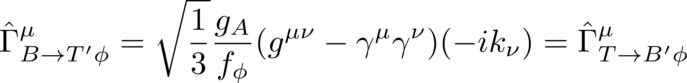
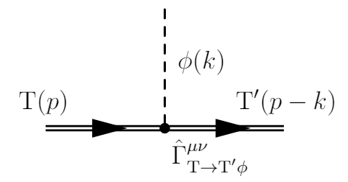
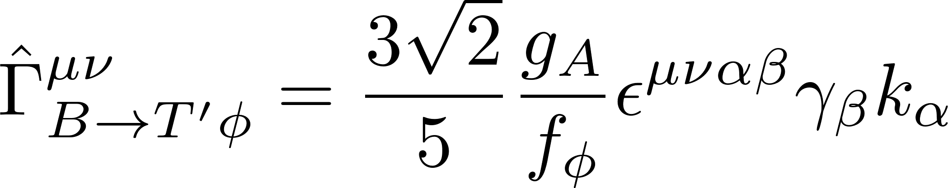
The interactions (Vertices)
Octet to Octet
Octet to Decuplet & Decuplet to Octet
Decuplet to Decuplet

Slide 6
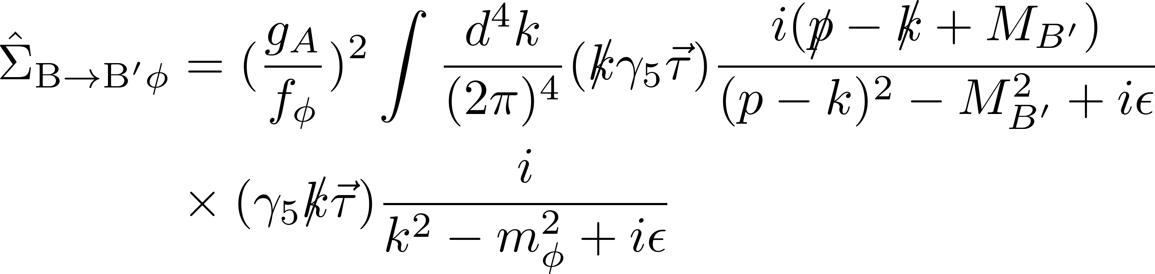
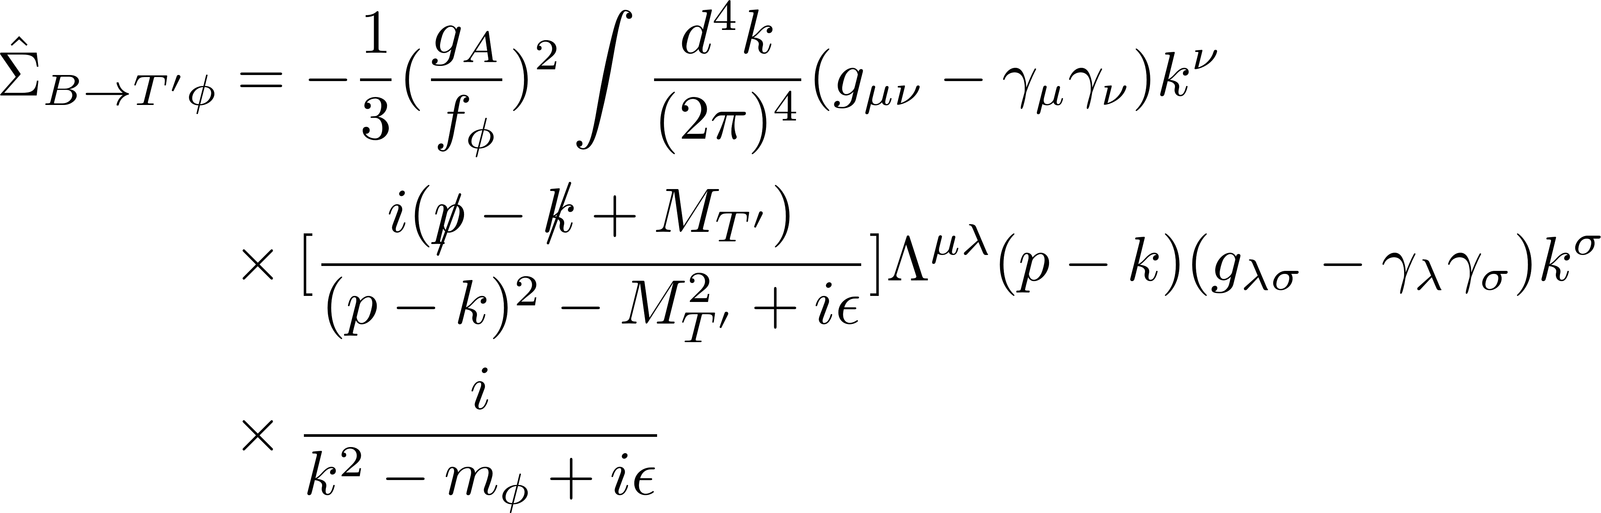

$B →B^{′}φ$ and $B →T′φ$
Octet to octet self-energy operator
Octet to decuplet self-energy operator

Slide 7
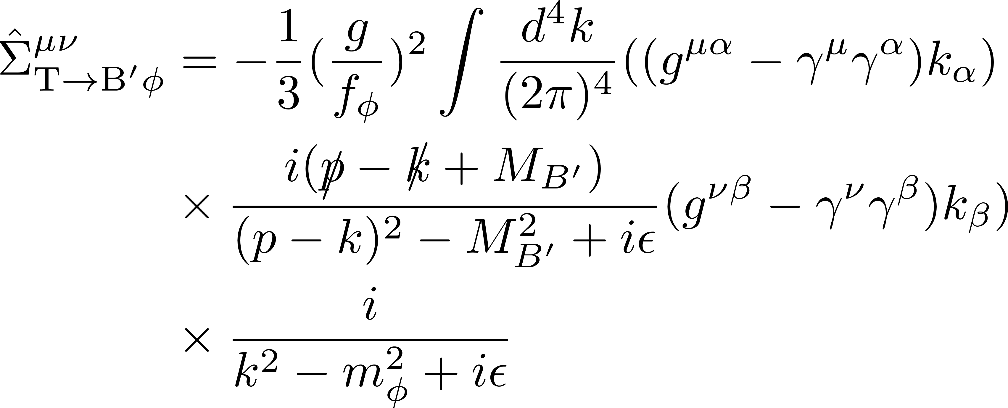
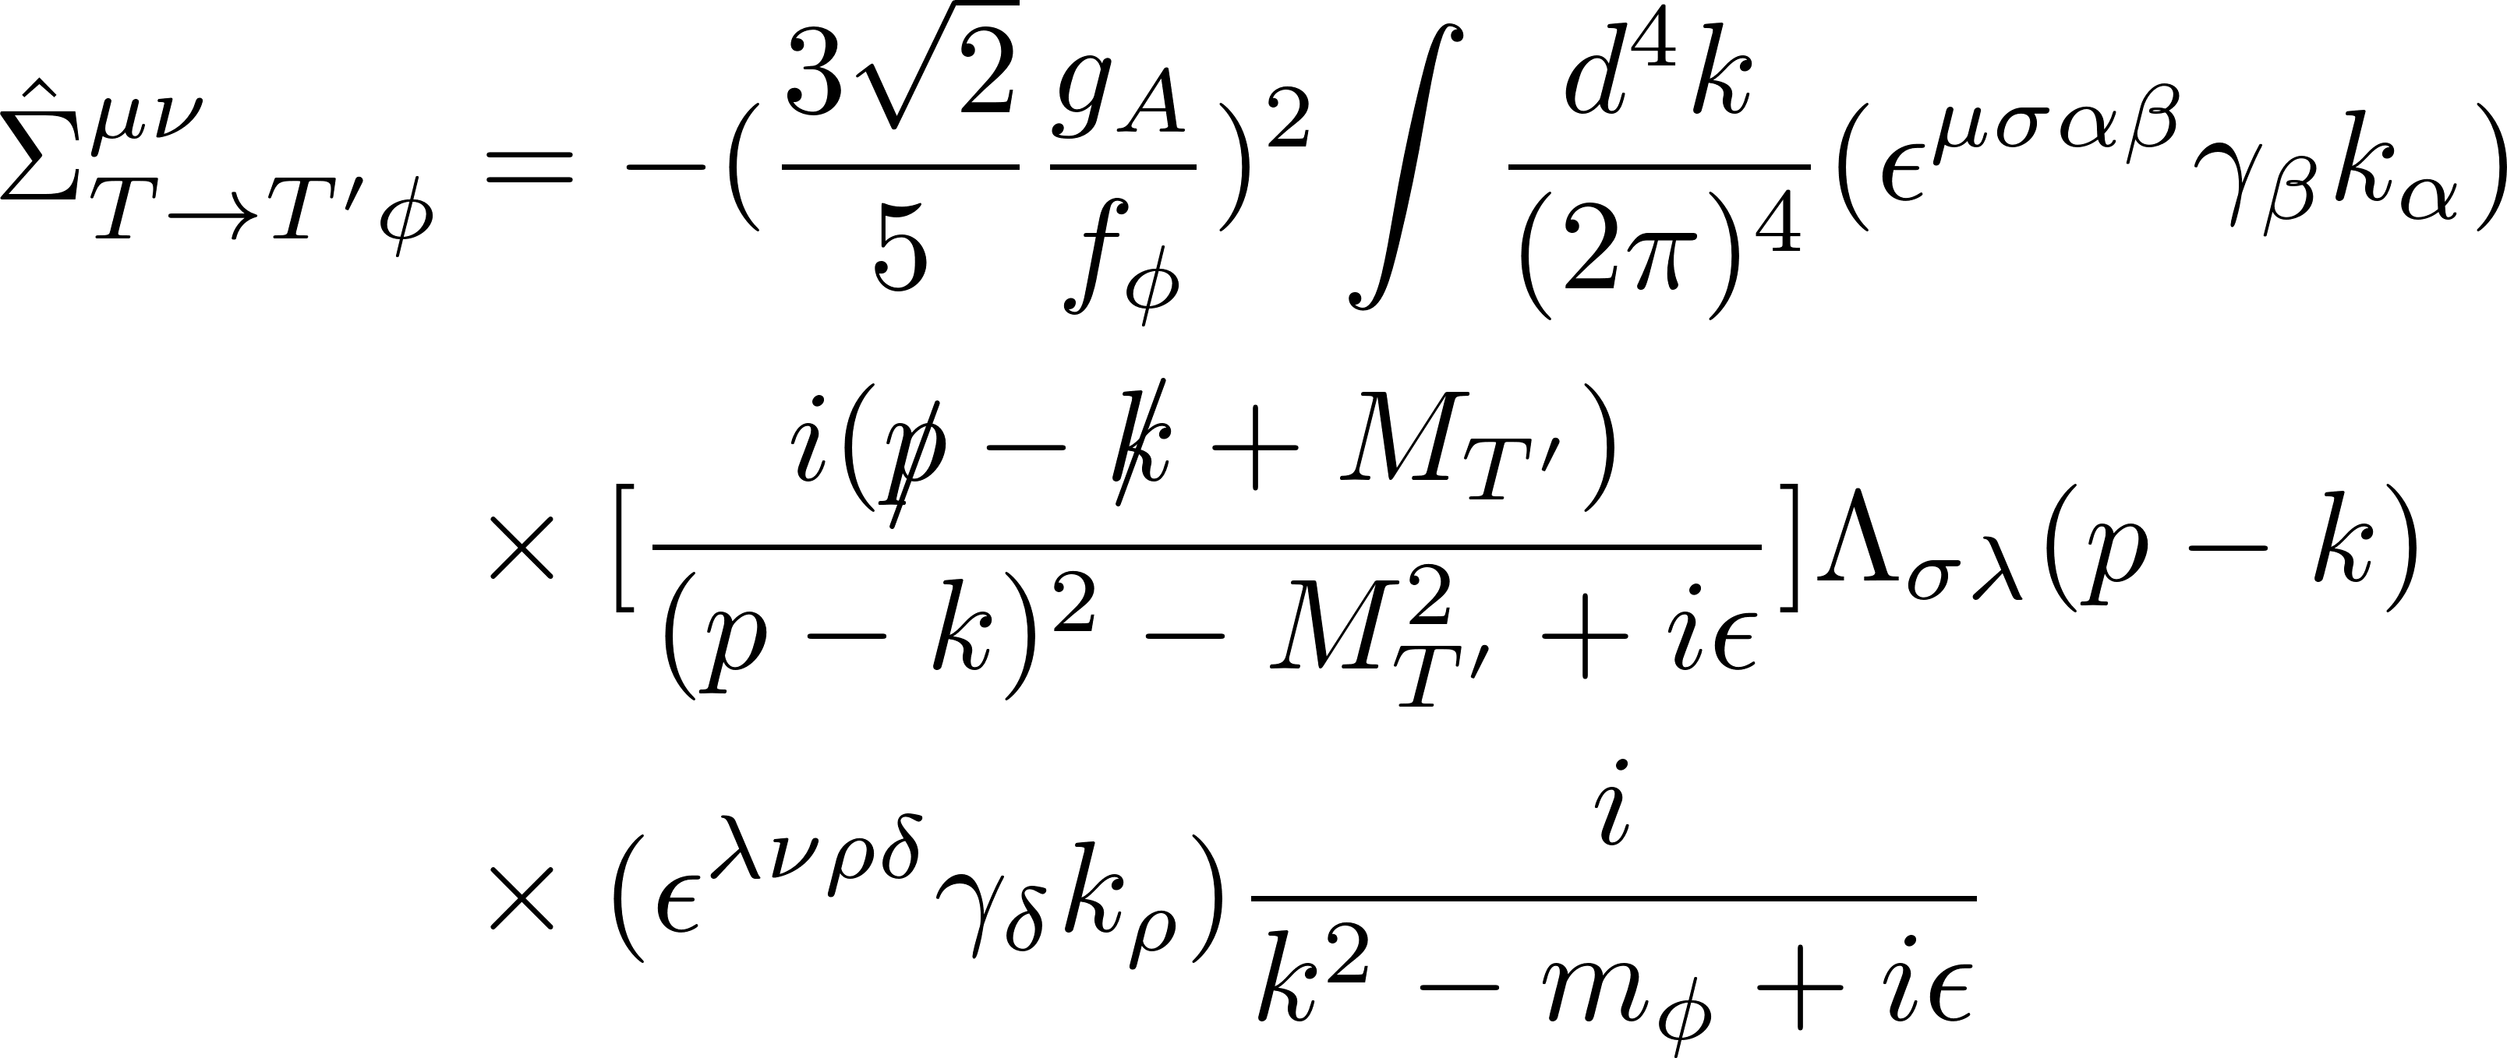

T$→B^{′}φ$ and T$→T′φ$
Decuplet to octet self-energy operator
Decuplet to decuplet self-energy operator

Slide 8
Regularization
Dimensional regularization
Finite range regularization
  n-pole form factor
  Pauli-Villars
  Dipole form factor

Slide 9
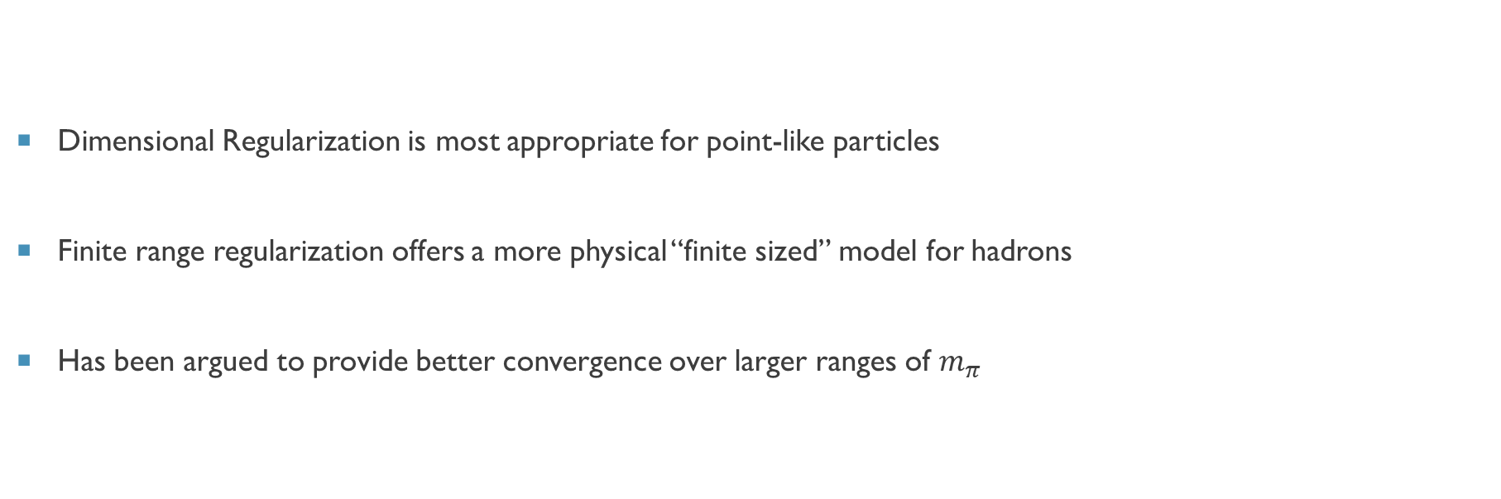
Why Finite Range?
Dimensional Regularization is most appropriate for point-like particles
Finite range regularization offers a more physical “finite sized” model for hadrons
Has been argued to provide better convergence over larger ranges of $m_{π}$

Slide 10
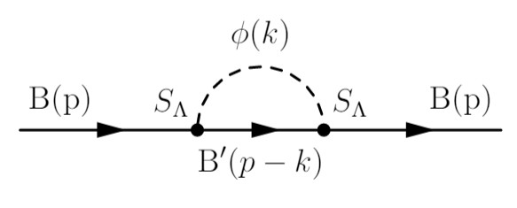
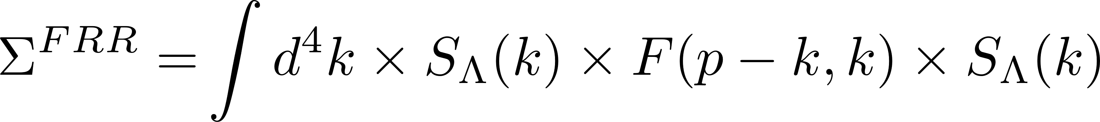
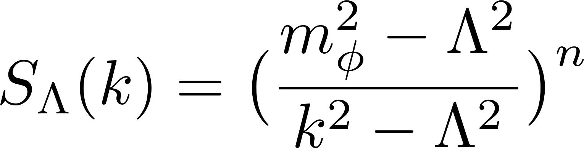
Finite Range Regularization
Apply a form factor to each vertex
“Finite size” of baryons
Form factors at hadronic vertices can be related to other observables involving meson loops
We consider a general n-pole form factor
where

Slide 11
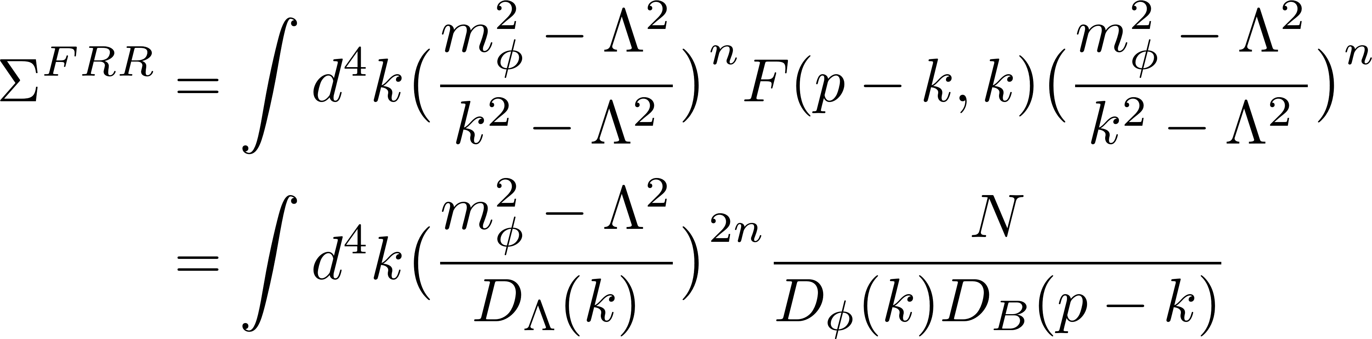
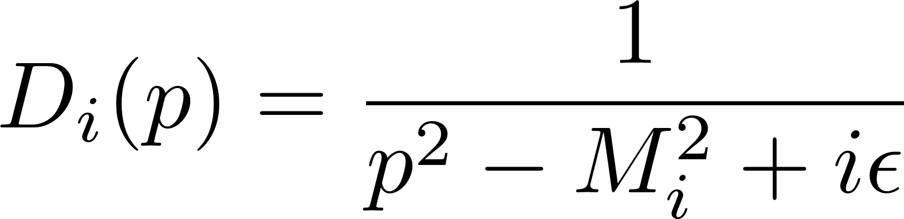
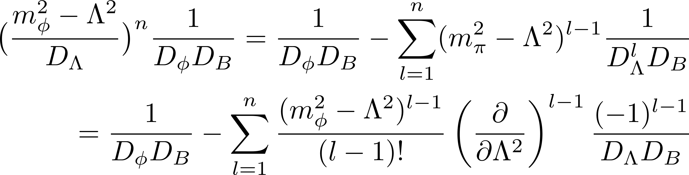
N-pole form factor
An n-pole form factor can be written as a summation
where

Slide 12
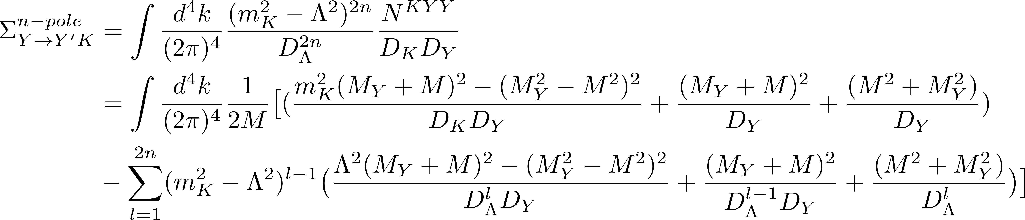
n-Pole Form Factor For Kaon-Hyperon Loop
n-pole formula applied to octet

Slide 13
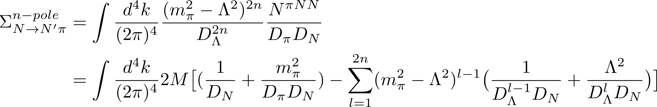
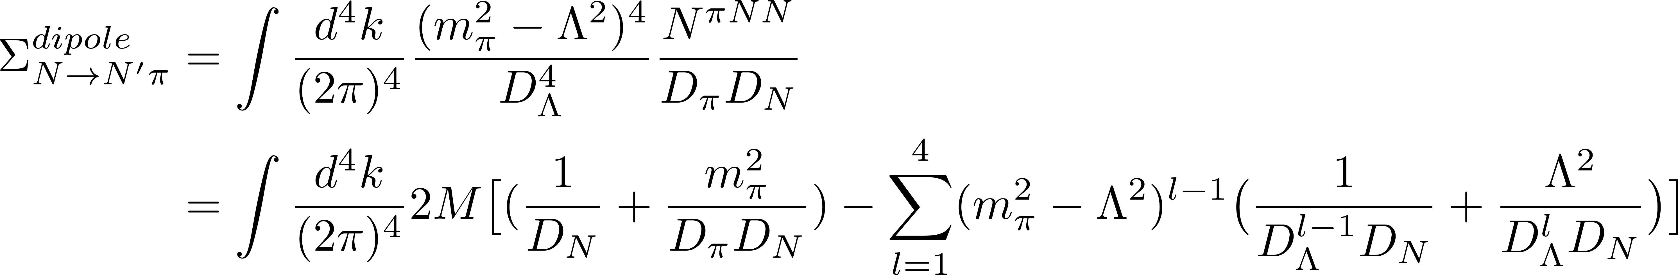
N-POLE Form Factor for Pion-Nucleon Loop
Easily applies to all cases in octet and decuplet
Plugging in n = 2 for a dipole

Slide 14
The final results for Pion-Nucleon

Slide 15
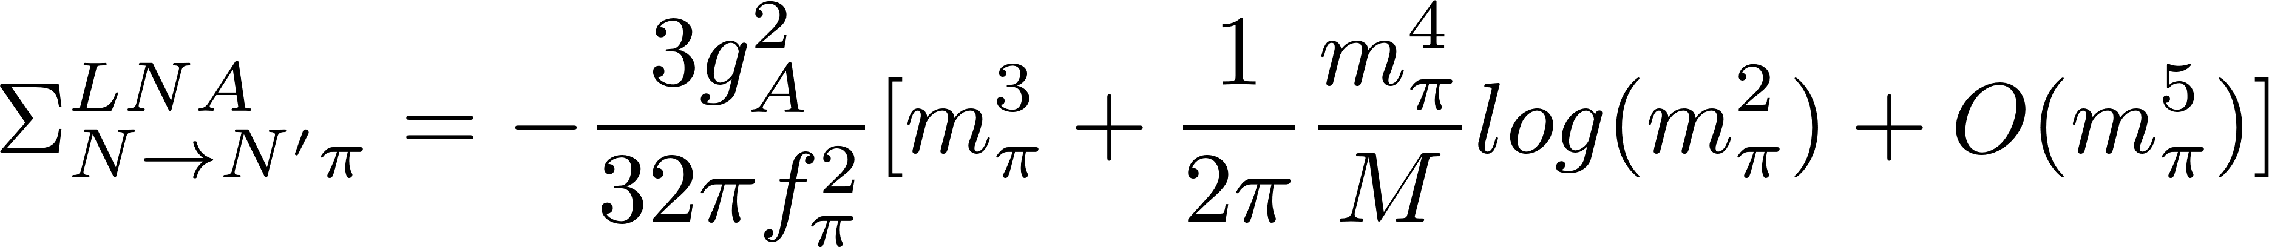
The final results for Pion-Nucleon
The same leading non-analytic behavior as for Dim. Reg. and other regularization schemes

Slide 16
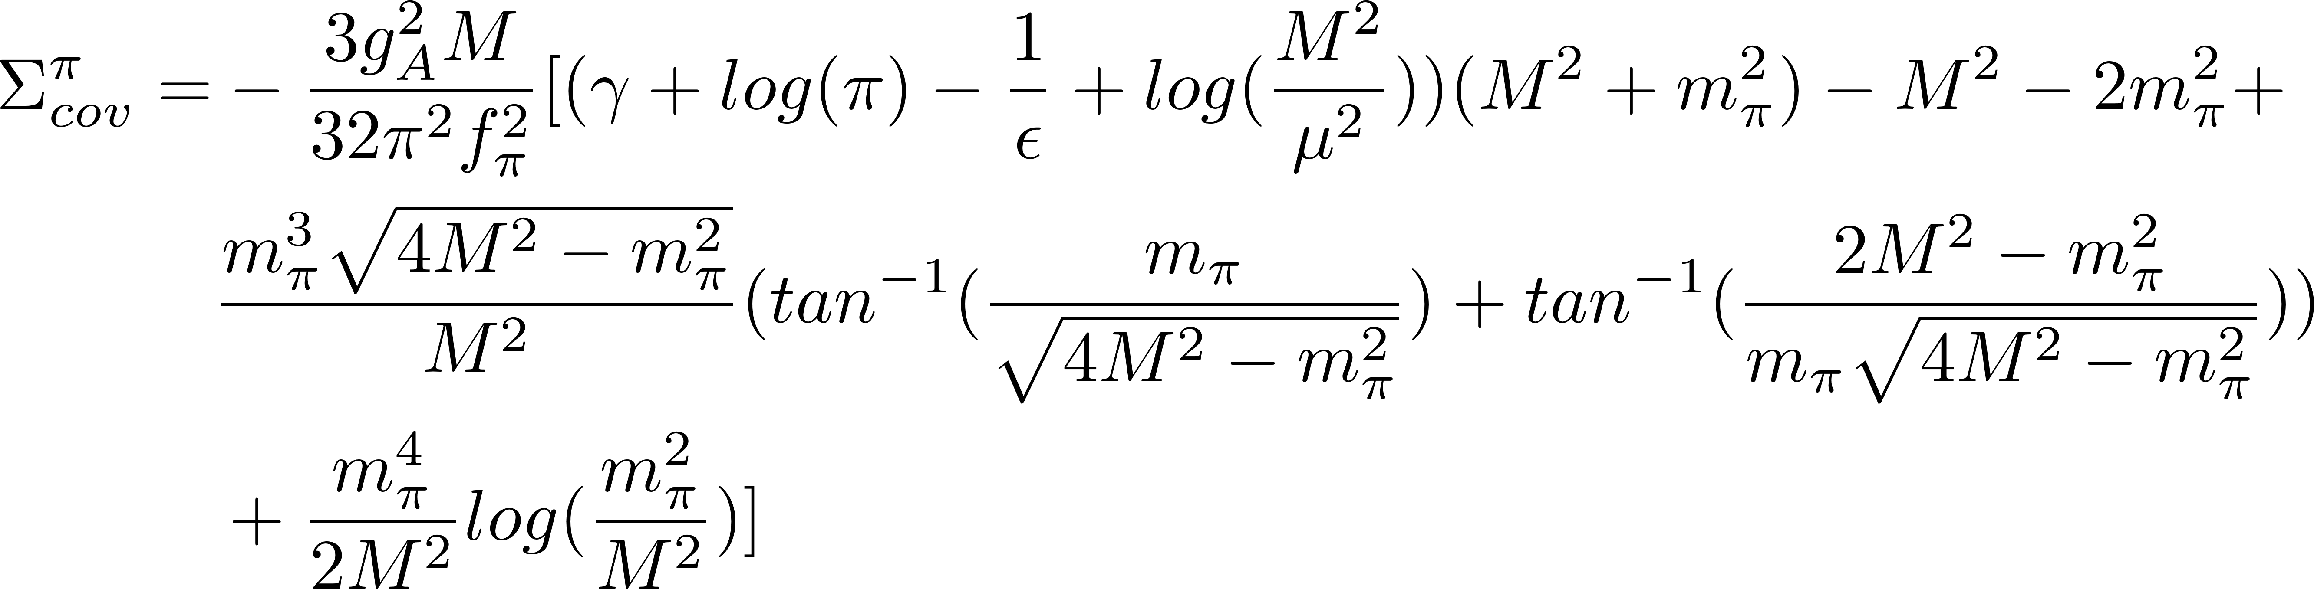
The final results for Pion-Nucleon
The same leading non-analytic behavior as for Dim. Reg. and other regularization schemes

Slide 17
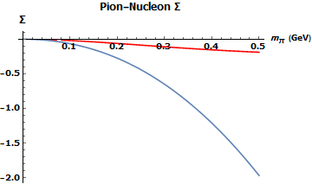
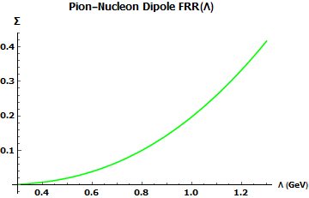

Results For the Pion-Nucleon Loop
Dim. Reg. vs. Finite Range
$$Finite Range−Red$$
$$Dim. Reg. −Blue$$

Slide 18
Summary and Outlook
What has been done
Computed self-energies for SU(3) octet and decuplet baryons
  Relativistic chiral effective theory
  Finite Range Regularization
  Future work
Verify LNA behavior for Finite range regularization in all cases for SU(3) octet and decuplet
Connection with sigma terms (mass)
Extend to 3-point functions (coupling of external fields to meson loops), e.g. electromagnetic form factors, parton distributions

Slide 19




Acknowledgements
I’d like to thank my mentor Wally Melnitchouk and collaborator Chueng-Ryong Ji, for their wisdom, help, and support on the project.
I’d also like to thank Jefferson Lab, the Department of Energy, the NSF, and the REU program at Old Dominion University for the opportunity to work over this summer.
NSF Award Number 1659177

Slide 20
References
Chueng-Ryong Ji, W. Melnitchouk, and A.W. Thomas, Phys. Rev. D 80, 054018 (2009)
Salamu, Ji, Melnitchouk, Thomas, and Wang, Phys. Rev. D 99, 014041 (2019)
M. Oettel and A.W. Thomas, Phys. Rev. C 66, 065207 (2002)
V. Pascalutsa, M. Vanderhaeghen., Phys. Lett. B 636 (2006) 31-39
S. Scherer and M.R. Schindler, arXiv: hep-ph/0505265
J.D. Bjorken and S. Drell, Relativistic Quantum Mechanics (McGraw-Hill, New York, 1965)
I.J.R. Aitchison and A. J. G. Hey Gauge Theories in Particle Physics (Institute of Physics Publishing, London, 2003)

