Slide 1
Scattering on a Finite,
Minkowski 1+1D Lattice
Alexandru M. Sturzu
Raúl A. Briceño
Maxwell T. Hansen

Slide 2
Motivation
Nuclear Physics is Non-Perturbative
Lattice QCD is the only systematic, non-perturbative tool for conducting QCD calculations
To date, lattice QCD is necessarily defined in a finite-Euclidean spacetime (imaginary time), in order to make Monte Carlo sampling possible
It has been recently proposed that Minkowski (real time) calculations may be possible, using either sophisticated sampling in classical computers or using quantum computers.
Looking forward into the future, here we consider the feasibility of using real-time calculations to determine few-body scattering amplitudes.

Slide 3



Lattice QCD - background
Discrete Space-time and Finite Volume characterize Lattice QCD
Given we are interested in the determination of scattering observables, we can safely consider a continuous yet finite volume
Furthermore, we restrict our attention to periodic boundary conditions in 1+1D, where:

Slide 4
Scattering in a finite volume
In a finite volume, there are no asymptotic states, hence scattering is not well defined.
We can consider different possibilities for circumventing this.
Possibility #1: Lüscher formalism.
  Relate the finite-volume spectrum to infinite-volume amplitudes
  This also works for Euclidean spacetime.
  Minkowski calculations do not provide anything new here.
Possibility #2: Directly extract amplitudes where in the infinite-volume limit we recover the physical amplitudes.
  This is uniquely Minkowski
  Here we explore this idea

Slide 5
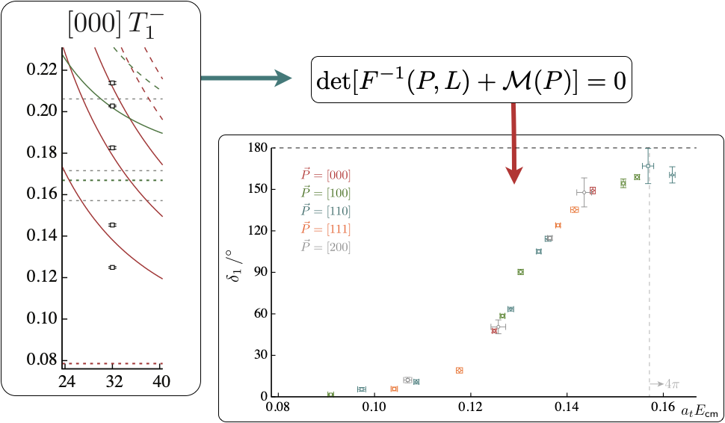


Slide 6
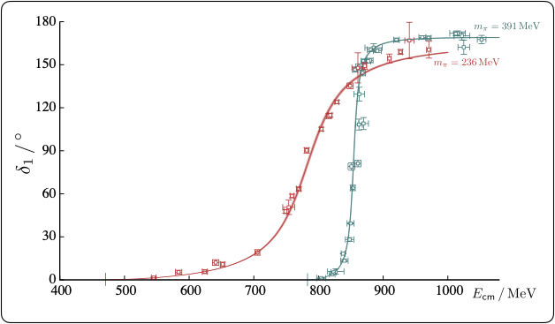

Slide 7



Lüscher Formalism and Correlation Functions
Able to calculate scattering amplitudes from Correlation Functions
For Euclidean metric:
Where and
The Minkowski case is very similar where:
Where the only additional step needed is a Fourier analysis on this final quantity

Slide 8




Infinite Volume Scattering Amplitude
First need to write down the infinite volume scattering amplitude in 1+1D that satisfies “unitarity”
is the phase space which is dependent on the kinematics and to an extent also the dimension, while encodes all of the dynamics

Slide 9


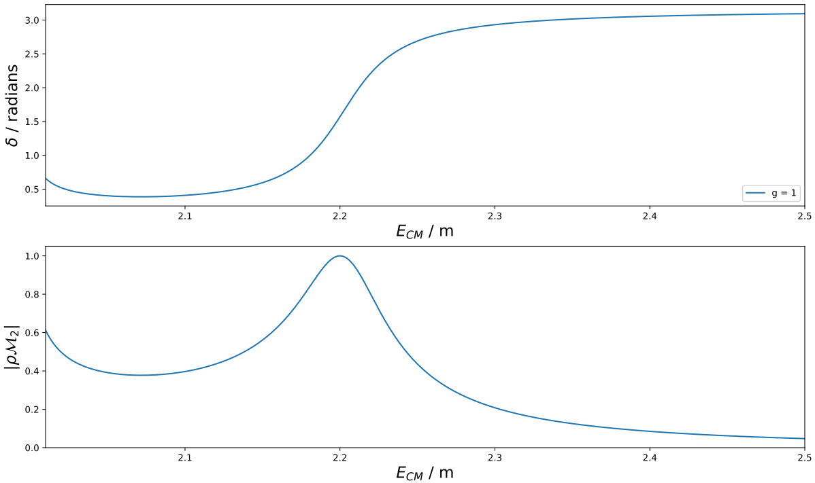
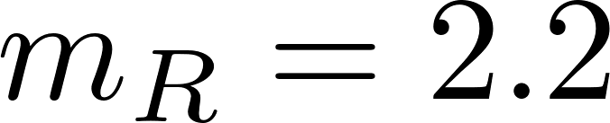
Infinite Volume Scattering Amplitude
For example, consider a Breit-Wigner amplitude:

Slide 10





Finite Volume Scattering Amplitude Analogue
The finite volume scattering amplitude analogue is given by:
Where is the previously derived scattering amplitude and is a geometric function defined as:
Which simplifies to:

Slide 11


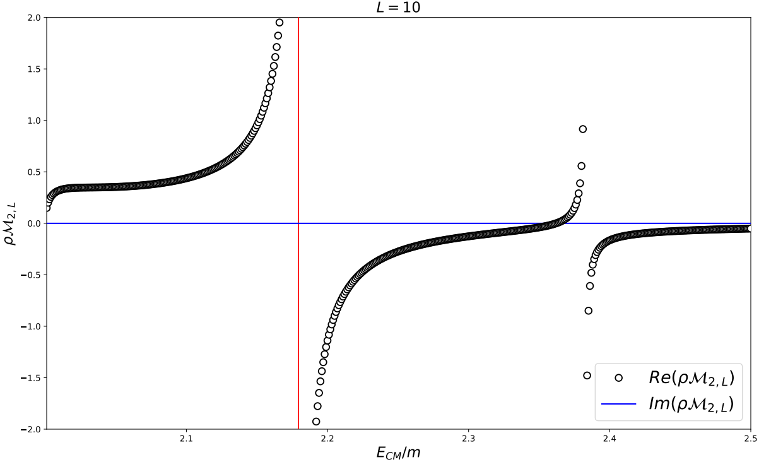
Finite Volume Scattering Amplitude Analogue
Producing a new form of

Slide 12

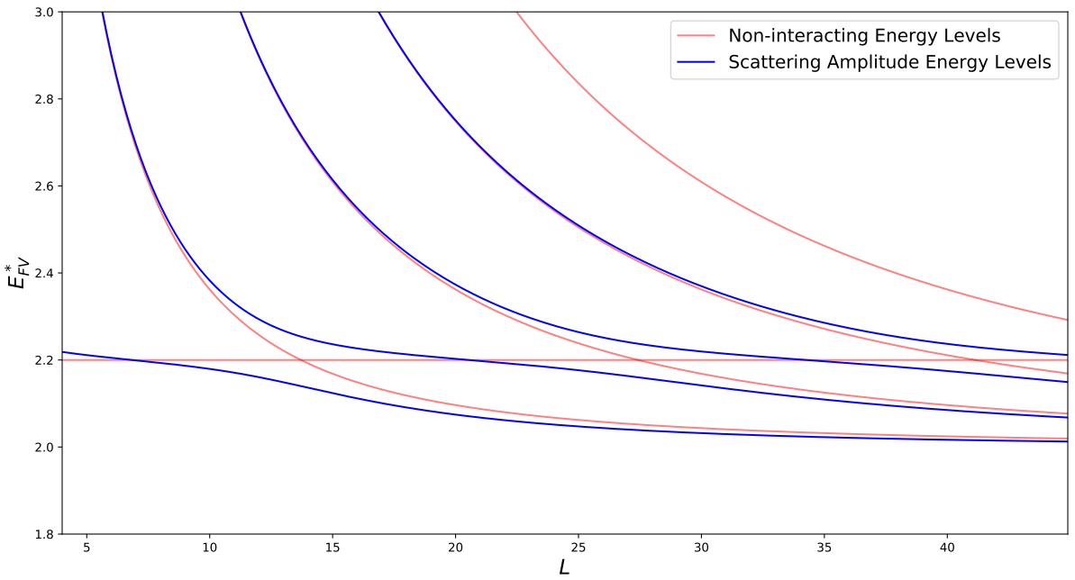
Volume Dependence of Finite Volume Energy
Finite Volume Energy was plotted as a function of volume length.
Need to look at quantization condition: , sample first few energies when condition is met, then increment
These conditions are obtained via the Lüscher formalism

Slide 13



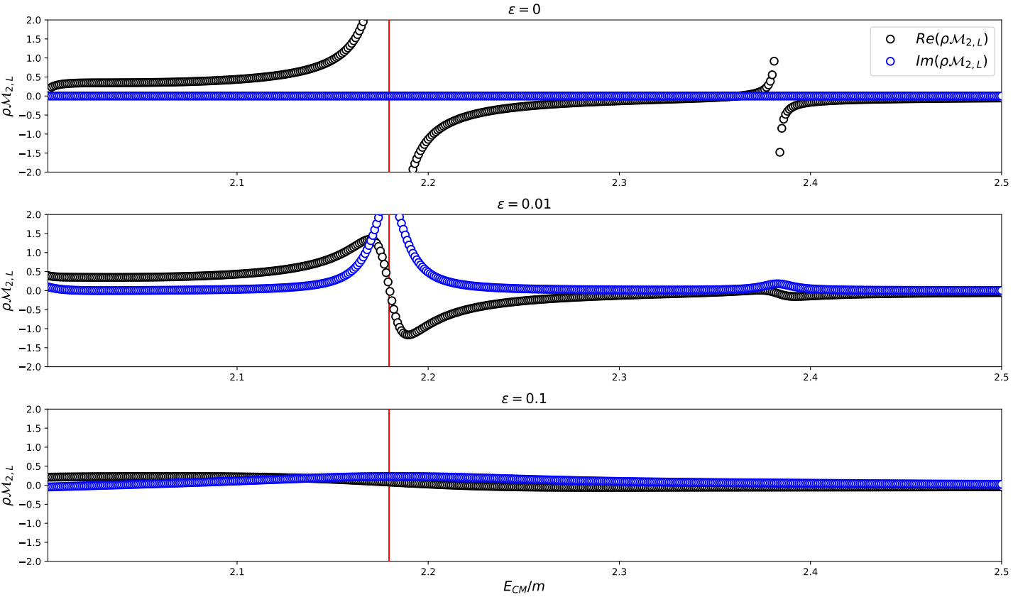
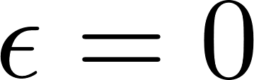
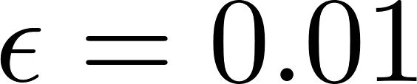
Smooth infinite-volume limit
In order to have a well defined infinite-volume limit, we need to first soften the poles by introducing a finite value of
This amounts to shifting
We can then take the ordered double limit:

Slide 14
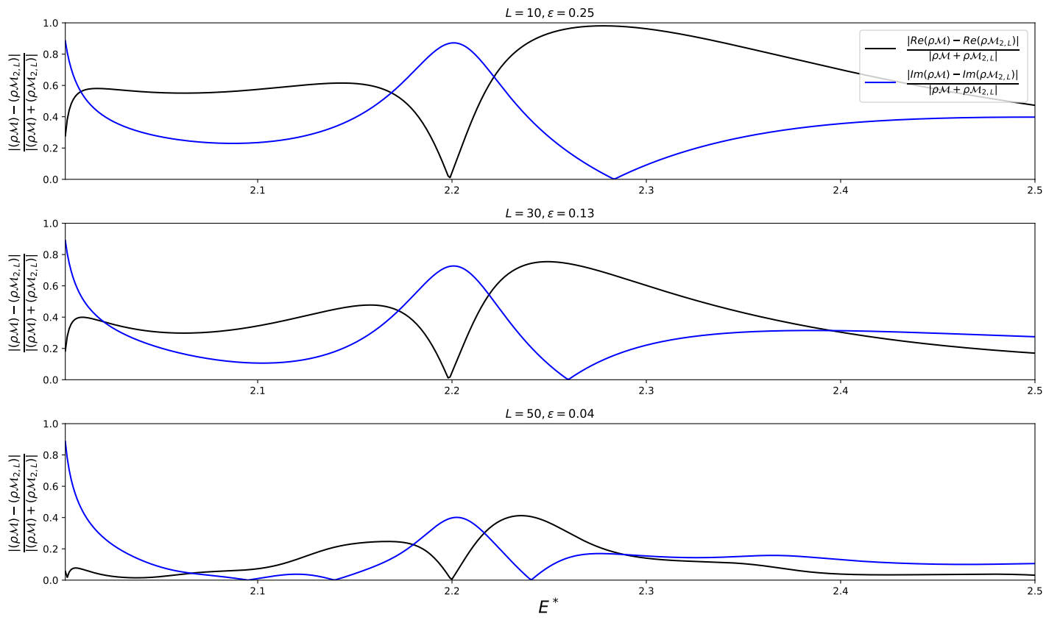
Difference Between Finite and Infinite Volume

Slide 15
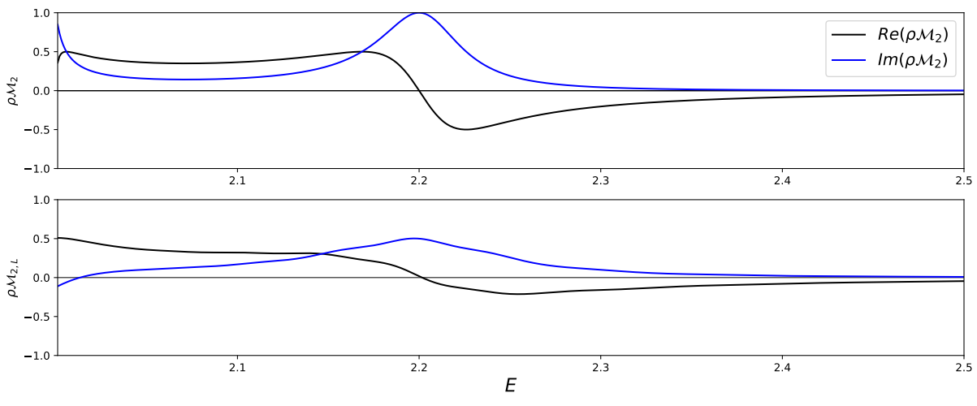
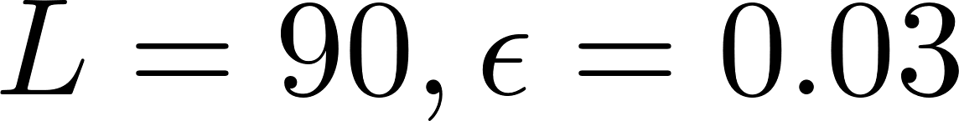
Difference Between Finite and Infinite Volume
Infinite Volume
Finite Volume

Slide 16
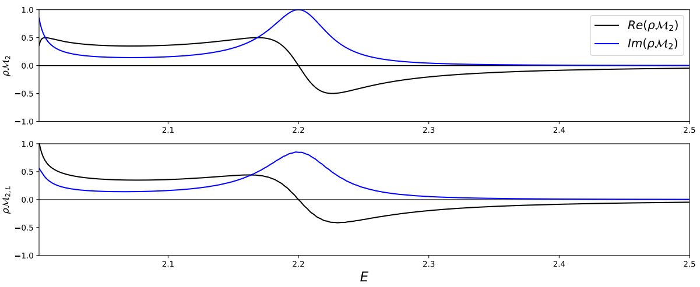
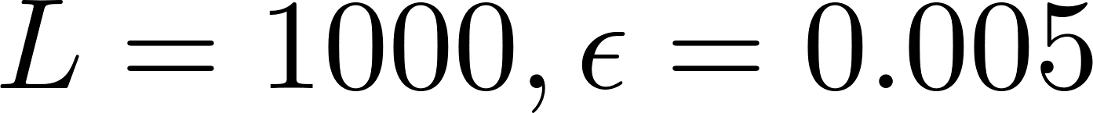
Difference Between Finite and Infinite Volume
Infinite Volume
Finite Volume

Slide 17
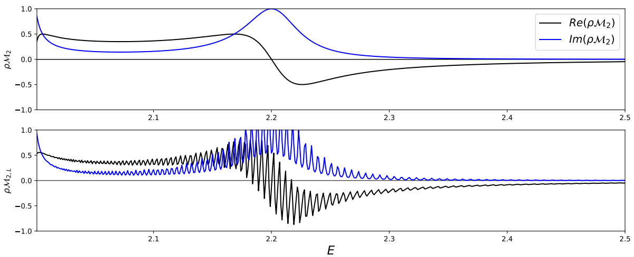
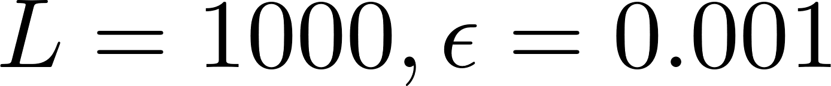
Difference Between Finite and Infinite Volume
Infinite Volume
Finite Volume

Slide 18
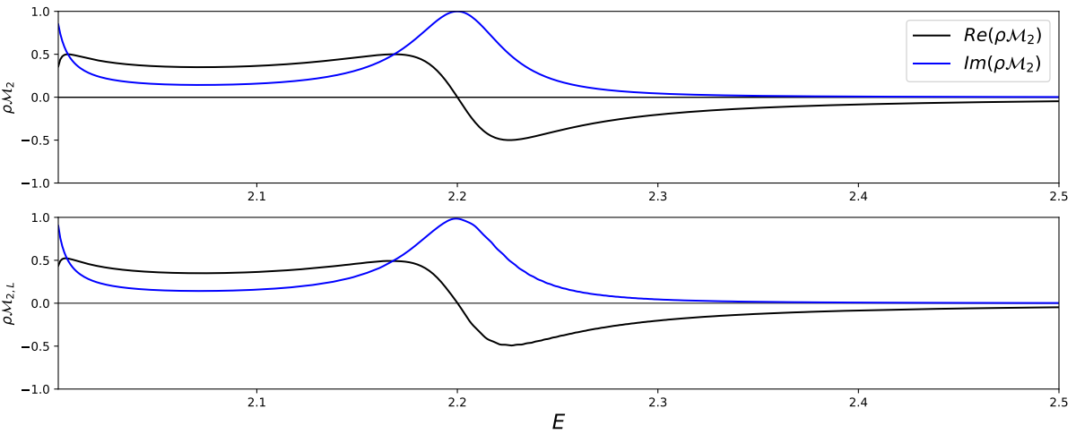
Difference Between Finite and Infinite Volume
Infinite Volume
Finite Volume

Slide 19

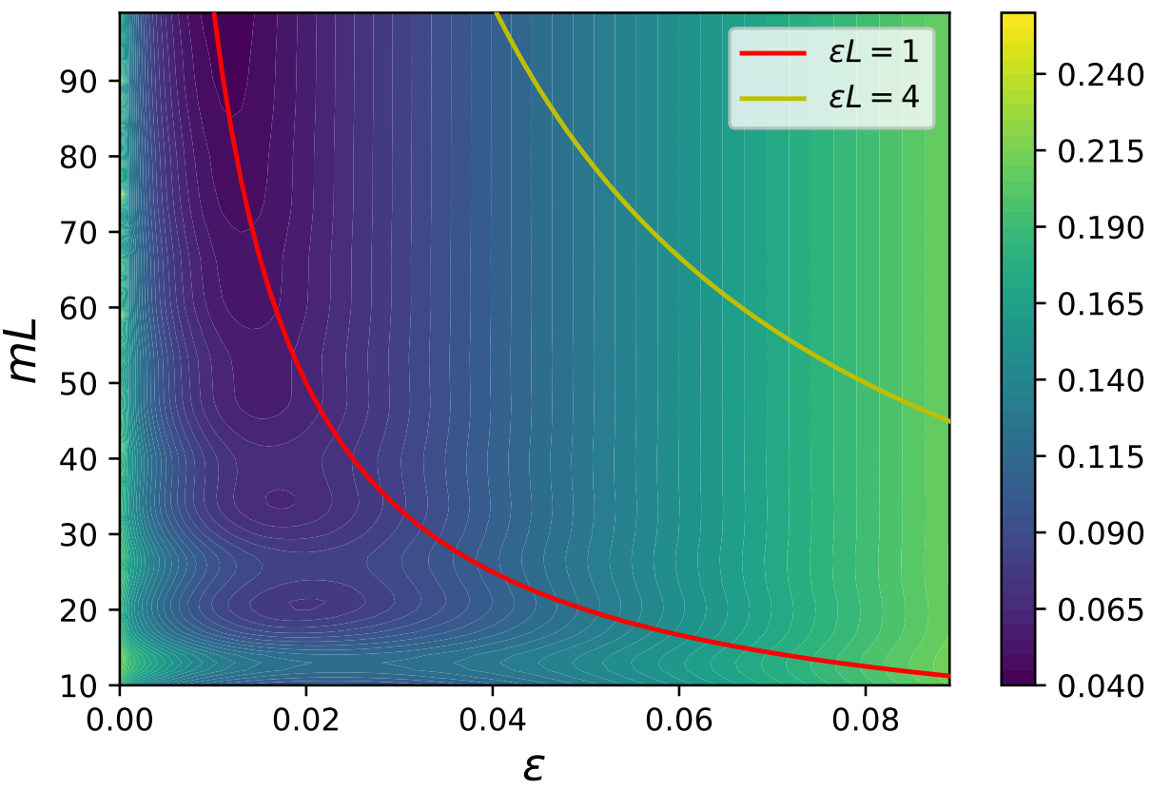
Parameter Variation

Slide 20
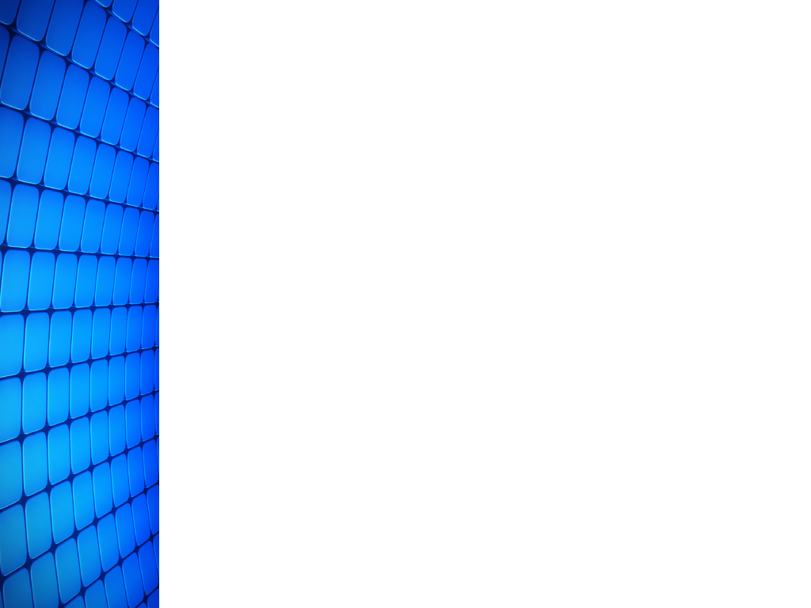
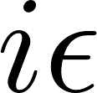

Summary:
Derived scattering amplitude equations
To compare, needed to calculate both infinite volume scattering amplitude and finite volume analogue
Needed to apply to input energy in order to take the difference between the two
Results show that as volume increases and decreases the infinite volume limit is approached
However, results also show that using the Minkowski metric seems impractical for determining scattering observables
Next we will consider performing extrapolations to the infinite volume limit.

Slide 21
Acknowledgements:
I would like to acknowledge Raúl Briceño, Lisa Surles-Law, Balsa Terzic, Geoff Krafft, Juan Vicente Guerrero Teran, Felipe Ortega-Gama, the Thomas Jefferson National Accelerator Facility, Old Dominion University, The Department of Energy, and the National Science Foundation for their support and the opportunity afforded to me in order to conduct this research under the REU program. This project was made possible because of the NSF award 1659177 to Old Dominion University.

Slide 22
References:
Andrei Alexandru, Gökçe Başar, Paulo F. Bedaque, Sohan Vartak, Neill C. Warrington. Monte Carlo Study of Real Time Dynamics. arXiv:1605.08040v2 [hep-lat], 10 Jun 2016
Christof Gattringer, Christian B. Lang. Quantum Chromodynamics on the Lattice, An Introductory Presentation. Springer-Verlag Berlin Heidelberg, 2010
Alessandro Baroni, Raúl A. Briceño, Maxwell T. Hansen, Felipe G. OrtegaGama. Form factors of two-hadron states from a covariant finite-volume formalism. arXiv:1812.10504v1 [hep-lat], 26 Dec 2018
Raúl A. Briceño, Jozef J. Dudek, Ross D. Young. Scattering processes and resonances from lattice QCD. arXiv:1706.06223v1 [hep-lat], 20 Jun 2017
John Bulava, Maxwell T. Hansen. Scattering Amplitudes from finite-volume spectral functions. arXiv:1903.11735v1 [hep-lat], 28 Mar 2019
Image Credit: https://ccl.northwestern.edu/netlogo/models/Pac-Man

